Slide 1
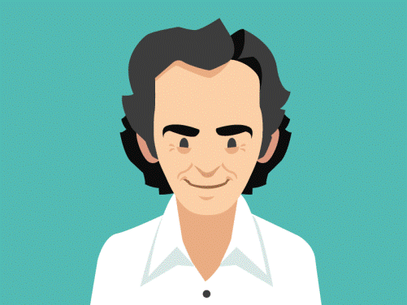
The adventures of Professor Feynman
Team Feynman:
Alexander, Aneliya, Borislav,
Kalina, Mariya, Neli,
Plamen , Stiliyan
https://github.com/Team-Feynman/The-Game

Slide 2
Table of contents
The goal of the project
Background and game scenarios
Development tools and platform.
What is realized till now
Future work
How we have worked
Live Demo of the game

Slide 3
The goal
To develop an interactive 2D animated Role-Play Game (RPG). The game is based on several interesting stories, which are inspired from the real life achievements of Professor Richard Feynman.
Advantages: This game is open and allows realization of many scenarios. When one scenario ends, the hero moves to the next level, where a new story starts. Thus the game could be continuously developed and extended.

Slide 4
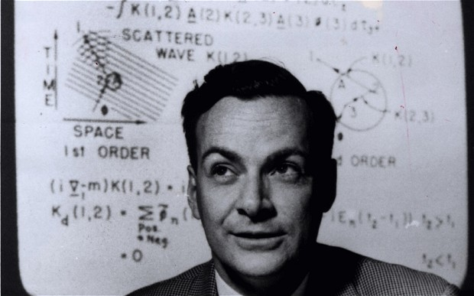
Background and game scenarios
Professor Richard Feynman (1918 – 1988) was an American
theoretical physicist, who received the Nobel Prize in Physics
in 1965 for his contributions to the development of quantum electrodynamics .
Before that, during World War II, he assisted in the development of the atomic bomb .
In the 1980s he was a member of the Rogers Commission, the panel that investigated the Space Shuttle Challenger disaster.
Possible game scenarios:
Part1: Professor Feynman and the subatomic particles.
Part 2: Professor Feynman and the atomic bomb.
Part 3: Professor Feynman and the space shuttle Challenger.
.

Slide 5
Development tools and platform
Team collaboration and development tools:
GitHub repository
Trello
Skype – Team Feynman group
OneDrive temporary file storage
Platform: MonoGame 3.5 for Visual studio.

Slide 6
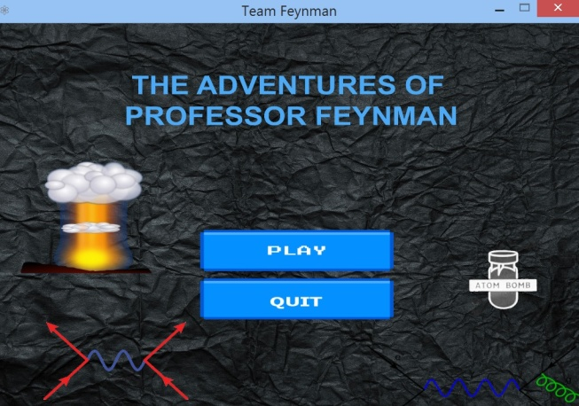
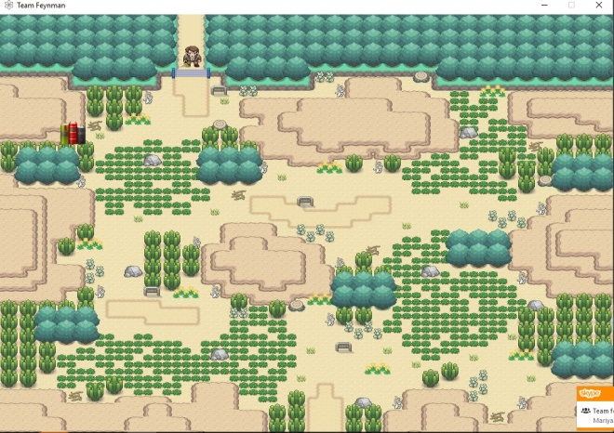
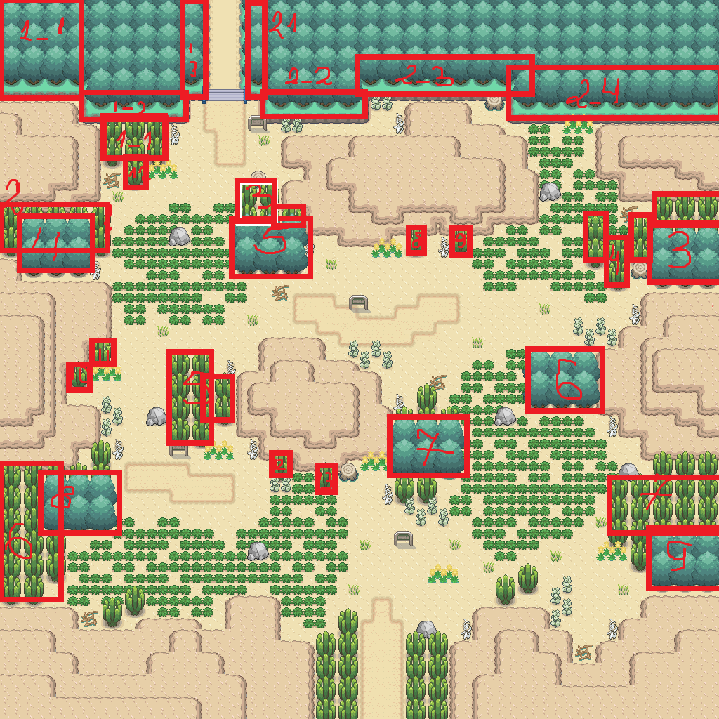
What is realized till now
Title screen with 2 buttons (Play and Quite) on the background and 2 objects (bomb and test tube)
The second screen, where the Professor is walking on the map.
All possible collisions during the movement of the hero on the map are programmed in the code.
This game level is accompanied using suitable music.

Slide 7


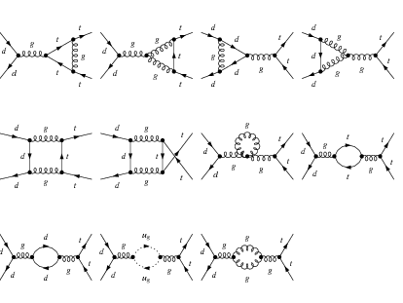

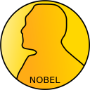
Future work
The goal of this level is to increase the IQ value of the hero up to some boundary, needed for creating of the Feynman diagrams.
During his movements on the screen
Professor Feynman collects some pieces , which help him to create
his famous Feynman diagrams.
Once he manages to collect something, his IQ value arises.
In the same time some obstacles appear – some books or equations or diagram falls from the top part of the screen.
Ones the Professor meets these obstacles, his IQ decreases with certain value.
At the end of this level, when the boundary IQ value is reached, the Professor Feynman gets a coin with Nobel face drawn on it.
During all the time a suitable music for all events is playing.

Slide 8
How we have worked
This was a real teamwork project. All of us have been working actively, but in different ways
Alexander – actively participated in code writing, the team discussions and game scenario description.
Aneliya – actively participated in the discussions, gave the initial idea about the game, searching resources on the net and code writing.
*Borislav, Kalina – participated once in the Skype discussion
Mariya – actively participated in all discussions, main contributor to the very important and time consuming work on editing of almost all images used in the game.
Neli – participated actively in team discussions, searching for images and other useful resources on the net, participated in describing project documentation.
Plamen - created the sceleton of the game code, gave the name of the game and main ideas about used platform, participated in team discussions, etc.
Stiliyan - actively participated in building the sceleton of the game code, code writing , team discussions, etc.

Slide 9
The adventures of Professor Feynman
Live demo

