Slide 1
Post-Disaster Hospital Simulation with Digital Twins and Adaptive Task Allocation
Jaydine Stiles, Joseph Ko | Dr. Yugyung Lee | June 30, 2025
Link to our Github: https://github.com/stilesj05/reu2025-cybersec-StilesAndKo

Slide 2
Problem Statement Overview
Current multi-agent rescue systems struggle to balance two key demands at once:
Trust-aware coordination: Agents’ reliability can change over time, and task assignments should reflect evolving trust levels.
Dynamic routing in damaged environments: Blocked passages require continuous replanning to find safe, efficient paths.
Our goal is to build a Neo4j-based knowledge graph that models rescue robots, human responders, patients, rooms, corridors, dynamic trust scores, risk levels, and cybersecurity events. We will then feed this graph into a quantum-enhanced optimizer to assign tasks and plan routes in real time.
Questions:
How does our Neo4j-based digital twin with quantum-enhanced optimization compare to a classical Dijkstra/QUBO hybrid in terms of mission completion time in dynamic hospital environments?
How does incorporating dynamic trust scores into the task allocation process affect patient extraction success rates in post-disaster hospital simulations?

Slide 3
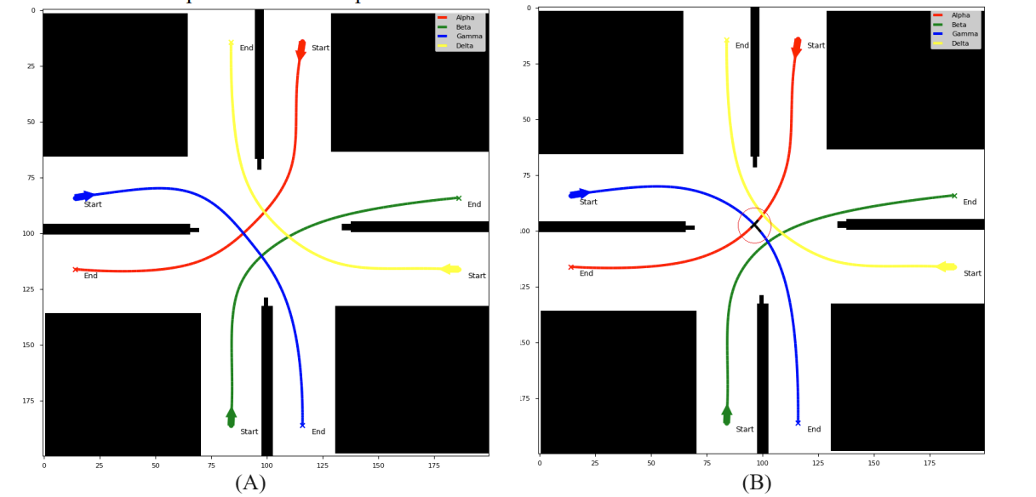
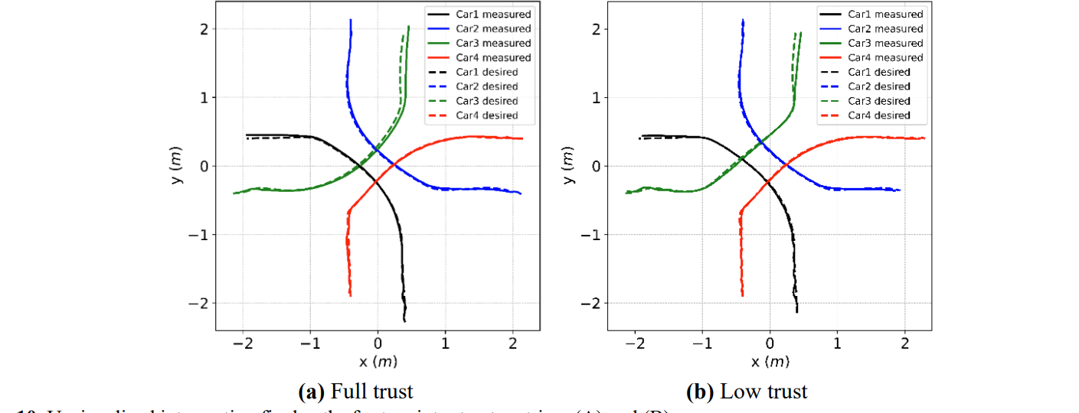
A Factor Graph Model of Trust for a Collaborative Multi-Agent System (Akbari, Behzad, et al)
The authors wanted to create a trust-aware coordination model for robots (agents) that can make decisions independently in a shared space (like cars at an unsignaled intersection). They wanted to make the trust update dynamically.
They used a Factor Graph—a type of probabilistic graphical model—to represent each agent’s decisions and how much other agents can trust them, incorporating things like:
How well they follow rules (e.g., avoiding collisions)
How close they stay to expected trajectories
How cooperative or “transparent” their actions are

Slide 4
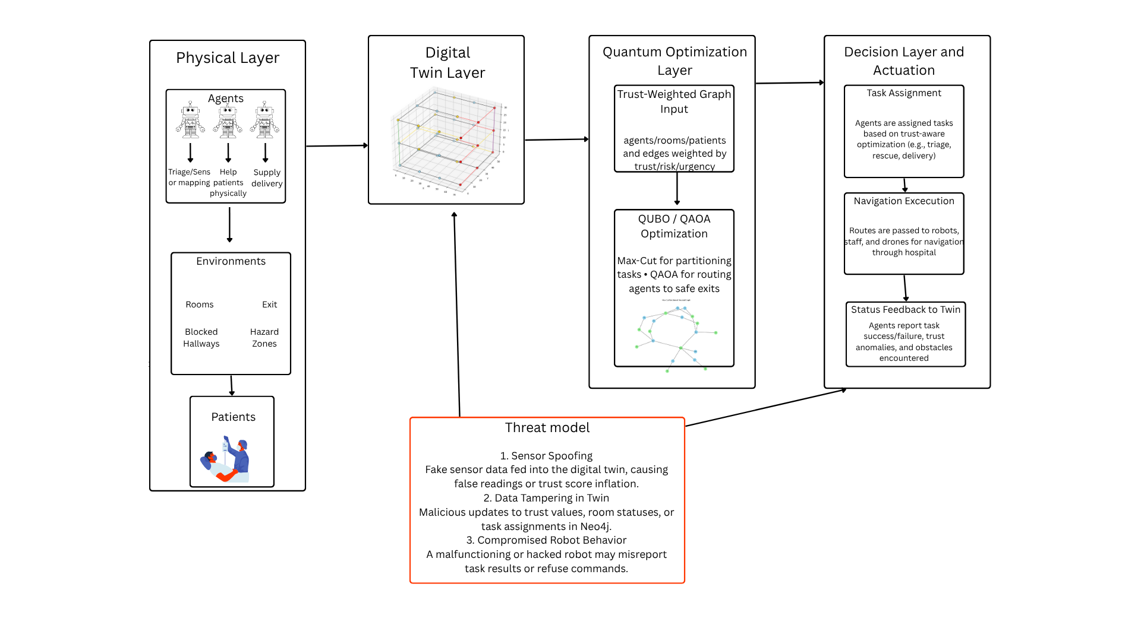
Conceptual Diagram

Slide 5
Method Overview
Tools & Libraries
Neo4j: Models the hospital layout as a dynamic knowledge graph
Qiskit: Runs QUBO/QAOA algorithms for quantum optimization
NetworkX: Used for classical Dijkstra-based baseline comparisons and to simulate the graph used for visualization in Neo4j
Python (NumPy, Pandas): Data preprocessing, simulations, and evaluation
Google Colab: Cloud platform for running and visualizing experiments
Unity3D (maybe in the future, might run out of time for this)

Slide 6
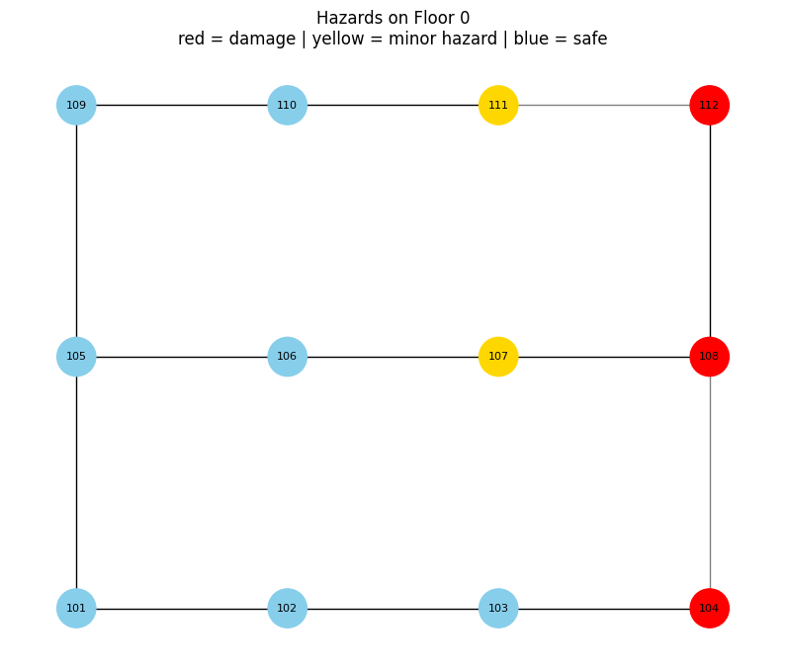
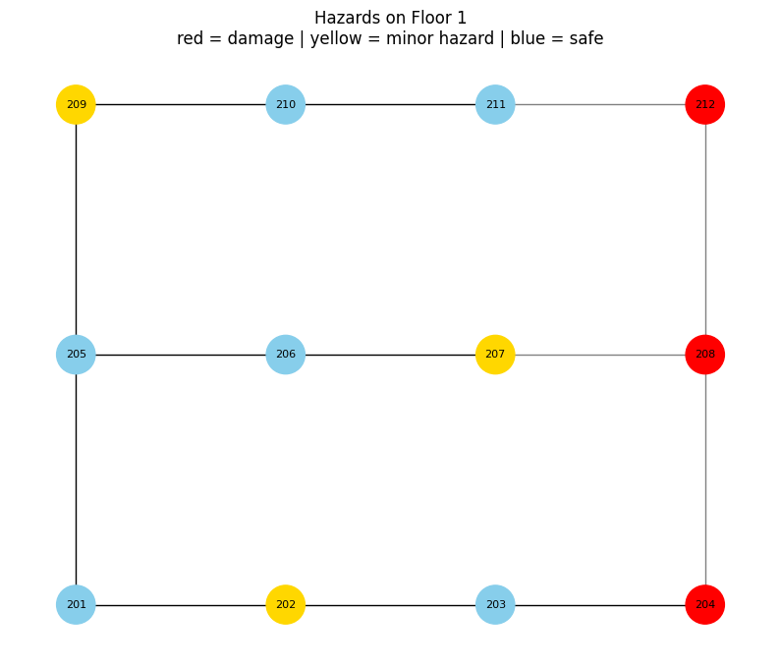
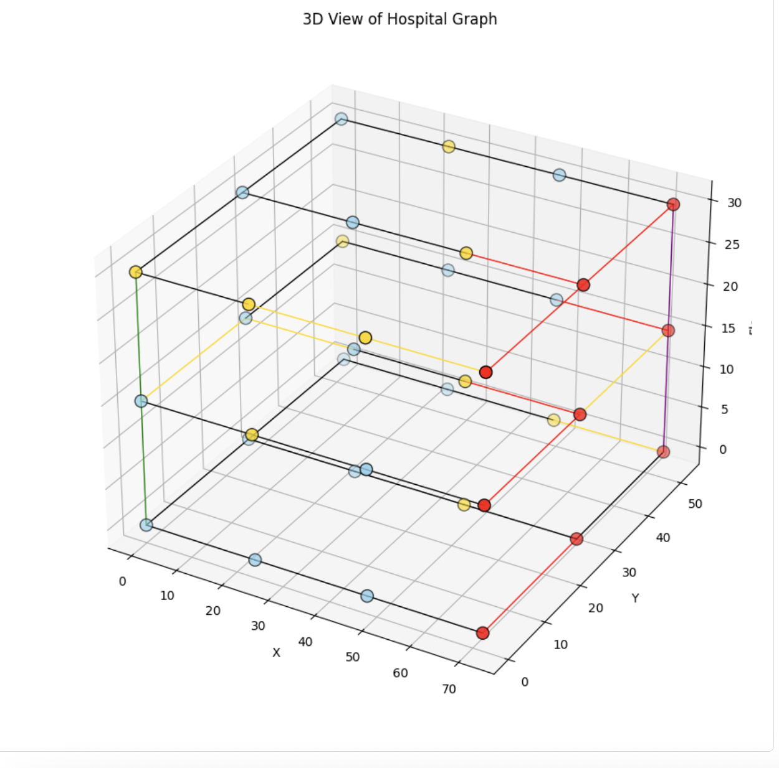
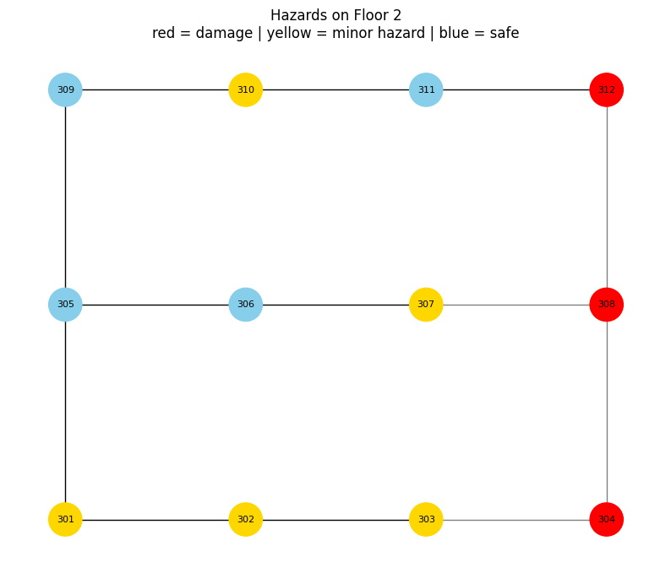
Preliminary Results

Slide 7
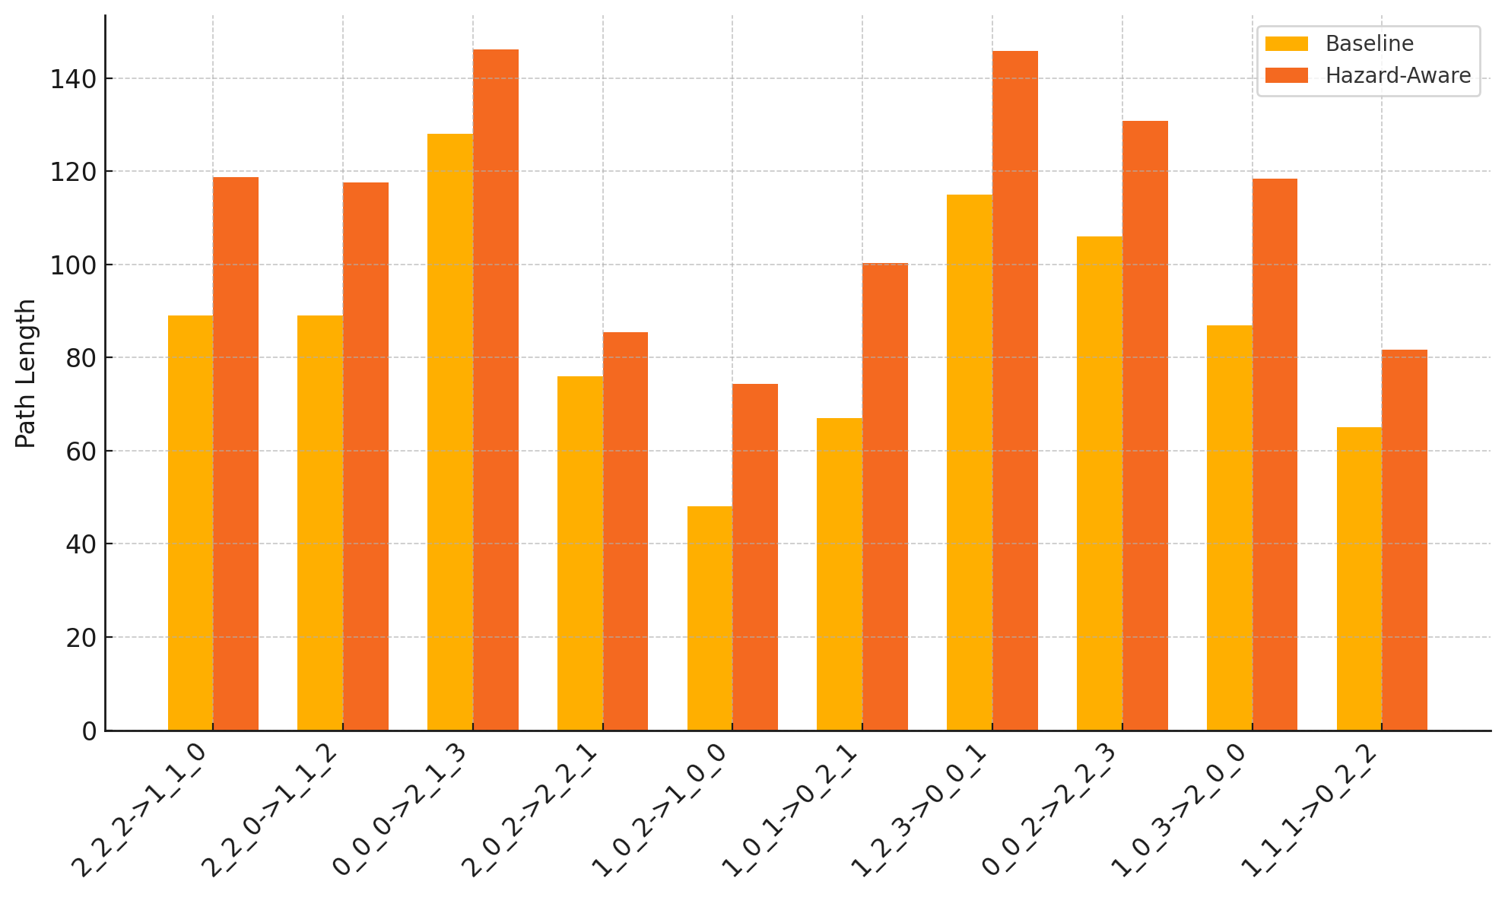
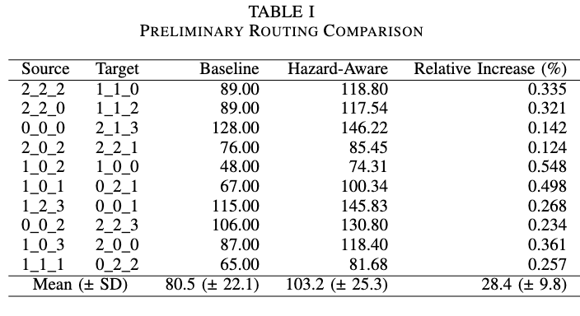
Preliminary Results

Slide 8
Next Steps and Current Challenges
Further Collaboration with our mentors and Giselle (cyber)
Finalizing our dataset (with Luke) and knowledge graph
→ Quantum opportunities
Implement a different model for task allocation comparison
Just keep making progress!

Slide 9
References
Akbari, Behzad, et al. “A Factor Graph Model of Trust for a Collaborative Multi-Agent System.” arXiv, 10 Feb. 2024, arxiv.org/abs/2402.07049.
Jameil, Ahmed K., and Hamed Al-Raweshidy. “Quantum-Enhanced Digital Twin IoT for Efficient Healthcare Task Offloading.” Discover Applied Sciences, vol. 7, 2025, article no. 525, https://link.springer.com/article/10.1007/s42452-025-07101-2.
Goeckner, A., Sui, Y., Martinet, N., Li, X., & Zhu, Q. (2024). Graph Neural Network–based multi-agent reinforcement learning for resilient distributed coordination of multi-robot systems. IEEE Transactions on Robotics. https://doi.org/10.1109/TRO.2024.XXXXX

