Slide 1
Week 4 Progress Report
Jaydine Stiles, Joseph Ko | Dr. Yugyung Lee | June 23, 2025

Slide 2
Problem Statement Overview
In disaster scenarios like post-earthquake hospital rescues, coordinating robotic agents in real time is complex due to blocked paths, shifting trust, and urgent patient needs. This project uses digital twins and quantum-enhanced graph optimization to simulate trust-aware task assignment and adaptive routing. The goal is to improve coordination efficiency and adaptability under uncertainty.

Slide 3
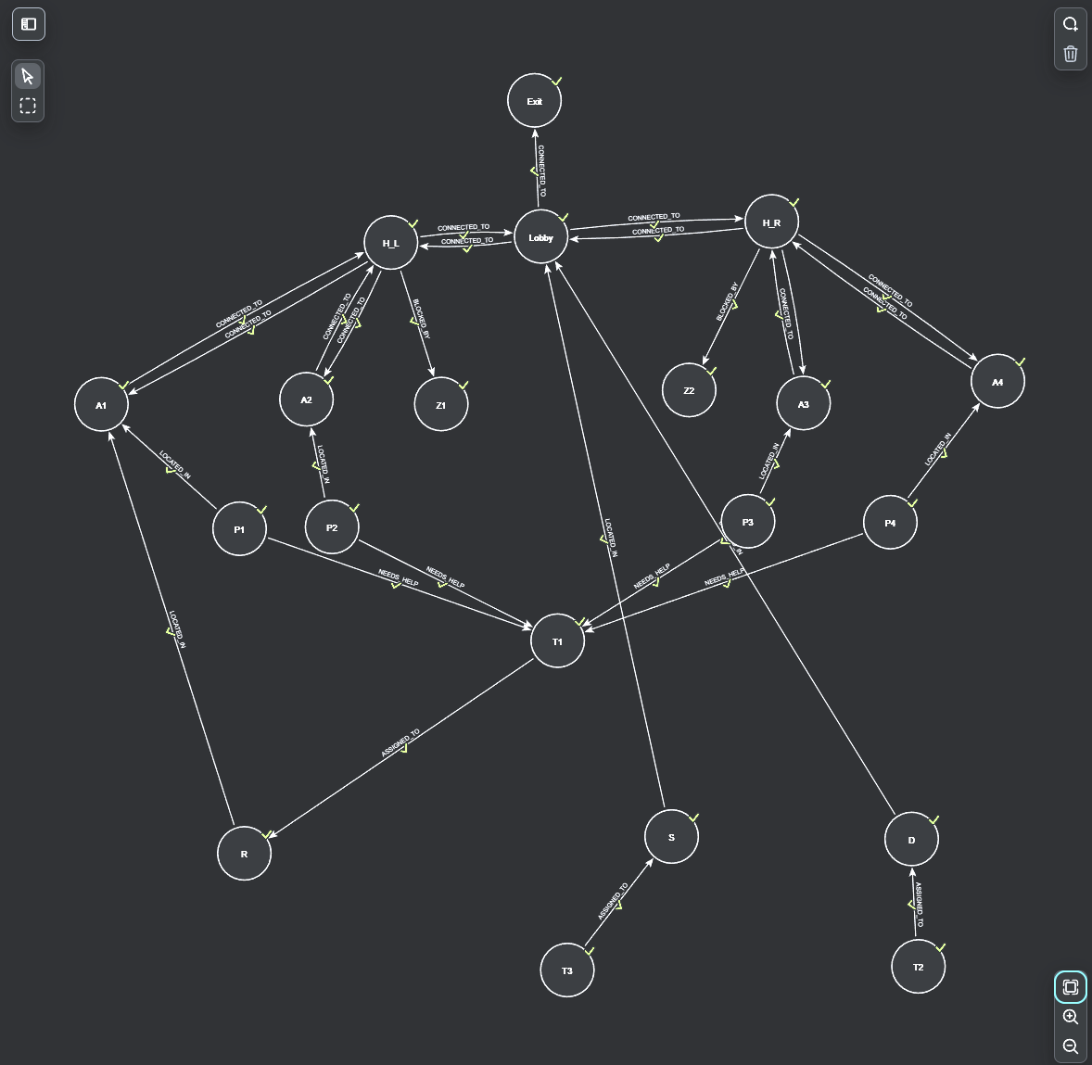

Slide 4
Literature Review
Robotics Classification of Domain Knowledge Based on a Knowledge Graph for Home Service Robot Applications (Wang et al., 2024)
How it works:
The robot looks at its surroundings (e.g. “What room am I in?” or “What tool is this?”).
The MobileNetV3 model (a fast, lightweight neural network) processes the image. → Example: Sees an image → says “this is a kitchen” or “that’s a spoon.”
The knowledge graph connects the dots: ➡ Example: “Kitchens usually have spoons—I’m probably in a kitchen.”
The robot makes faster decisions by reasoning with the graph and checking relationships between rooms, tools, and functions.
Uses transfer learning — it first learned on big image sets, then fine-tuned for homes. → Example: Like learning to spot animals in general, then focusing on house pets.
Results:
Room recognition: 88% accuracy Tool recognition: Nearly 100% for some tools (e.g. saw, scoop, scissors) Speed: 63 ms per image → much faster than older models like ResNet

Slide 5
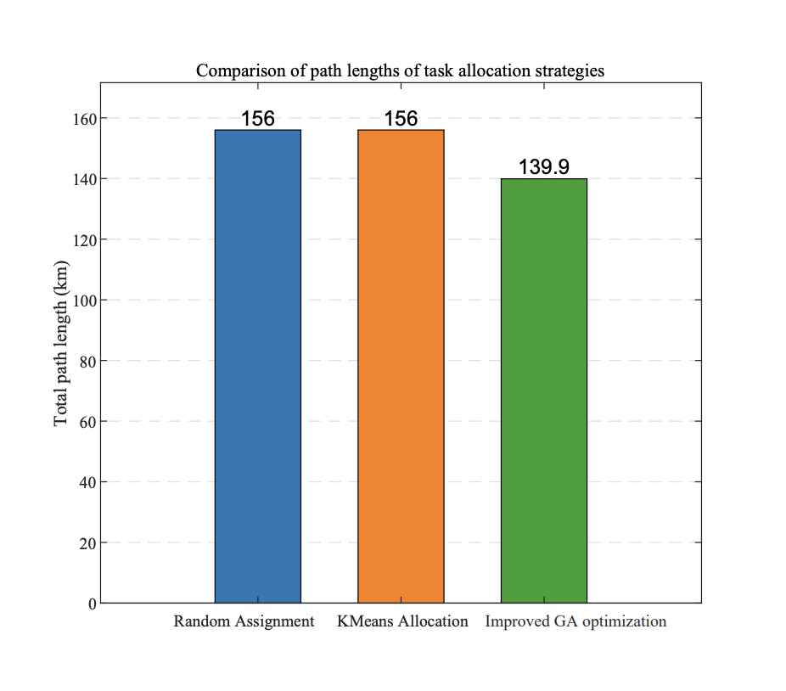
Literature Review
UAV-UGV Cooperative Trajectory Optimization for Medical Rescue (Chen et al., 2025)
How it worked:
The system assigned tasks to UAVs and UGVs → Example: "UAV delivers small med kit" / "UGV carries large supplies"
The Genetic Algorithm (continued testing and improving task plans) figures out who does what
Informed-RRT* (drawing random lines through a maze to find a path without crashing) generates safe paths around rubble
CMA-ES (constant tweaking to make route more efficient) fine-tunes the order of tasks for each vehicle
UAVs and UGVs follow their assigned routes, working together
All paths are checked to avoid crashes and save time
Results: Mission completion time: ~27 min vs. ~100 min for random or K-Means assignment) Shorter paths = lower energy use Scales well — worked with 15 tasks, 30 tasks, even 60 tasks

Slide 6
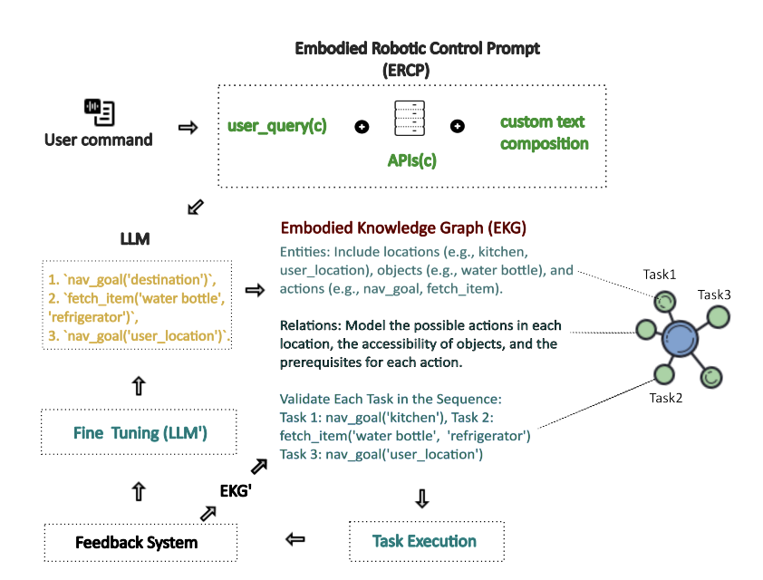
Literature Review
Safety Control of Service Robots with LLMs and Embodied Knowledge Graphs (Qi et. al, 2024)
How it worked:
The user gives a command (e.g. "Get me a water bottle").
The ERCP breaks the command into small steps. ("Go to kitchen" → "Find fridge" → "Grab bottle")
The LLM turns those steps into instructions. The EKG checks each step to make sure it’s safe and possible → Example: "Is the fridge reachable? Is the hallway blocked?"
The robot follows the plan, step-by-step. A feedback loop updates the robot’s knowledge if things change → Example: "Hallway now blocked, find another path."
Success rate: 90% of tasks completed safely (better than older systems) Only 3% errors (others had 7–18%) Safety: Fewer accidents—broke safety rules much less

Slide 7
AI Methods
Quantum Optimization QUBO: For task allocation
QAOA: Optimized pathfinder

Slide 8
Next Steps
Finalize Knowledge Graph Schema
Define Key Constraints and Logic (eg. trust, safety, and urgency modeling)
Expand the QUBO model

Slide 9
Current Challenges
Dynamic Property Modeling
Updating trust scores, patient urgency, blocked paths

Slide 10
References
Qi, Yong, et al. Safety Control of Service Robots with LLMs and Embodied Knowledge Graphs. 2024,
arXiv:2405.17846v1. arXiv.
Chen, Kaiyuan, et al. UAV-UGV Cooperative Trajectory Optimization and Task Allocation for Medical Rescue Tasks in Post-Disaster Environments. 6 June 2025, arXiv:2506.06136, https://arxiv.org/pdf/2506.06136.
Wang, Yiqun, Rihui Yao, Keqing Zhao, Peiliang Wu, and Wenbai Chen. “Robotics Classification of Domain Knowledge Based on a Knowledge Graph for Home Service Robot Applications.” Applied Sciences, vol. 14, no. 24, 2024, article 11553, https://doi.org/10.3390/app142411553.

