Slide 1
Week 3 Progress Report
Jaydine Stiles, Joseph Ko | Dr. Yugyung Lee | June 15, 2025

Slide 2
Problem Statement Overview
As robotic systems become central to high-stakes operations—such as delivery, search and rescue, healthcare, and automation.
The need for secure and trustworthy multi-agent coordination is critical. These systems often rely on digital twins: virtual replicas of physical robots, environments, and tasks. Supports simulation, planning, and monitoring.
Challenges include:
Risks around cybersecurity, data integrity, and trust erosion—where digital twins may become desynchronized or manipulated by adversarial attacks (e.g., sensor spoofing or communication interference)
Investigate how Quantum AI, particularly quantum-enhanced graph-based optimization, can be used to:
Improve task allocation, path planning, and load balancing in real time across robot teams and human collaborators.
Enable trust-aware coordination by detecting anomalies and optimizing decisions using secure graph structures within a digital twin framework.

Slide 3
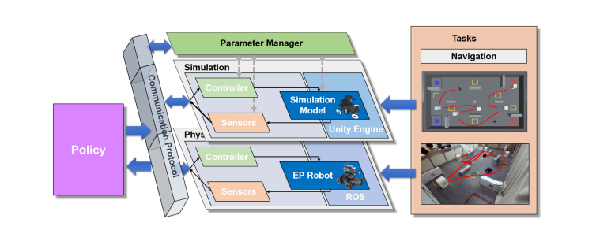
NeuronsGym (Li et al., 2024)
Hybrid framework with simulated (Unity3D) and physical (RoboMaster) systems.
The robot/AI can interact with simulation systems through communication protocols (TCP/IP, WebSockets, etc.) to send actions, receive feedback, and enable training or evaluation in a virtual environment.
NeuronsGym helps the robots learn how to move more safely and effectively than previous methods.

Slide 4
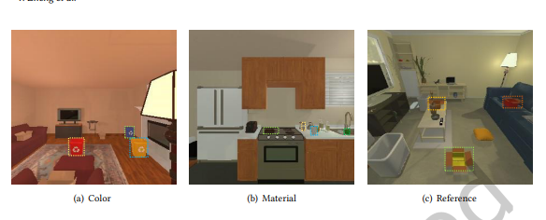
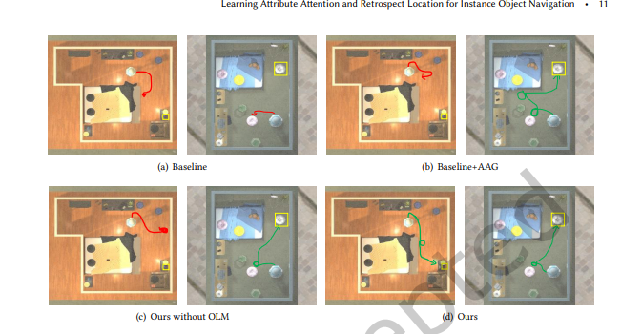
Learning Attribute Attention for Instance Navigation (Zheng et al., 2025)
Introduces a cascade architecture to improve instance-level object navigation (ION).
Uses Object-Attribute Attention Graph (OAAG) and Retrospect Module (ORLM) for better perception and memory, enhances fine-grained object identification and spatial recall.

Slide 5
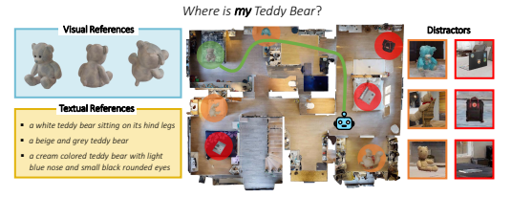
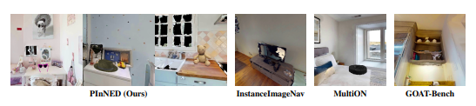
Personalized Instance Navigation (Barsellotti et al., 2024)
Defines a new PIN task: finding user-specific items among lookalikes (for example, a specific teddy bear in a sea of 5 other teddy bears).
PInNED dataset supports zero-shot generalization using Objaverse-XL objects.

Slide 6
AI Methods
Graph Neural Networks (GNNs)
Quantum Approximate Optimization Algorithm (QAOA)
TIP and ECT trust updates embedded in a live knowledge graph
Autoencoders/anomaly detection models

Slide 7
Next Steps
Priority: With guidance from Dr. Lee and support from our graduate mentors, we will likely focus on one or two of the following technical directions for week 4—depending on what is most strategic with our learning goals. However, we plan to explore all three areas in depth over time, as gaining hands-on experience in each is essential before we begin collecting data for our final research project.
📌 1: Knowledge Graphs Focus
Creating graphs where nodes represent robots, humans, tasks, and digital twin states. Encode trust relationships as edge weights that evolve over time based on success/failure logs. Use networkx, neo4j, or R to visualize and analyze trust propagation and anomalies.
📌2: Simulate Adversarial Failures
Modify an environment (e.g., RoboTHOR) to simulate Adversarial Input to occasionally inject fake position or image data through code. We could use failure logs and LLMs to generate explanations of what went wrong and why.
📌 3: Explore Quantum Optimization for Task Allocation
Use simulators (like Pennylane or D-Wave Ocean) to model graph-based coordination tasks as quantum optimization problems. Run small experiments comparing classical vs. quantum approaches to task assignment or anomaly detection. Measure runtime, solution quality, and scalability of quantum-enhanced methods.

Slide 8
Current Challenges
More hands-on experience!

Slide 9
References
Barsellotti, Luca, et al. “Personalized Instance-Based Navigation toward User-Specific Objects in Realistic Environments.” Advances in Neural Information Processing Systems, vol. 37, 16 Dec. 2024, pp. 11228–11250, https://arxiv.org/pdf/2410.18195. Accessed 15 June 2025.
Li, Haoran, et al. “NeuronsGym: A Hybrid Framework and Benchmark for Robot Navigation with Sim2Real Policy Learning.” IEEE Transactions on Emerging Topics in Computational Intelligence, 1 Jan. 2024, https://doi.org/10.1109/tetci.2024.3488732. Accessed 11 June 2025.
Zheng, Yanwei, et al. “Learning Attribute Attention and Retrospect Location for Instance Object Navigation.” Journal of Data and Information Quality, 4 Jan. 2025, https://doi.org/10.1145/3706423. Accessed 14 June 2025.

