Slide 1
Week 5 Progress Report
Jaydine Stiles, Joseph Ko | Dr. Yugyung Lee | June 30, 2025

Slide 2
Problem Statement Overview
Current multi-agent rescue systems struggle to balance three key demands at once:
Trust-aware coordination: Agents’ reliability can change over time, and task assignments should reflect evolving trust levels.
Dynamic routing in damaged environments: Blocked passages require continuous replanning to find safe, efficient paths.
Our goal is to build a Neo4j-based knowledge graph that models rescue robots, human responders, patients, rooms, corridors, dynamic trust scores, risk levels, and cybersecurity events.
We will then feed this graph into a quantum-enhanced optimizer to assign tasks and plan routes in real time.

Slide 3
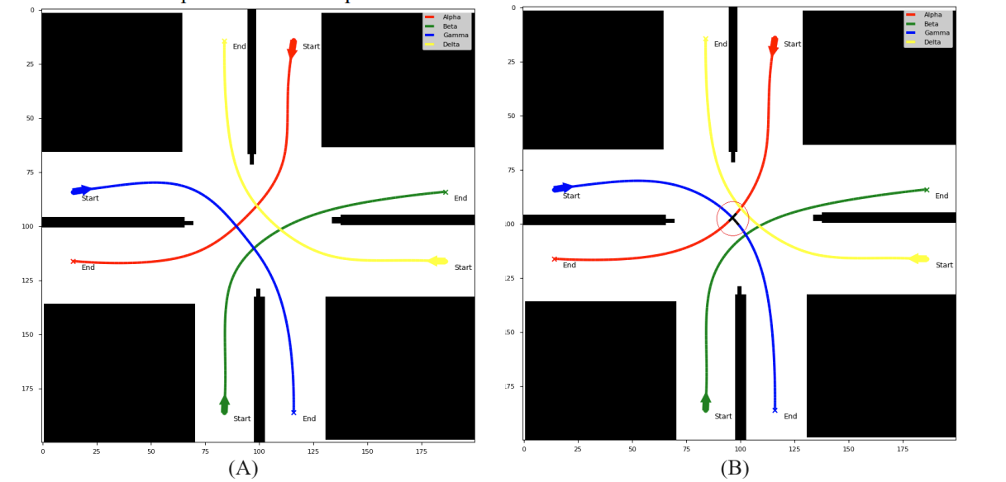
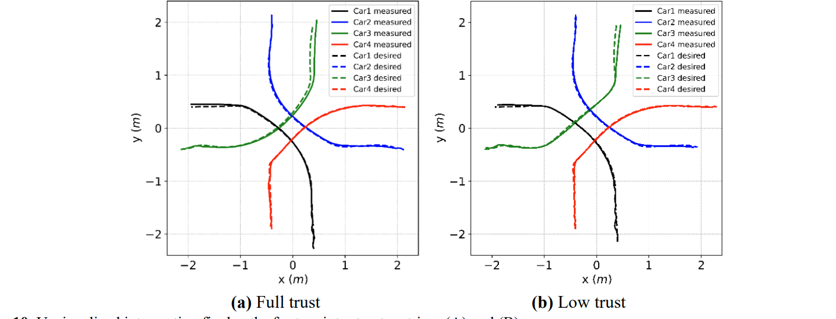
A Factor Graph Model of Trust for a Collaborative Multi-Agent System (Akbari, Behzad, et al)
The authors wanted to create a trust-aware coordination model for robots (agents) that can make decisions independently in a shared space (like cars at an unsignaled intersection). They wanted to make the trust update dynamically.
They used a Factor Graph—a type of probabilistic graphical model—to represent each agent’s decisions and how much other agents can trust them, incorporating things like:
How well they follow rules (e.g., avoiding collisions)
How close they stay to expected trajectories
How cooperative or “transparent” their actions are

Slide 4
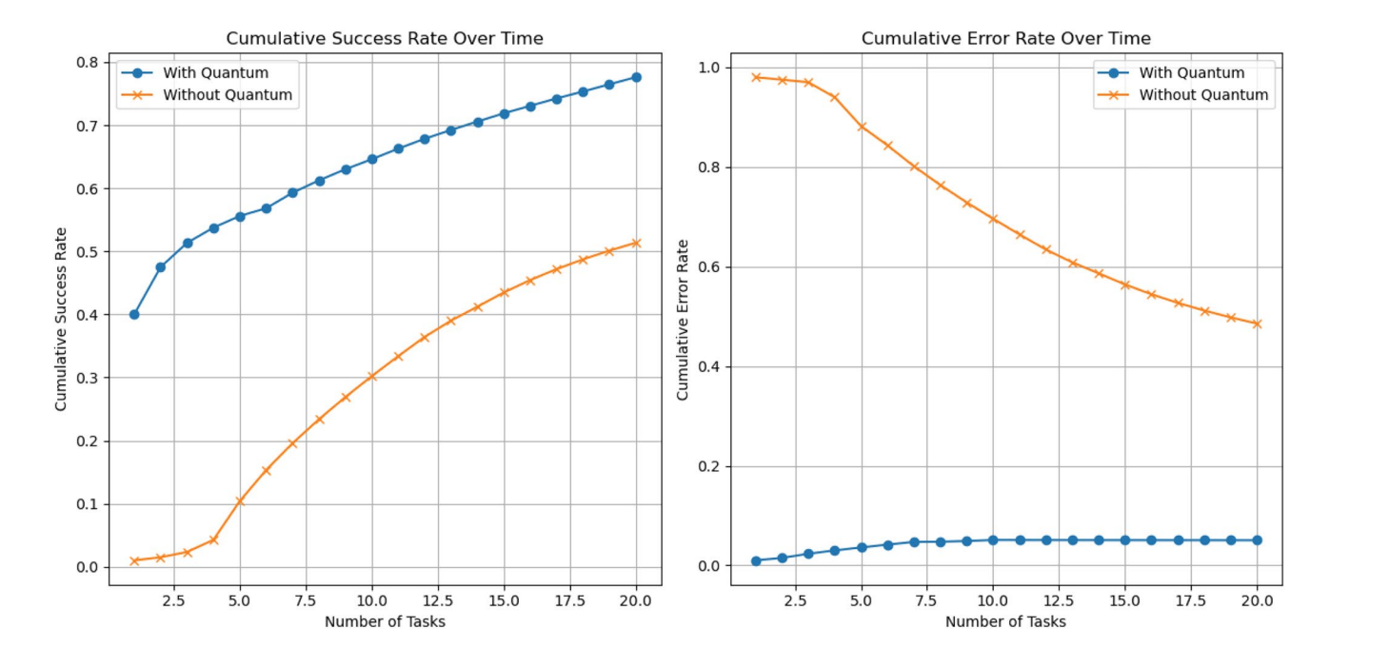
Quantum‑Enhanced Digital Twin IoT for Efficient Healthcare Task Offloading (Jameil, Ahmed K., and Hamed Al-Raweshidy.
The authors wanted to compare standard digital twin task offloading with their quantum-enhanced digital twin (QEDT) model.
Proposes a secure digital twin architecture for healthcare using Quantum Key Distribution and blockchain.
Ensures confidentiality, authentication, and data integrity in IoT communications.
Demonstrates reduced vulnerabilities in healthcare systems through secure task offloading and real-time state mirroring.

Slide 5
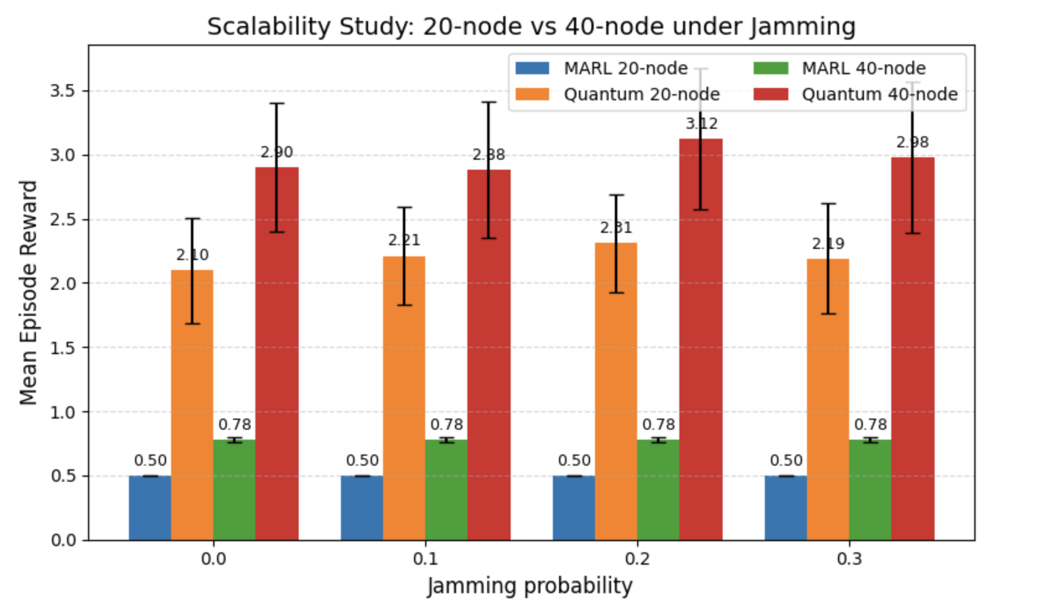
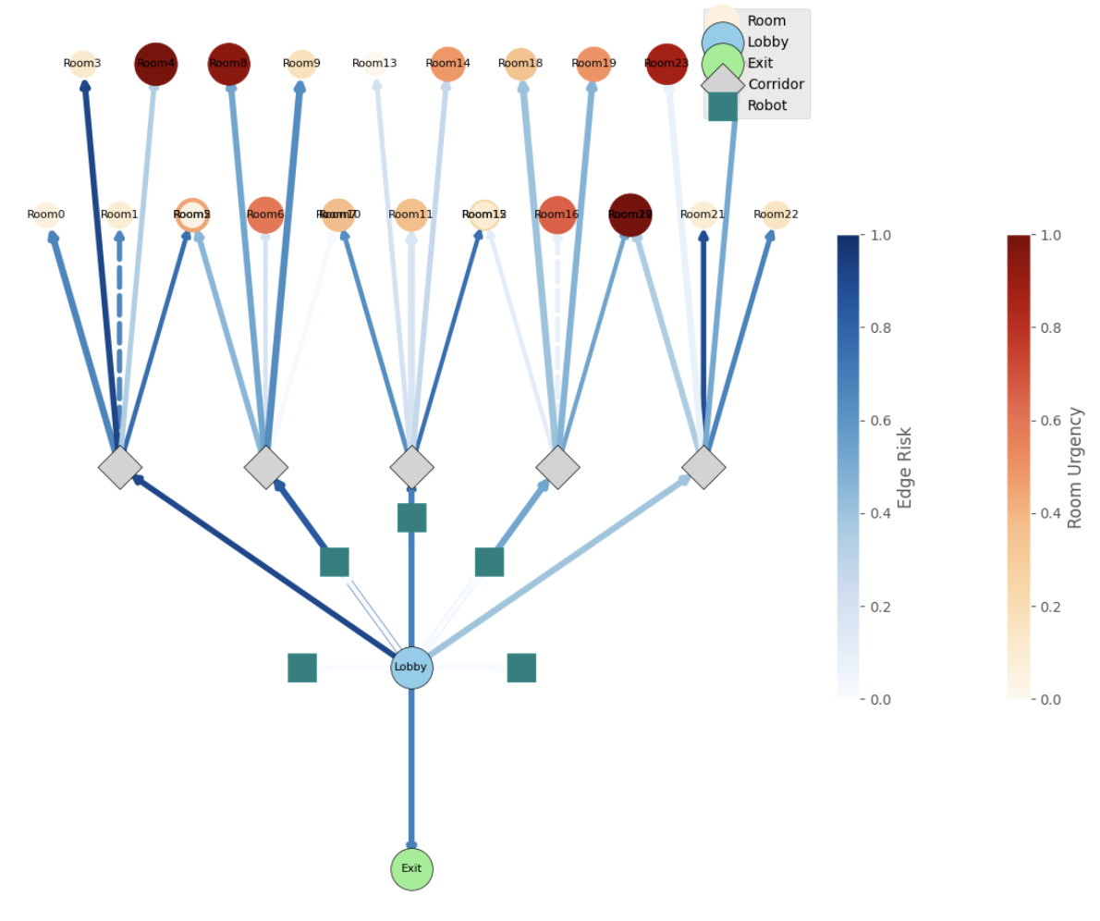
Graph/SOTA

Slide 6
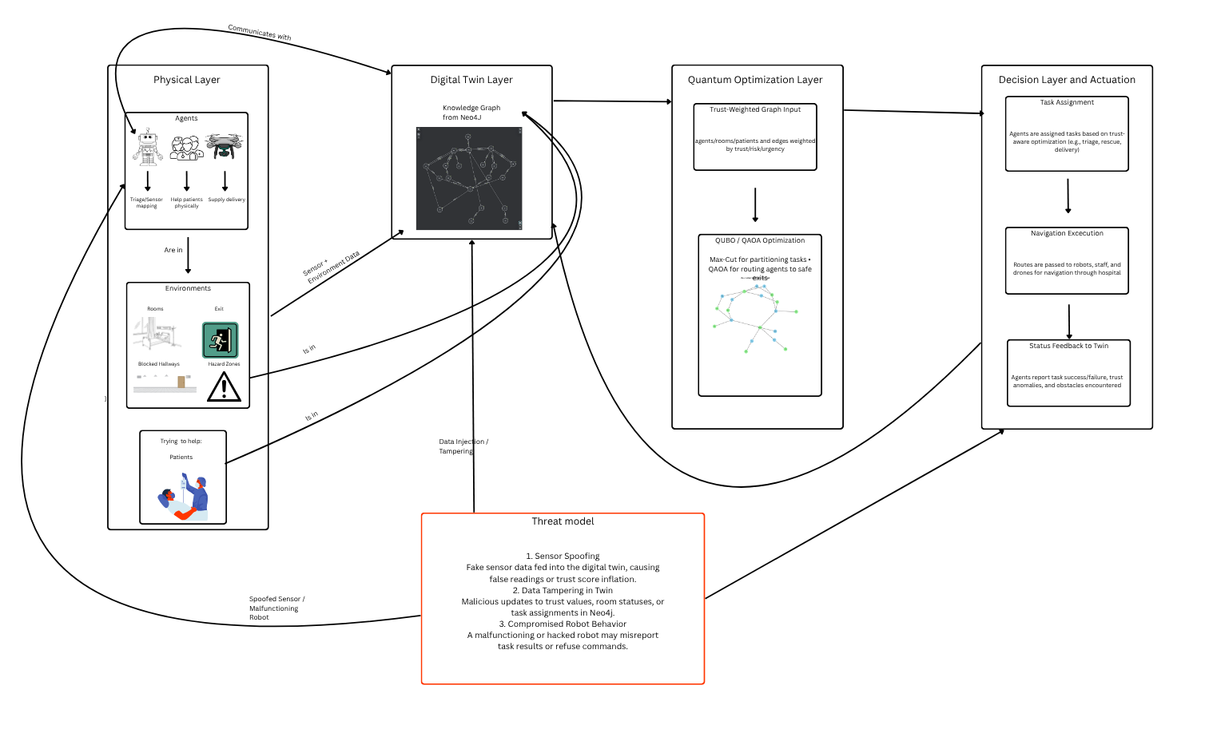
Conceptual Diagram

Slide 7
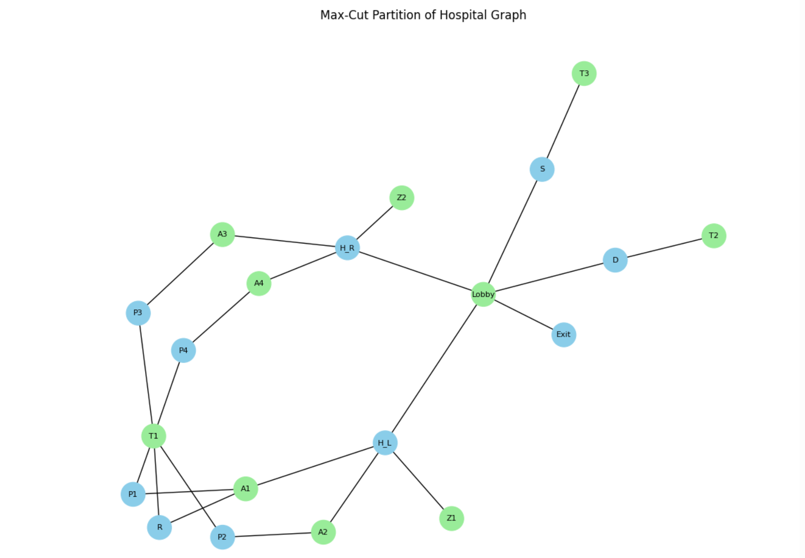
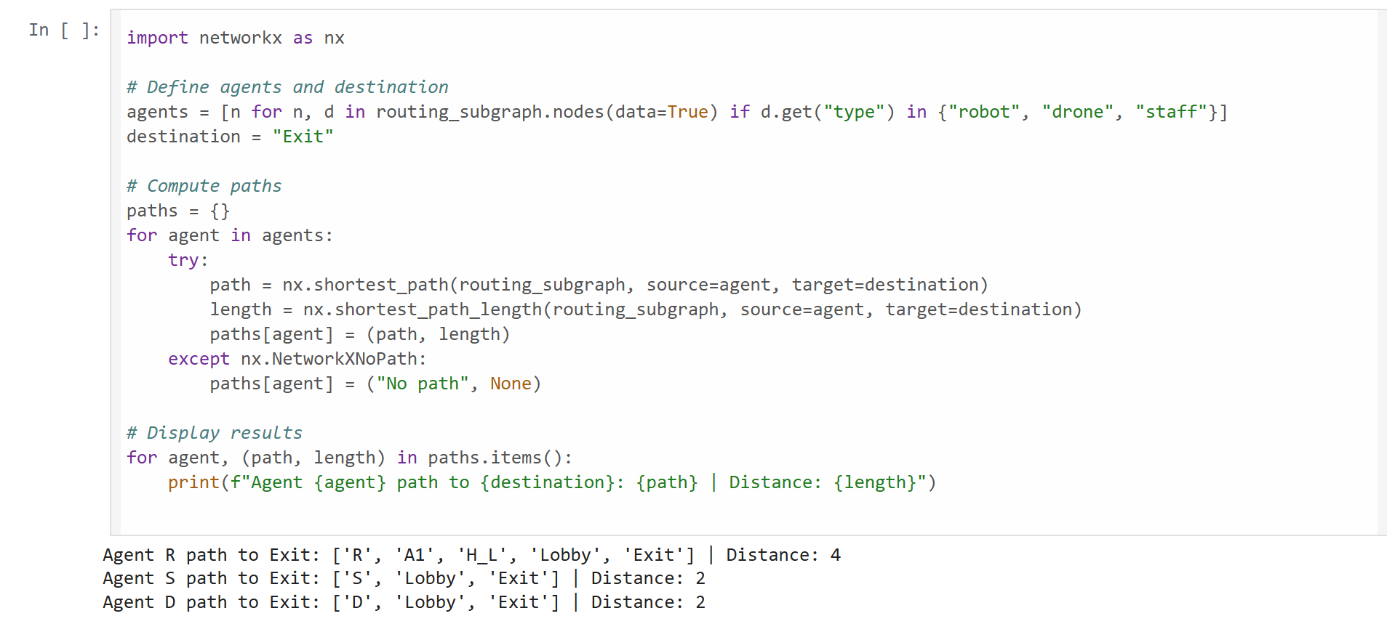
Experiment | Model | Dataset | Metric | Baseline | Expected Outcome
Exp1 | Max-Cut QUBO | scenario_model.graphml | Task Success Rate | Greedy Assignment | +10–15% success rate under trust-aware constraints
Exp2 | Quantum Routing | Subgraph (Agents + Hazards) | Path Efficiency | BFS/Dijkstra | Baseline distances are 2–4; QAOA routing expected to avoid hazards and yield shorter or safer alternate paths under dynamic threat updates.

Slide 8
Next Steps and Current Challenges
Further Collaboration with our mentors and Giselle (cyber)
Implement a different model for task allocation comparison
Just keep making progress!

Slide 9
References
Akbari, Behzad, et al. “A Factor Graph Model of Trust for a Collaborative Multi-Agent System.” arXiv, 10 Feb. 2024, arxiv.org/abs/2402.07049.
Jameil, Ahmed K., and Hamed Al-Raweshidy. “Quantum-Enhanced Digital Twin IoT for Efficient Healthcare Task Offloading.” Discover Applied Sciences, vol. 7, 2025, article no. 525, https://link.springer.com/article/10.1007/s42452-025-07101-2.
Goeckner, A., Sui, Y., Martinet, N., Li, X., & Zhu, Q. (2024). Graph Neural Network–based multi-agent reinforcement learning for resilient distributed coordination of multi-robot systems. IEEE Transactions on Robotics. https://doi.org/10.1109/TRO.2024.XXXXX

