Slide 1
TADs
Boundaries
1 kb
Feature 1
Feature 1 Binary
1
0
0
1
1
0
0
1
1
0
Feature 1 Distance
0
1
1
0
1
1
1
1
0
0
Response Vector Y
1
0
0
1
0
0
0
0
1
1
Bins
1
2
3
4
5
6
7
8
9
10

Slide 2

TAD
TAD Boundary
Point
10 kb bin
Genome
0 | 1 0 | 1 0 | 0 0 | 1 0 | 1 0 | 1
0 | 1 0 | .7 .5 | 0 0 | 0 0 | 0 .2 | .8
1 | 0 1 | 0 0 | 1 2 | 3 2 | 1 0 | 0
0 | 9 0 | 7 5 | 0 0 | 0 0 | 0 2 | 8
Outcome Y
Feature Xᵢ Region
Mourad Predictor Xᵢ
Distance Predictor Xᵢ₁
Overlap Predictor Xᵢ₂

Slide 3
TAD
10 kb bin
TAD Boundary
Point
Genome
0 | 1 0 | 1 0 | 0 0 | 1 | 1 0 | 1
0 | 1 0 | .7 .5 | 0 0 | 0 | 0 .2 | .8
1 | 0 1 | 0 0 | 1 2 | 3 | 1 0 | 0
0 | 9 0 | 7 5 | 0 0 | 0 | 0 2 | 8
Outcome Y
Feature Xᵢ Region
Mourad Predictor Xᵢ
Distance Predictor Xᵢ₁
Overlap Predictor Xᵢ₂

Slide 4
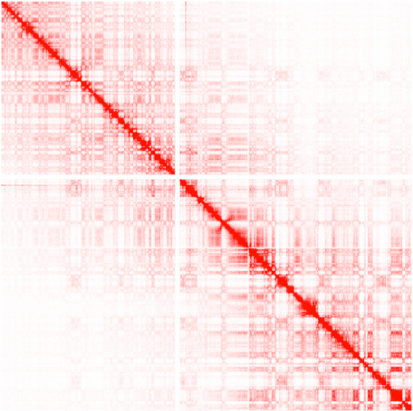

Slide 5
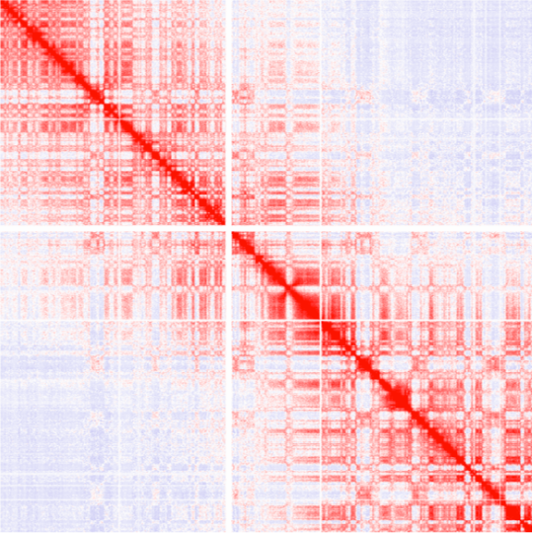

Slide 6
