Slide 1
TAD
TAD Boundary
Point
Genome
Functional Genomic Element
Outcome
1
0
1
0
0
0
0
1
Genomic Bins
Notes:
Diagram of Model Construction
Figure 1. Diagram of the model construction used for downstream analysis. Positional coordinates of TAD boundaries were obtained from Rao et al from contact matrices of X different cell lines. The linear genome was binned according to the resolution of the respective HiC experiment (5kb for GM12878; 10kb for all others). The response vector Y used for classification was determined by whether or not a genomic bin contained a TAD boundary or not. The positional coordinates of each functional genomic element, obtained from ENCODE, was used to define the feature space of the models.

Slide 2

I
II
III
A
1
1
2
3
I
II
III
0
1
3
B
I
II
III
Total Width
Feature Width
C
Feature Width / Total Width
X
base pairs
Notes:
Diagram of Predictor Types
Figure 2. Diagram of the 3 predictor types considered when predicting which genomic elements were associated with the formation of TAD boundaries. (A) The overlap counts (OC) predictors were calculated by considering the total number of elemental regions that overlapped with each genomic bin. (B) The overlap percent (OP) predictors were calculated by dividing the sum of all feature widths within a bin and dividing by the total bin width (either 5 or 10kb depending on the cell line). For simplicity, an example for bin III is shown above. (C) The distance predictors were calculated by measuring the distance (in base pairs) from the center of each genomic bin the center of the nearest elemental region of interest. For simplicity, an example for bin II is shown above.
**make into flowchart; top to bottom
**mention 3 ways to describe relationship between TADs and genomic elements

Slide 3
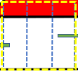
I
III
(A)
(B)
1
II
Total Width
1
Feature Width
(C)
Feature Width / Total Width
X
base pairs
Notes:
Diagram of Predictor Types (edited; changed format, changed legend)
Figure 2. Diagram of the 3 predictor types considered when assessing the relationship between TAD boundaries and functional genomic elements. Each predictor type was used as the feature space in downstream analyses for predicting which genomic elements were associated with the formation of TAD boundaries. (A) The overlap count (OC) predictors were calculated by considering the total number of elemental regions that overlapped with each genomic bin. For bin (I), there is only one overlapped region with that bin. Therefore, the ith position in the feature vector would be 1. (B) The overlap percent (OP) predictors were calculated by dividing the sum of all feature widths within a bin and dividing by the total bin width (either 5 or 10kb depending on the cell line ). An example for bin (III) is provided. (C) The distance predictors were calculated by measuring the distance (in base pairs) from the center of each genomic bin to the center of the nearest elemental region of interest. An example for bin (II) is provided.

Slide 4
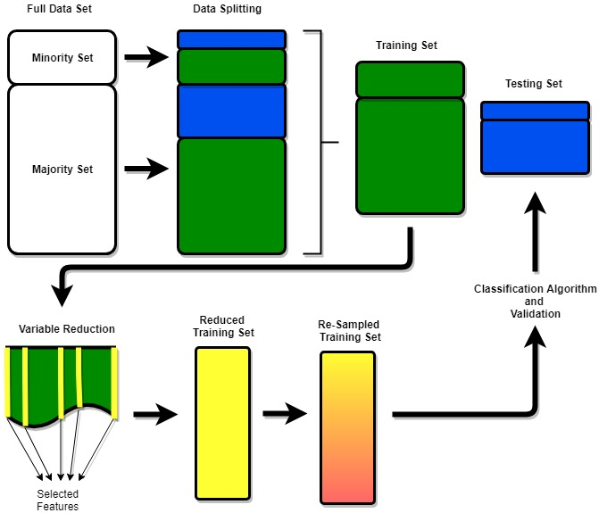
Notes:
Ensemble Pipeline
Figure 3. A diagram of the ensemble pipeline. The process was the same for each combination of predictor type, variable reduction technique, and resampling method considered. The data was split into a 7:3 training set to testing set ratio. The variable reduction technique of choice was performed. The training set was then reduced and the classification algorithm of choice was performed. Lastly, the algorithm was validated on the testing set.

Slide 5
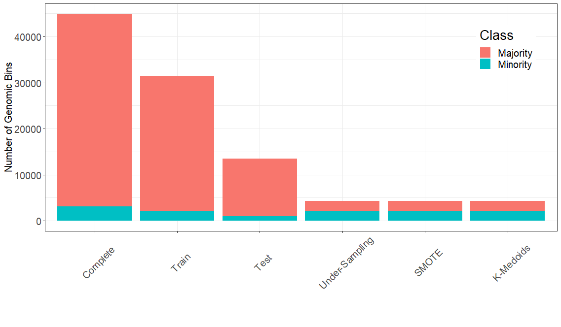
Notes:
Class Imbalance
Figure 4. Barplots illustrating the issue of class imbalance. The majority class represents the number of genomic bins without TAD boundaries in them, while the minority class represents the number of genomic bins with TAD boundaries in them. Each sampling technique considered created perfectly balanced data.
**put over-sampling technique
**put other cell lines (supplementary)

Slide 6
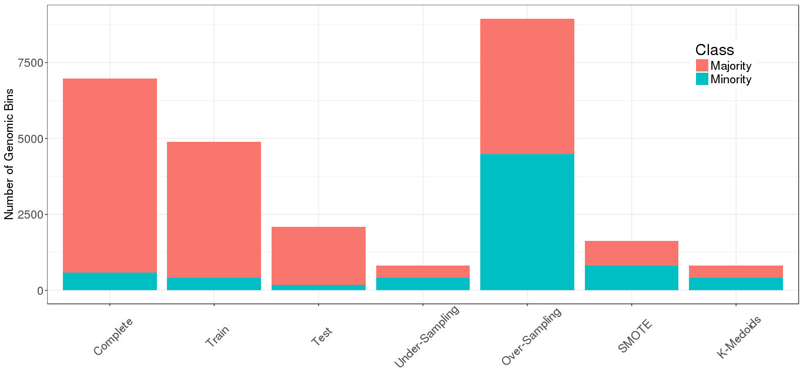
Notes:
Class Imbalance (edited; added oversampling)

Slide 7
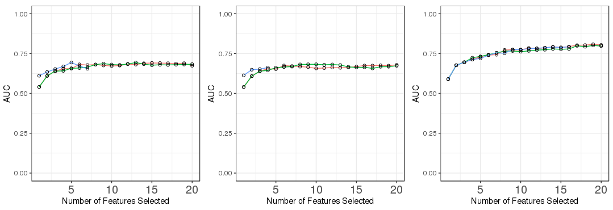
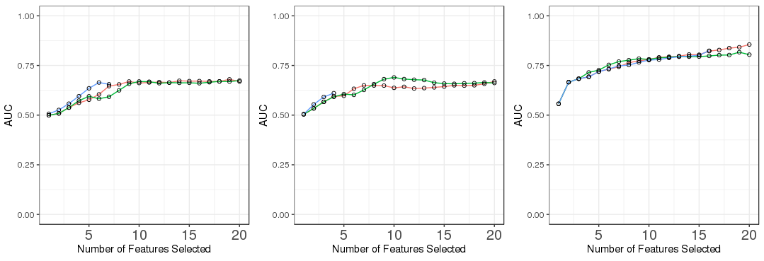
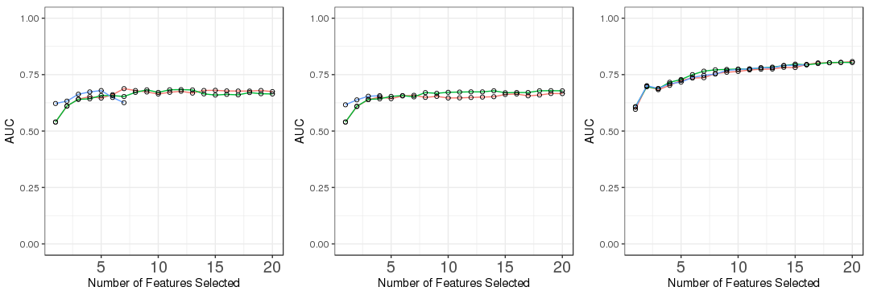
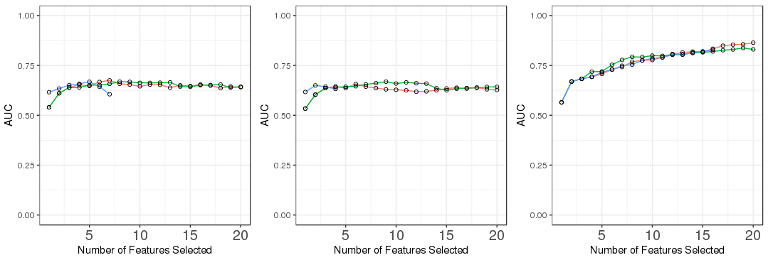
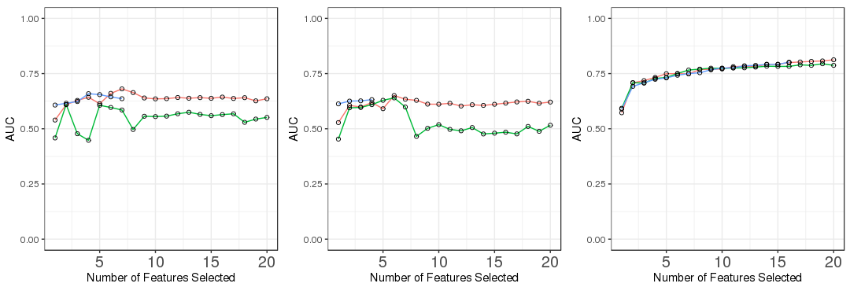
(B) Random Under-Sampling
(C) Random Over-Sampling
(D) SMOTE
(A) No Resampling Technique
(E) K-Medoids
Notes:
Impact of Variable Reduction
Figure 5. Comparisons of the different variable reduction techniques considered across each of the sampling techniques. Each plot includes the AUC measures for a random forest model with a particular predictor type and sampling technique, for each of the 3 variable reduction techniques (AIC, KS-test, LASSO).
**supplementary!
**look at other metrics (MCC)
**label plots across columns by predictor type
**include legend

Slide 8
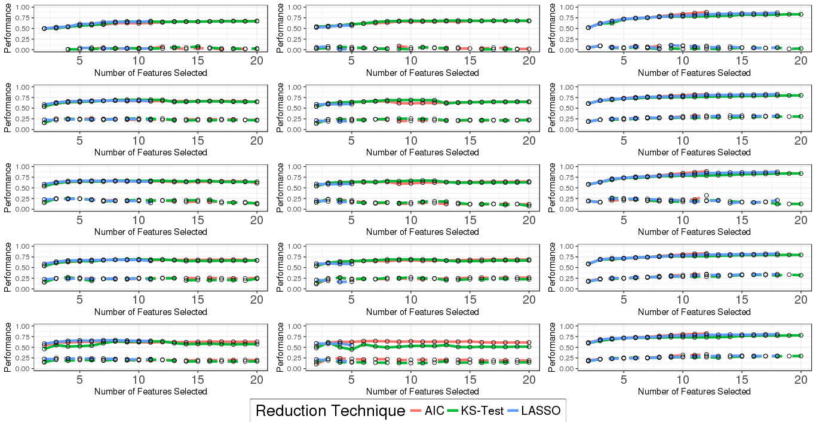
Notes:
Impact of Variable Reduction (edited; added F1 score)

Slide 9
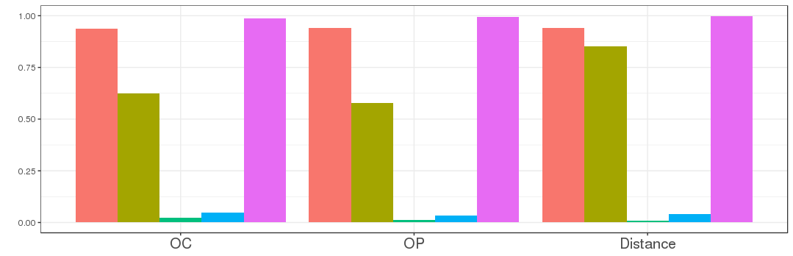
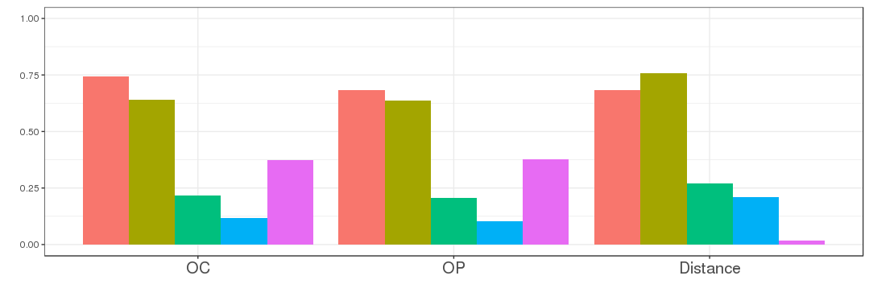
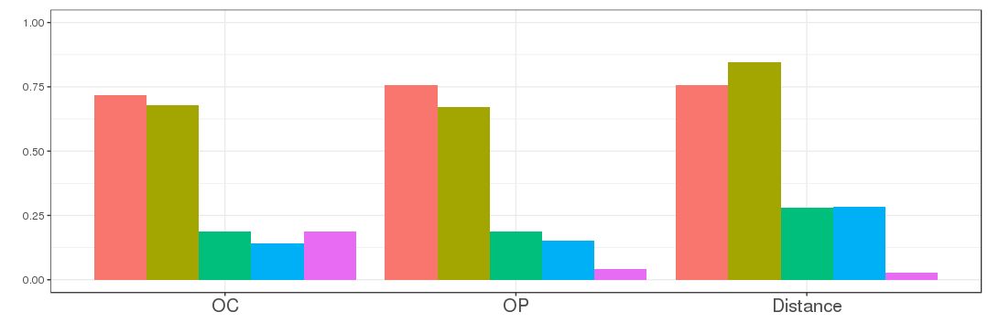
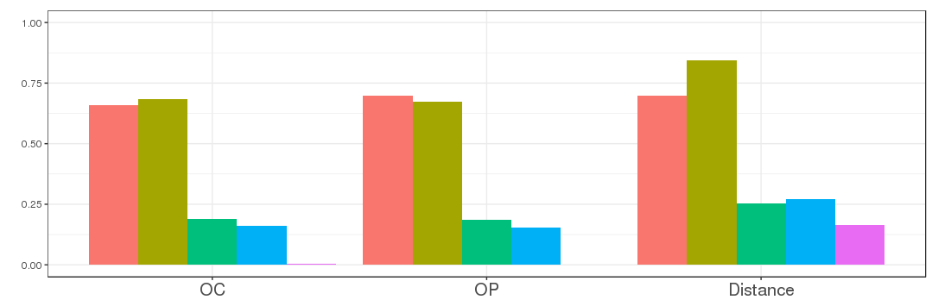
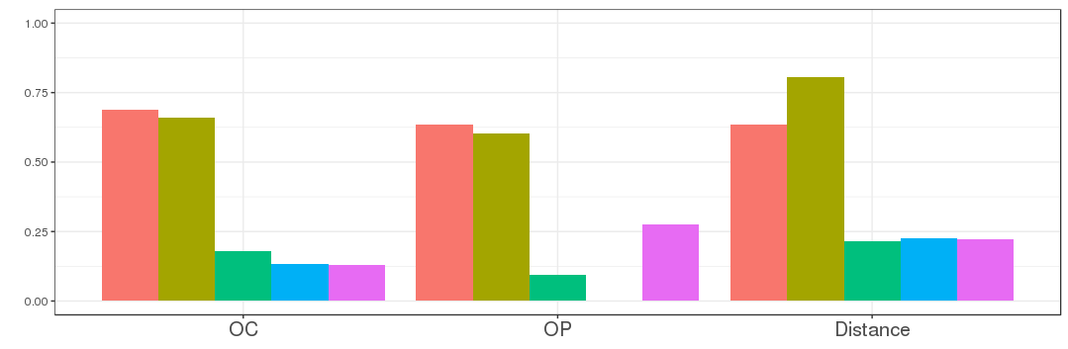
(B) Random Under-Sampling
(C) Random Over-Sampling
(A) No Resampling Technique
(D) SMOTE
(E) K-Medoids
Notes:
Model Performances
Figure 6. Performance metrics for a variety of random forest models using LASSO regularization, by predictor type and sampling technique.
**remove SS gap
**provide table

Slide 10
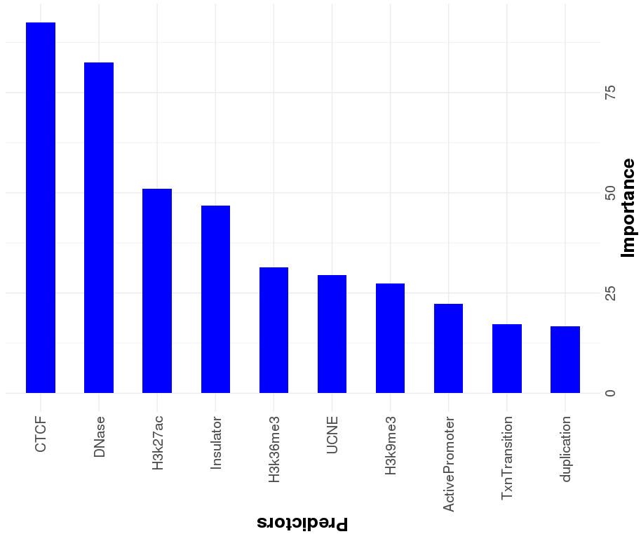
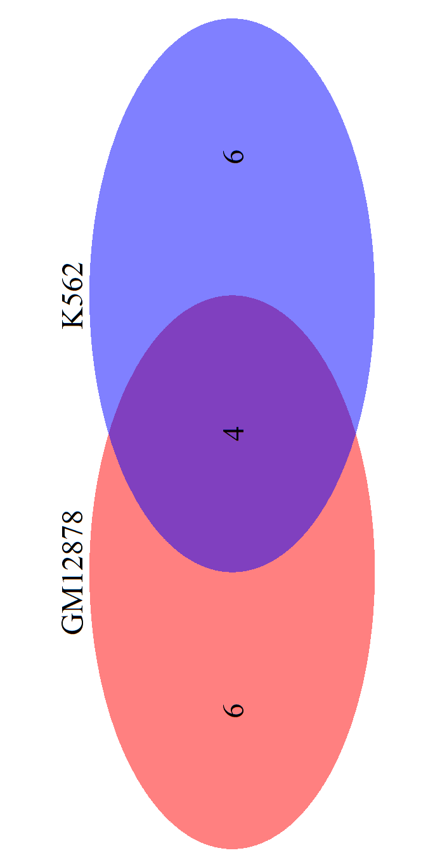
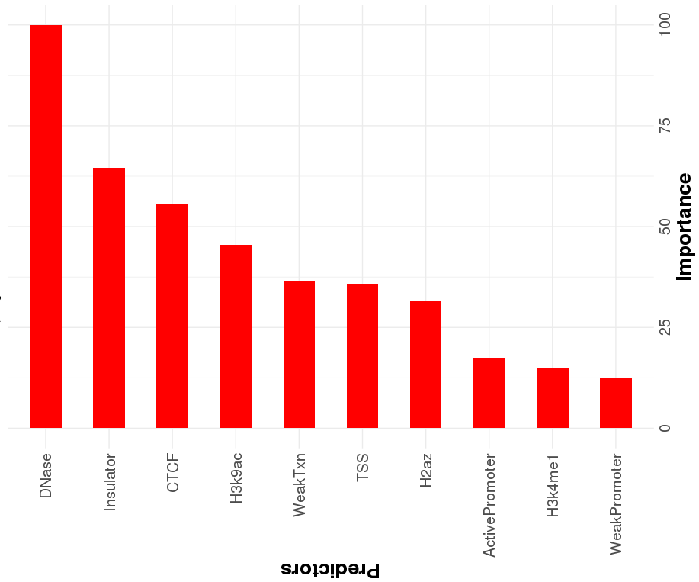
(B)
(C)
(A)
Notes:
Feature Importance
Figure 7. Comparisons between GM12878 and K562 cell lines. The top 10 most predictive features associated with the formation of TAD boundaries for GM12878 (A) and K562 (B). (C) A venn diagram depicting the overlap of the most predictive functional genomic elements between GM12878 and K562.
**include table with ranked importances
**provide table

