Slide 1
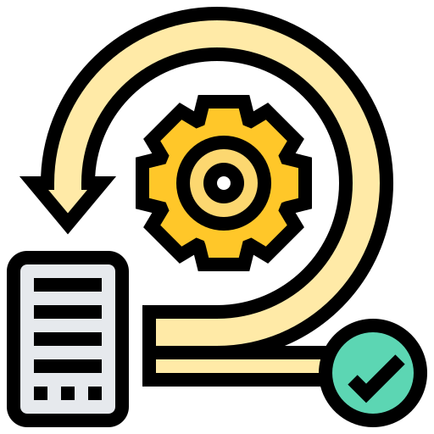
Iterators and Generators
Definitions, Implementations and Examples
SoftUni Team
Technical Trainers
Software University
https://softuni.bg

Slide 2
Table of Contents
What are Iterators?
Loops and Iterators
What are Generators?
The yield Statement
Generators and Functions
Generator Expressions
2
Notes:
2

Slide 3
Have a Question?
sli.do
#python-advanced
Notes:
3

Slide 4

What are Iterators?
__iter__() and __next__()

Slide 5
What are Iterators?
Iterator is simply an object that can be iterated upon
An object which will return data, one element at a time
Iterator object must implement two methods, __iter__() and __next__() (iterator protocol)
An object is called iterable if we can get an iterator from it
Such are: list, tuple, string, etc...

Slide 6
Example: Iterator
The iter() function (which calls the __iter__() method) returns an iterator from an iterable
my_list = [4, 7, 0, 3]
# get an iterator using iter()
my_iter = iter(my_list)
print(next(my_iter)) # 4
print(next(my_iter)) # 7
print(my_iter.__next__()) # 0
print(my_iter.__next__()) # 3
next(my_iter) # Error

Slide 7
For Loops and Iterators
The for loop can iterate automatically through the list
The for loop can iterate over any iterable
A for loop is implemented as:
iter_obj = iter(iterable)
while True:
try:
element = next(iter_obj) # get the next item
# do something with element
except StopIteration:
# if StopIteration is raised, break from loop
break

Slide 8
Explanation
The for loop creates an iterator object (iter_obj) by calling iter() on the iterable
Inside the loop, it calls next() to get the next element and executes the body of the for loop with this value
After all the items exhaust, StopIteration is raised which is internally caught and the loop ends

Slide 9
Problem: Custom Range
Since iterators are implemented using classes, create a class called custom_range that receives start and end upon initialization
Implement the __iter__ and __next__ methods, so the iterator returns the numbers from the start to the end (inclusive)
1
2
…
10
one_to_ten = custom_range(1, 10)
for num in one_to_ten:
print(num)

Slide 10

Solution: Custom Range
class custom_range:
def __init__(self, start, end):
self.i = start
self.n = end
def __iter__(self):
return self
def __next__(self):
if self.i <= self.n:
i = self.i
self.i += 1
return i
else:
raise StopIteration()

Slide 11
Problem: Reverse Iter
Create a class called reverse_iter which should receive an iterable upon initialization
Implement the __iter__ and __next__ methods, so the iterator returns the items of the iterable in reversed order
4
3
2
1
reversed_list = reverse_iter([1, 2, 3, 4])
for item in reversed_list:
print(item)

Slide 12
Solution: Reverse Iter
class reverse_iter:
def __init__(self, iterable):
self.iterable = iterable
self.i = len(self.iterable) - 1
def __iter__(self):
return self
def __next__(self):
# TODO: Implement

Slide 13

What are Generators?
Way of Creating Iterators

Slide 14
What are Generators?
Generators are a simple way of creating iterators
A generator is a function that returns an object (iterator)
This iterator can later be iterated over (one value at a time)
yield

Slide 15
Example: Generators
def first_n(n):
num = 0
while num < n:
yield num
num += 1
sum_first_n = sum(first_n(5))
print(sum_first_n)

Slide 16
The yield Statement
If a function contains at least one yield statement, it becomes a generator function
Both yield and return will return a value from a function
The difference between yield and return is that the return statement terminates a function entirely
Yield however pauses the function saving all its states and later continues from there on successive calls

Slide 17
Generators vs Normal Functions
Generator function contains one or more yield statements
It returns an iterator but does not start execution immediately
Methods like __iter__() and __next__() are implemented automatically
Once the function yields, the function is paused
When the function terminates, StopIteration is raised automatically on further calls

Slide 18
Example: Generator Function
def my_gen():
n = 1
print('This is printed first')
yield n
n += 1
print('This is printed second')
yield n
n += 1
print('This is printed at last')
yield n
The value of "n" is remembered between calls

Slide 19
Generator Expression
Generators can be easily created using generator expressions
Same as lambda function creates an anonymous function, generator expression creates an anonymous generator function
The syntax for generator expression is similar to that of a list comprehension
The difference between them is that generator expression produces one item at a time

Slide 20
Example: Generator Expression
# Initialize the list
my_list = [1, 3, 6, 10]
# square each term using list comprehension
# Output: [1, 9, 36, 100]
print([x**2 for x in my_list])
# same thing can be done using generator expression
# Output: <generator object <genexpr> at 0x0000000002EBDAF8>
print((x**2 for x in my_list))

Slide 21
Problem: Squares
Create a generator function called squares that should receive a number n
It should generate the squares of all numbers from 1 to n (inclusive)
print(list(squares(5)))
[1, 4, 9, 16, 25]
def squares(n):
i = 1
while i <= n:
yield i * i
i += 1

Slide 22
Problem: Generator Range
Create a generator function called genrange that receives a start and an end
It should generate all the numbers from the start to the end (inclusive)
print(list(genrange(1, 10)))
[1, 2, 3, 4, 5, 6, 7, 8, 9, 10]

Slide 23
Solution: Generator Range
def genrange(start, end):
i = start
n = end
while i <= n:
yield i
i += 1

Slide 24

Summary
Iterator is an object that can be iterated upon
Functions that returns iterators are called generators
Generators - yield, Functions - return
Generator expression is like a list comprehension
Notes:
24

Slide 25
Questions?
Notes:
25

Slide 26












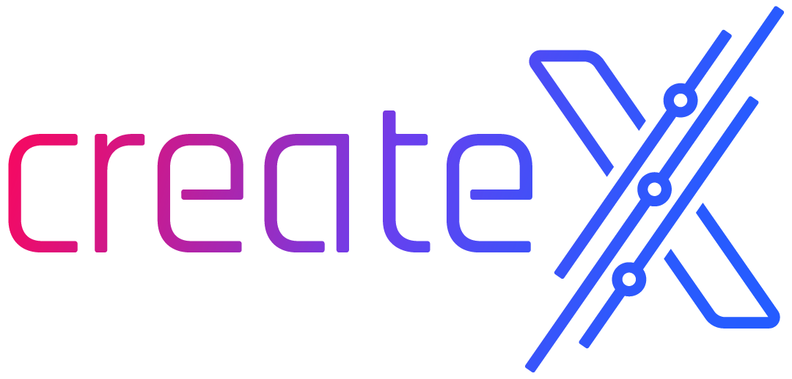
SoftUni Diamond Partners

Slide 27

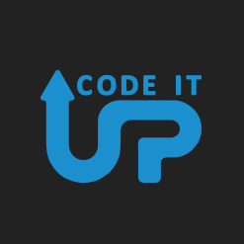
Educational Partners

Slide 28

License
This course (slides, examples, demos, exercises, homework, documents, videos and other assets) is copyrighted content
Unauthorized copy, reproduction or use is illegal
© SoftUni – https://about.softuni.bg
© Software University – https://softuni.bg
Notes:
28

Slide 29
Trainings @ Software University (SoftUni)
Software University – High-Quality Education, Profession and Job for Software Developers
softuni.bg, softuni.org
Software University Foundation
softuni.foundation
Software University @ Facebook
facebook.com/SoftwareUniversity
Software University Forums
forum.softuni.bg
Notes:
29

