Slide 1

UCI: Unified Complaint Interface
Dhaval Kumar | 201000013 | B.Tech CSE
Kondury Rishabh | 201020425 | B.Tech DSAI
Kushal Jain | 201000025 | B.Tech CSE
Supervisor : Dr. Santosh Kumar, Assistant Professor CSE
Dr. Shyama Prasad Mukherjee International Institute of Information Technology, Naya Raipur

Slide 2
Coverage Of The Presentation
Introduction
Unified Complaint Interface
Issues to be addressed
Drawbacks of existing solutions
Proposed Methodology
Our solutions
Future Plans
References

Slide 3
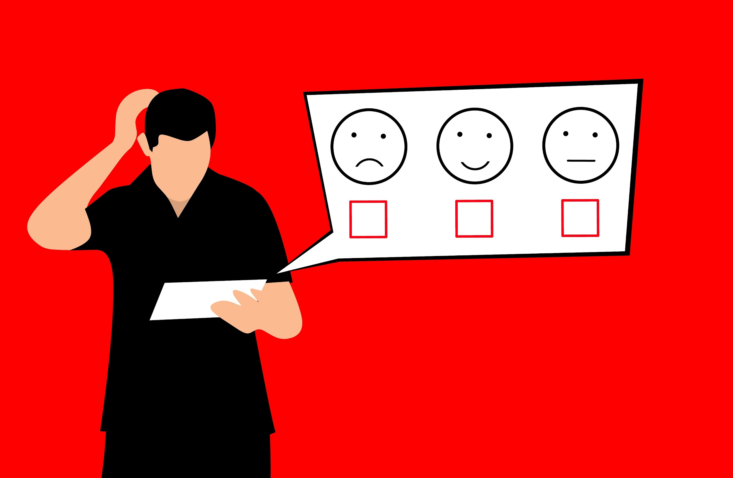
Introduction
Complaint management is the process of handling, managing, responding to, and reporting user grievances.
Challenges with Complaint Management System:
Different kinds of complaints
Different departments
Good User Friendly Interface
Easy Way to address complaints
We will be creating a better complaint system in our project.

Slide 4
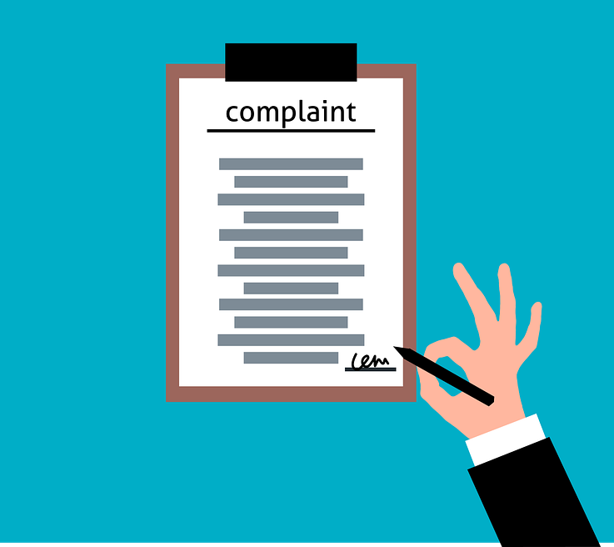
Unified Complaint Interface
Single Website for any kind of complaint
Written in code
Deployed on world wide web
Addresses coordination challenges by increasing:
Transparency
Traceability
Efficiency
Buildup Trust
Fig 1. Handwritten Complaint

Slide 5
Issues to be addressed
Drawbacks in the current complaint system:
Some government agencies are still doing it on paper
Lack of a portal to get update on a filled complaint
Confusion due to multiple websites for each individual department
Because of aforementioned reasons the issues of filling a complaint and feedback on complaint still exists. Using our platform we can address all the mention issues.

Slide 6
Drawbacks of existing solutions
Multiple Platform to address different problem
Lack of coordination among the the different government departments
Unable to follow up on a complaint
Lack of proper centralized system to collect all the complaints

Slide 7
Proposed Methodology
The complaint data stored in departments and main table in a secure database.
Filing the Complaint
Admin Login
Only authorized user of a department can login to the department’s page
Admin View
Authorised user can view all the complaints of his/her department
Admin Actions
Based on the complaint authorized user can update the status on a complaint
Feedback on Complaint
The user who initially filed the complaint through the complaint page can view the status of his/her complaint with Ref. ID

Slide 8
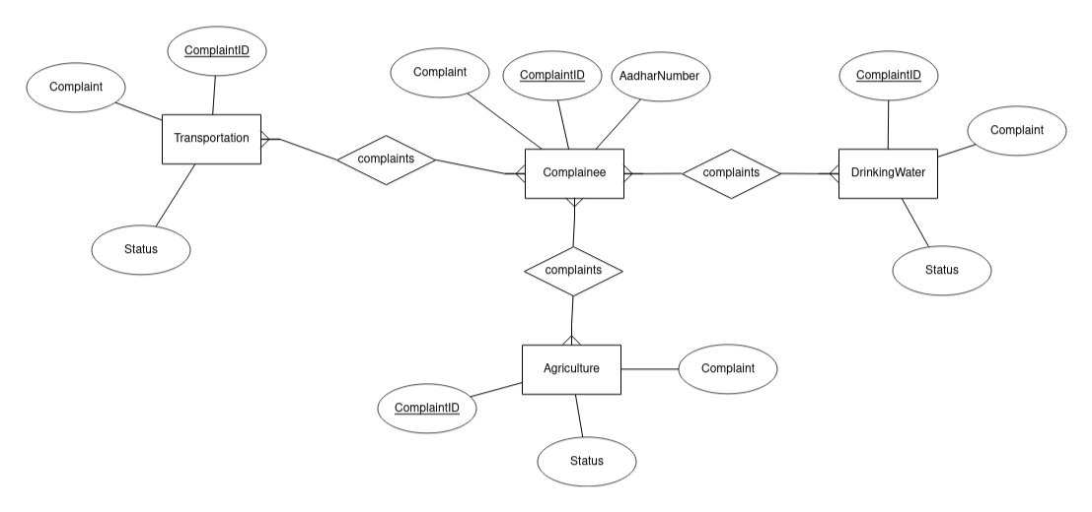
ER Diagram

Slide 9
Our Solution
Due to the large influx in the number of complaints related to different problems in urban centers.
Common issues include water shortage, electricity cuts, and sewage system-related problems.
Various departments deal with their respective issues and they have to maintain their complaint portal, which might be obscure, hard to access, and the complainant has to visit multiple outlets for separate issues.
UCI makes it easier for the user to file the complaint regardless of the problem. Now that some person can go to UCI and register both of his complaints.
This will have a significant impact on the current scenario of complaint management for local authorities as UCI also provides them a portal to look at the complaints filed and update the status of the complaint.
Due to the simplicity of UCI, it makes it easy to file and view the status of complaints, removing the need for physical queues. For the authorities, it provides a centralized portal making their work easier to work on the issues.

Slide 10
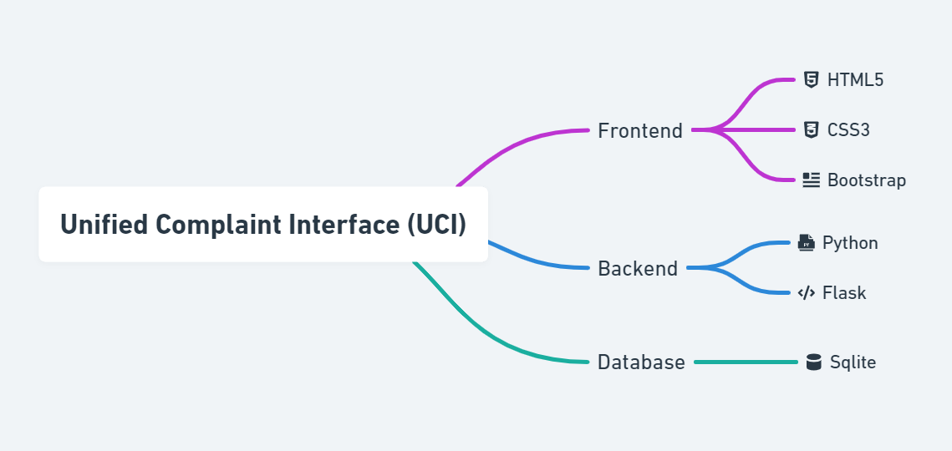
Tech Stack

Slide 11
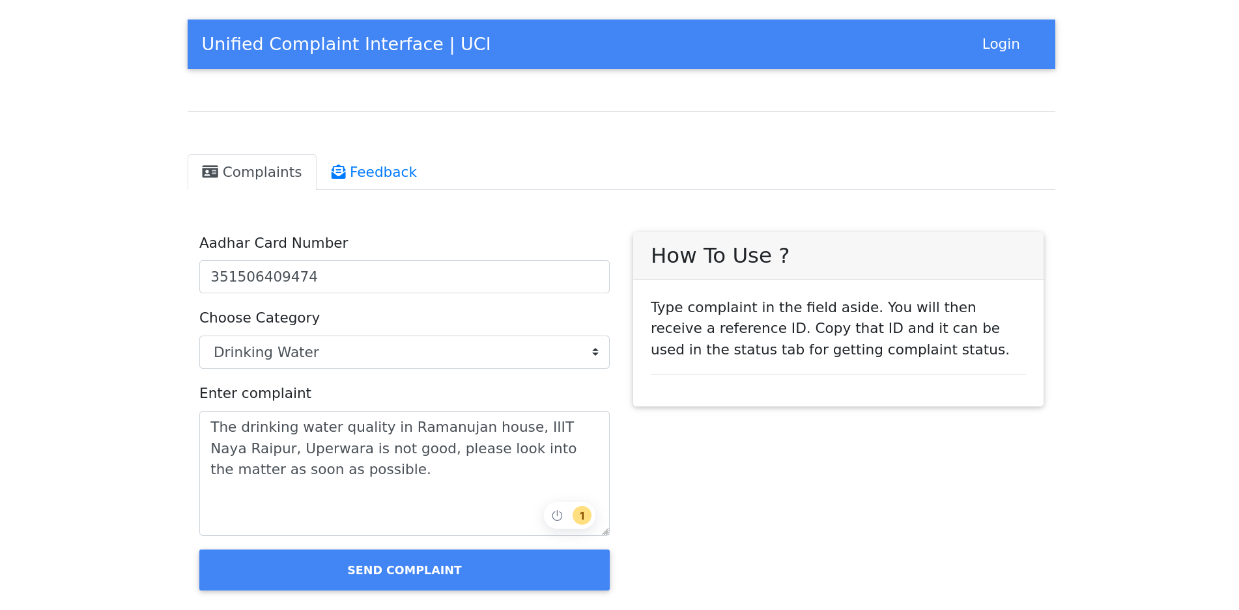
Fig 3. Homepage

Slide 12
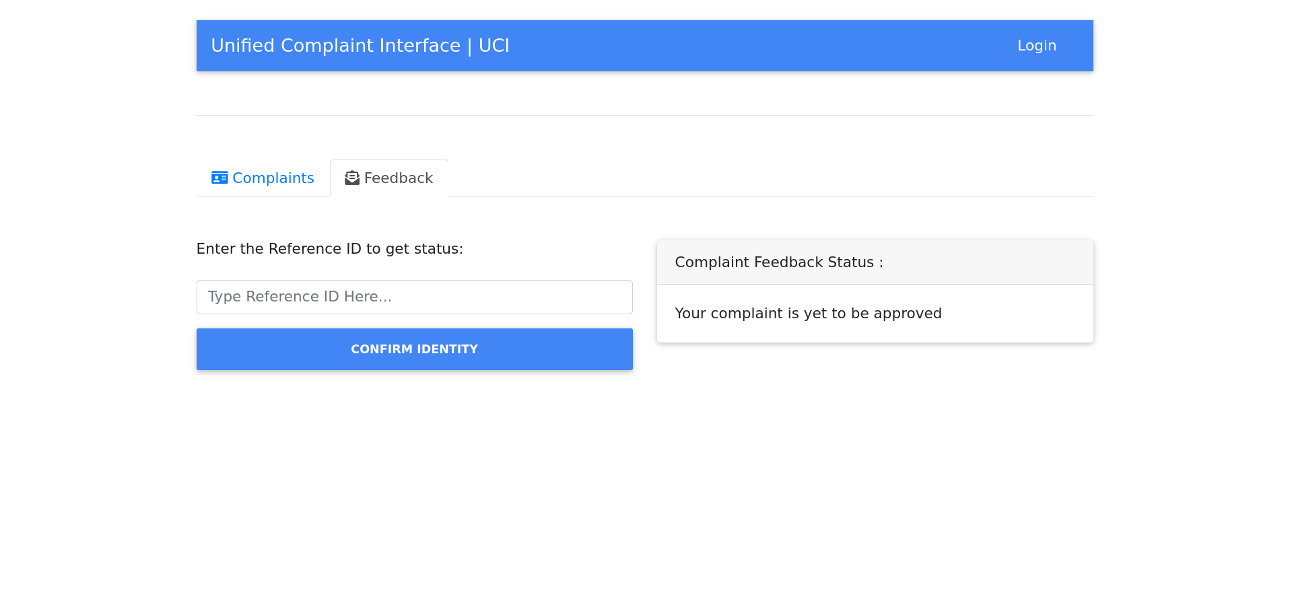
Fig 4. Feedback Page

Slide 13
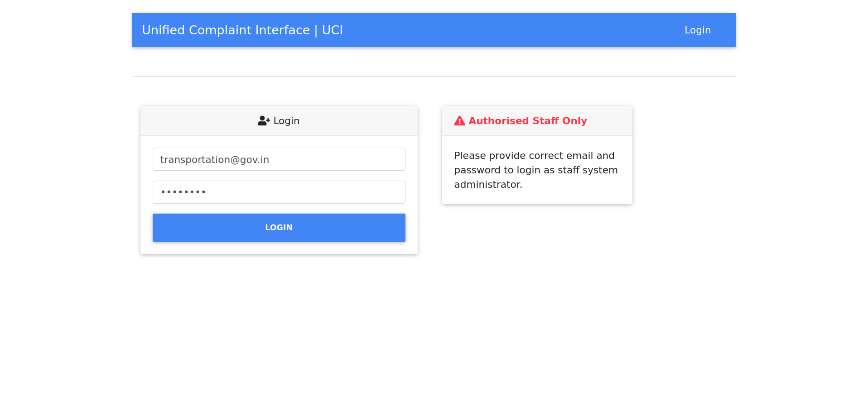
Fig 5. Admin Login Page

Slide 14
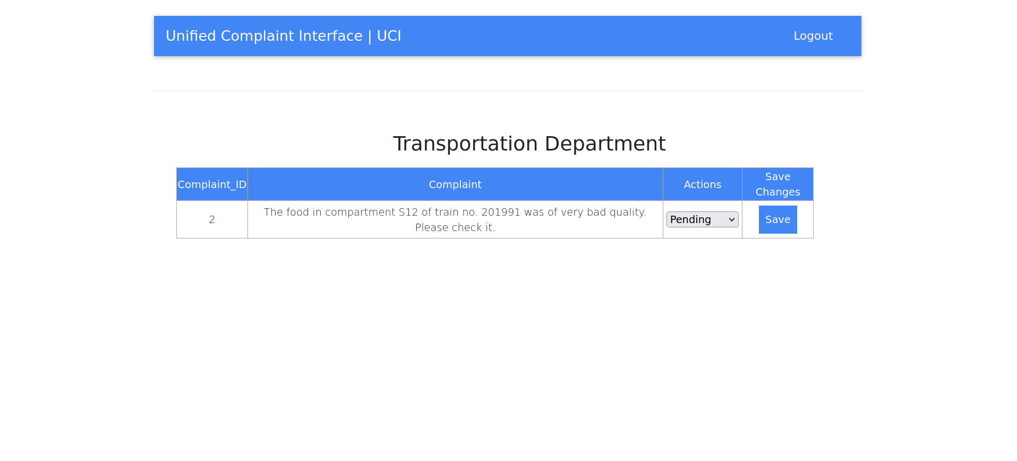
Fig 6. Complaint Management Page

Slide 15
Future Plans
We would be adding add ML model to convert handwritten complaint to our format.
We would develop a mobile application with GPS support.
Addition of google maps to find the location of user who is filling the complaint making it easier to work on the complaint for the government.

Slide 16
References
[1] Cho Y., Hiltz R., & Fjermestad J., “An Analysis of Online Customer Complaints: Implications for Web Complaint Management.” in Proceedings of the 35th Hawaii International Conference on System Sciences, Hawaii, (2002).
[2] Jay DiMare & Richard S. Ma, “Service Oriented architecture Revolutionizing today's
banking systems.” White Paper.
[3] Julta, D., Craig, J., & Bodorik, P., “Enabling and Measuring Electronic Customer Relationship Management Readiness,” in Proceedings of the 34th Hawaii International Conference on System Sciences, Hawaii, (2001).
[4] Najar, A. S., Al-Sukhni, H. A., & Aghakhani, N., “The Application of Service-Oriented Architecture in the E-complaint System.” Paper presented at (ICCSN '10) the Second International Conference on Communication Software and Networks, (2010, 26-28 Feb. 2010).
[5] Razali R., Abd Halim K. N., & Jusoff K., “Quality Improvement of Services in Unversiti Teknologi Mara Pahang from a Management Perspective.” Management Science & Engineering Vol.5, No.1, (2011), pp. 71-80.

Slide 17
Thank You!
Project Made by,
Dhaval Kumar, Kondury Rishabh and, Kushal Jain
At IIIT Naya Raipur
Under the Guidance of,
Dr. Santosh Kumar, Assistant Professor CSE, IIIT Naya Raipur
Link : https://unified-complaint-interface.herokuapp.com/

