Slide 1
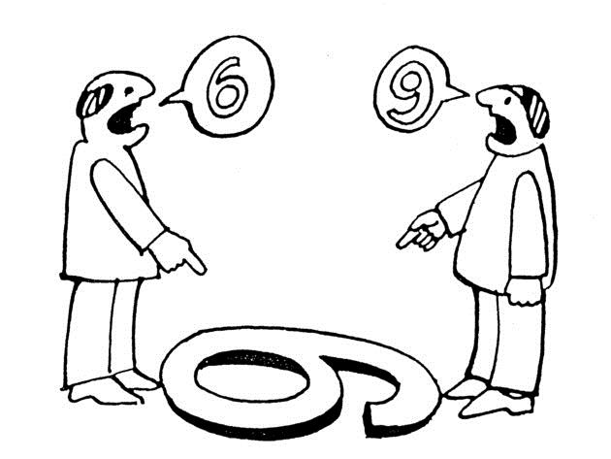
Perception

Slide 2
per·cep·tion
pərˈsepSH(ə)n/
noun
noun: perception; plural noun: perceptions
synonyms: | recognition, awareness, consciousness, appreciation, realization, knowledge, grasp, understanding, comprehension, apprehension; formalcognizance "our perception of our own limitations"
A way of regarding, understanding, or interpreting something; a mental impression.

Slide 3
“One has not only an ability to perceive the world but an ability to alter one’s perception of it; more simply, one can change things by the manner in which one looks at them.”
– Tom Robbins

Slide 4
Many factors influence the way in which we perceive the world and the people in it. Our different cultural backgrounds, life experiences, and personal values all affect our interactions and relationships with others, as do our personalities, our social skills, and our styles and approaches to dealing with people and problems. In the workplace, especially as managers and supervisors, we need to learn the skills that enable us to understand and manage other people's perceptions of us.
This is not as difficult as you may think, although it does require a good deal of thought, motivation, self-awareness—and practice. Once you have the skills, however, you will find it easier to communicate with people and to motivate and lead them.

Slide 5
Isn't it rather manipulative to "manage" perceptions?
Techniques for managing perceptions can be positive or negative, depending on the context. We live in a society in which people and organizations spend billions employing others—advertising and public relations companies—to manage perceptions. You can employ the same techniques used by these companies to influence others and change their perceptions of you. At the very least, you can become aware of the effect your behavior has on others. At best, you will learn to use this awareness to develop skills that allow you to manage your behavior in a way that furthers your career.

Slide 6
Why is perception management important to my career?
Careers are no longer managed by organizations, but by individuals themselves. You will be judged not only on what you do, but on how you do it—so other people's perceptions and evaluations of you play an important role in your career. People with the skills to influence others' perceptions have a far better chance of controlling their own destiny.

Slide 7
Why do I find it so hard to change others' perceptions of me?
Within seconds of meeting someone, you will make an impression on that person. First impressions are lasting impressions; therefore, if you have made a negative first impression, you will have a hard time changing it. Doing so requires a consistent flow of new positive messages. That means learning to be aware of—and ready to evaluate—your behavior at all times. It will take time and energy.
First you must understand both that person's existing perception and the new one you wish to make. You then need to create a bridge between the two and find opportunities to convey your positive messages. The persona you put forward, however, must be you. Any deception will be easy to spot, simply because living a lie is extraordinarily difficult to sustain.

Slide 8
Why, if I just want to do a good job, should I care what other people think about me?
Common wisdom suggests that you need to take care of your relationships as you move up the career ladder. People can harbor grudges for years. If someday you should find yourself on the way back down, you do not want to risk encountering an unforgiving individual in a position of power. If you cannot change your attitude, you had better have skills that make you indispensable!

Slide 9
What to Do? Understand Yourself and How You Are Perceived
To understand how others view you, you need to gain an accurate understanding of yourself.
Spend some quiet time alone each day examining who you are and who you are not.
Encourage informal feedback from trusted peers and managers. You may be surprised at how they perceive you. Be aware that they will give subjective views based on personal opinions, so attempt to remain objective and explore what about you may have influenced these views.
360-degree surveys, which gather the views of audiences, both inside and outside the business, can be helpful but focus on skills as well as behavior. Be aware of the differences between the two. While both may be learned and modified, changing the way you behave usually involves altering personality traits and perceptions and is more difficult than acquiring new technical skills.
When reviewing test results, try not to concentrate only on personal information that feels hurtful. Look for patterns in the feedback. Consider the when's and why's. Stress often allows unintentional behavior to surface. It is possible, too, that you have been completely unaware of the behavior that has created the impression you want to change.
Remember that building self-awareness requires courage and commitment, so do not allow yourself to become discouraged by what you learn.

Slide 10
Determine your Strategy
Before you embark on a perception management strategy, determine your goals, how you intend to accomplish them, and how you will monitor your progress. Focus initially on changing one thing that will create a quick win.
Consider the context in which you are working and use the feedback you have received to select your goals. You may have a strong desire to change your behavior and others may have encouraged you to do so—but remember—people are accustomed to the old you and may not react to the new you as you expect. It will help if you concentrate on four tracks:
Communicate your intentions to people who may be affected. Look for an opportunity, such as an annual formal performance appraisal, to make your intentions known; you will likely win more support and understanding if things should not work out exactly as you plan. You are also likely to receive more praise when they do.
Gain support from your manager or key members of your team to help keep you focused. A good support group is essential when you seek to change something about yourself-witness the success of groups such as Alcoholics Anonymous and Weight Watchers.
Find a coach to provide ongoing direction and support. A coach can make impartial observations and encourage you to continue, or change, your strategy as you move forward. Working with a coach takes time and commitment, so allow for this in your plan.
Evaluate your progress at each milestone in your plan, either formally or informally. You may wish to keep a daily journal of the details that tend to slip away if they do not get written down. Frequent informal feedback from friends and colleagues is important. You might tell them in advance that you intend to approach them for feedback, so that they can consciously pay attention to your behavior; then give them enough time to observe you before asking for that feedback. A more formal option is to revisit the 360-degree questionnaire and see whether others have noticed a change.
The changes you succeed in bringing about may not be immediately recognized by others. It may take months, but do not lose heart-consistency and perseverance are key.

Slide 11
Do:
Increase your own awareness
Be aware of the effect you have on others
Learn to interpret other people's verbal and nonverbal signals
Know the effect that stress has on you and how this looks to others
Be visible at strategic moments
Encourage feedback from people you value, without making unreasonable demands
Allow others to make their own choices
Give yourself adequate time and make perception management part of your personal development
Be consistent, patient, and forgiving
Do Not:
React emotionally to the feedback you receive
Act defensive
Become unmotivated
Be ingratiating
Behave aggressively and try too hard too quickly
Expect too much
Embroil others in your views of yourself
Pester people for feedback
Be political or manipulative in your behavior

Slide 12
You can go too far!
In trying to change your behavior, it is easy to overdo and alienate the very people you are attempting to influence. Pursue your goals for change, but err on the side of subtlety.

Slide 13
In a nutshell, perception management is the ability to create an impression through conscious activities and awareness of other people and the impact your behavior has on them. To be successful, define your target audience, superimpose their values on yours, adjust your communication style, encourage feedback, and be aware of how you adapt at every step of the way.

