Slide 1
Performance persistence in MLB Free Agency
Chris Hua / Wharton Senior Thesis
16 November 2016

Slide 2
Outline
Research question
Context and importance
Current work
Planned methodology
Conclusion

Slide 3
Research question
Do certain MLB teams consistently outperform others in picking free agents?

Slide 4
Hypotheses
Certain performance traits are/were undervalued.
Performance
Certain MLB teams can consistently price players, in free agency, better than other teams.

Slide 5
Context and importance
Free agent contracts are a massive expense
better pricing = more efficient allocation
$533M in 2015
Applying finance methodologies (performance persistence) to sports
Why MLB?
Lots of salary and performance data readily available
Few restrictions on salary: luxury tax is weakest in American pro sports

Slide 6
Data
Baseball-Reference
Historical transactions (e.g. free agent)
Sean Lahman’s Baseball DB
Player game statistics, salary information

Slide 7
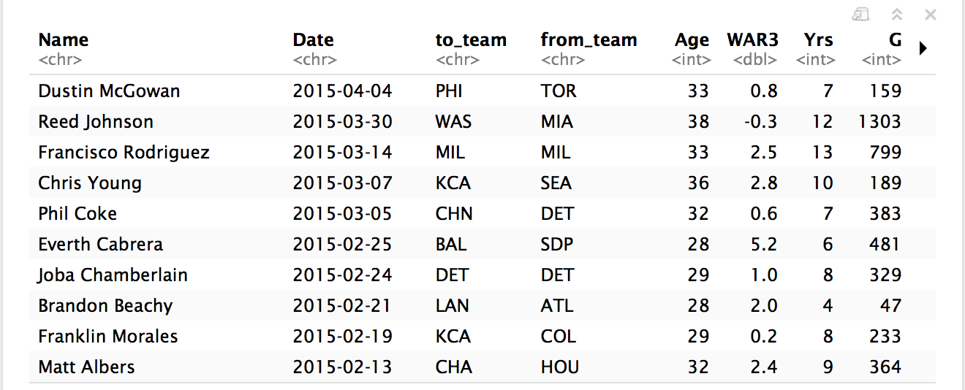
Current work
Reproducible, extensive data pipeline in R
Load and get free agent transactions and yearly salaries in 1 line
https://github.com/stillmatic/thesis
Subset to only players switching teams
Often done in literature

Slide 8
Modelling salaries
Few related problems to answer:
Model salaries paid as function of previous performance
Which performance measures best explain salary amounts
Linear regression on lagged indicators of performance vs yearly salary
Last years, average of last 3 years, and best of last 3 years
Performance indicators include
Will also try to control for length of contract

Slide 9
Modelling change
Bayesian changepoint detection
Outlier detection

