Slide 1
gdT Repertoire Meeting
08/26/2015

Slide 2
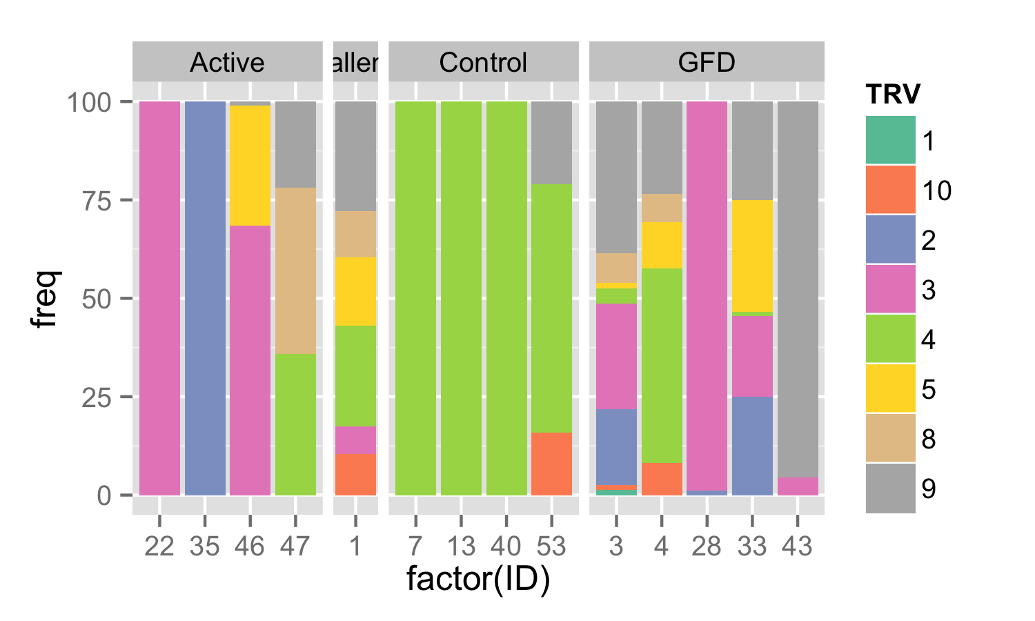
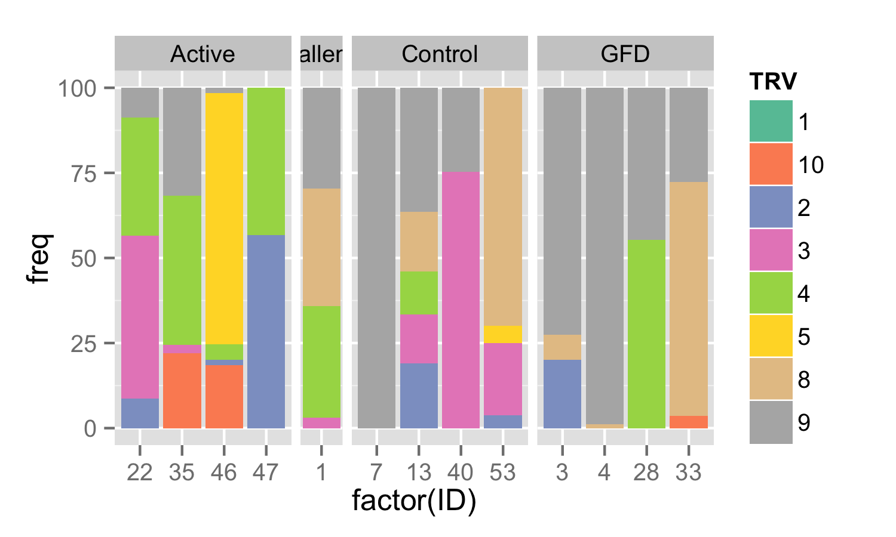
V region representation
IEL
PBL

Slide 3
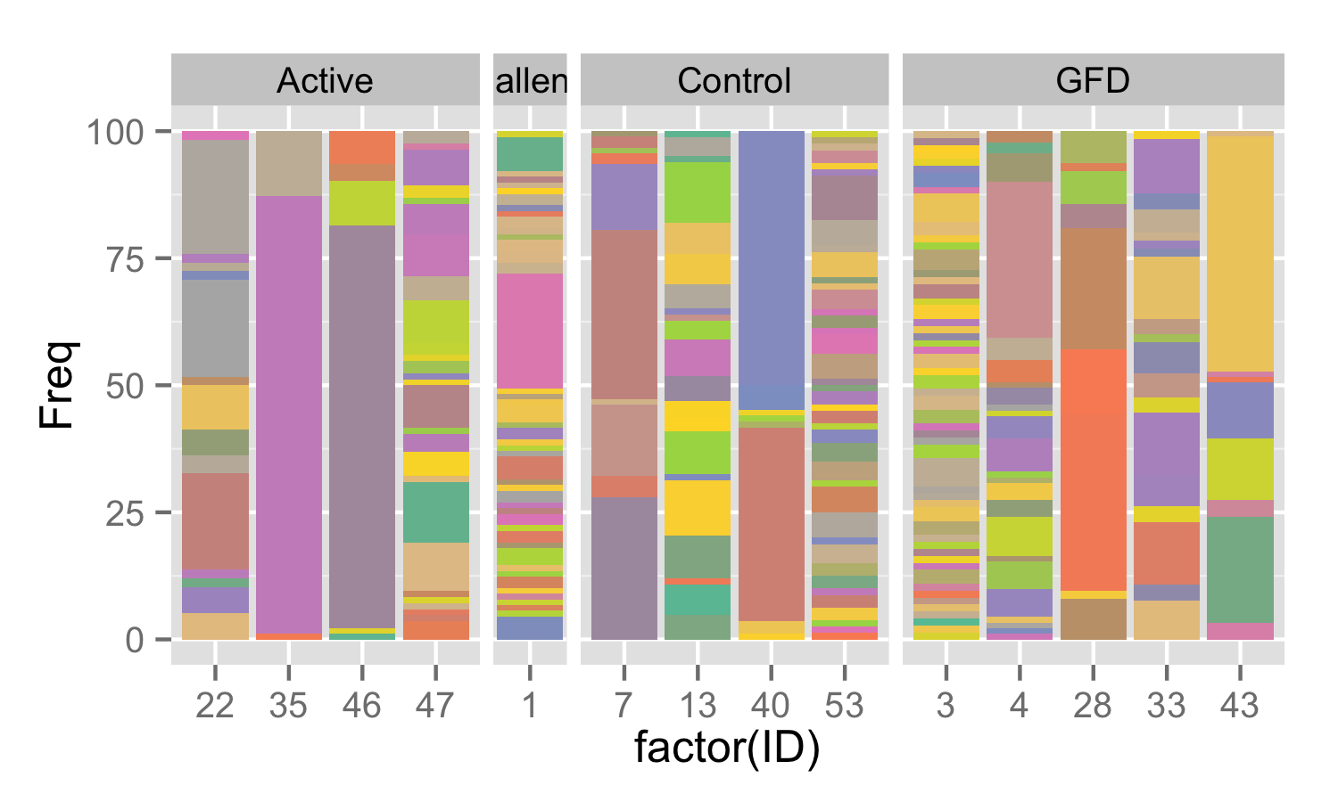
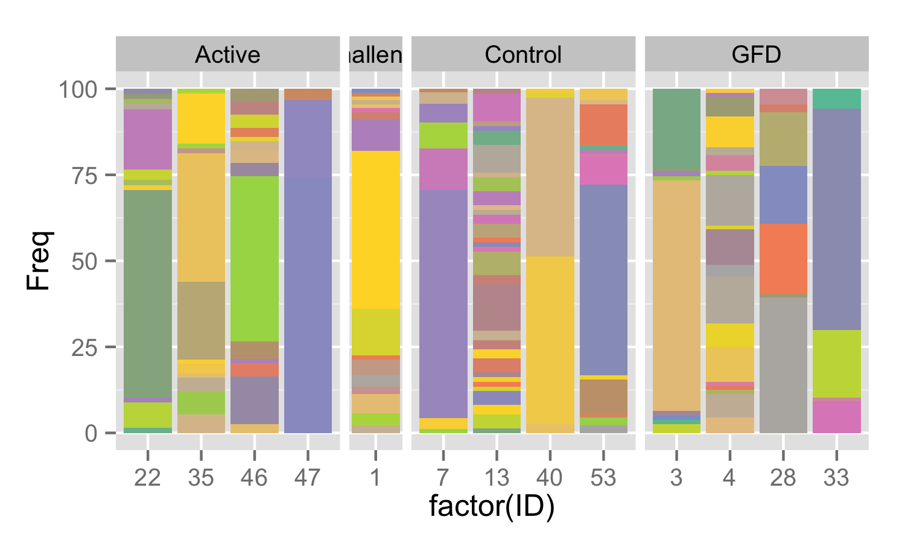
TRD clonal representation
IEL
PBL

Slide 4
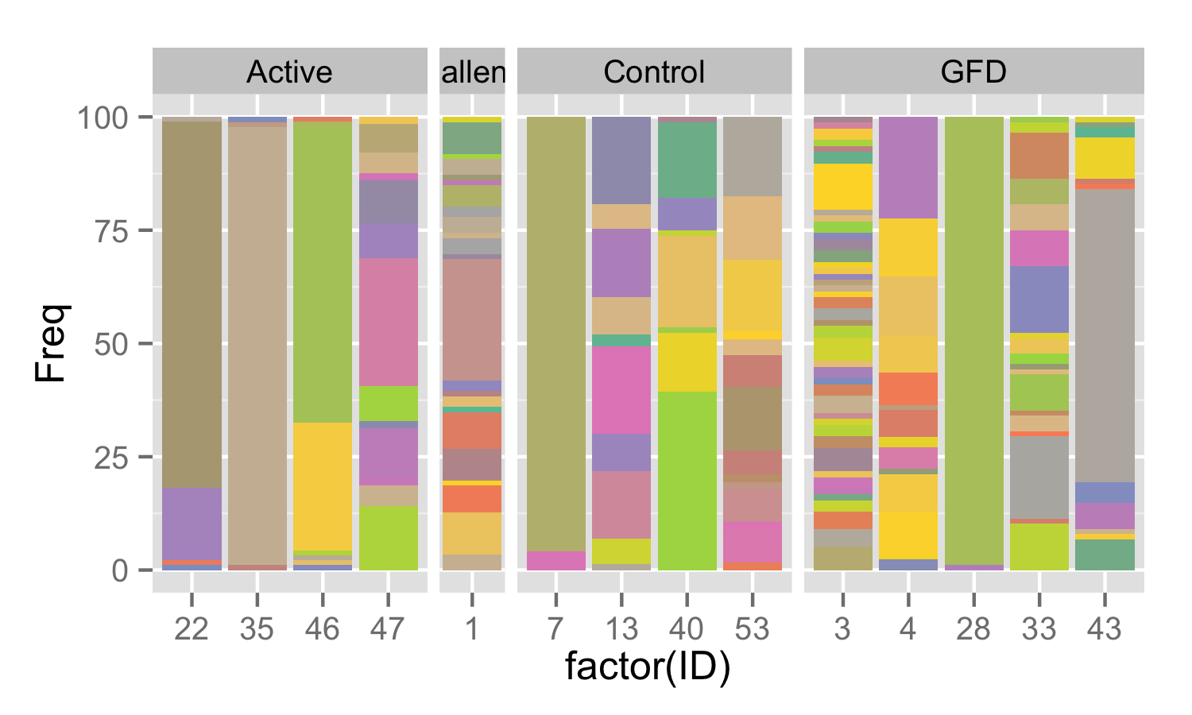
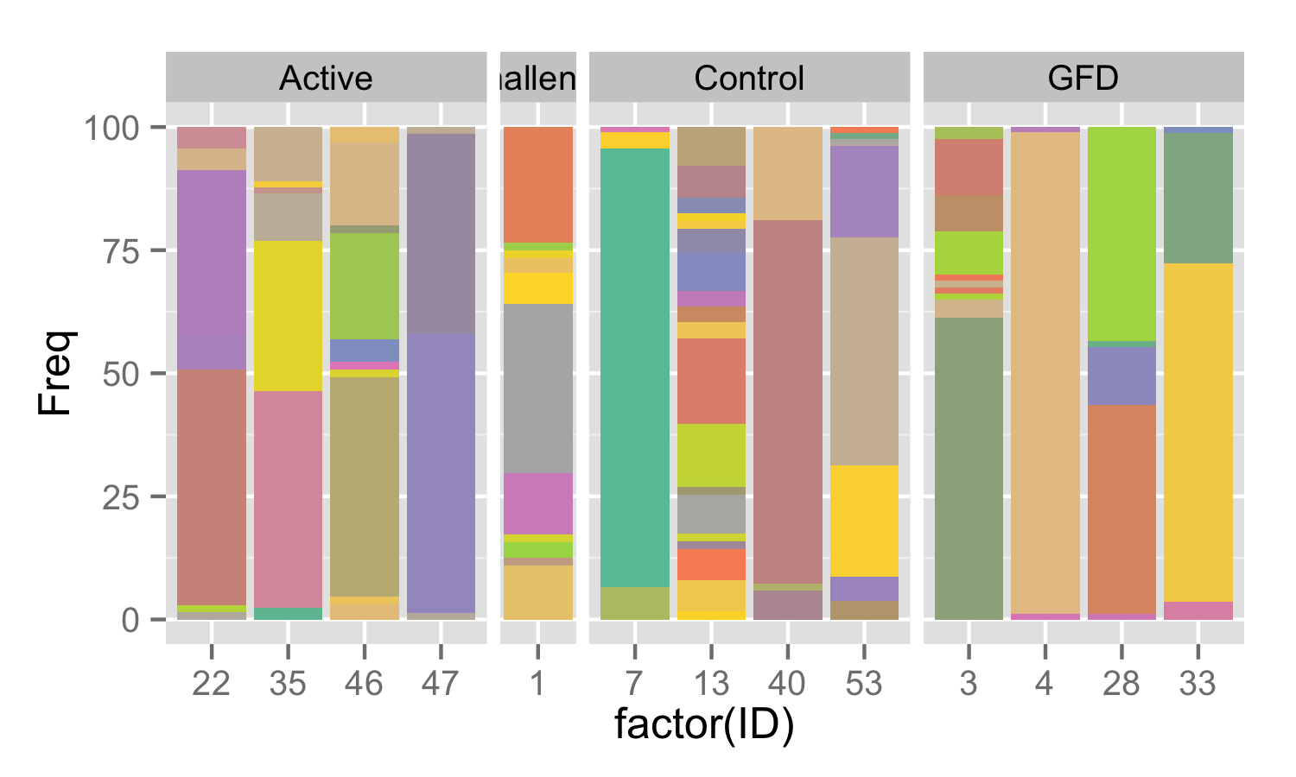
TRG clonal representation
IEL
PBL

Slide 5
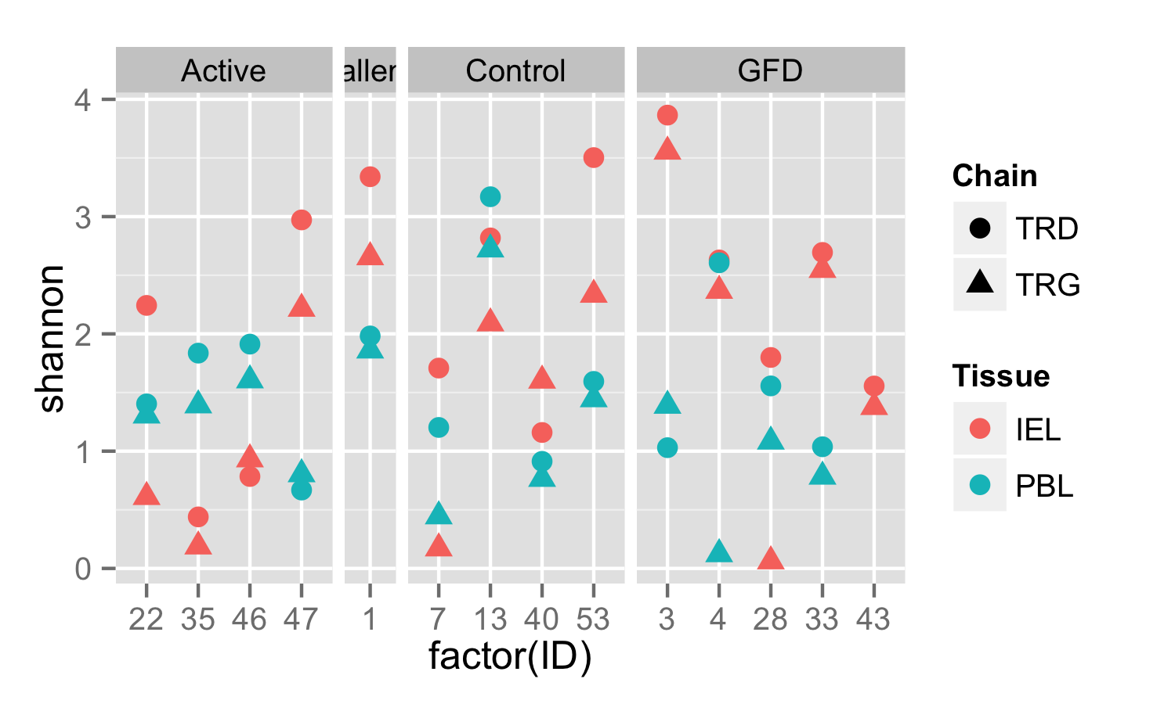
Clonal Diversity as measured by Shannon Entropy

Slide 6
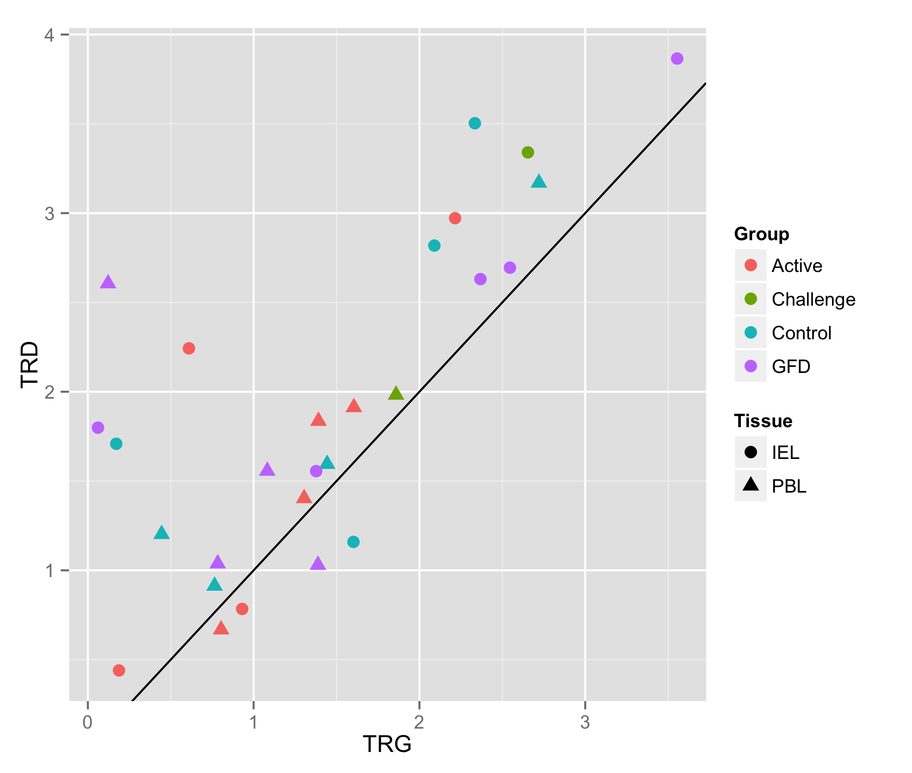
TRD Chain tends to be more diverse per individual

Slide 7
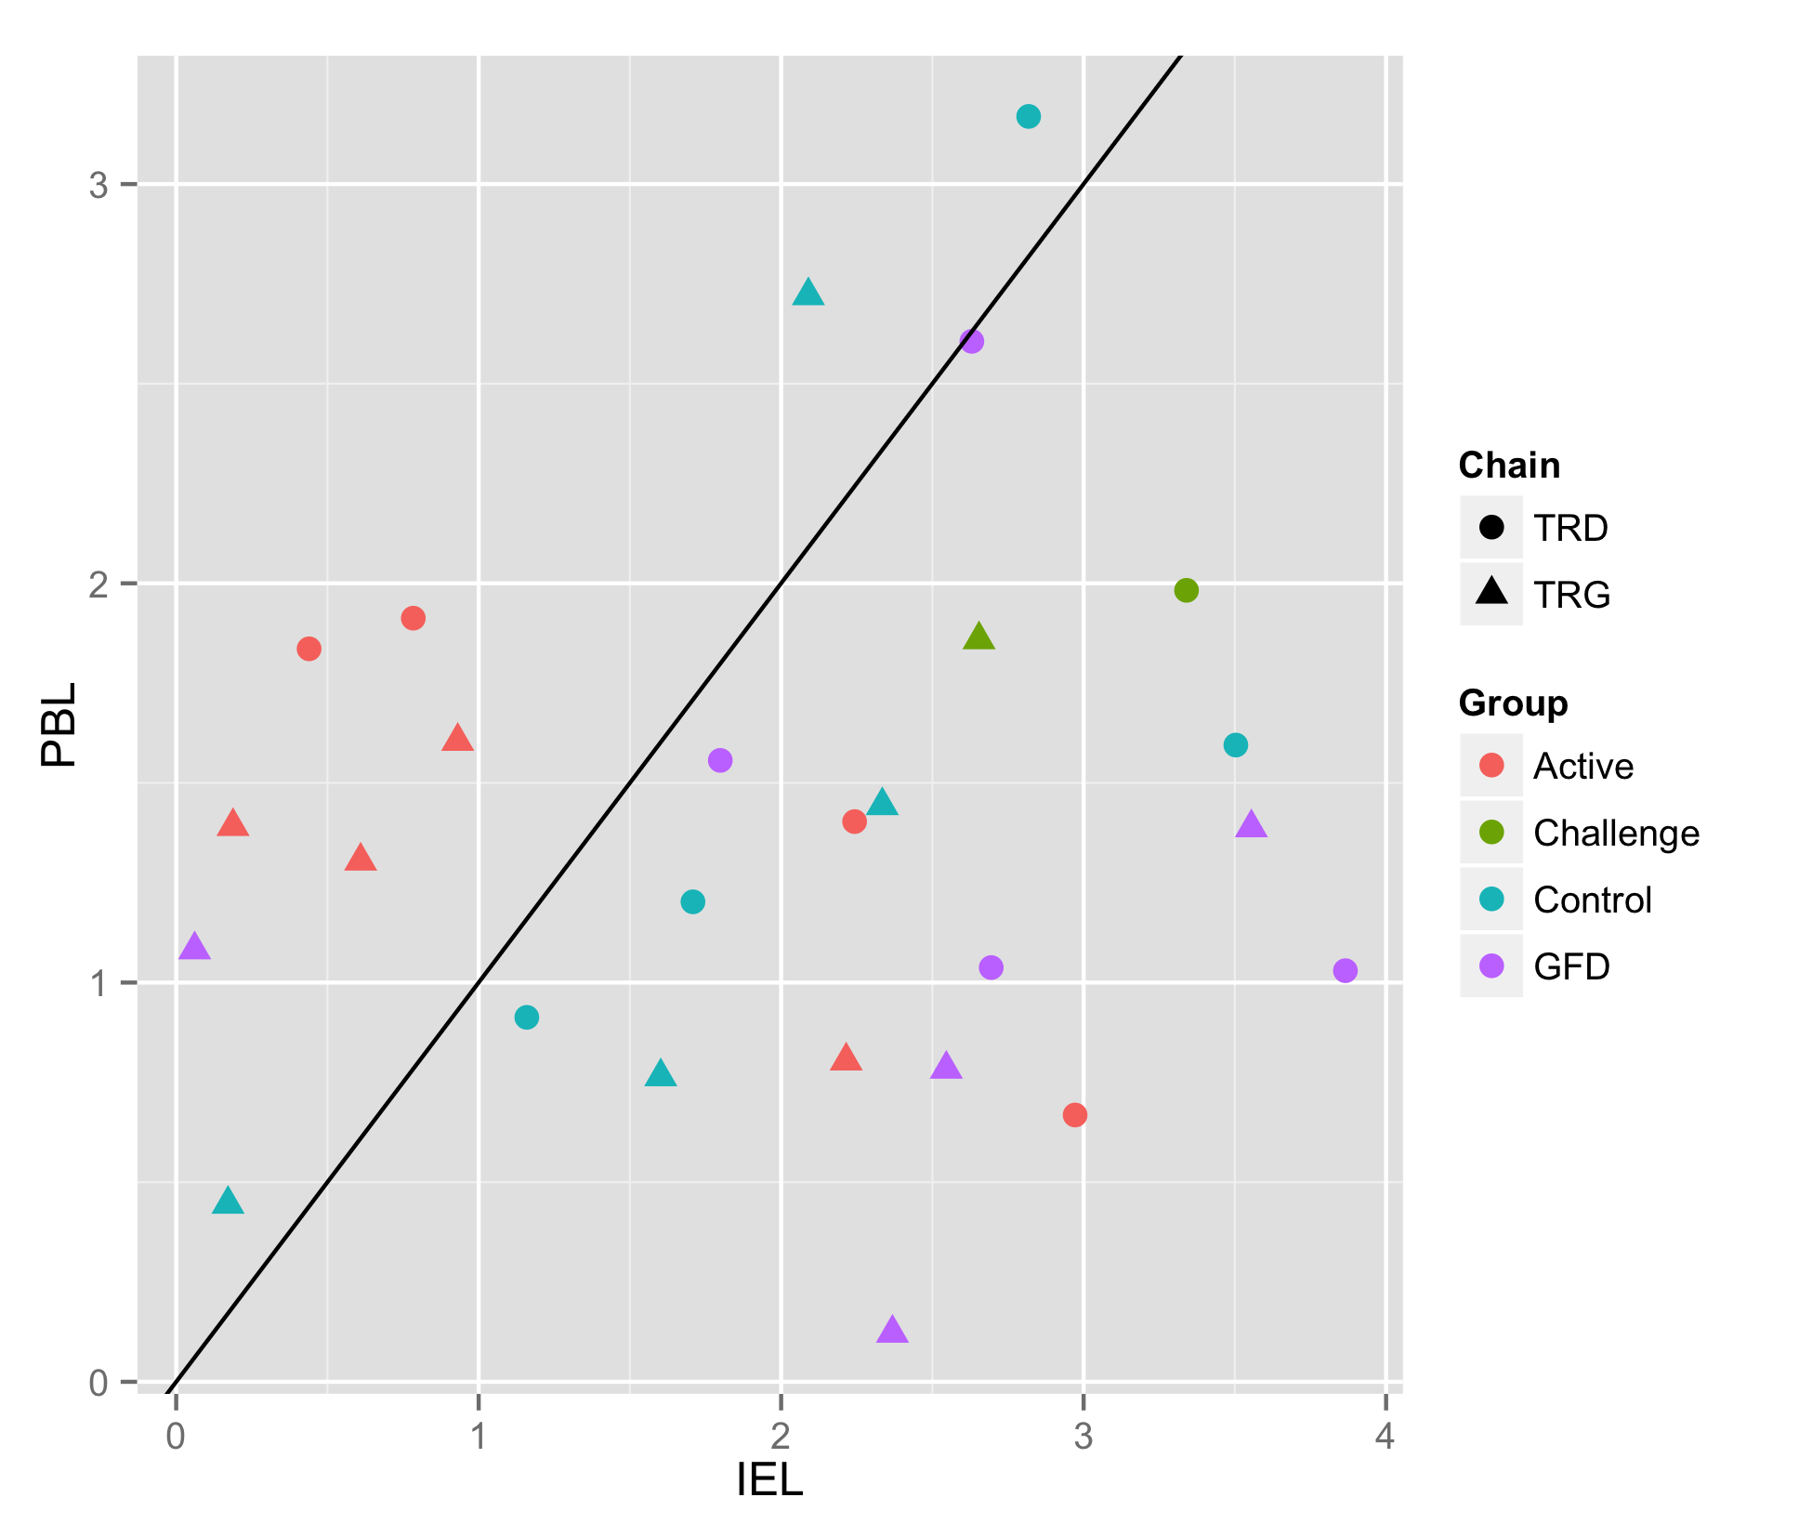
Active Group has relatively reduced IEL Diversity

Slide 8
Nearly all clones are unique between patients – however there are 4 exact matches
Group | ID | Tissue | Chain | TRV | CDR3 | TRJ | Freq | Count | NT
Active | 35 | IEL | TRD | 1 | CALGDQRVPIPWTGGYRHTDKLIF | 1 | 86.17 | 81 | 2
Active | 46 | PBL | TRD | 1 | CALGDQRVPIPWTGGYRHTDKLIF | 1 | 1.26 | 1 | 1
Challenge | 1 | IEL | TRD | 1 | CALGEYGRGSWGISHTDKLIF | 1 | 2.25 | 2 | 1
Challenge | 1 | PBL | TRD | 1 | CALGEYGRGSWGISHTDKLIF | 1 | 1.12 | 1 | 1
Active | 46 | PBL | TRG | 2 | CATWDGPNYYKKLF | 2 | 1.54 | 1 | 1
GFD | 3 | IEL | TRG | 2 | CATWDGPNYYKKLF | 2 | 5.13 | 4 | 1
Active | 46 | IEL | TRG | 9 | CALWEVLYKKLF | 1/2 | 1.08 | 1 | 1
GFD | 33 | IEL | TRG | 9 | CALWEVLYKKLF | 1/2 | 3.41 | 3 | 1

Slide 9
And 9 other pairs with matching CDR3 sequences
Group | ID | Tissue | Chain | TRV | CDR3 | TRJ | Freq | Count | NT
Challenge | 1 | IEL | TRG | 3 | CATWDRDSSDWIKTF | P2 | 1.16 | 1 | 1
Challenge | 1 | IEL | TRG | 5 | CATWDRDSSDWIKTF | P2 | 1.16 | 1 | 1
Challenge | 1 | IEL | TRG | 4 | CATWDGLYYKKLF | 1 | 3.49 | 3 | 1
GFD | 3 | IEL | TRG | 2 | CATWDGLYYKKLF | 1 | 2.56 | 2 | 1
Control | 13 | PBL | TRG | 2 | CATWDGYYKKLF | 1/2 | 7.94 | 5 | 2
GFD | 3 | IEL | TRG | 2 | CATWDGYYKKLF | 2 | 1.28 | 1 | 1
GFD | 3 | IEL | TRG | 9 | CALWEVDYKKLF | 1 | 5.13 | 4 | 1
GFD | 3 | PBL | TRG | 9 | CALWEVDYKKLF | 1/2 | 61.25 | 49 | 1

Slide 10
Group | ID | Tissue | Chain | TRV | CDR3 | TRJ | Freq | Count | NT
Active | 22 | PBL | TRG | 9 | CALWEVHYYKKLF | 1/2 | 7.25 | 5 | 1
GFD | 3 | PBL | TRG | 9 | CALWEVHYYKKLF | 2 | 1.25 | 1 | 1
GFD | 3 | IEL | TRG | 8 | CATWVYYKKLF | 1 | 1.28 | 1 | 1
GFD | 4 | IEL | TRG | 5 | CATWVYYKKLF | 1 | 11.76 | 10 | 1
GFD | 3 | IEL | TRG | 9 | CALWEVRYKKLF | 1 | 2.56 | 2 | 1
GFD | 4 | PBL | TRG | 9 | CALWEVRYKKLF | 1/2 | 97.78 | 88 | 3
GFD | 4 | PBL | TRG | 8 | CATWDYYKKLF | 1/2 | 1.11 | 1 | 1
GFD | 28 | PBL | TRG | 4 | CATWDYYKKLF | 1/2 | 43.53 | 37 | 1
GFD | 3 | IEL | TRG | 3 | CATWDRPEKLF | 1/2 | 2.56 | 2 | 1
GFD | 33 | IEL | TRG | 3 | CATWDRPEKLF | 1 | 3.41 | 3 | 1

Slide 11
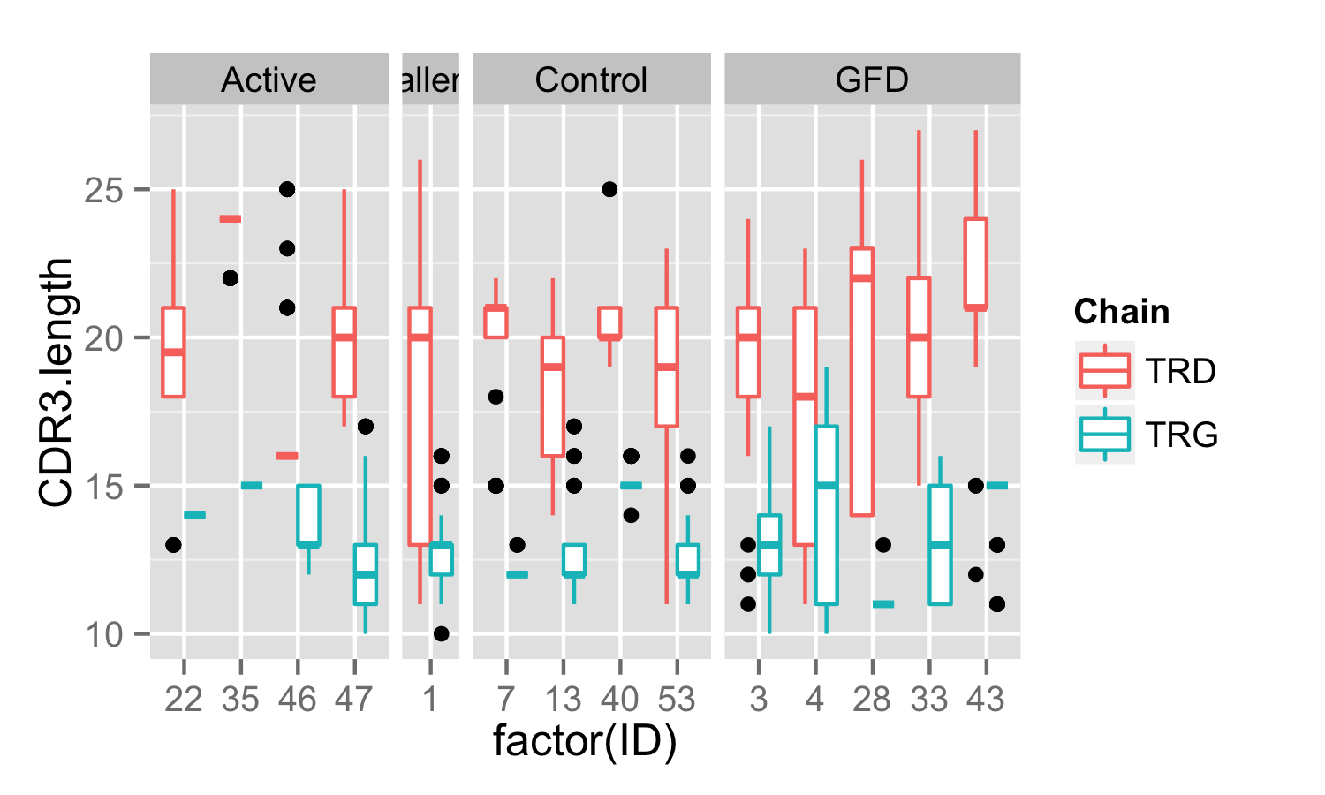
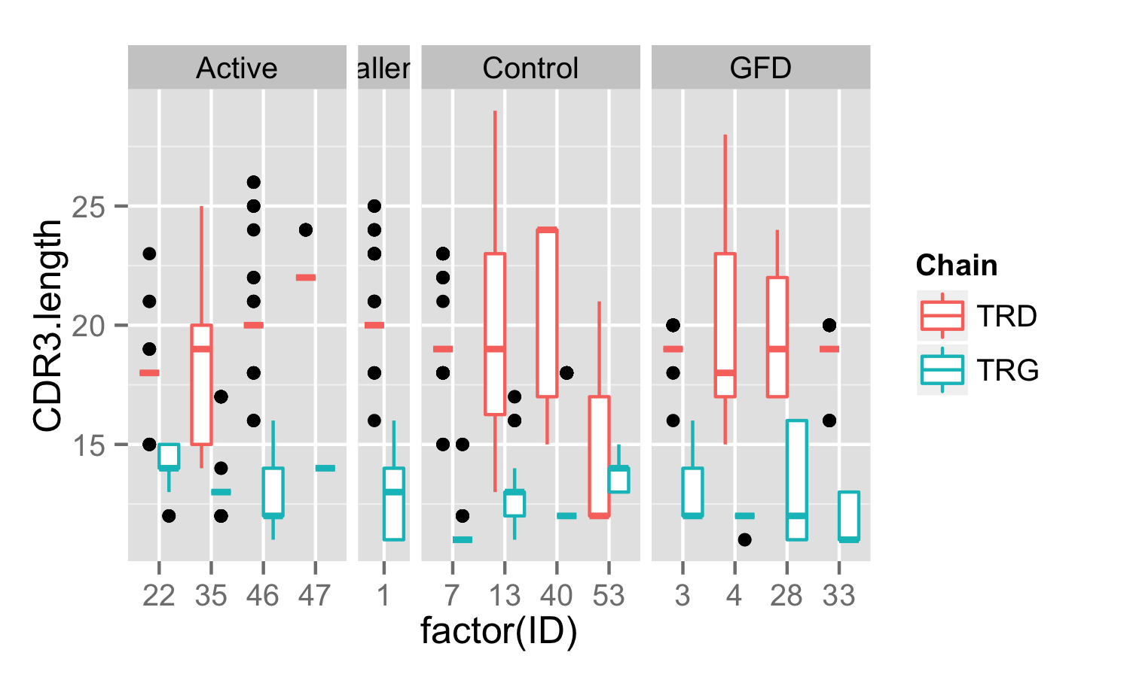
CDR3 Sequence Length
IEL
PBL

Slide 12
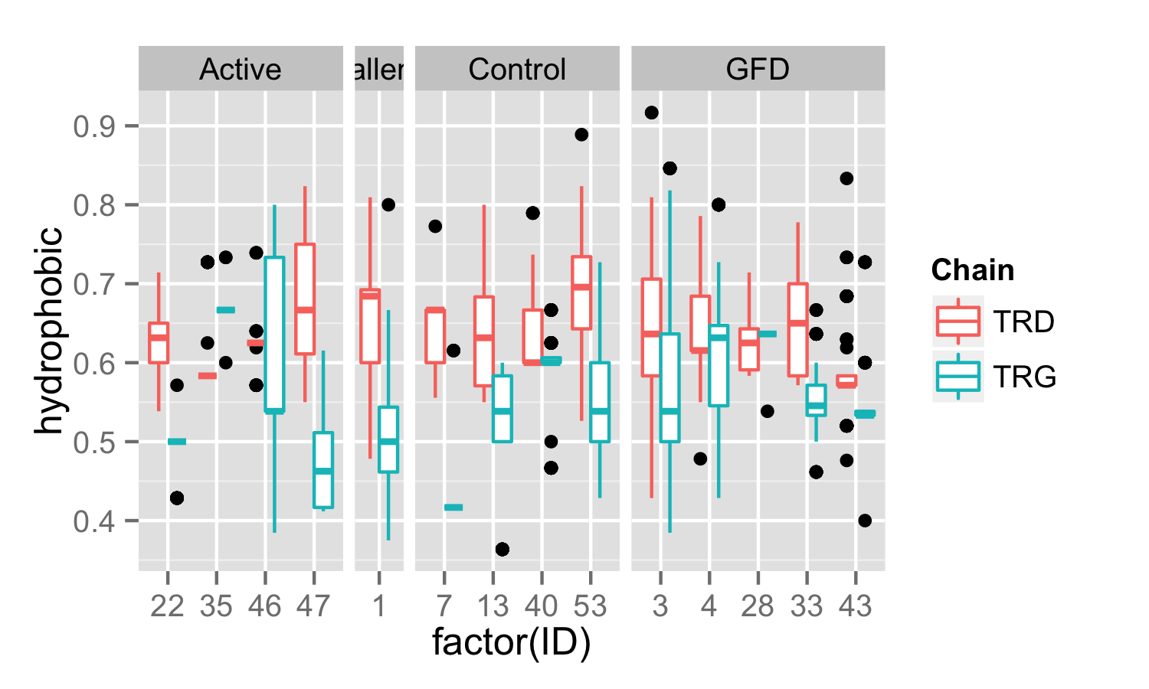
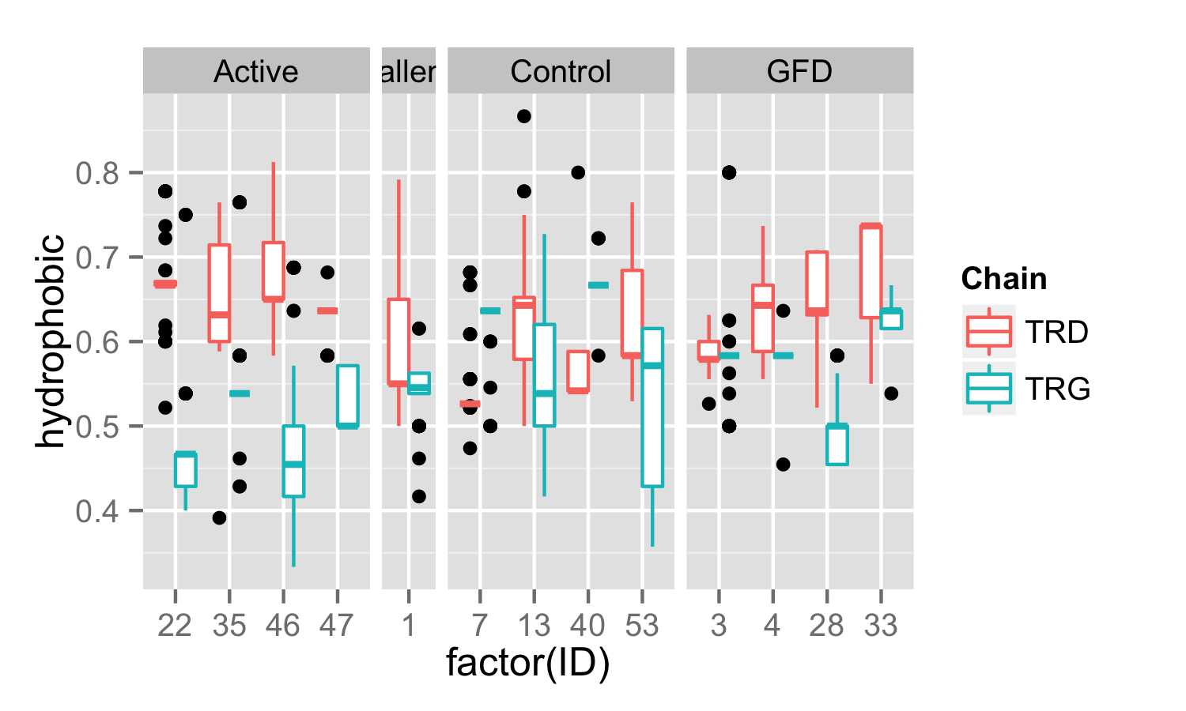
CDR3 Sequence Hydrophobicity (AVLIPFMWGC)
IEL
PBL

Slide 13
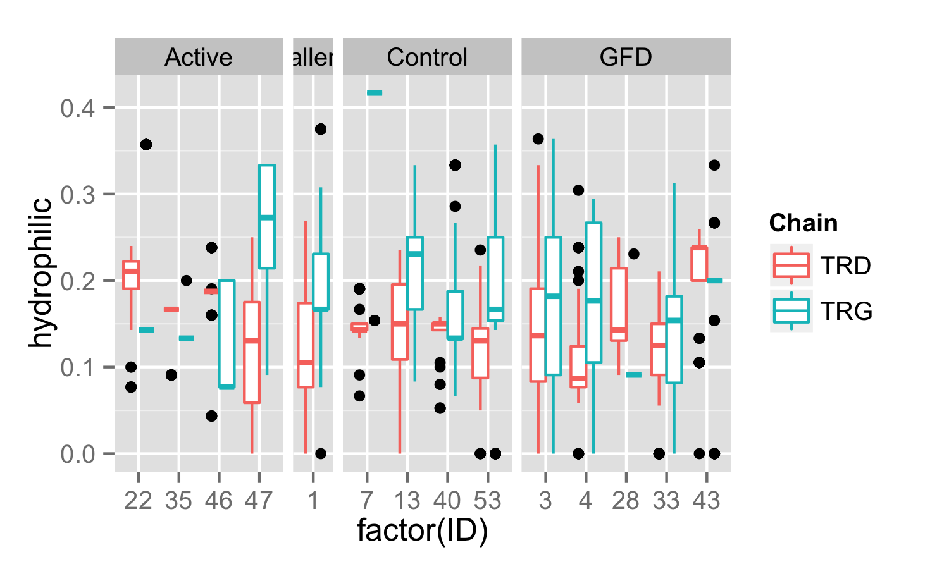
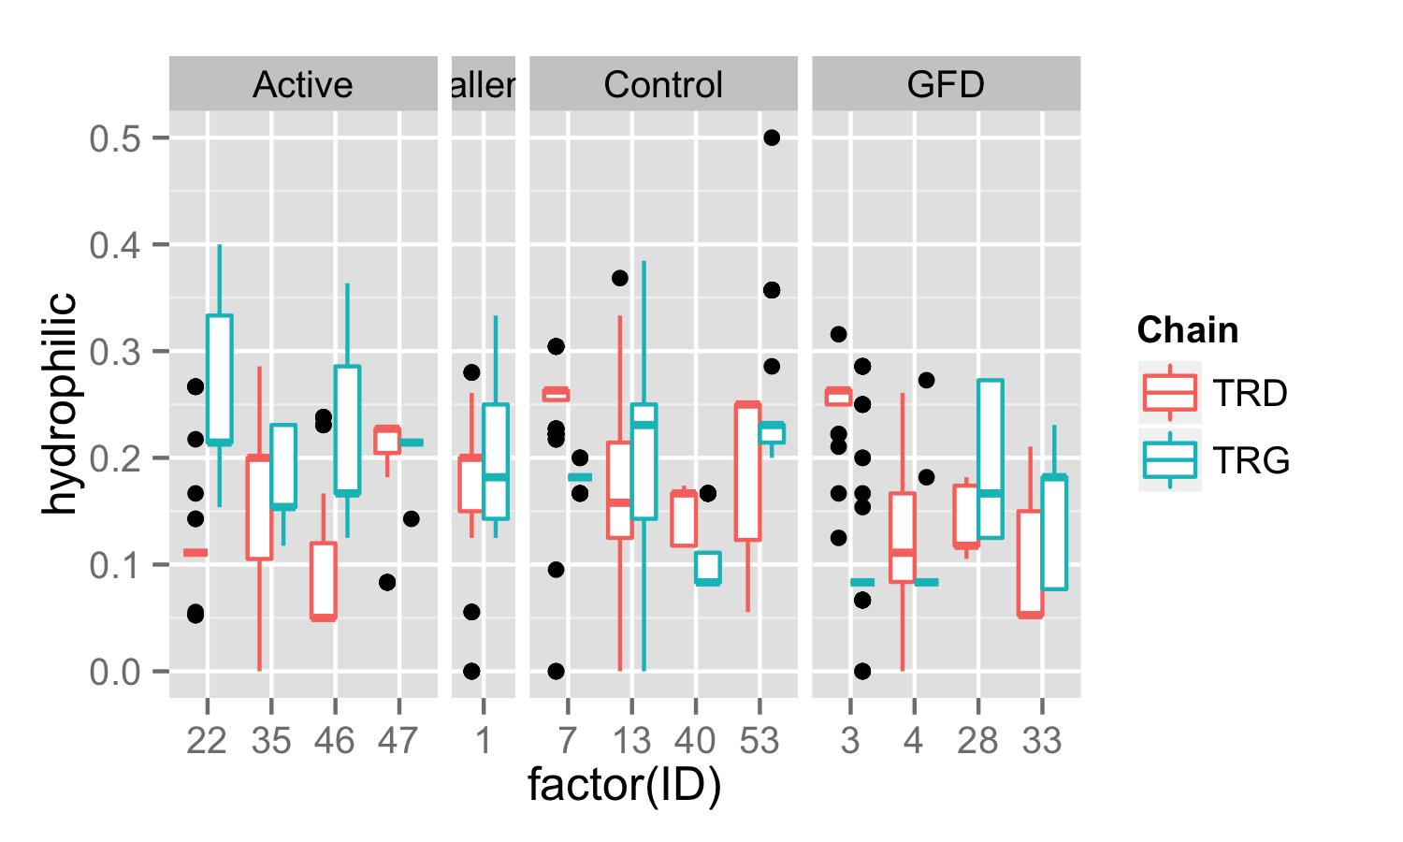
CDR3 Sequence Hydrophilicity (NQSTY)
IEL
PBL

Slide 14
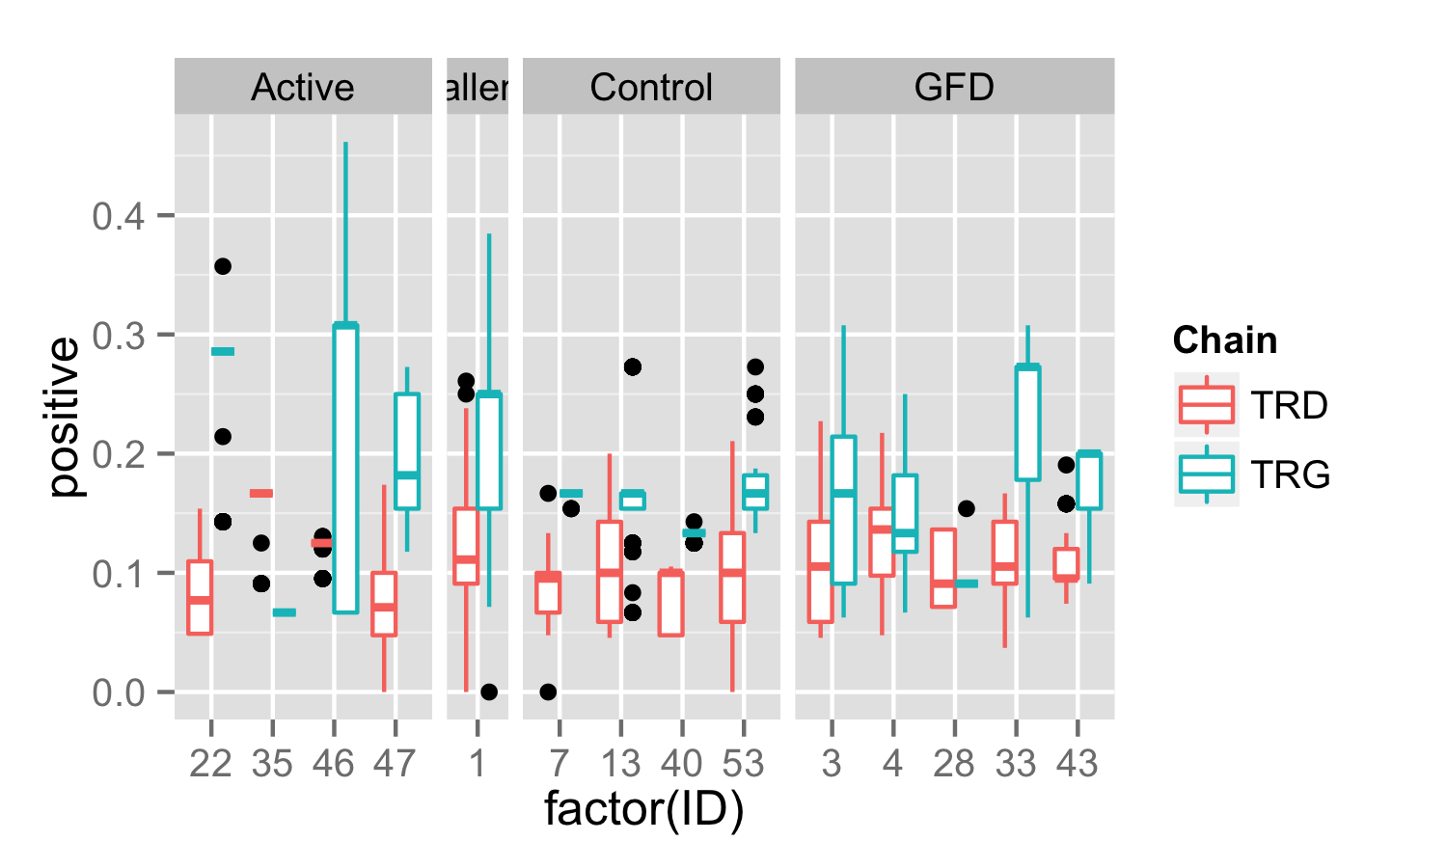
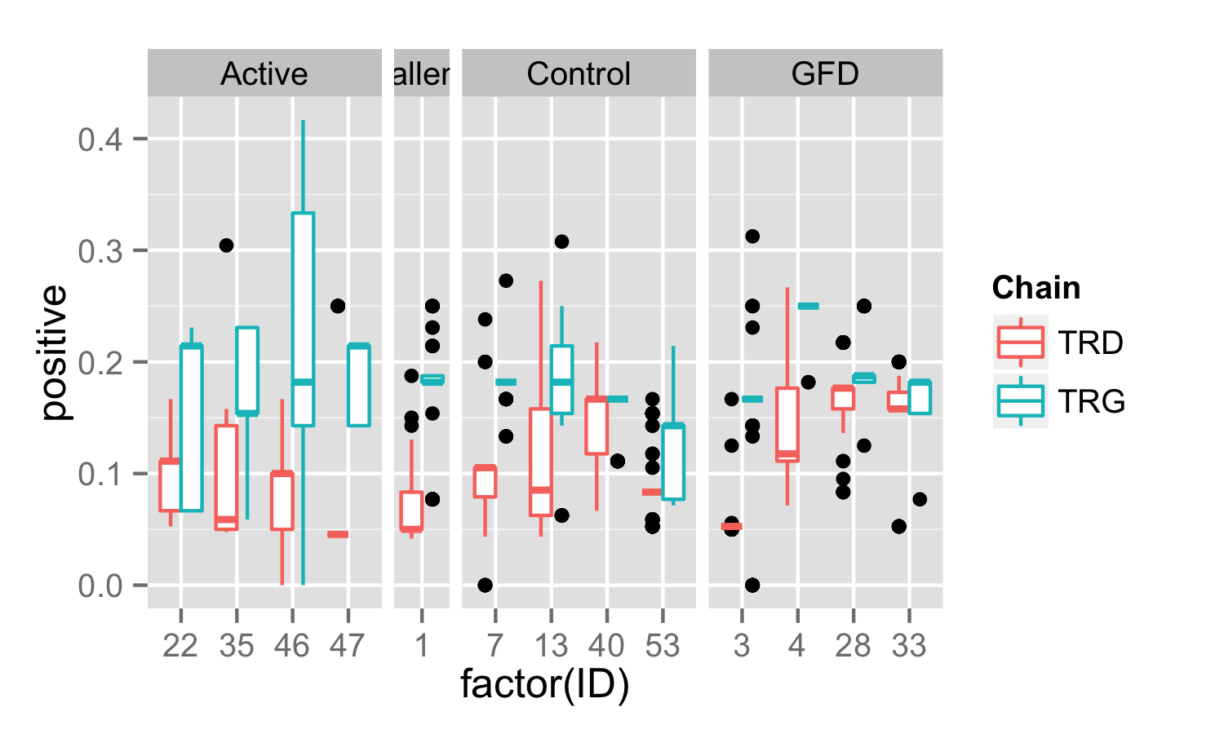
CDR3 Sequence Positive Charge (KRH)
IEL
PBL

Slide 15
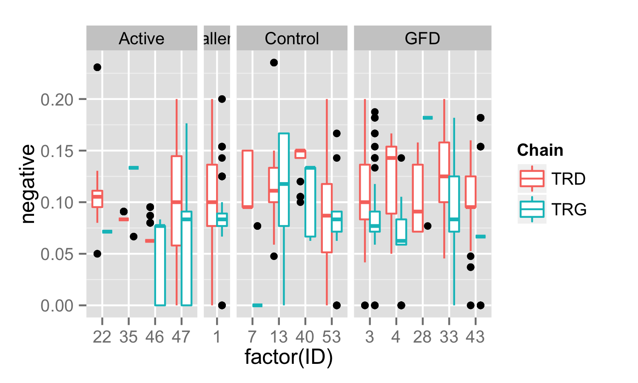
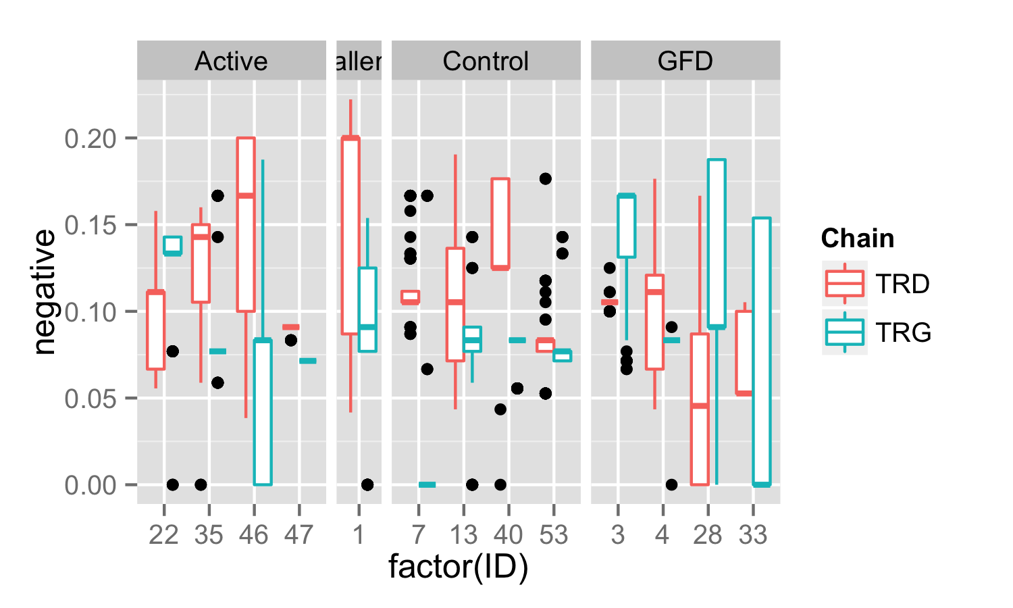
CDR3 Sequence Negative Charge (DE)
IEL
PBL

