Slide 1


Hybrid LZA: A Near Optimal Implementation of the Leading Zero Anticipator
Amit Verma
National Institute of Technology, Rourkela, India
Ajay K. Verma, Philip Brisk and Paolo Ienne
Processor Architecture Laboratory (LAP)
& Centre for Advanced Digital Systems (CSDA)
Ecole Polytechnique Fédérale de Lausanne (EPFL)
csda
csda

Slide 2
What is a Leading Zero Anticipator
Number of leading zeros in the addition/subtraction
of the two input integers
1 0 1 1 0 0 1 1 1 1 0 0
-
1 0 0 1 1 1 1 0 1 1 1 1
0 0 0 1 0 1 0 0 1 1 0 1
Leading zeros
LZA
sub
3

Slide 3
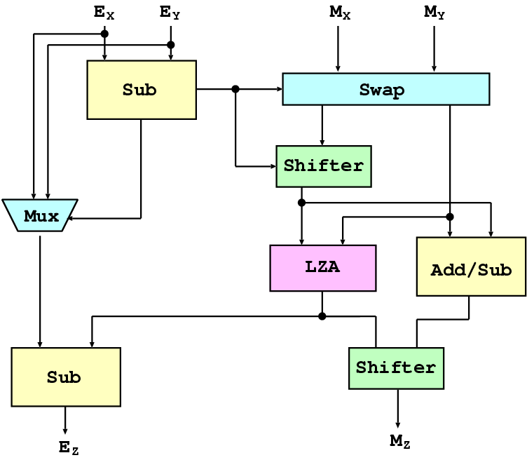
Why Do We Need LZA
Standard IEEE 754
Floating point representation
(sign bit, mantissa, exponent)
Normalization: Adjusting exponent in
such a way that MSB of mantissa is 1
Normalization after addition/subtraction requires LZA

Slide 4
Outline
Related work
Exact/Inexact LZAs and their shortcomings
Main idea
  Hybrid of exact and inexact LZA
Improving delays of MSBs of LZA using exact LZA
  Via faster recognition of consecutive zero block in addenda
Improving delays of LSBs of LZA using inexact LZA
  Via faster error detection mechanism
Experimental results
Conclusions

Slide 5
Related Work
Exact LZAs
  Earlier work [Ng93, Inoue94]
  Recent work [Gerwig99]
Inexact LZAs
  General inexact LZA [Kershaw85, Knowels91 Bruguera99, ]
  Inexact LZA for positive addenda [Suzuki96]
Error detection
  Detection after shifting [Suzuki96]
  Concurrent error detection [Kershaw85, Quach91, Schmookler01]

Slide 6
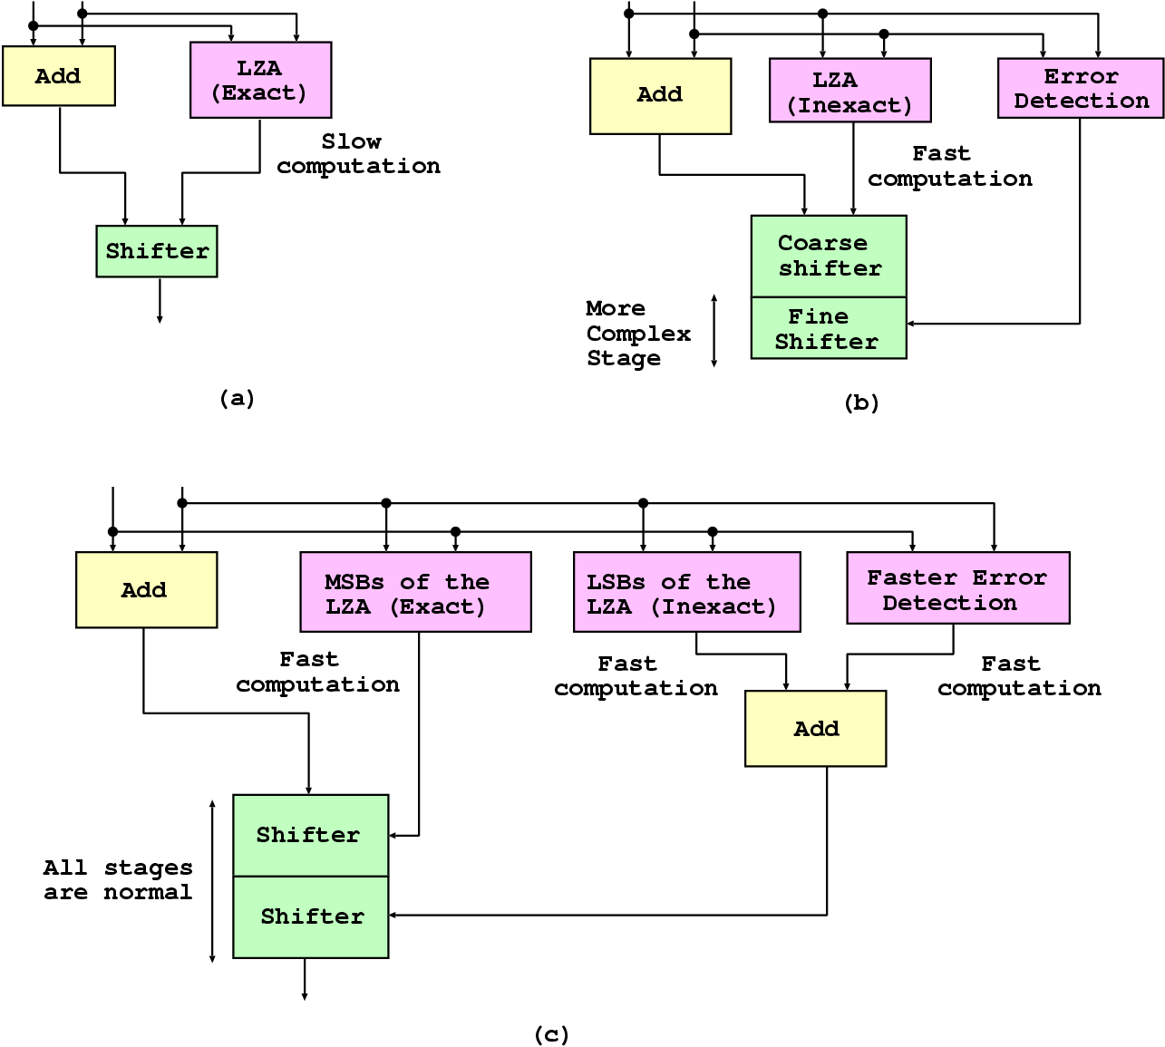
Exact and Inexact LZA

Slide 7
Desired Delay of LZA
A
B
A
B
Adder
LZA
Exponent
Barrel
Shifter
Subtractor
Z
E

Slide 8
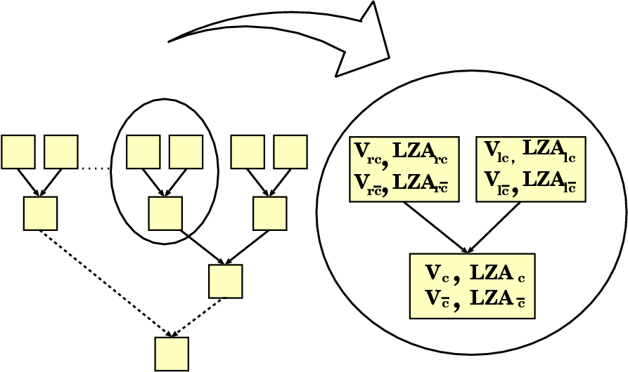
Exact LZA: Initial Design [Gerwig99]
LZA_{c} = LZA of a block assuming there is an incoming carry
v_{c} = true, if all bits of the addenda are zero in the block
assuming an incoming carry to block

Slide 9
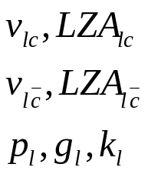

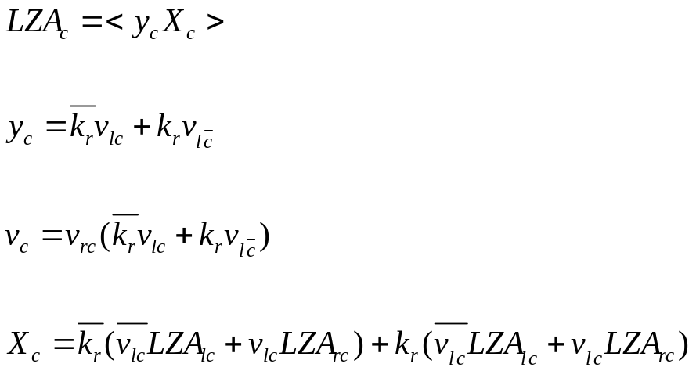
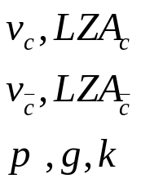
Exact LZA: Initial Design [Gerwig99]
c
Depend only on k, v_{c} and v_{c} of blocks

Slide 10
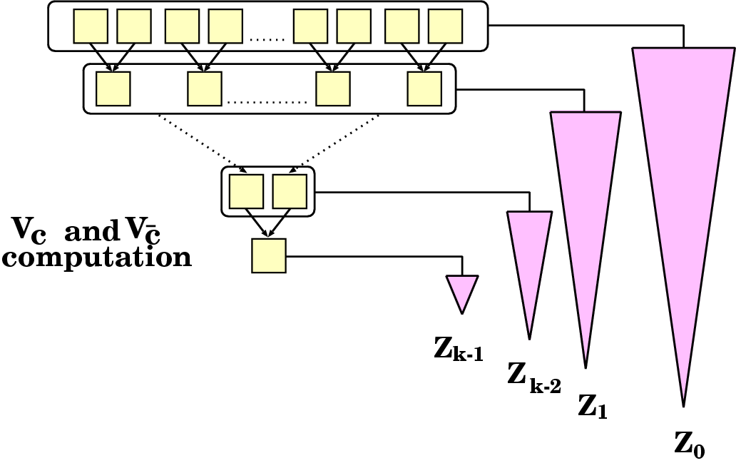
How Can We Improve
Faster computation of v_{c} and v_{c} will improve the delays of MSBs of LZA

Slide 11
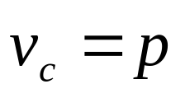
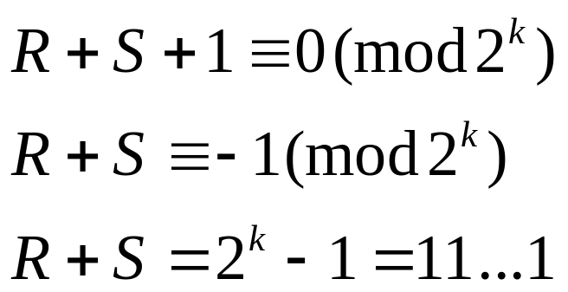
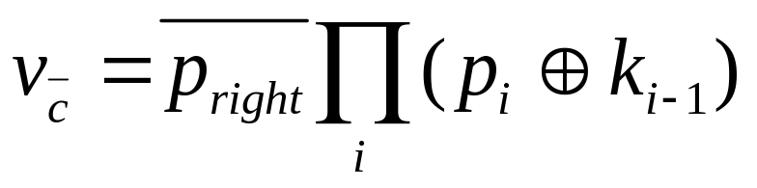
Faster Computation of V_{c} and V_{c}
1
Theorem:
R
Proof:
S
00 … 00
Theorem:

Slide 12
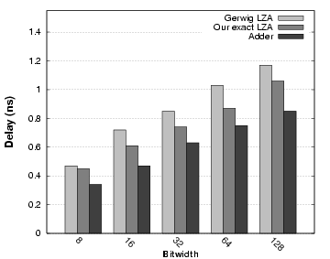
Delay Improvement of Exact LZA
Typically 2-3 MSBs of LZA have smaller delays than that of adder

Slide 13
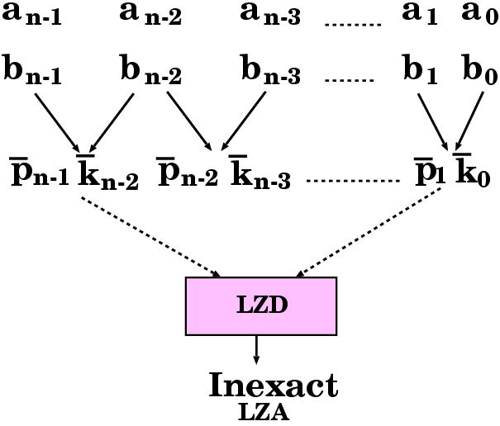
Inexact LZA: Basic Design [Suzuki96]
Theorem: In the addition of two normalized integers leading zeros
will occur only if the block is of the form (p^{i} g k^{j} *).
c
1 0 1 1 1 1 0 0 0 0 1
0 1 0 0 0 1 0 0 0 0 0
0 0 0 0 0 0 0 0 0
z
Can be zero or one depending on carry
Propagate should be followed by propagate or generate
(i.e., final result is positive)
Any signal other than propagate must be followed by kill

Slide 14
Error Detection [Quach91/Schmookler01]
Theorem: There can be an error of one bit if and only if there is an
incoming carry on the last bit of the block of the form (p^{i} g k^{j}),
i.e., the block has a suffix of the form (p* g k* p* g).
Compute the incoming carry for each bit position
Check for each bit position if it is the last bit of the block of the form (p* g k*)
Combine the two values to compute the error expression

Slide 15
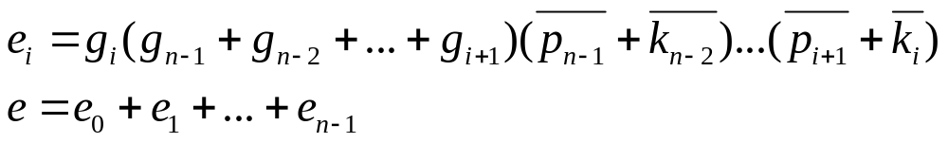
Improved Error Detection
Theorem: An string, starting with p, has a suffix of the form (p* g k* p* g), if and only if it has a suffix which satisfies the two conditions
  It has at least two g’s
  Propagate must not be followed by a kill, i.e., (p_{i} k_{i-1}) must be false at each bit position

Slide 16
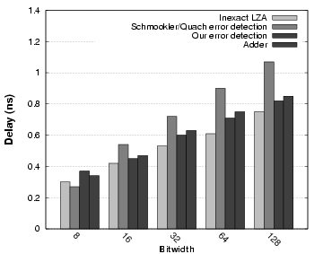
Delay Improvement of Error Detection

Slide 17
Algorithm
Design an exact LZA, and compute the individual bit delays by synthesizing it
Design an inexact LZA, and compute the individual bit delays by synthesizing it
Based on the delays decide k such that k MSBs should be computed using exact LZA, and others should be computed using inexact LZA
Design the floating point addition based on the hybrid LZA

Slide 18
Experimental Setup
FP addition using
exact LZA
FP addition using
inexact LZA +
error detection
Input N
(bitwidth)
Logic synthesis
FP addition using
hybrid LZA
FP addition with
no LZA
Synopsis Design Compiler
- compile_ultra
- minimize delay

Slide 19
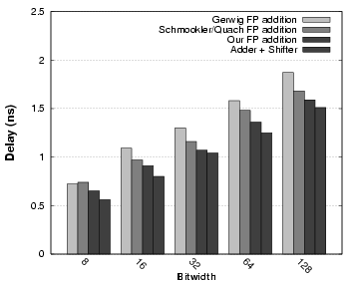
Results: Delay Comparison

Slide 20
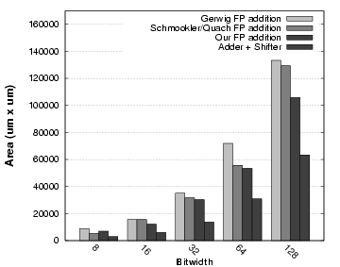
Results: Area Comparison

Slide 21
Conclusions and Future Work
We have presented a new design of LZA, which is a hybrid structure of the exact and the inexact LZA
The presented LZA improves the delay of floating point addition by 7-10%
The delay of the FP addition with our LZA is marginally higher than the delay of FP addition without using any LZA

