Slide 1
PX-303
PX-303
Oscilloscope computer
Control computer
Boost
tank
Driver
section
PT1-
PT10
NI
PCI-6133
Delay generator
Driver fill manifold
PIV acquisition computer
BNC-575 delay generator
Driven fill manifold
PT1
PX-303
Ekspla NL-303D PIV laser
Vacuum relay
Driven
section
Control panel
Ekspla NL-303D rupture laser
MST fill manifold
Phantom V1211 PLIF camera
PLIF acquisition computer
PT10
Pulse-burst laser delay generator
Pulse-burst laser

Slide 2
Boost
tank
Boost
tank
Driver
section
High-pressure supply manifold
Driver fill manifold
Supply cylinder 1
Supply cylinder 8
Driven
section
Vacuum
Vent
Driven fill manifold
Vent
Vacuum
TiO₂ seeder
Mass flow control
MST fill manifold
Vacuum
N₂ supply
Driven fill
Driver fill
Digital regulator
N₂ Ar CF₄ SF₆
22 °C water bath
Vapor collector
Acetone

Slide 3
Ambient (N₂)
Vortex ring
(N₂, Ar, CF₄, or SF₆)
Imaging window
PIV
PLIF
Laser sheet
Vortex ring
generator

Slide 4
Ambient (N₂)
Vortex ring (Ar)
Imaging window
PLIF
PIV
Laser sheet
Vortex ring
generator

Slide 5
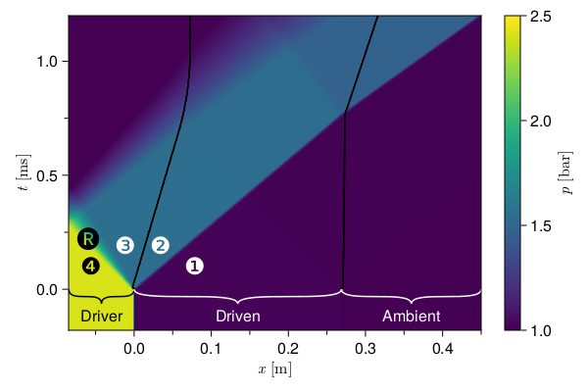
Expansion wave
Contact surface
Shock wave
④ ③ ② ①
Diaphragm

