Slide 1
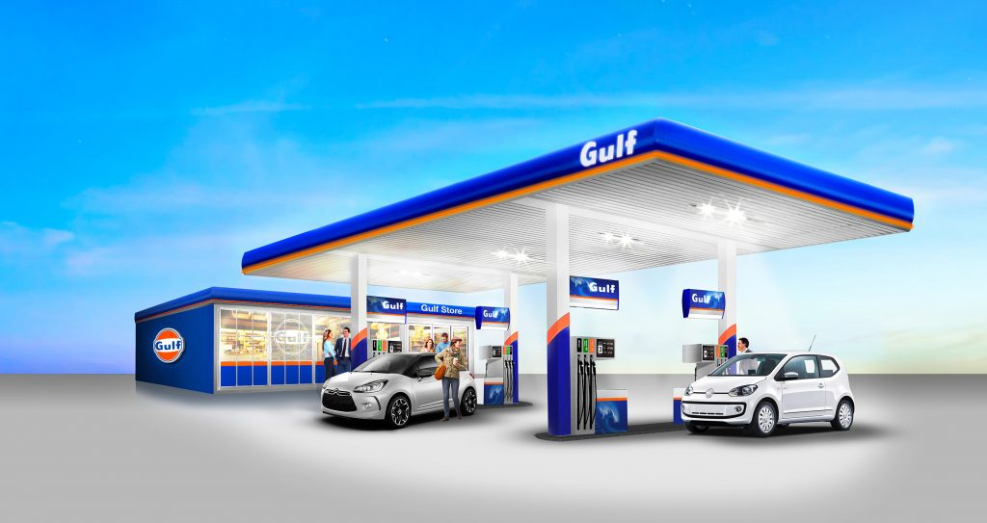
Assignment 3: Queueing at a Gas Station

Slide 2
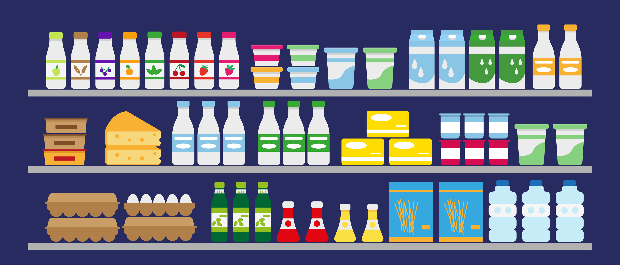
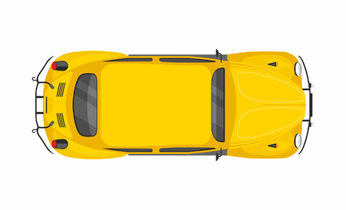
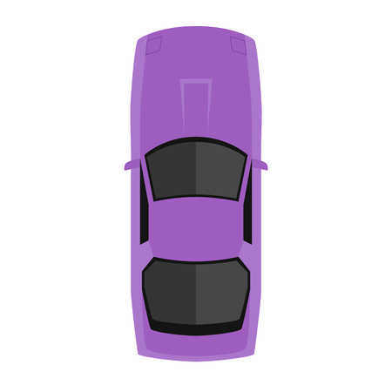
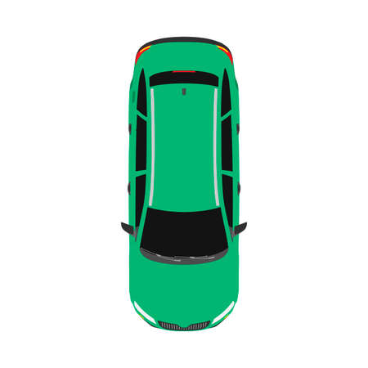
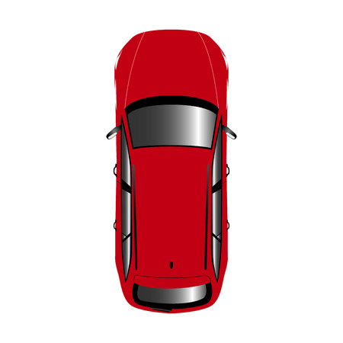
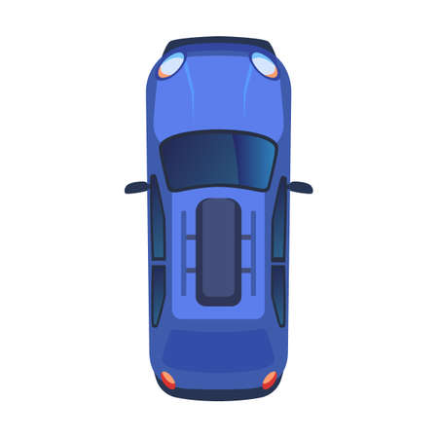
Shop / Cash register
3
C
1
2
Pump 1
Pump 2
Pump 3
Pump 4

Slide 3
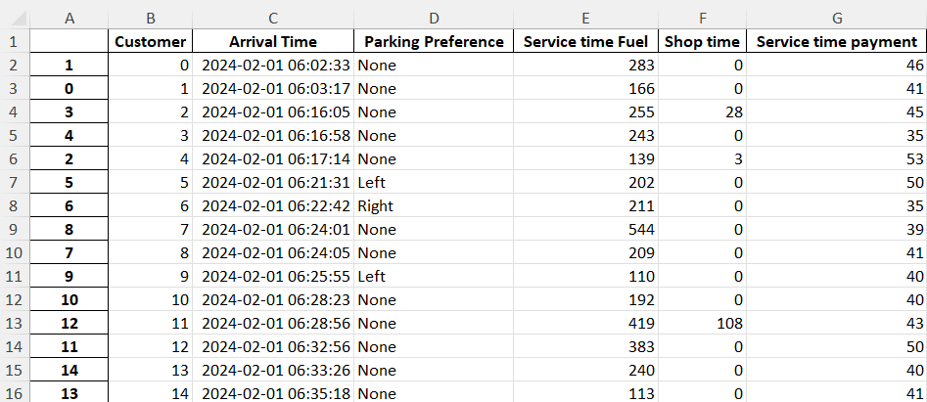
Data

Slide 4
Typical features of this queueing station
An open queueing network
Customers can “be at two places simultaneously”: a car can occupy a parking spot, while its driver is queueing in the shop
There is a complicated blocking structure:
  Some customers wait in the queue although there is a server available (because they insist on parking on a specific side, or because the server is a parking place blocked by another car)
  Customers may have finished service at all stations, but may still be blocked by a car in front of them

Slide 5
Shop / Cash register
C
Pump 1
Pump 2
Pump 3
Pump 4

Slide 6
Shop / Cash register
C
Pump 1
Pump 2
Pump 3
Pump 4

Slide 7
Shop / Cash register
C
Pump 1
Pump 2
Pump 3
Pump 4

Slide 8
Shop / Cash register
C
Pump 1
Pump 2
Pump 3
Pump 4

Slide 9
Alternative Scenarios
Pick 2 from the following 3 scenarios:
No Blocking
Replacing the shop by payment terminals
Four lanes with one pump each

Slide 10
Scenario 1: No Blocking
The purple car insists on parking in the left lane
and is therefore blocked.
If the green and yellow cars have no parking
preference, they can overtake the purple car
and park in the right lane.
As soon as the blue car owner returns from the
cash register, the blue car can overtake the red
one and leave
Shop / Cash register
C
Pump 1
Pump 2
Pump 3
Pump 4

Slide 11
Scenario 2: No Shop
Customers never go to the shop. Instead they have
an additional payment time added to their service
time at the pump.
The purple car insists on parking on the left and
blocks the cars behind it.
Pump 1
Pump 2
Pump 3
Pump 4

Slide 12
Scenario 3: Four lanes of one pump
Now there are still four pumps, but they are
placed next to each other instead of behind
each other.
This way, there is no blocking near the pumps.
The only blocking takes place in the queue.
Suppose that the yellow car insists on parking
on the right (Pump 1 or 3), then it blocks the
purple car, who could otherwise go to pump 3.
Shop / Cash register
Pump 1
C
Pump 3
Pump 2
Pump 4

