Slide 1

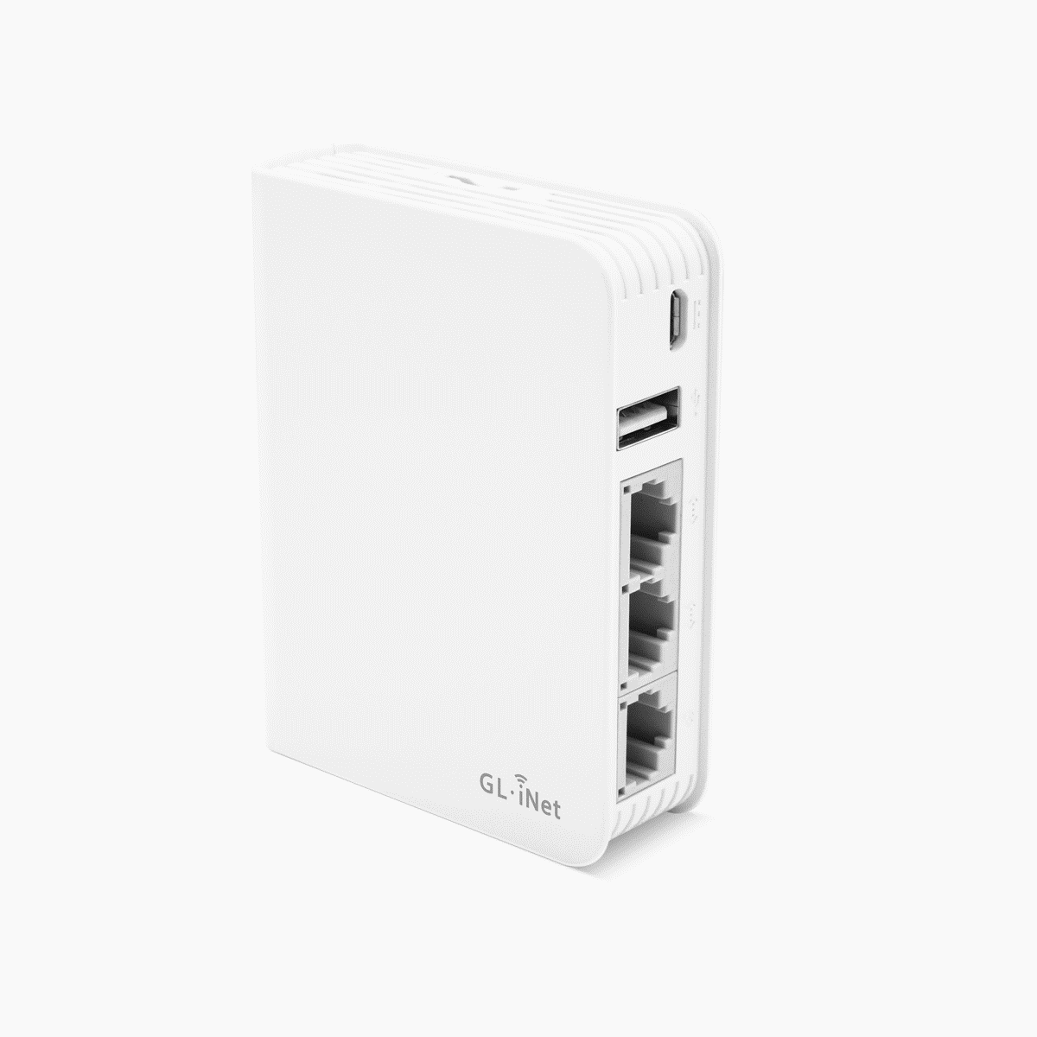
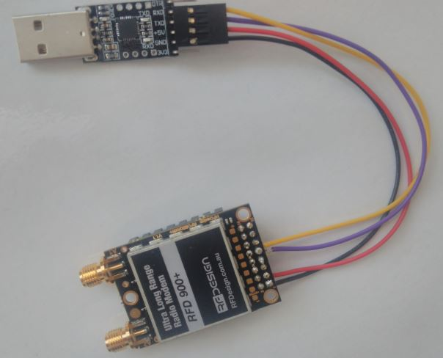
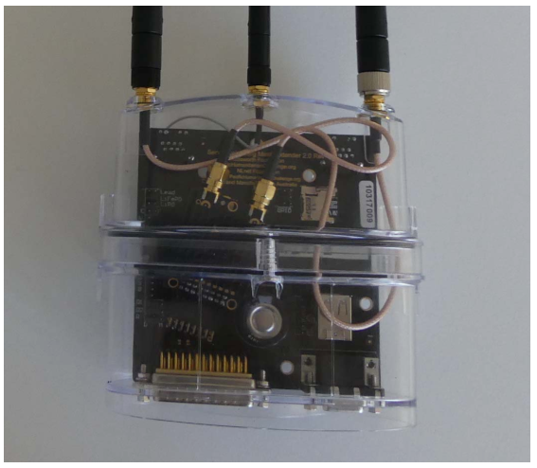
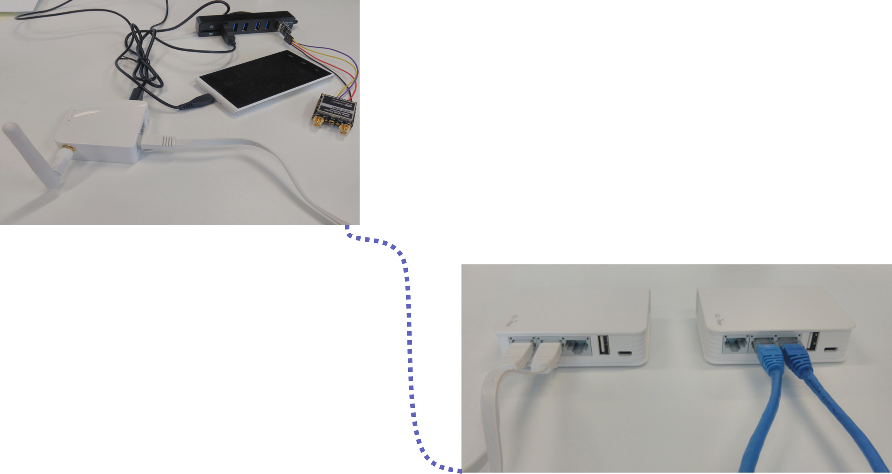
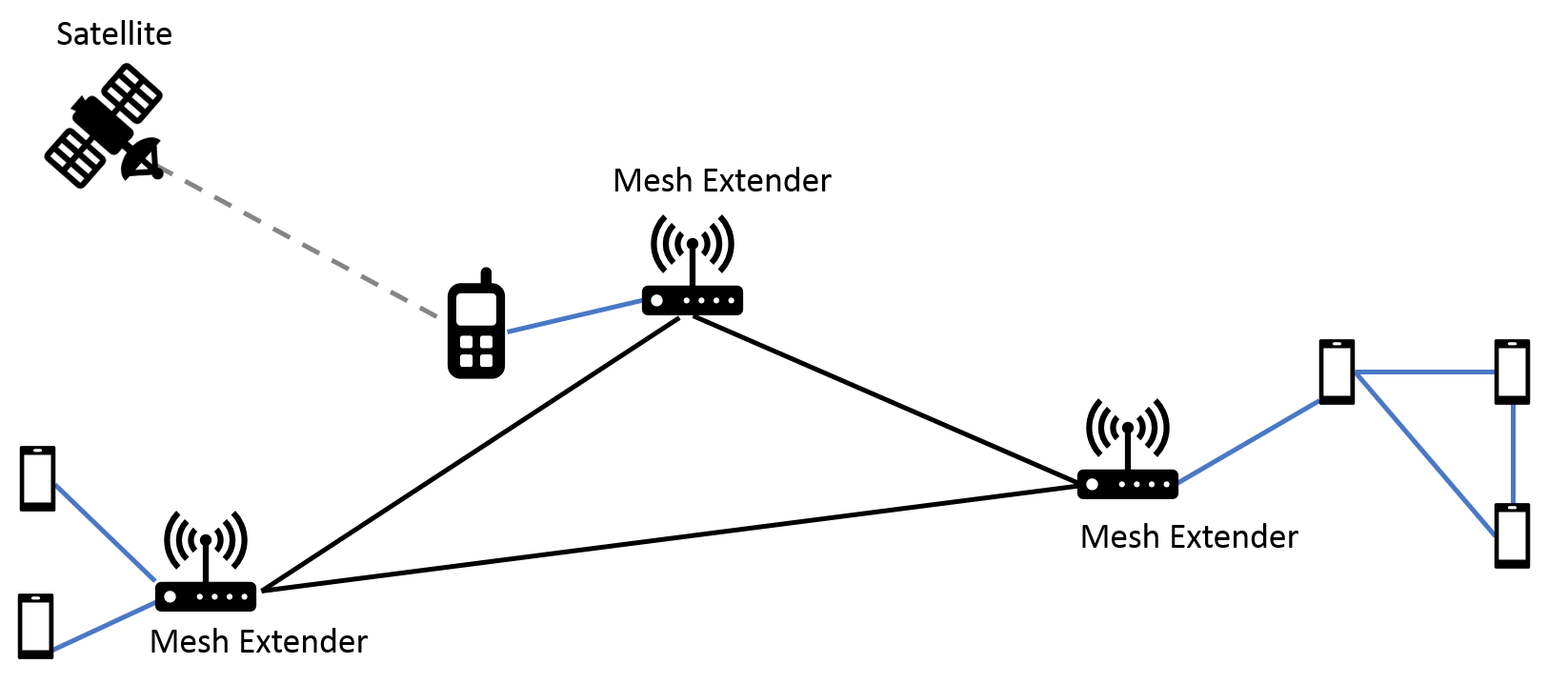
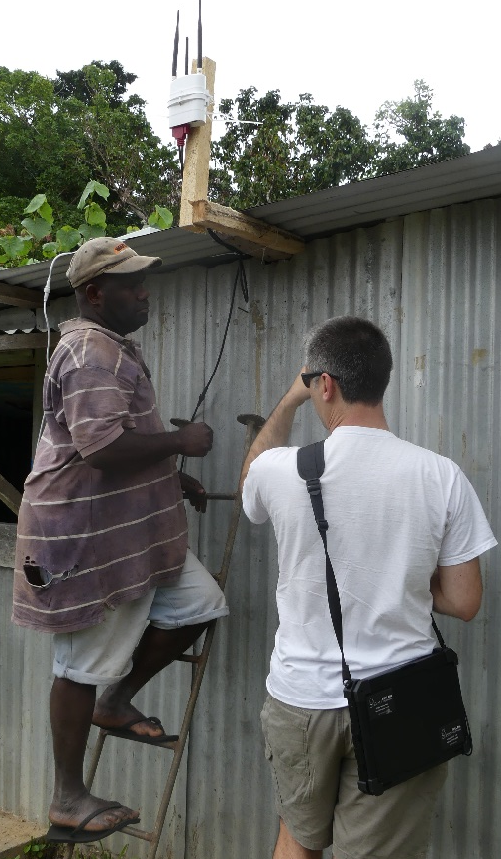
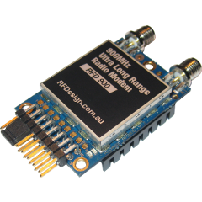
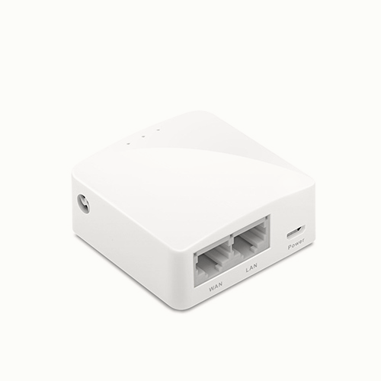

Serval Project: Designing a simple testbed for radio devices in 2 months
Stéphane Imbert | Supervisor: Paul Gardner-Stephen | Flinders University
Introduction to the Serval project
Materials
Communications systems are well-developed over the world. Companies like Telstra, Optus or Vodafone offers a communication possibility in a huge part of Australia. However, this communication system doesn’t cover the whole country and it can sometimes fail. For instance, during natural disaster, a part of a city can be cut off any communication mean.
This situation is problematic. Communication is very important for emergency services and it can save life.
The Serval project goal is to offer an alternative to the current communication’s systems. Serval project is designed to be easy to deploy and affordable.
Figure 1: Infrastructure of the Serval project
Figure 3: GL-AR750
Figure 4: RFD900+
Figure 5: Mesh Extender
GL-inet are small Linux routers. They can be used to setup the network but also to collect data and transfer it.
They can be used in a lot of projects thanks to the freedom offer by Linux and their small size.
RFD900+ is a radio receiver. It is able to receive long range data sent by the Mesh extenders. Plugged in the router, we can monitor the mesh extender
The Mesh Extender. It is the radio device we want to test and monitor.
We can see it as an access point and a router in the Serval network. It has two types of communications:
Wi-Fi with close users devices.
UHF with far Mesh Extenders
A practical testbed for radio devices
Conclusions
Figure 6: Remote site setup
A simple solution for a simple testbed
This solution and all the needed development was fully designed and developed in around 2 months.
It is designed to be easy to reproduce and install.
A general solution that can be adapted to a lot of projects
This testbed is based on Linux routers. Using python or C, we can implement a server that allow us to connect to each site and collect data to test the good functioning of a radio device or other types of devices. We can add components to the router if he is unable to test one aspect of the device.
An affordable solution
In addition to being completely customisable, the solution is in general quite cheap. The biggest cost will come from the extensions added to the routers.
An ever improvable solution:
The backbone of this solution is based around Linux and coding. Therefore, one can always improve the system.
Adding a graphical interface to the client, transforming the TCP server in a web based application, adding compatibility with other devices are just a few possible ameliorations.
To test the different components of a Mesh extender, we are using:
A router as a control node we can communicate with
A radio interface to understand the Mesh Extender
A phone to have a real test environment
Figure 7: Main site setup
Legend:
Wi-Fi UHF Satellite communication
Two routers:
They are connected to each remote site using wires
Can be access through a Wi-Fi network
Objectives
Figure 2: Tests in Vanuatu
Some faults were revealed during tests in Vanuatu.
The team, here at Tonsley, lacks a real environment testbed to reproduce these faults and find new one.
Collecting the Mesh Extender messages
Figure 8: Mesh Extender’s messages through the testbed
USB
TCP
My goal is to design this testbed and deploy it in Tonsley.
The testbed should be
practical,
affordable,
easy to reproduce and use
RFD900+:
It receives every message sent by the Mesh Extender
It is connected to the router with USB adaptor
Server TCP:
It collects data from the rfd900+
Translate binary data in text
Send the data to the client
Client TCP:
Able to choose multiple server
Receive data from a server
Display data
Notes:
To change this poster, replace our sample content with your own. Or, if you'd rather start from a clean slate, press the New Slide button on the Home tab to insert a new page. Now enter your text and pictures in the empty placeholders. If you need more placeholders for titles, subtitles or body text, copy any of the existing placeholders, then drag the new one into place.

