Slide 1

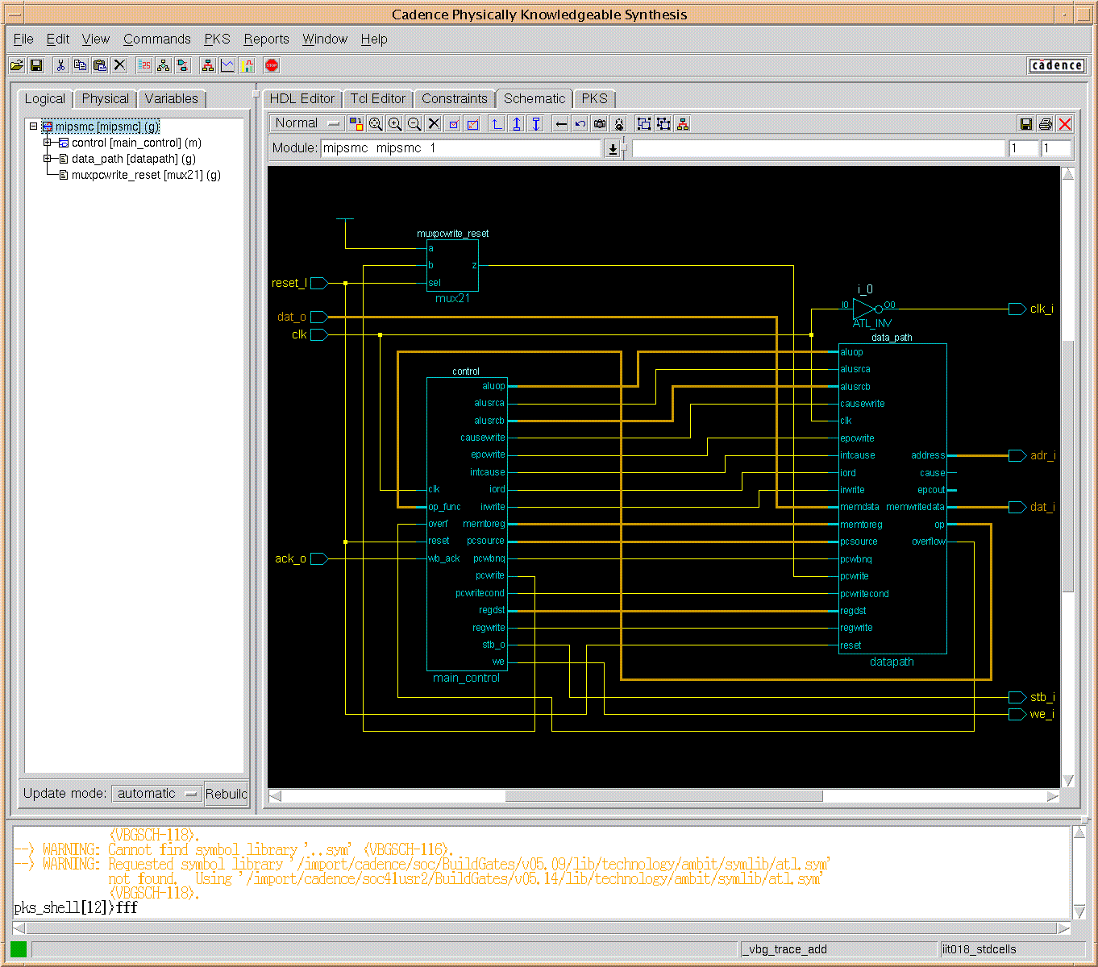
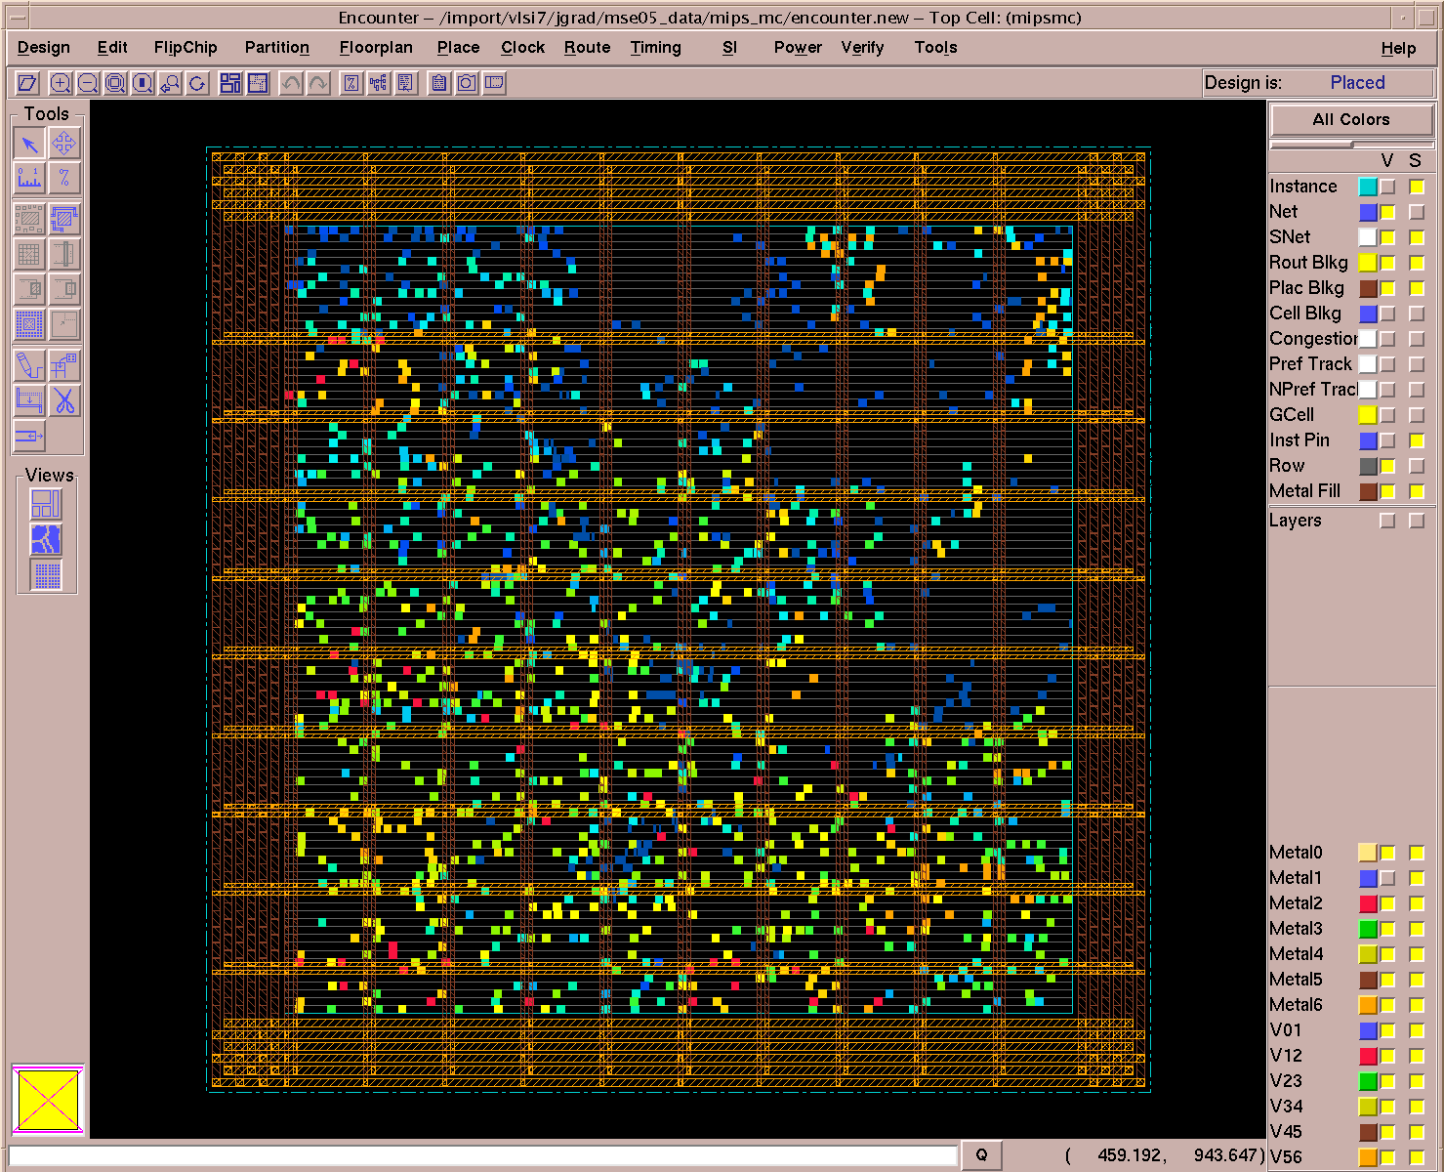
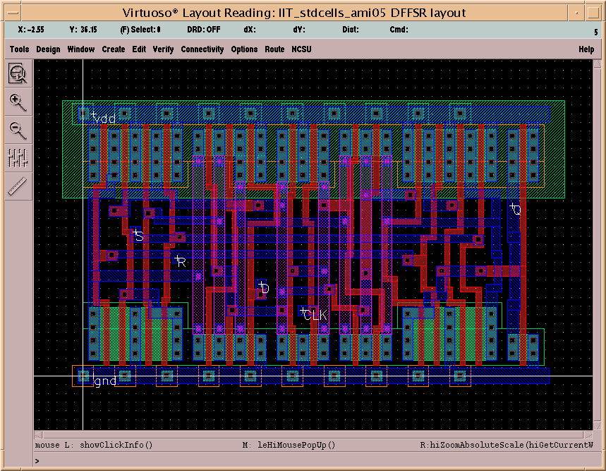
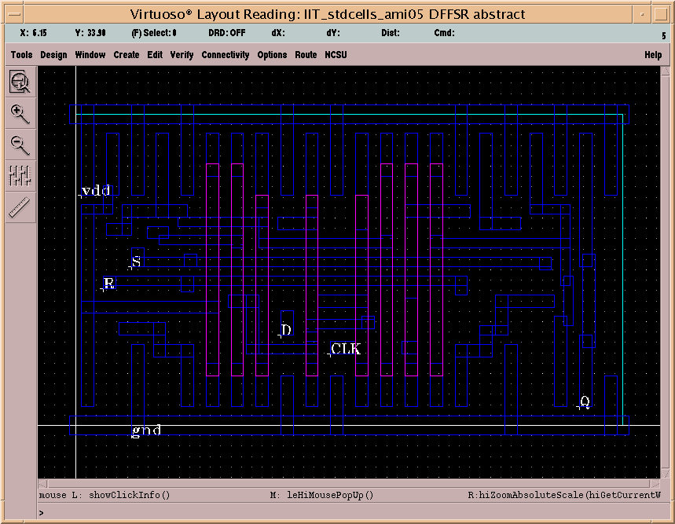
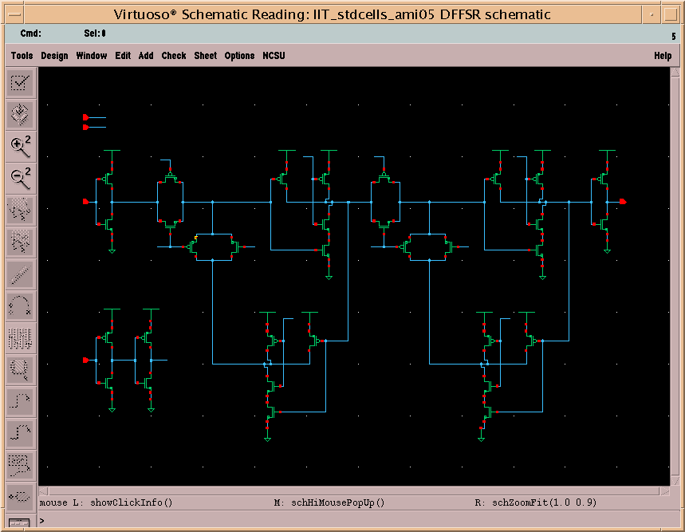
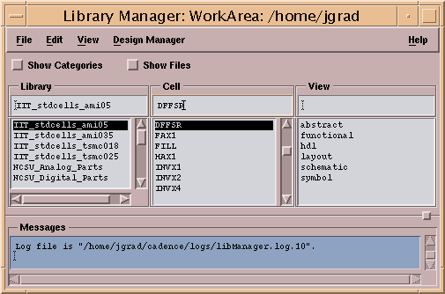
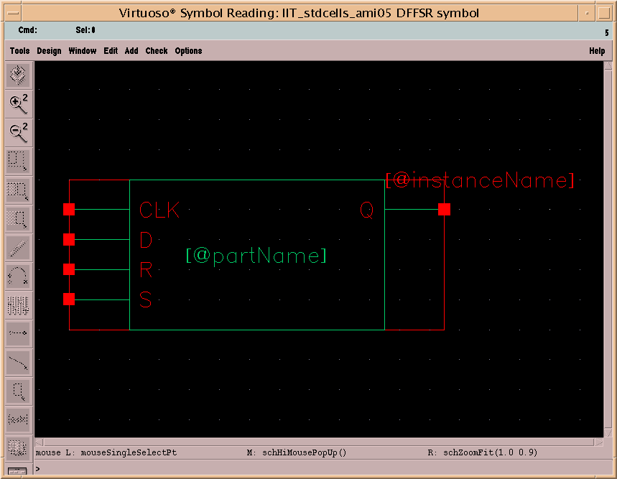
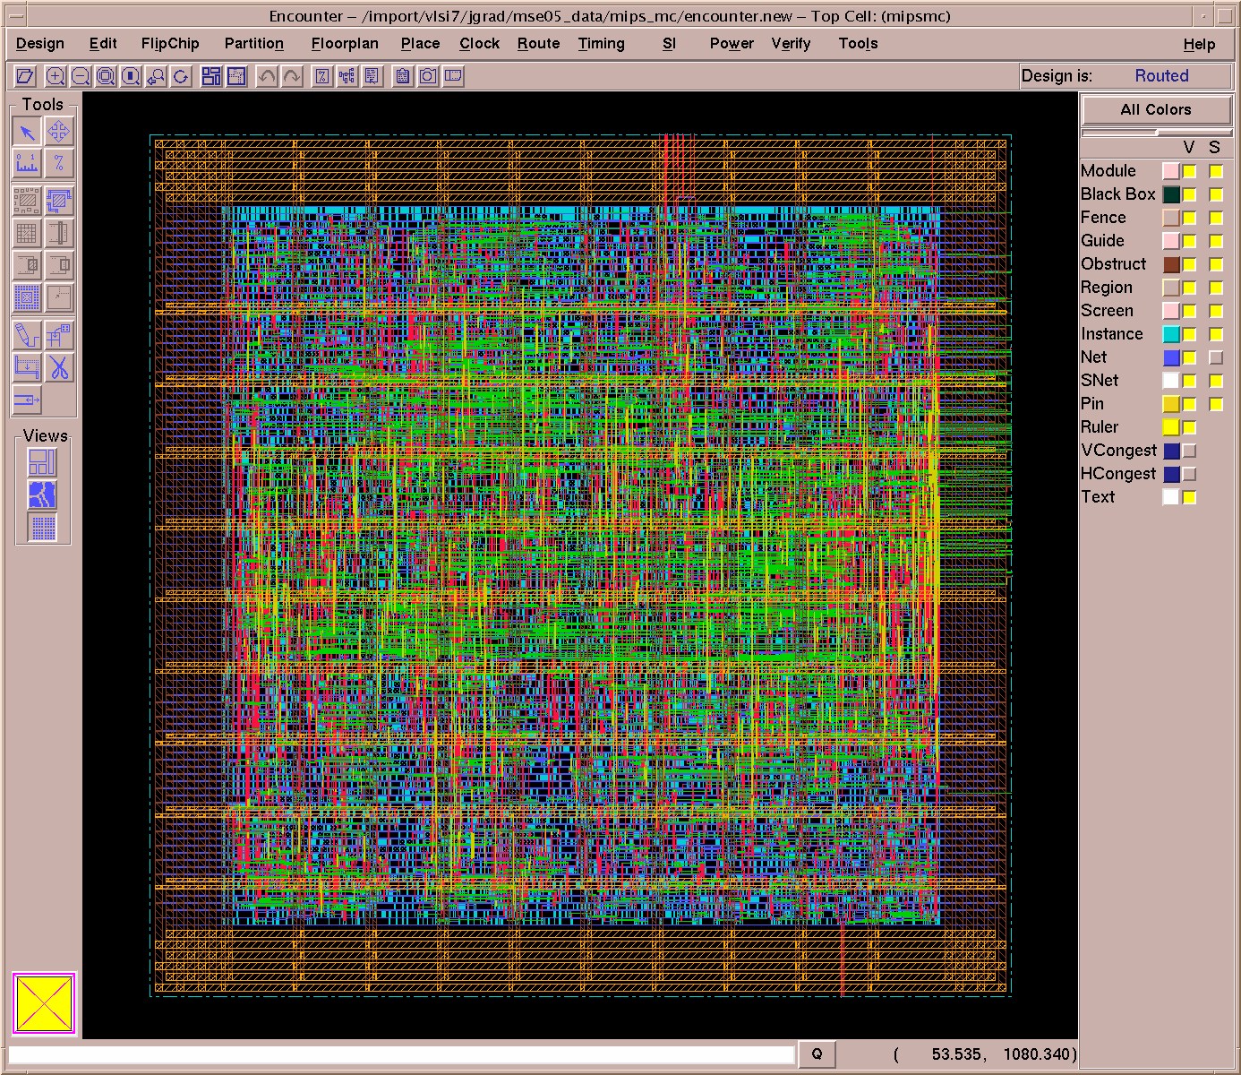
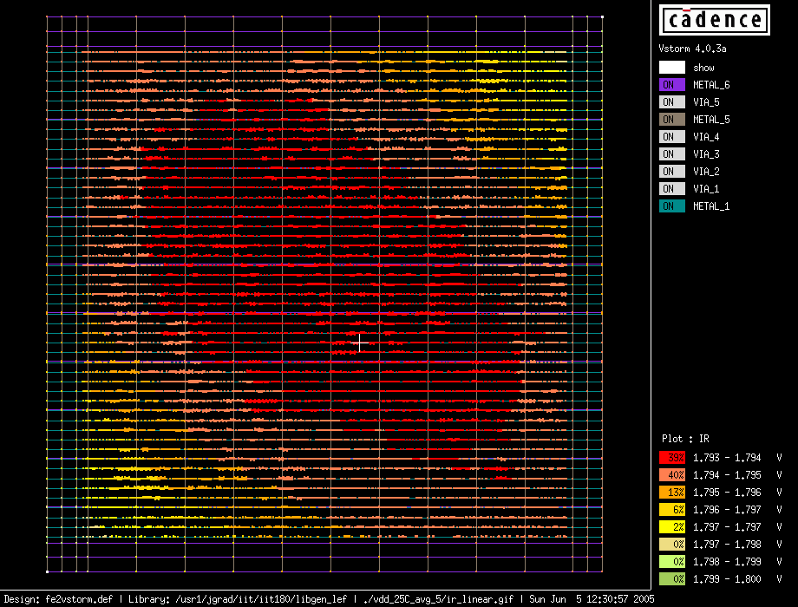
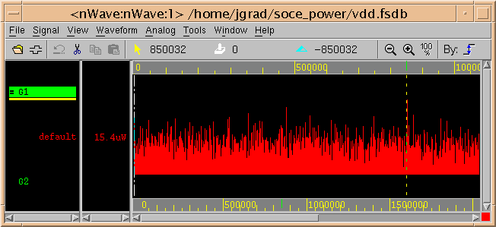
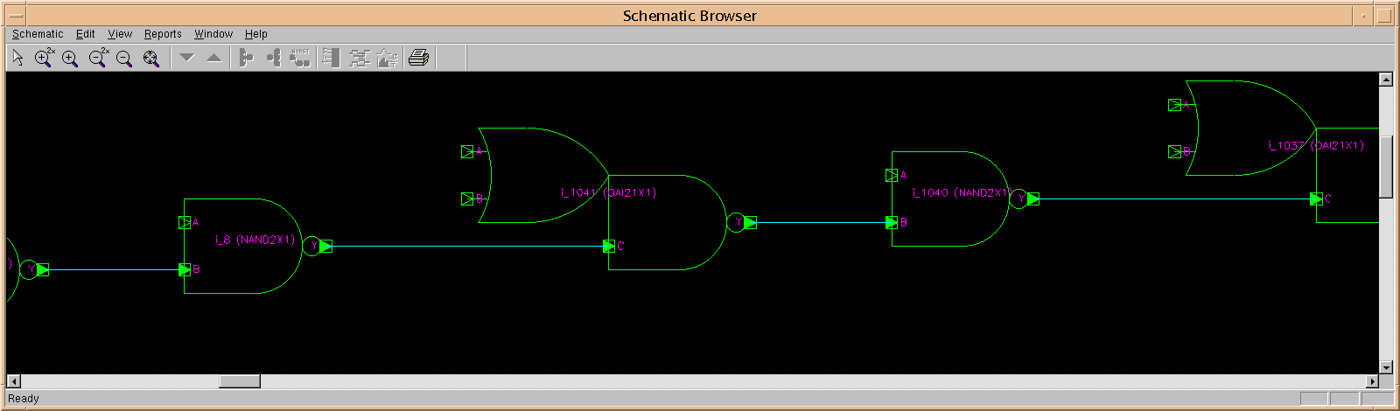
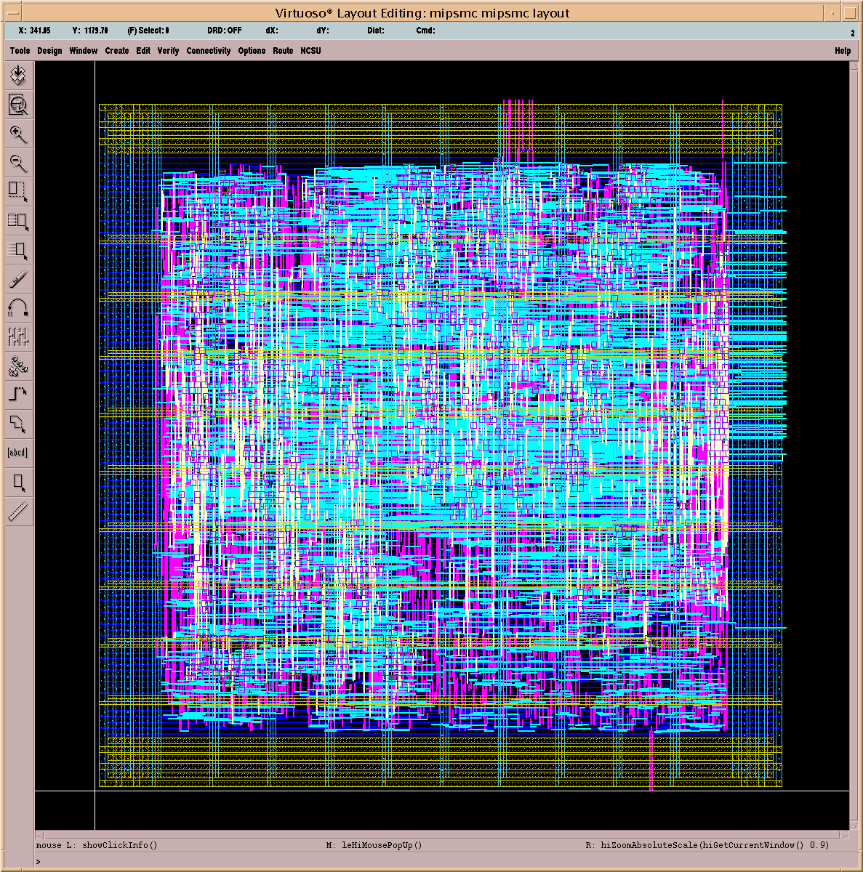
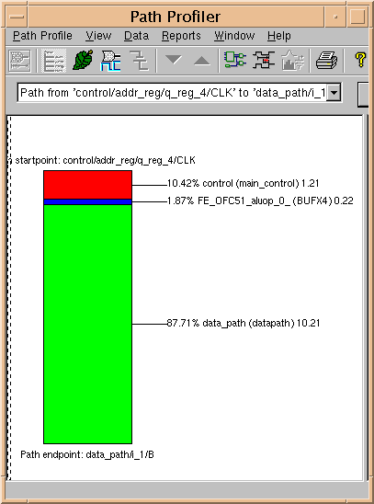
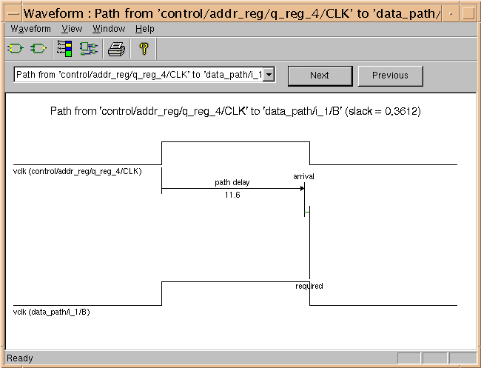
A Framework for High-Level Synthesis of System-on-Chip Designs
`
James E. Stine, Johannes Grad, Ivan Castellanos, Jeff Blank,
Vibhuti Dave, Mallika Prakash, Nick Iliev, and Nathan Jachimiec
http://vlsi.ece.iit.edu
VLSI Computer Architecture, Arithmetic, and CAD Research Group (VCAAC)
Illinois Institute of Technology, Chicago IL USA
IIT CELL LIBRARY
IIT PHYSICAL DESIGN FLOW
The IIT cell library has been developed to provide a free, non-proprietary library for MOSIS SCMOS rules.
It supports both commercial and public domain EDA tools.
The library is available for free upon request from http://vlsi.ece.iit.edu/scells
List of Cells
Highlights
Flow templates for many University-supported Cadence and Synopsys tools
Fully automated interface between all tools
Used at IIT in research as well as several undergraduate and graduate classes
AND2X1
AND2X2
AOI21X1
AOI22X1
BUFX2
BUFX4
CLKBUF1
CLKBUF2
CLKBUF3
DFFNEGX1
DFFPOSX1
DFFSR
FAX1
FILL
HAX1
INVX1
INVX2
INVX4
INVX8
LATCH
MUX2X1
NAND2X1
NAND3X1
NOR2X1
NOR3X1
OAI21X1
OAI22X1
OR2X1
OR2X2
TBUFX1
TBUFX2
XNOR2X1
XOR2X1
Characterization
  Performed using Cadence Signalstorm
  Spice accurate delay and power umbers
  5x5 lookup tables
New for Version 2
  Set/Reset Flops
  Support for AMI 0.35μm
  Techfiles for Fire&Ice, Voltagestorm
  DF-II Schematics
1) Logic Synthesis
2) Floorplanning
Cadence PKS
Synopsys Design Compiler
Cadence RTL Compiler
Cadence SOC Encounter
Power Planning
Placement
Clock Tree Synthesis
Figure: MIPS Core HDL Toplevel in PKS
Figure: Clock Tree Display in Cadence Encounter
Supported MOSIS Technologies
AMI 0.5μm (includes pads)
AMI 0.35μm (includes pads)
TSMC 0.25μm
TSMC 0.18μm
3) Place & Route
4) Power Analysis
Place & Route Flow Steps
In-Place Optimization
Routing (Cadence Nanoroute)
Extraction (Cadence Fire&Ice)
Static Timing Analysis
GDS Export
Cadence Voltagestorm
IR-Drop Analysis
SOCKS: SOC SIMULATION AND VERIFICATION
Figure: MIPS Core IR-Drop Plot
Dynamic power analysis in Encounter
Switching Activity from VCD File
The SOCKS platform is a Leon based system-on-chip with an AMBA bus.
It provides an empty AMBA block for student experiments and a testbench with debug support.
SOCKS includes several C/C++ code examples, make-files and Cadence NC-Sim simulation scripts.
The SOCKS platform is used in a SOC class at IIT for the implementation and verification of a floating point unit designed by students accessed by a LEON processor (a compliant SPARC v8 processor)
Figure: Routed MIPS Core in Encounter
Figure: MIPS Core Dynamic Power Consumption
SOCks ASIC
Custom Logic
HDL Code
Firmware
C/C++ Code
Leon
Custom Logic
5) Signoff Timing
6) Chip Finishing
Sparc CPU
Memory Controller
AHB
Controller
AHB
Slave Interface
VHDL Compiler
Verilog Compiler
C/C++ Compiler
Object Linker
Fully automated import
LVS (Diva)
Mask level extraction (DIVA)
Uses NCSU techkit
AHB Bus
Leon
Custom Logic
ram.dat
rom.dat
Post-Route Timing Analysis
Uses extracted parasitics
Supported
  Synopsys Primetime
  Cadence CTE
External
Memory
RAM/ROM
IO Monitor:
Text Output
File Output
Clock/
Reset
Generator
HDL Simulator: NC-Sim
Simulation Testbench
Simulation
Waveforms
TXT.OUTPUT
INT.OUTPUT
Figure: SOCKS Platform Block Diagram
Figure: SOCKS Simulation Flow
Figure: MIPS Core Static Timing Analysis in Synopsys Primetime
Figure: MIPS Core in Cadence Virtuoso

