Slide 1
The SOCks Design Platform
Johannes Grad

Slide 2
System-on-Chip (SoC) Design
Combines all elements of a computer onto a single chip
  Microprocessor
  Memory
  Address- and Databus
  Periphery
  Application specific logic
Software development must take place on simulation models or FPGAs until the actual chip is fabricated
Hardware/Software Co-Design issues: Need to make educated guess on what becomes hardware and what is done in Software early in the design process

Slide 3
“Soft” IP Blocks
Synthesizable HDL code (commercial HDL is usually encrypted)
From Synopsys Designware, Opencores, MIPS, etc.
Can be implemented on any Library
HDL for 8051, 6800 available
Usually highly configurable
  Cash (Yes, No, How big, Code/Data separate or unified)
  Pipelined (Yes, No)
  SRAM interface (single cycle, multi cycle)
  User Defined Instructions
Timing, Area and Power depend on process, CAD tools used, and user skills
Popular Example: Synopsys DesignWare

Slide 4
“Hard” IP Blocks
Fully implemented, verified mask layout block
Available only for specific process
Not configurable
Guaranteed Timing, Area, Power Consumption
E.g. MIPS Hard-IP cores
Note:
SOCks uses Soft-IP cores

Slide 5
The Leon Core
Available in the public domain (under GNU License)
http://www.gaisler.com/
Synthesizable VHDL soft-core
Highly configurable for many different scenarios
Verified in several silicon implementations
Contains AMBA controller
Turbo-Eagle uses 2 instances of Leon:
  Master CPU called “Leon”
  Slave CPU called “DSP” (a Leon core configured for DSP)
“Leon” has been modified by Cadence for this project to run at twice the bus frequency and to use 2-port instead of 3-port RAMs
“DSP” still runs at bus frequency

Slide 6
The AMBA bus (1)
Developed by ARM
http://www.arm.com/products/solutions/AMBAHomePage.html
Common bus interface for rapid SoC development
Paradigm: “Design Reuse”
  Only need to code and verify a block once
  Can use over and over in other AMBA systems
Avoids glue logic between blocks with custom busses
“AMBA Compliance Testbench” to certify blocks as compatible
“AHB” – High Speed Version
“APB” – Peripheral low speed version
  Use Bridge to interface to “AHB”
  Less stringent requirements for low throughput blocks
  Isolates critical bus segments from slower blocks

Slide 7
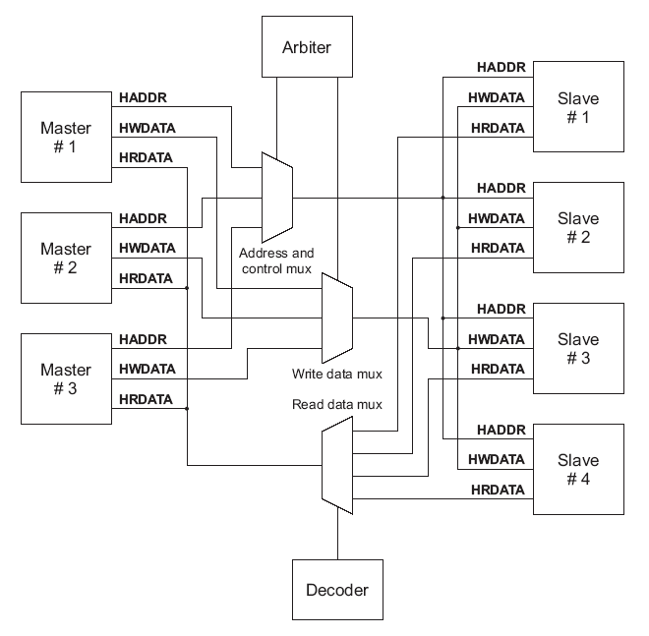
The AMBA Bus (2)
Multiplexed, not tri-stated
  Uses dedicated Point-2-Point links between blocks
  Uses Multiplexer to establish link and grant bus
  Avoid long busses that connect to many blocks
  Possible because wire density much greater than with discrete components
1 transfer takes 2 cycles:
    Address Phase
    Data Phase
Transfer Types
  Single Word
  Burst
  Split
Only positive-edge logic
  Easier timing analysis
  Supports more libraries

Slide 8
SoC Design Flow
1) Firmware Design
“Firmware” is the code that is executed on an embedded system
Not visible to the consumer
Typically resides in Flash memory
  Can update code in the field
  Can offer user to download firmware
Tools used:
  GCC SPARC compiler, linker and assembler
  Installed on the ECE servers “skew” and “vulcan”
  Include “/opt/rtems/bin” in your $PATH variable:
  setenv path (/opt/rtems/bin:$PATH)

Slide 9
SoC Design Flow
2) RTL Design
VHDL, Verilog or mixed design (SystemC in the future)
Instantiate memories and PHYs in testbench
Load RAM and ROM images into testbench
Run Simulation, capture output in file
Compare file to golden file (known good output)
Tools used:
  Cadence Incisive Platform:
  NC-VHDL, NC-Verilog, NC-SIM

Slide 10
SoC Design Flow
3) Synthesis
Generate timing models for all RAMs
Partition design into blocks
Create timing constraints
Synthesize blocks and toplevel
Output netlist and toplevel timing constraints
Tools used
  Cadence Encounter Platform:
  PKS, BuildGates or RTL Compiler
  Note: Synthesis not part of SOCks Project

Slide 11
SoC Design Flow
4) Physical Implementation
Generate geometry abstracts for all RAMs
Create floorplan, place RAMs, crate power structures
Partition design into blocks and implement each block
Load blocks, flatten toplevel
Run final timing and DRC analysis
Tools used:
  Cadence Encounter Platform:
  SOC Encounter, Nanoroute, Fire&Ice
  Note: Physical Implementation not part of SOCks Project

Slide 12
SOCks Overview
SOCks ASIC
Leon
Custom Logic
Add your digitial
logic here
The “cubing” logic is located here by default
Sparc CPU
Memory Controller
AHB
Controller
AHB
Slave Interface
AHB Bus
External
Memory
RAM/ROM
IO Monitor:
Text Output
File Output
Clock/
Reset
Generator
Simulation Testbench

Slide 13
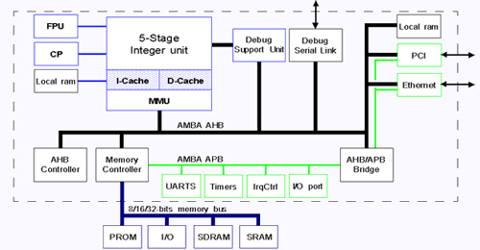
Leon Overview

Slide 14
SOCks Design Flow
Custom Logic
HDL Code
Firmware
C/C++ Code
VHDL Compiler
Verilog Compiler
C/C++ Compiler
Object Linker
Leon
Custom Logic
ram.dat
rom.dat
HDL Simulator: NC-Sim
Simulation
Waveforms
TXT.OUTPUT
INT.OUTPUT

Slide 15
Getting SOCks
Make sure you have 50MB space available
Use “quota –v” to check
Install the data:
  tar xvf /import/vlsi7/jgrad/socks/socks.tar
This will create a folder ./socks
Add this line to the bottom of your .cshrc file:
  set path (/opt/rtems/bin $path)
Test it by seeing if the compiler is found:
  which sparc-rtems-g++
Remember to run skew or vulcan. From other machines, do
  ssh skew or ssh vulcan

Slide 16
SOCks Distribution Content
Directory | Description
./exe | Unix scripts to compile and simulate the SOCks ASIC
./doc | SOCks Documentation
./firmware | C/C++ Source Code Folder
./firmware/cube | Demo program #1
./firmware/bubblesort | Demo program #2
./sim | HDL Simulation Folder
./testbench | VHDL test-bench code
./testbench/include | Test-bench include files
./testbench/Tcl | TLC Scripts for NC-Sim
./hdl | HDL Folder
./hdl/custom | HDL for the Custom Logic
./hdl/TOP | HDL for the ASIC toplevel
./hdl/rtllib | Compiled HDL folder
./hdl/rtllib/custom | Compiled Custom logic
./hdl/rtllib/top | Compiled Top-level logic

Slide 17
SOCks Design Flow
1) Setting up a firmware folder
Creating a new source code folder
  cd ./firmware
  cp –r bubblesort project1
Use the “bubblesort” project as a template
Put your C code into leon_test.c
You can create as many folders as you want in the “firmware” folder
For simulation you will then specify which firmware-folder to use

Slide 18
SOCks Design Flow
2) Compiling the Firmware
Creating and compiling the source code
  cd project1
  [emacs | pico | etc.] leon_test.c
  make
All compilation instructions are in “Makefile”
Simply type “make” and your code will be compiled and linked
Use emacs or pico as your text editor
The compilation result will be in “ram.dat” and “rom.dat”
Those will be read into the testbench memories

Slide 19
SOCks Design Flow
3) Creating Digital Logic
In this step digital logic is created that will go into the “custom” block
This block communicates with the Leon through the Amba bus
Creating and compiling the custom logic HDL
    cd ../../hdl/custom
    [emacs | pico | etc.] custom_top.v
    cd ..
    ../exe/socks_compile
Your folder has to be called “custom”
The compiler will compile all files that end in “.v”
“Compile” in this context means to build a HDL simulation model, not a binary fom C code

Slide 20
SOCks Design Flow
4) Running the Simulation
Running the simulation (replace “project1” with the name of your firmware folder)
    cd ../sim
    ../exe/socks_sim project1
Running the simulation and creating waveforms for the custom logic
    ../exe/socks_sim project1 partial
    simvision&
Running the simulation and creating waveforms for the entire design
    ../exe/socks_sim project1 full
    simvision&

Slide 21
SOCks Design Flow
5) Clean Up
Removing all temporary data to save space
    cd ..
    exe/socks_clean
This removes all temporary data
Can be helpful to minimize disk space usage
Also useful to force the tool to re-compile and build everything

Slide 22
Example:
The Cube Example
This a very simple SOC:
  Software is running on the Leon
  Hardware acceleration is provided for “x=y³”
Steps to run this:
    cd firmware/cube
    make
    cd ../../hdl
    ../exe/socks_compile
    cd ../sim
    ../exe/socks_sim cube
    cat INT.OUTPUT
The firmware used the function to output numbers
That output can be found in INT.OUTPUT

Slide 23
Example
The Bubblesort Program
This is a software-only example
The custom-logic is still “x=y³” but we will not use it
All we do is compile firmware and run it on the Leon
  cd firmware/bubblesort
  make
  cd ../../hdl
  ../exe/socks_compile
  cd ../sim
  ../exe/socks_sim bubblesort
The output is printed directly on the screen

