Slide 1

ECEN 4010/50X0: PROJECT
Thomas Kidd and James E. Stine
Oklahoma State University
Python Encouragement and Proliferation Group
November 15, 2024

Slide 2
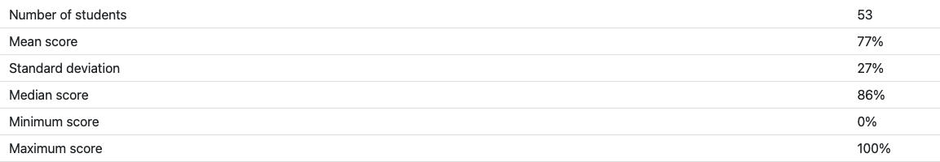
Exam
Our goal is to have you be proficient
Yes, we know there are other tools available, but we feel its important you know how to handle the data.
We are still going through data and will adjust scores to give students the benefit of the doubt.
Still there are students that are struggling with doing this in a timed environment and the only solution is practice!

Slide 3
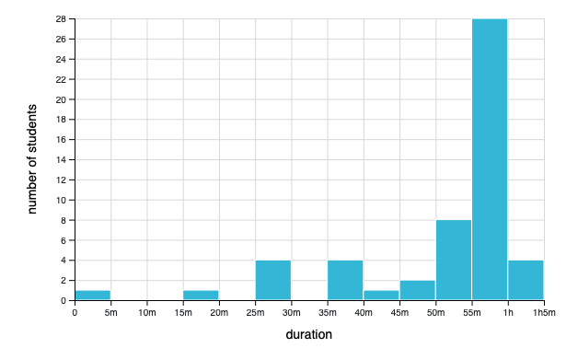

Slide 4
Exam Projections
Overall, we do not want to penalize students who did well.
If you did sufficiently well, you have the option of taking the final exam which will be like the last exam.
We have yet to figure out how that will modify the overall course percentages.
We promise to make the score percentages known before next Wednesday
There will be an additional homework to help students with grades who did not do well on something initially.
There will also be some required last homework that will be out we hope Wednesday
This will be an additional optional but encouraged for many students.
Again, we try to penalize people incorrectly and we do care that you do well.

Slide 5
Project Intro
You are tasked with completing the jupyter notebook
Due the day of the final exam, turned in on CANVAS
The goal of the project is to help you learn how to use many libraries together. This is a skill!!
The project requires your understanding of the basic functionalities of these libraries
Labels:
THIS IS A LINK
This is IMPORTANT

Slide 6
Project Outline
Fetching, using, and manipulating datasets
Requires knowing sklearn, numpy, matplotlib, and pandas
Baseline ML training with sklearn
Use sklearn to train and evaluate your model on the data
Create your own SimpleNN and CNN
Use pytorch to pull in data, train your model and evaluate it
Compare Sklearn and your custom models

Slide 7

Why python?
For simplicity
For cross platform
For the extensive number of libraries that are out there:

Slide 8
What libraries will we use?
High level:
Torch (version 2.5.1+cu124): pytorch docs
Sklearn (version 1.5.2): Scikit-learn docs
Numpy (verison 1.26.4): numpy docs
Matplotlib (version 3.9.2): matplotlib docs
Pandas (version 2.2.3): pandas docs

Slide 9
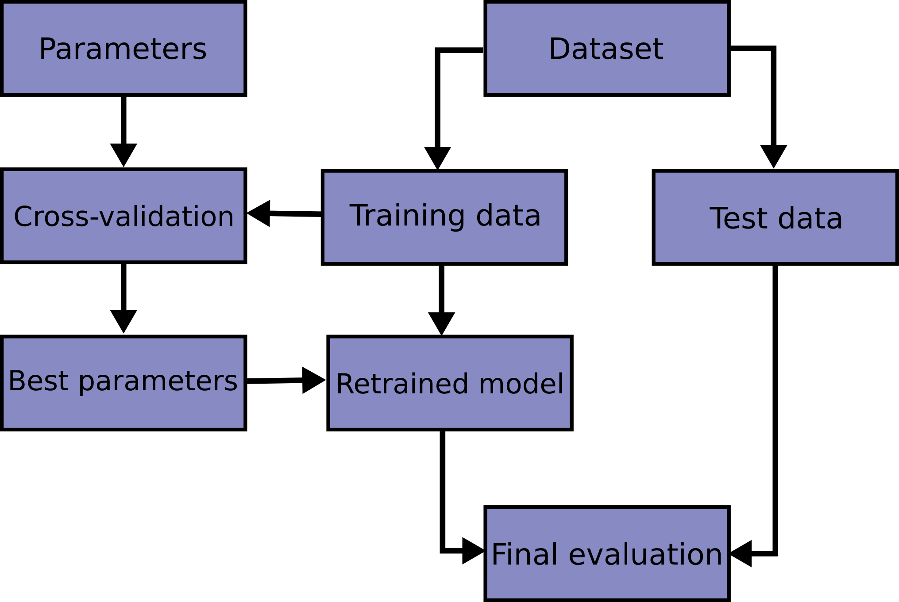
Why many libraries? → Data Flow

Slide 10
Sklearn functions
Step 1 is to bring in some data!
Section 7.4.3. Downloading datasets from the openml.org repository
openml.org is a public repository for machine learning data and experiments, that allows everybody to upload open datasets
The sklearn.datasets package is able to download datasets from the repository using the function:
sklearn.datasets.fetch_openml.

Slide 11
Sklearn functions
What does fetch_openml return?
Type: <class 'sklearn.utils._bunch.Bunch'>
Data IMPORTANT
Target IMPORTANT
DESCR
feature_names
target_names

Slide 12
Pandas
pandas.core.frame.DataFrame
Properties:
2-dimensional: It has rows and columns.
Labeled axes: Both rows and columns have labels.
Heterogeneous data: Can contain different data types (e.g., integers, floats, strings) in different columns.
Indexing: Supports various types of indexing (label-based, integer-based, boolean indexing).
Methods: Provides a wide range of methods for data manipulation, aggregation, and analysis.
Type: pandas.core.series.Series
Properties:
1-dimensional: It has a single axis (either rows or columns).
Labeled axis: The axis has labels (index).
Homogeneous data: Contains data of a single data type.
Indexing: Supports label-based and integer-based indexing.
Methods: Provides methods for data manipulation and analysis similar to those available for DataFrame but specific to 1-dimensional data.

Slide 13
Class / Object Recap
Classes have attributes:
info = Object.data assigns the objects data attribute to the info variable
Classes have functions:
Object.function() will execute a function of the class that the object belongs to

Slide 14
Pandas Important Functions
X.info()
Feature matrix info: <class 'pandas.core.frame.DataFrame'>
RangeIndex: 70000 entries, 0 to 69999
Columns: 784 entries, pixel1 to pixel784
dtypes: int64(784)
memory usage: 418.7 MB
None: function returns None
y.info()
Labels info: <class 'pandas.core.series.Series'>
RangeIndex: 70000 entries, 0 to 69999 Series
name: class Non-Null Count Dtype 70000 non-null int64
dtypes: int64(1) memory usage: 547.0 KB
None
In RAM!! Be careful!!

Slide 15
Two fun functions
DataFrame.memory_usage()
Data memory usage:
Index 132
pixel1 560000
pixel2 560000
pixel3 560000...
dtype: int64
Labels memory usage: 560132

Slide 16
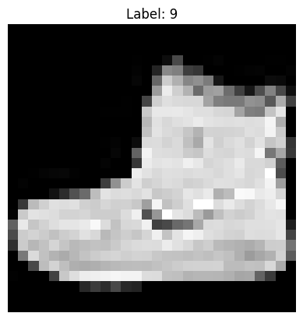
Visualize the DATA!
From matplotlib import pyplot as plt
We can use the imshow() function!
First argument:
2D array of data
MUST reshape data from 784 1D to (28x28) 2D
Second argument: colormap or cmap=’gray’

Slide 17
Split the data
Train_test_split: Split arrays or matrices into random train and test subsets.
Parameters:
Arrays: numpy, scipy, pandas
train_sizel: 0-1
test_size: 0-1
random_state: int

Slide 18
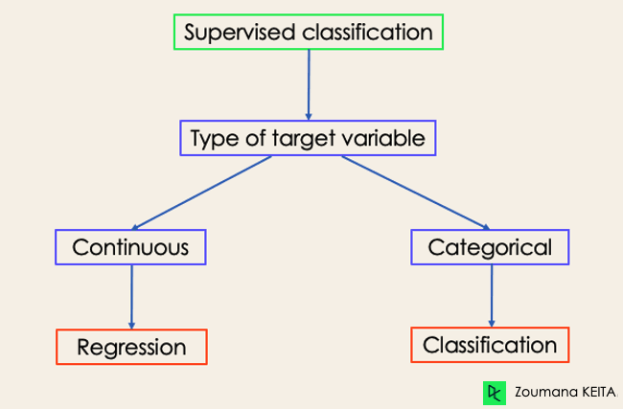
Types of learning
Supervised
Classification
Regression
Unsupervised
Clustering
Dimensionality Reduction

Slide 19
AI prediction types
Classification: predicts discrete label
Regression: predicts a continuous value
Natural Language Processing
Time Series Forecasting: predict the future based on observed data

Slide 20
Two options
Use pre existing algorithms using sklearn
Sklearn.linear_model
Logistic Regression
Ridge Classifier
SGD Classifier
Create custom algorithms using torch
Torch
Torch.nn:basic building blocks for graphs
Torch.optim: is a package implementing various optimization algorithms
Torch.utils.data: help load data for tensors

Slide 21
Logistic Regression
Purpose: used for classification tasks
Output: Predicts the probability of an instance belonging to a class, often 0 or 1
Decision Rule: If P(X) > 0.5 classify as 1 else classify as 0

Slide 22
Key Parameters
max_iter: the maximum number of iterations for the optimization solver to converge
Solver: Optimization algorithm (e.g. lbfgs)
Some solvers a better for certain data types
Penalty: a way to prevent overfitting

Slide 23
Usage in Sklearn
Logi Reg Github
<class 'sklearn.linear_model._logistic.LogisticRegression'>
This class has the following
attributes we will use:
Classes_
Coef_
Intercept_
n_features_
This class has the following
functions we will use:
Fit
Predict
Score

Slide 24
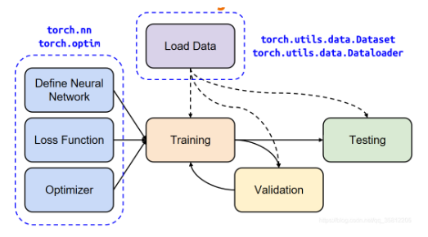
Moving on to custom NN

Slide 25
Torch functions
Torch.nn: These are the basic building blocks for graphs
Torch.optim:is a package implementing various optimization algorithms.
Torch.utils.data: At the heart of PyTorch data loading utility is the:
torch.utils.data.DataLoader class.

Slide 26
Always start with Data
Sklearn
Pytorch
Training and Test Data
Pandas DataFrame
torch.tensor
Training and Test Data
Pytorch tensor
DataLoader object
TensorDataset
T’s that have the same size of the first dimension

Slide 27

Create DataLoaders
train_loader
test_loader
Parameters:
tensor_dataset
batch_size
Shuffle
num_workers (default 0)
Provides an iterable way to train on your dataset

Slide 28
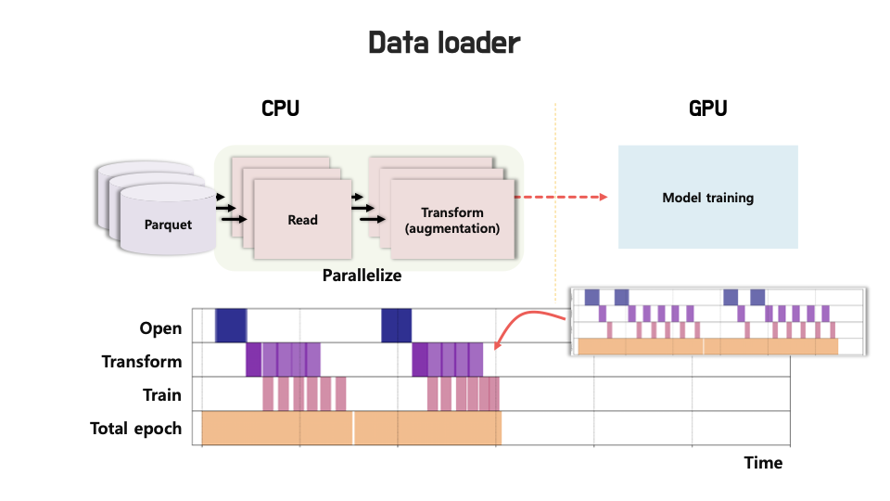
Why is this so important

Slide 29


Define Neural Network Model
Remember our images are 1D 784 tensors
Purpose: SimpleNN is a fully connected neural network (also called a feedforward neural network) designed to classify input data
Structure
Initialize the class __init__
to define your layer
forward method defines
how data flows

Slide 30
Define loss function and optimizer
All the loss functions aim to quantify how “wrong” the models predictions are and guide the optimizer to minimize this error
Use nn.CrossEntropyLoss() for multi classification
All optimizers adjust model weights to minimize the loss function during training
Use Adam os SGD optimizers

Slide 31
Train Model in a loop
We do training in epochs: meaning that in one epoch all of the training data has been passed through the network once during training.
Each epoch consists of several batches. Once all of the batches of data went through the network, one epoch is finished.
Loop using the train_loader
Zero the optimizer
Forward Pass
Compute loss
Update weights
Backward pass

Slide 32
Evaluate the model
Loop using the test_loader
Get the output
Get the prediction
Compare to label
Count correct pred

Slide 33
Recap
Fetching, using, and manipulating datasets
Requires knowing sklearn, numpy, matplotlib, and pandas
Baseline ML training with sklearn
Use sklearn to train and evaluate your model on the data
Create your own SimpleNN and CNN
Use pytorch to pull in data, train your model and evaluate it
Compare Sklearn and your custom models

