Slide 1
Open-source Toy-SRAM Test chip High Specific Bandwidth
We make high specific bandwidth multiport memories child’s play
Suggesting a first-class citizen 10T-SRAM, which is pumped & replicated for additional ports
To pare much of the custom circuit design from processors.

Slide 2
Features of TOY-SRAM
The custom core consists of a 10T SRAM dense library cell and its associated, well-tuned, hand-placed, standard cell decoders, and I/O circuitry in a hard macro. The array is 64 registers of 24 bits so that 3 copies produce 72-bit SEC-DED error correction for 64 bits. Its size is approximately 360 PC x 450 M3 tracks. This array + wrapper is 2/3 of the area of many standard 2R1W register files, because it uses the 10T SRAM cell, optimized decoders, and I/O circuitry, which are carefully placed and separated from the “wrapper.”
A CAD-friendly “wrapper” with latches, clocking system, and output muxes supporting SDR and DDR clocking per port. When used correctly the SDR or early read is < 10 FO4 (CLK to Q) and the late read is < 20FO4. The wrapper enables sharing many custom cores and can multiplex BIST input/output and column redundancy if necessary
An algorithm to expand read or write ports without redesigning the hard macro.At ISSCC 2011, an early version of SRAM used bank duplication to produce 4 Read ports with 2 banks of 2R2W custom cores by writing duplicate data to both banks and reading from each bank. Similarly, one can write separate data to copies, maintain a MostRecentlyWritten per-register bit, read both copies, and select the most recently written one to increase the number of Write ports. This allows growth both Read and Write ports from single custom core, using additional copies in addition to faster sub-clocking.

Slide 3
What is specific bandwidth? Why does Toy-SRAM do so well?
It measures the Read & Write bandwidth per unit area for a 64Reg x 8B
It is an analog to specific gravity which is mass per unit volume – Bandwidth per unit area
Its more encompassing than bit density, which drives complexity to improve bandwidth
It is enhanced by having a 10T SRAM separate 2 read + 1 write ports and
Supports low-cost super-pipelining.(2x + the system frequency without latch overhead)
Enables energy efficient ultra-low voltage operation by avoiding read disturb
It’s Read & Write specific bandwidth can be expressed with two metrics:
Technology dependent “X TB/(sec * mm²)”
Technology independent “Y 1/(FO4 delay * PC PITCH * min horizontal metal pitch)”
We would demonstrate specific bandwidth results from 130nm. to 2nm.
And use it to grow as many ports as necessary through replication
To produce as more efficient processors/accelerators with less circuit effort.

Slide 4
Test Structures for inclusion in a Toy-SRAM Test Site
Experiment →
400PC
72 bits x 64 regs 2 clocking modes regfile. ALL Signals are LATCH BOUNDED
2R 1W SingleDataRate,
Its synthesized wrapper contains:
250 latches and for the data in/out
LCB’s, clock generation, and pre-pre-decode
4R2W DoubleDataRate R&W
Its synthesized wrapper contains:
500 latches and for the data in/out
LCB’s, clock generation, and pre-pre-decode
Double pump mux stage at border minimizing double pump path depth.
Updated array sizing
64 registers ix 8B with SEC-DED using 3 3B sub-arrays
~500-1000 nets from the ADD/CLK wrap to the cores 95% in M3, 5% D5
->Pipe clean With SDR and Validate DDR methodology/characterization
->Measure performance from silicon, and ease technology migration through templates
Add + Data
wrap
2R1W
64x24
1350 M3 tracks
2R1W
64x24
2R1W
64x24
=2R1W 64x72
Blue – custom cell
Orange: synthesized hard core

Slide 5
Testsite definition. Proposed 2 experiments
Experiment and testsite top levels
Soft Macro
RTL+syn [BIST]
Soft Macro
RTL+syn [BIST]
Hard Macro
P&R with pre-place
Hard Macro
P&R with pre-place
THEN
Array
64x25
2R1W
Array
64x25
2R1W
Array
64x25
2R1W
Array
64x25
2R1W
Array
64x24
2R1W
Array
64x24
2R1W
=64x72
2R1W
=64x72
4R2W
Single Pump Read & Write
Double Pump Read & Write
Similar array between 2 experiments

Slide 6
Sub-Array - placement of pre-decoders, decoders et al :
304 PC = 18.24 um
400PC
Bit line direction
Proposed 64x24
15
16
GAP
26
TAP
Bit cells (12bits x 16words)
Local Eval
Bit cells (12bits x 16words)
Bridge
I/O: +,- write Word Line Driver, Nor,, 2* XNAND pwe bir
GAP
Bit cells (12bits x 16words)
Local Eval
Bit cells (12bits x 16words)
Word line direction
18 13.5T
=27 9T
1x9T
TAP
decoder
Prech A₀₁₂pre-decode
decoder
Clocks+
A₃₄₅pre-decode
decoder
Prech A₀₁₂pre-decode
decoder
1350 M3 tracks
8 9T rows decoders
1x9T
Bit cells (12bits x 16words)
Local Eval
Bit cells (12bits x 16words)
GAP
I/O: +,- write Word Line Driver, Nor,, 2* XNAND pwe bir
GAP
Bit cells (12bits x 16words)
Local Eval
Bit cells (12bits x 16words)
Word line direction

Slide 7
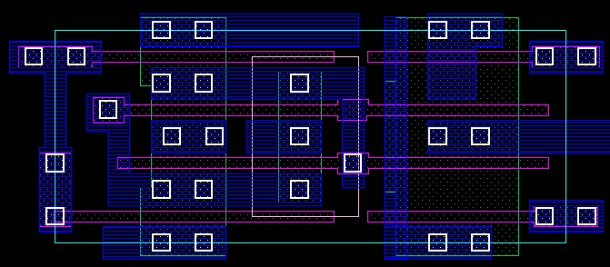
2R1W Cell Layout Optimization. Rotated in 45 nm
WBL
RBL0
RWL0
WWL
Cell size
1.824μm × 0.76μm
= 1.39μm²
2R1W
2
RWL1
RWL
WWL
2x1
(T/C)
WBLb
RBL1
2
Three ports (2R1W) is optimal for cell layout density
Terminals at cell edge: Contacts shared w/neighboring cells
Neither strongly wire-limited or device-limited
WL and BL width/spacing optimized to maximize performance

Slide 8
Compact/Composable, Double Pumped (4W2R 64 regs x 8B) for wiring impact, area power, delay 2 copies of this for full 4R 2W
2. R1W
64x
3*24b
W0R01
MUX
2R1W
64x
3*24b
W1R01
Presence bit
R01
R(0,1)
2R1W
64x3*24
Wr
ap
2R1W
64x3*24
3 cases of increasing ckt effort
SDR read and write. (VS REF design)
~same area ~80% read ~140% write power
~12FO4 latency
SDR – READ, DDR WRITE (VS REF)
~50+% area ~40+% read ~140+% write power
~10FO4 latency
For DDR- READ+WRITE (VS REF)
2-4 layers of wires opened
~25+% area ~40+% power ~70+% write power
~10FO4 & 20FO4 latency
R23
2R1W
64x
3*24b
W0R23
2R1W
64x
3*24b
W1R23
R(2,3)
2R1W
64x3*24
2R1W
64x3*24
W0
W1
W(1)
4 of these =
4R2W 64x288
2 x 72 wires vertical
W(0)
R01(E)
R23(L)
2R1W
64x
3*24b
W0R01R23 (L)
2R1W
64x
3*24b
W1R01R23(L)
4 x 144 wires R 2 *144 wires W
R01(E)
R23(L)
W0
W1
2R1W
64x
3*24b
W0,W1
R01(E)R23(L)
W0(E)
W1(L)
4 x 144 wires R 2 *144 wires W

Slide 9
Plans for TOY-SRAM
With Jim Stine – 130nm register file 5LM
If provided 14nm Global foundaries
Hope – IBM 2nm which does not have a complete BEOL, and can use our simpler system

Slide 10
Toy-SRAM key components
SIZE-SPEED A 10T SRAM dense library cell and its associated, well-tuned hand placed, standard cell decoders, and I/O circuitry in a hard macro. The array of 64 registers of 24 bits so that 3 copies produce 72-bit SEC-DED error correction + redundancy with efficient wiring below on half of D5 and below, This array + wrapper is 2/3 of the POR 2R1W array’s area , because it uses the 10T SRAM cell, and the decoders and I/O circuitry are hand placed and segregated from:
CLOCKING-CONNECTION A CAD friendly “wrapper” with the latches, clocking system completely done with combinatorial logic, and muxes, for BIST, redundancy and others. When used correctly the SDR or early read is as fast as any IBM array and the late read is less than the delay of many competitors.
COPYING FOR ADDITIONAL PORTS An algorithm to expand read or write ports without redesigning the hard macro & A potential factor of 2 interleave, getting single port access to 2x array width for register pairs
Our system can replace many of the existing register files by double pumping Write & Read (if the latency is tolerable) and duplicating for any additional ports.
It is the most labor efficient way to produce or extend a multi-ported file, and usually more silicon efficient, once we have the Toy-SRAM in silicon.

Slide 11
Backup

Slide 12
Sketches of non-traditional design changes
We have This is a 6-bit address (64 register) decoder, which uses 6 bits and and enable pulse in order to minimize the custom core size and complexity we did a little pre-decode in the synthesized wrapper.
This requires 12 signals for 6-bit address and enable
Bit 0 and its complement is ‘ANDED’ with the enabled clock pulse
Bit 3 and is complement are brought into the array
Bits 1,2 and 4,5 are expanded to one hot signals out of 4 each.
We distribute the local pre-decode in available spaces in the design
We align a write circuit and 2 copies of 2 state holding XNAND latches (one early and one late for each read port) with the bit-cell.
We allocate the wires from the wrapper, and global wires within the array
Assumptions (only a little of the the deign depends on this):
9 Track high cell library. a range of device widths and at least 1 M1 free across the row .
13.5T x 4 PC 10T register file cell - a conservative (near ground rule clean) design

Slide 13
Read path 2, Write path 1 (w/dup decoder) Each circuit has a delay of about 1FO4.
Pre decode 345.
_{In center region}
_{In the hard wrapper PDS}
_{Duplicated for double pump.}
_{Per sub array}
_{Mux for double pump.}
4 PC wide
16fN 16fP
4 PC wide 8fN 4fP
4 PC wide
16fN 16fP
4 PC wide 8fN 4fP
_{64 signals}
_{one hot To}
_{read pulldown}
_{Or Write port}
4 PC wide 8fN 4fP
_{8 signals}
_{one hot}
4 PC wide
16fN 16fP
_{4 signals}
_{one hot}
A₃
A₄
Decoder region
4 row pairs for R₀,R₁ ,W_{up} ,W_{dn}
A₅
_{Precharge}
_{In the hard wrapper PDS}
_{Duplicated for double pump.}
_{Buffer after DP mux}
2 PC wide 2fN 2fP
_{Local eval}
4 PC wide 8fN 4fP
Pre decode C012
4 PC wide
16fN 16fP
A₁
4 PC wide 8fN 4fP
4 PC wide
16fN 16fP
_{setup &}
_{hold here}
_{setup &}
_{hold here}
A₂
_{setup &}
_{hold here}
C
_{P16 dot}
_{Nfet pulldown}
A₀
3 row pairs for R₀,R₀₁ & W
Under the Local Eval
1 Row pair for Precharge
2 PC wide
2fN 2fP NOR
4 PC wide 8fN 4fP
4 PC wide
16fN 16fP
A₁
4 PC wide 8fN 4fP
2 XNAND
2 PC wide
8fN 8fP
2 PC wide
8fN 8fP
A₂
_{In the hard wrapper PDS}
_{Duplicated for double pump.}

Slide 14
Details of double pump path
For double pump, we duplicate in wrapper
For Read :Input address latches, first stage logic
For Write :Input address & data latches, first stage logic
In the double pump timing loop in core:
For Read: predcode, decode, pulldown, LE, OR, XNAND
For Write: predcode, decode, Cell write.

Slide 15
Critical edges. 2x per cycle.
Setup from the addresses to the clocks
A₀
A₁₂
A₃₄₅
Minimum pulse up width
Write (coincident data)
Read (coincident pre-charge)
Minimum pulse low width
Double pumped path
Read: Pre-decode, Decode, Read pulldown, Local eval, NOR2, XNAND
write: Pre-decode, Decode, Cell write

Slide 16
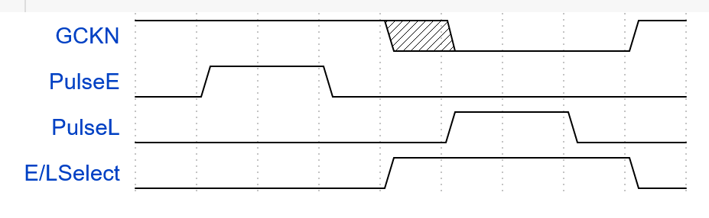
Single edge Clock generator for Double Pump Best electrical answer, all in the hard wrapper Not verity correct, but better performance
GCN
7+(1,2,3,4) FO4 DELAY
1,2,3,4 FO4 DELAY
PULSE-STROBE_{early}
PULSE-STROBE_{late}
Pre decode C012
GCN
Independent of GCKN duty-cycle
7+(1,2,3,4) FO4 DELAY
EARLY/LATE SELECT
PULSE-STROBE
Use PULSE STROBE_{early} for XNAND_{early}
Use PULSE STROBE_{late} for XNAND _{late}
OR PULSE STROBE_{early} and PULSE STROBE_{late} for address strobe

Slide 17
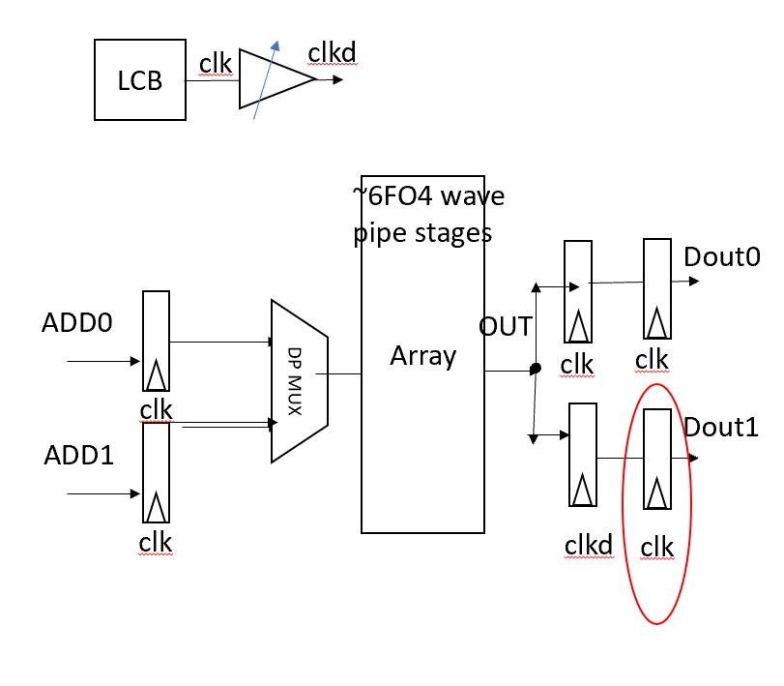
What is ”double pumped”
Double pump read is sending two decode to read signals down the same logic within one processor cycle, each ending in a different XNAND
Double pump write is sending two decode to write signals down the same logic within one processor cycle
The shorter the path, the safer and easier it is to create timing rules. In FIRST the early path finishes before the late path starts
Pulse gen
clkd
GCN
clk
Tunable delay
CUSTOM ARRAY

Slide 18
Low level cell design - local eval migrate + shrink
4 x LE circuits Across 27 M3 pitches (2 cell rows = 3 9T rows)
the outside row is all PFET
This allows a wider N-well in LE
Connect across to cell NW
Taps are on one edge of the total array
Connect (M1) cell local bit line to LE input
Connect (M3) global Bit line to LE output
2fin P precharge PC
input
NA2 4finN 2finP .
Local bit line right
Global bit line
Local bit line left
Local eval schematic
Target 12-16 PC
NWell
10T
Bitcell
10T
Bitcell
PC
PC
Local bit line
Local bit line
NWell
PC
NA2
NA2
PC
NWell
Local bit line
Local bit line
27T
Global bit line
Global bit line
10T
Bitcell
10T
Bitcell
NA2
NA2
Global bit line
Global bit line
Local bit line
Local bit line
NWell
PC
PC
NWell
NWell
Local bit line
Local bit line
PC
PC
16 of 10T SRAM
currently 12
5nm. 2-4-4-4 cell
6 pc x 3 (9T ckt rows Precharge gate contact @ edge
align to the 2 rows of 13.5T bit cells, connects the N-wells
16 of 10T SRAM
currently 12
5nm. 2-4-4-4 cell

Slide 19
Keepers at local and global circuitry
Include an “conditional” keeper
Always on
Always off
Delayed until evaluation compete
Global bit lines meet with dynamic or/keeper
Always on
Always off
Delayed until evaluation compete
Followed by an early or late XNAND pair
2fin P precharge PC
input
NA2 4finN 2finP .
Local bit line right
Global bit line
Local bit line left
Local eval schematic

Slide 20
Decoder region - compressed and wired to allow 50% cell occupancy w/24 bits per sub-array with nothing above M3.
Decoder circuits: 4pc NAND2 -8 fN 4fP & INV 16fN 16fP on 2 rows
The WWL decoder uses 2 of these – at top/bottom edge of the decoder
Balances the same load of 2x as many fins as RWL
Reduces M2 wires by 1 and wiring load of word lines by eliminating strap across mid
Final Pre-decoder uses the same arrangement
Pre-C012 under the Local eval (3x2 rows x 16 PC. Each side)
Pre-345 under the I/O spine (3x2 rows x 32PC middle)
The remaining 2 rows in the local eval are for PC driver
OR2 is created with Inverted inputs and 2 2 finger inv output
The remaining 2 rows in the center region are for buffering XNAND clocks

Slide 21
RIB – decoder (the WWLD is dupl )+Pre-dec 16PC under LE
In the bit cell region
8 rows of the region are decode (NA2+4 finger INV). With the WWL duplicated for fanout
In the bit cell region under the local eval
6 rows of the region under the LE are Pre-decode (NA2+4 finger INV)
2 rows of the region under the LE are PC drv (NA2+2 *2 finger INV)
GAP
GAP
GAP
4 PC drivers.
16 Write WWL UP INV
16 Write WWL UP INV
PC DRV
Write WWL UP INV
8 8fn4fpNAND2 with common signal.
Pre-decodr+ inpu inv
8 8fn4fpNAND2 with common signal.
Write WWL UP NAND.
8 8fn4fpNAND2 with common signal.
.
8 8fn4fpNAND2 with common signal.
.
.
.
8 8fn4fpNAND2 with common signal.
8 8fn4fpNAND2 with common signal.
8 8fn4fpNAND2 with common signal.
Reat WWL 0 NAND
Reat WWL 0 NAND
PDRWL0
8 8fn4fpNAND2 with common signal.
.
.
.
.
.
Reat WWL 0 INV
16 Reat WL 1 4 finger INV
16 Reat WL 1 4 finger INV
16 Reat WL 1 4 finger INV
PD RWL1
16 Reat WL 1 4 finger INV
Reat WWL 1 INV
.
.
.
8 8fn4fpNAND2 with common signal.
8 8fn4fpNAND2 with common signal.
Reat WWL 1 NAND
Reat WWL 1 NAND
8 8fn4fpNAND2 with common signal.
8 8fn4fpNAND2 with common signal.
.
.
8 8fn4fpNAND2 with common signal.
PDWWL0
Write WWL UP NAND.
Write WWL UP NAND.
8 8fn4fpNAND2 with common signal.
8 8fn4fpNAND2 with common signal.
.
.
.
8 8fn4fpNAND2 with common signal.
16 Write WWL DN INV
.
.
Write WWL UP INV
Write WWL UP INV
16 Write WWL DN INV
GAP
GAP
GAP

Slide 22
Center region is for the bit₃₄₅ decoders + clock buf
6 rows of the center region are the last Pre-decode (NA2+4 finger INV)
They take 32 PC each
2 rows of the center region are for XNAND clk driver
GAP
GAP
GAP
Write WWL UP INV
4 PC drivers.
16 Write WWL UP INV
16 Write WWL UP INV
XNAND CLK DRV
Write WWL UP INV
8 8fn4fpNAND2 with common signal.
Pre-decodr+ inpu inv
8 8fn4fpNAND2 with common signal.
Write WWL UP NAND.
Write WWL UP NAND.
8 8fn4fpNAND2 with common signal.
.
8 8fn4fpNAND2 with common signal.
.
.
.
8 8fn4fpNAND2 with common signal.
8 8fn4fpNAND2 with common signal.
8 8fn4fpNAND2 with common signal.
8 8fn4fpNAND2 with common signal.
Reat WWL 0 NAND
Reat WWL 0 NAND
Reat WWL 0 NAND
PDRWL0
Reat WWL 0 NAND
.
.
.
.
.
Reat WWL 0 INV
Reat WWL 0 INV
16 Reat WL 1 4 finger INV
Reat WWL 0 INV
16 Reat WL 1 4 finger INV
Reat WWL 0 INV
PD RWL1
16 Reat WL 1 4 finger INV
16 Reat WL 1 4 finger INV
Reat WWL 1 INV
Reat WWL 1 INV
Reat WWL 1 INV
Reat WWL 1 INV
8 8fn4fpNAND2 with common signal.
8 8fn4fpNAND2 with common signal.
8 8fn4fpNAND2 with common signal.
8 8fn4fpNAND2 with common signal.
Reat WWL 1 NAND
Reat WWL 1 NAND
Reat WWL 1 NAND
.
Reat WWL 1 NAND
.
.
.
.
8 8fn4fpNAND2 with common signal.
PDWWL0
8 8fn4fpNAND2 with common signal.
Write WWL UP NAND.
Write WWL UP NAND.
Write WWL UP NAND.
8 8fn4fpNAND2 with common signal.
8 8fn4fpNAND2 with common signal.
.
Write WWL UP NAND.
.
.
.
.
16 Write WWL DN INV
16 Write WWL DN INV
Write WWL UP INV
Write WWL UP INV
Write WWL UP INV
Write WWL UP INV
GAP
GAP
GAP

Slide 23
M2 Wiring in decoder region and over bitcell
We use a separate RWLD for the top half and the bottom half of the Write word line, and do not connect the two. This frees up M2 wires for wiring and powering the decoders
We connect the 8 consecutive connects to the decoders on an M1 track that is free on either the N or P side of the 4-finger balanced NAND2 (8N 4P) Gate. Thus, we only need 1 M2 for input
Total in decoder region out of 6M2 per 4 PC.
RWL0+RWL1 - 2
NAND INPUT - 1
VDD or GND 1
Strap and connect from NAND to INV 1. (WWL is outside this region)

Slide 24
Wiring across the decoder region
From hard wrapper
High fanout on low resistance (D)
XN clocks (4)
C * A_{0 ,} C *~A₀ (6), A_{3 , ~}A₃ (6)
Low fanout on M3
PD_{2,3}, PD_{4,5}, (12*2)
From Pre decode
Center - High fanout on low resistance (D)
Over bit region: R_{0,1} PD₀₋₇ (16), Over Decoder region: W PD_{0-7 ,} (8)
Low fanout on M3
M3 branch for: W,R_{0,1} UpperPreDecode_{0-7 ,} (24). ( from center region)
M3 branch for: W,R_{0,1} LowerPreDecode_{0-7 ,} (6) (from under the Local eval)

