Slide 1
Consumer vs Corporation
Irene Wang
Cathy Ma

Slide 2
Elevator Pitch

Slide 3
Layout
Sketch of the tables, chairs, iPads

Slide 4
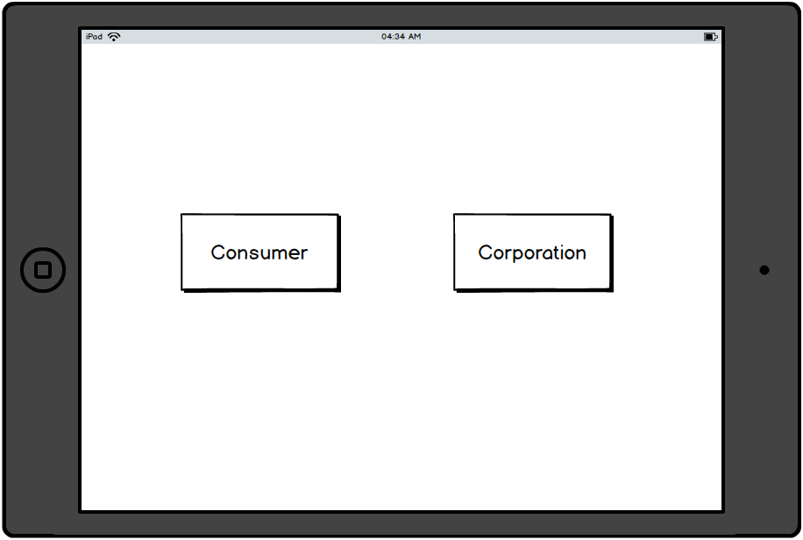
Landing Page

Slide 5
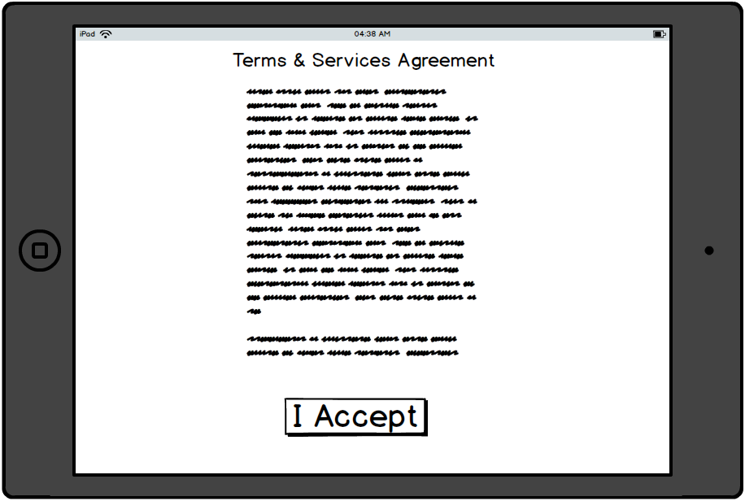
Consumer UI

Slide 6
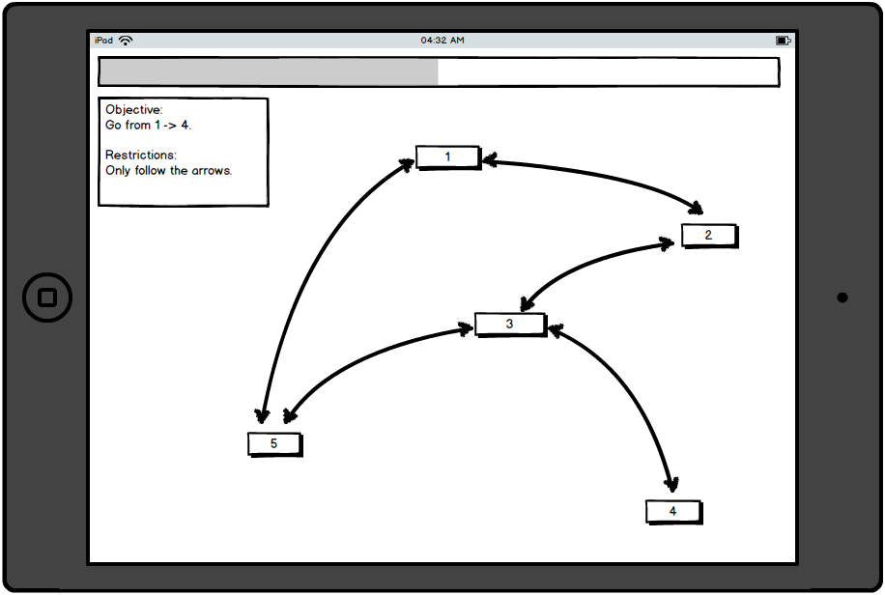
Consumer UI

Slide 7
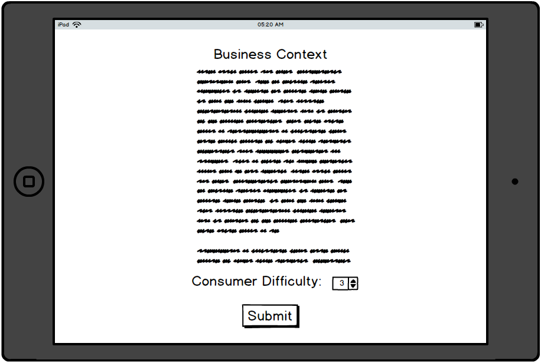
Corporation UI

Slide 8
Consumer Vs Corporation

Slide 9
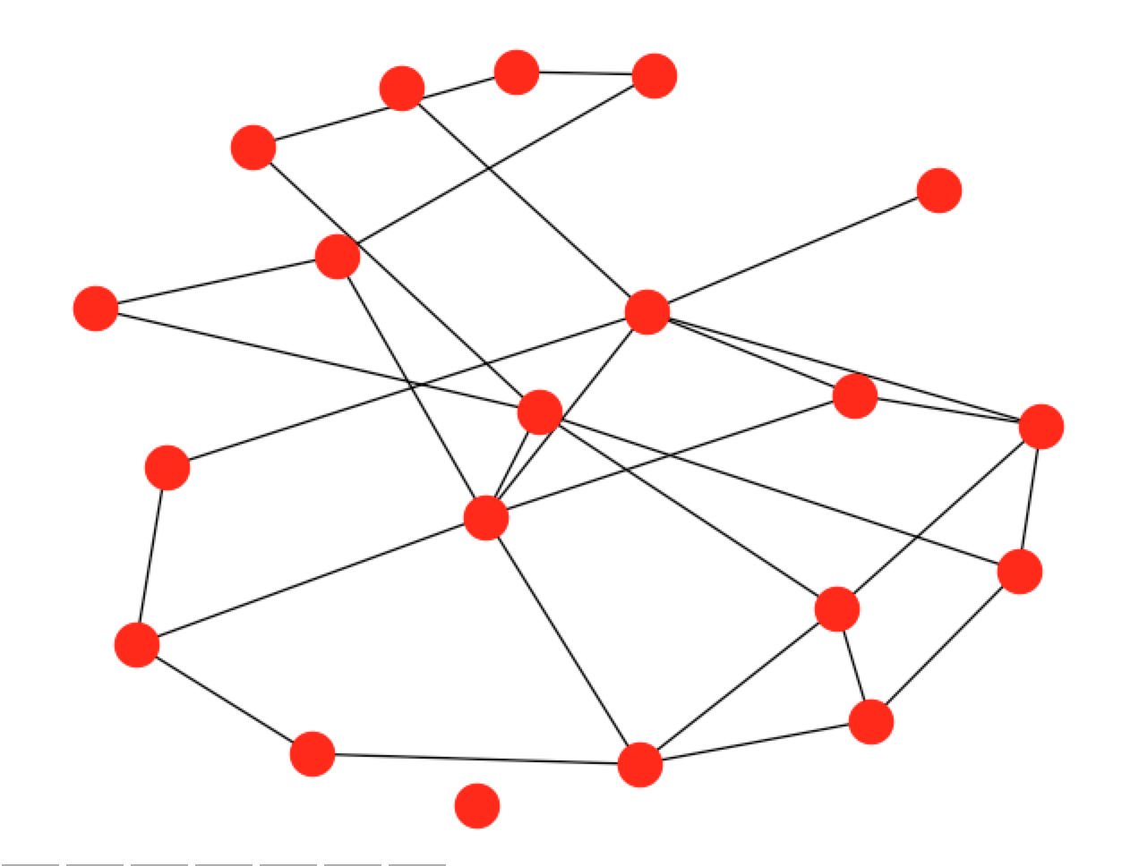
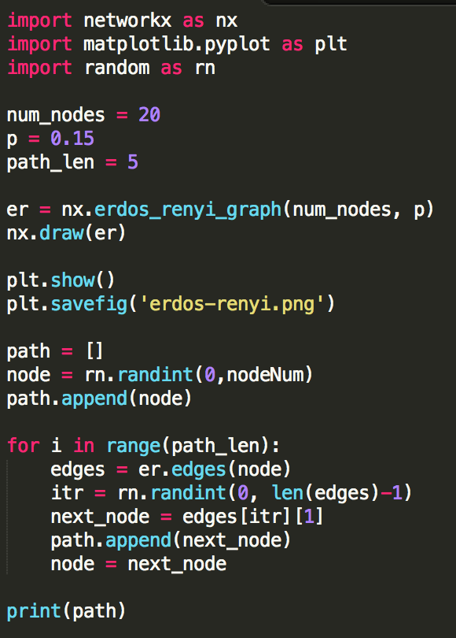
Consumer Graph

Slide 10
Context

