Slide 1
Consumer vs Corporation
Irene Wang
Cathy Ma

Slide 2
Elevator Pitch
A game that abstractly simulates the relationship between the consumer and corporation illuminates the extent to which the corporation controls the consumer’s experience with the Internet.
Notes:
Our project abstractifies the relationship between a consumer of the Internet and an Internet corporation into a simple, but telling game. It illuminates the positive and negative effects the corporation can have on the user’s Internet experience for its own personal (and potentially arbitrary) gain. The project clarifies how the interests of the public and the interests of business might run counter to each other. By depicting the conflict of interest in the style of a game, the project takes on a creative form to elucidate a hidden phenomenon pervasive in our Internet experience.

Slide 3

Layout

Slide 4
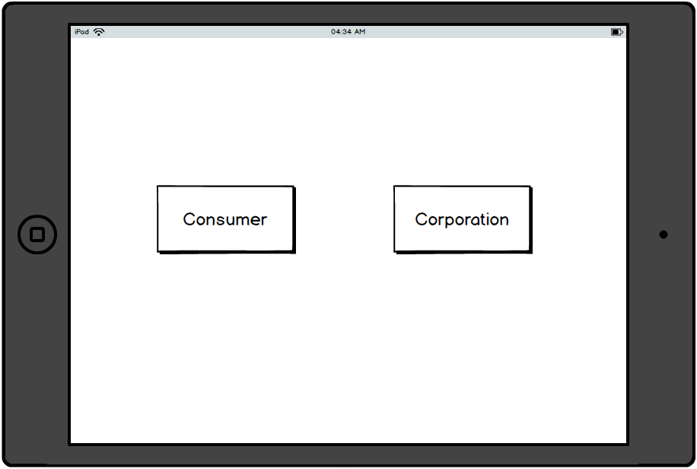
Landing Page

Slide 5
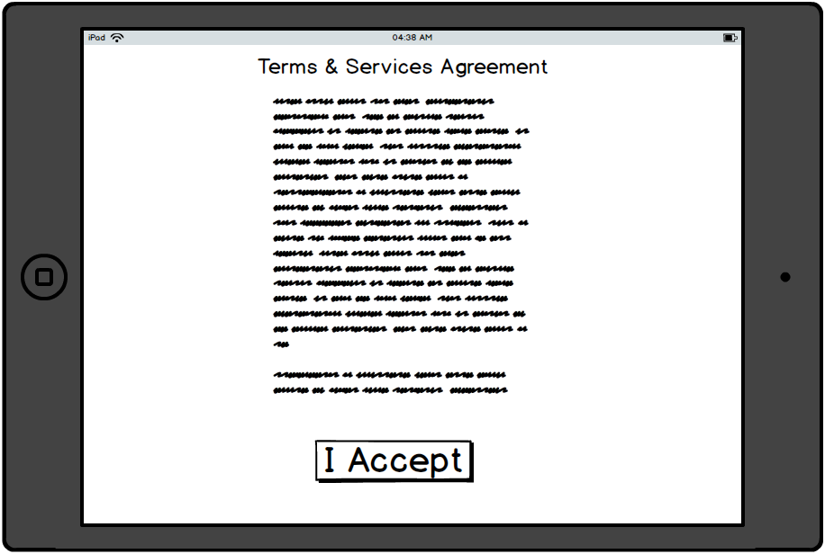
Consumer UI

Slide 6
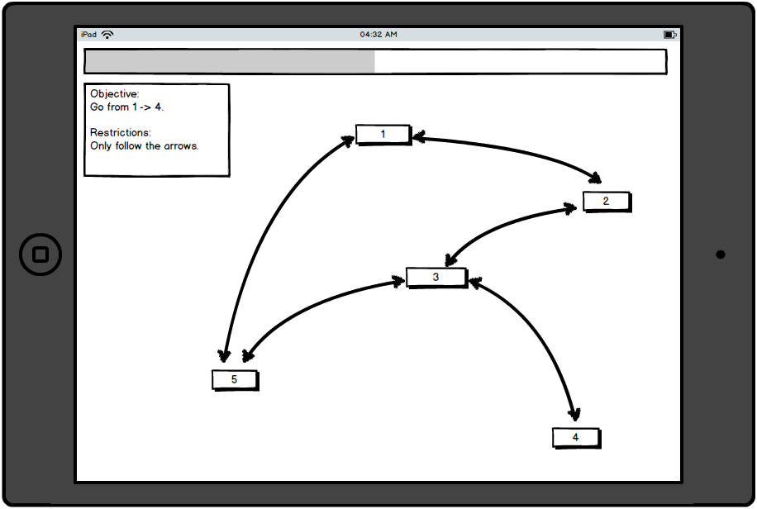
Consumer UI

Slide 7
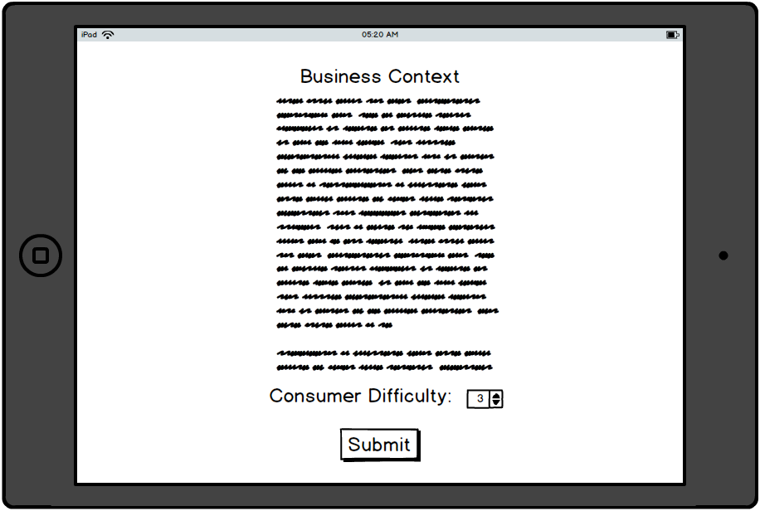
Corporation UI

Slide 8
Consumer Vs Corporation

Slide 9
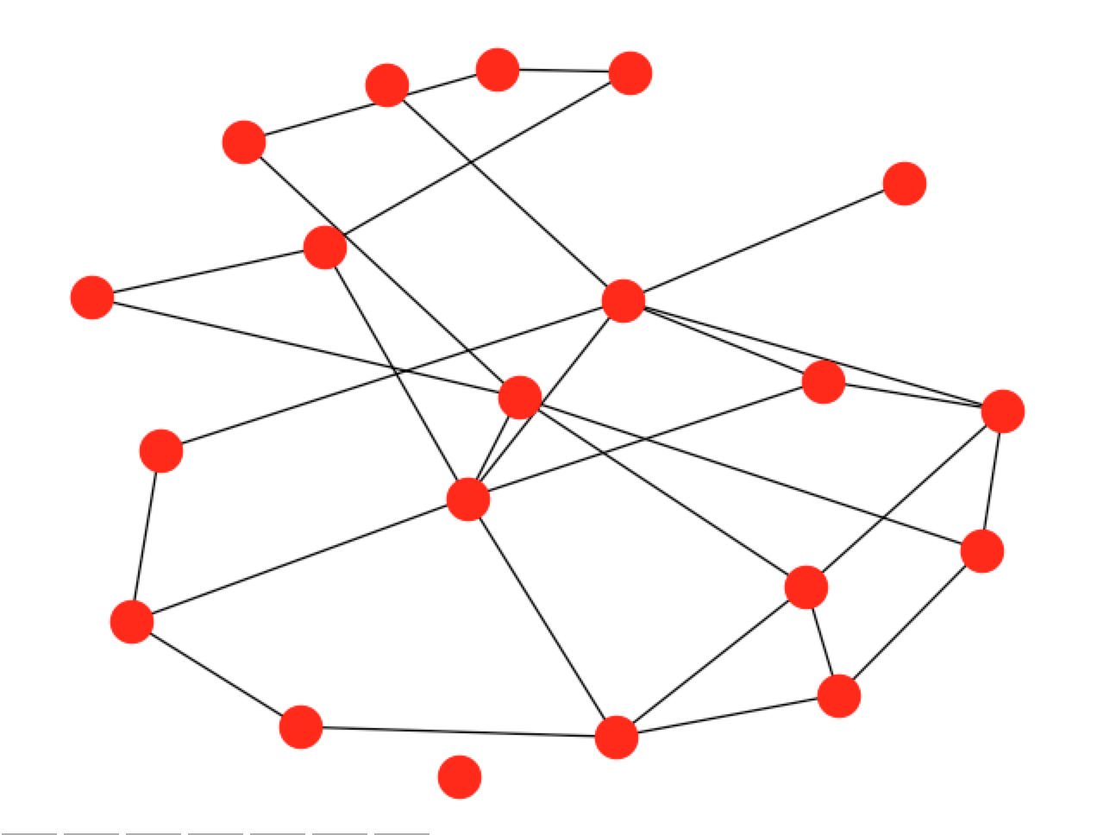
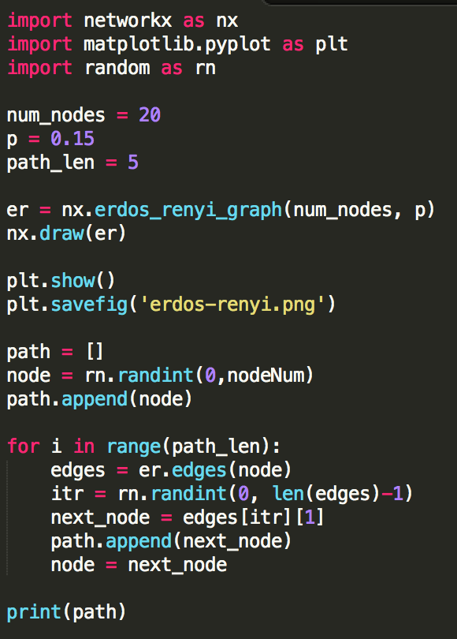
Consumer Graph

Slide 10
Context
The consumer and the corporation have diverging interests
Television Delivers People (1978) by Richard Serra
Consumers are products delivered to corporations
The actions of the corporation can benefit or harm the consumer experience
Notes:
Increasing distrust between the consumer and the corporation due to diverging interests and a general perception of “dishonesty” in a corporation’s objectives. In the post-war era, artists critiqued media in new ways upon finding that the utopian idea that media could be used as a public forum was unfeasible. The post-war era disillusionment lent to the perception that art was controlled by large networks and corporations. Television Delivers People (1978) by Richard Serra is an early piece that offers the idea that consumers are products delivered to television advertisers. He used the easily-recognizable style of the now outdated television style, which is an idea particularly applicable in the iconic interface of the tablet and web. His idea on the materialistic nature of the corporation translates to the current relationship between people and modern technological enterprises.

