Slide 1


Data Science Project
Elaborated by :
KONYALI Mohamed Amine
DAGHBOUJI Mohamed Amine
BOUSLEH Malek
STITI Bacem
BEN OTHMAN Walid
NJIHA Brad Steve

Slide 2

OUTLINE
Business Understanding
Data Modeling
Introduction
Deployment
Data Preparation
Deployment

Slide 3
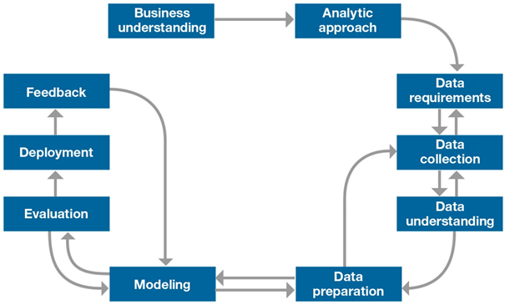
Introduction
Methodology IBM Master plan
Introduction
Business Understunding
Data Preparation
Data Modeling
Deployment
Notes:
Remove Bad channels

Slide 4

Business understanding
Introduction
Business Understunding
Data Preparation
Data Modeling
Deployment

Slide 5
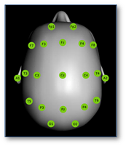
Data Preparation
Our baseline experiments focus only on the first 21 channels
Introduction
Business Understunding
Data Preparation
Data Modeling
Deployment

Slide 6
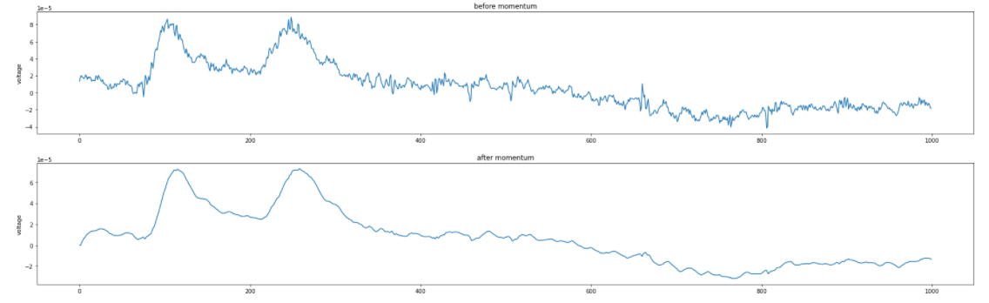
Moving averages
Introduction
Business Understunding
Data Preparation
Data Modeling
Deployment
Notes:
Remove Bad channels

Slide 7
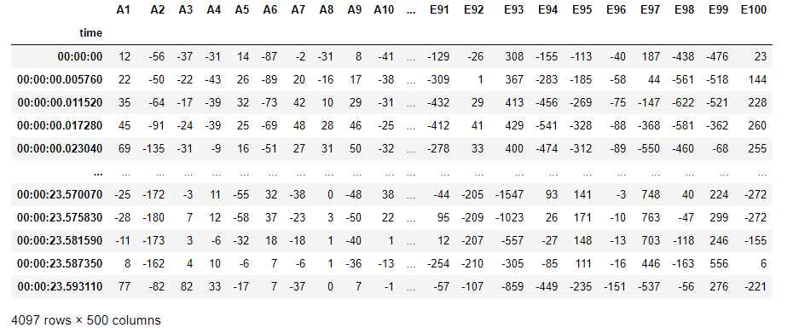
Bonn Data Preparation
Introduction
Business Understunding
Data Preparation
Data Modeling
Deployment

Slide 8
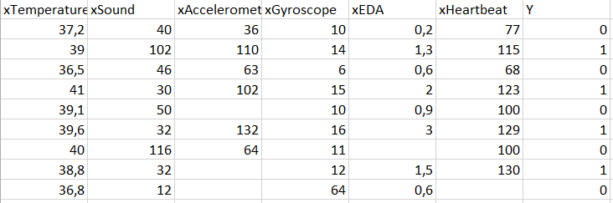
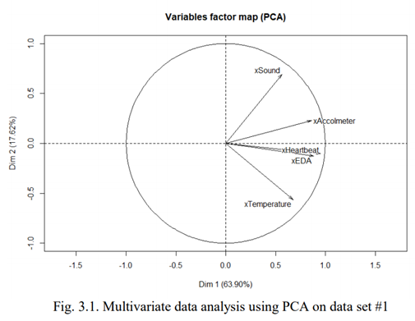
External Data Preperation
Introduction
Business Understunding
Data Preparation
Data Modeling
Deployment

Slide 9
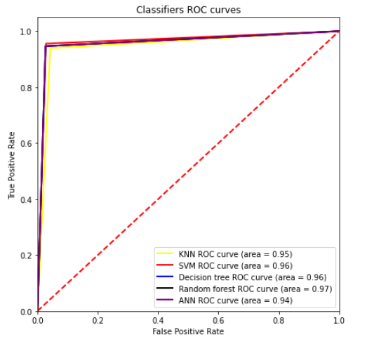
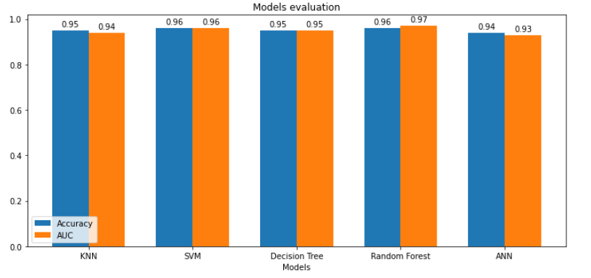
Internal Data Modeling :Bonn university Data
Binary Classification
Introduction
Business Understunding
Data Preparation
Data Modeling
Deployment

Slide 10
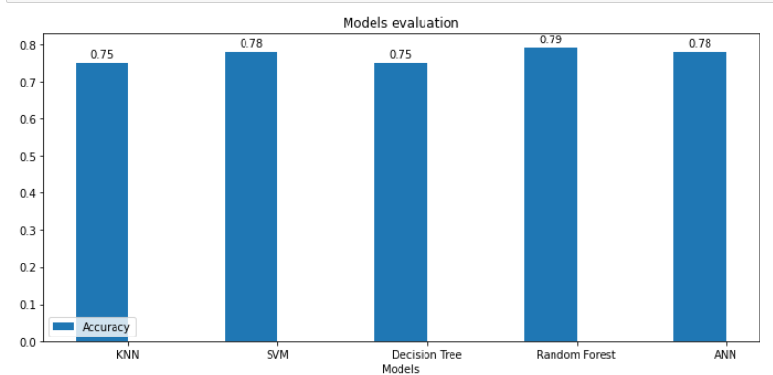
Internal Data Modeling :Bonn university Data
Multi Classification
Introduction
Business Understunding
Data Preparation
Data Modeling
Deployment

Slide 11
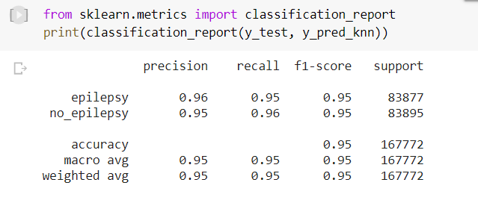
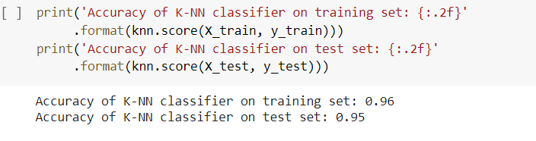
Internal Data Modeling :ISIP Data
KNN
Introduction
Business Understunding
Data Preparation
Data Modeling
Deployment

Slide 12
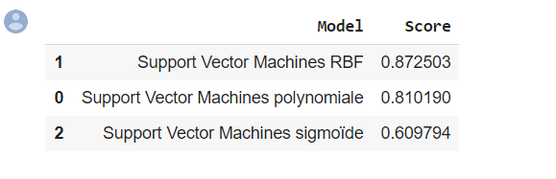
SVM
Introduction
Business Understunding
Data Preparation
Data Modeling
Deployment

Slide 13
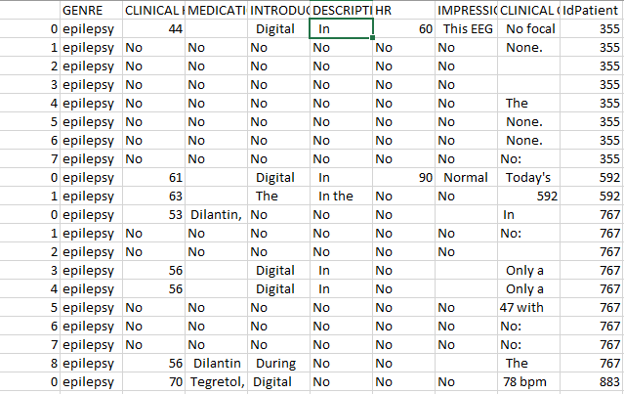
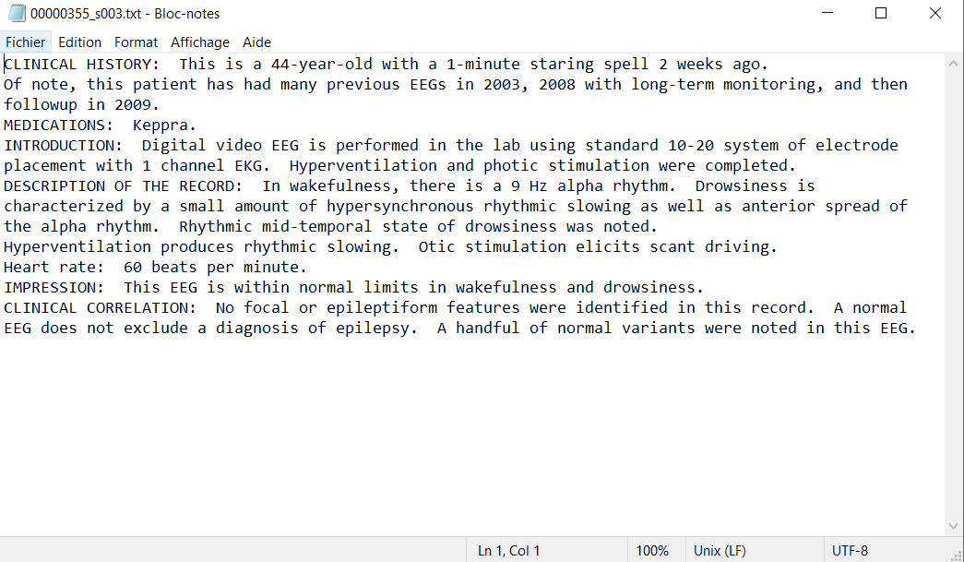
Internal Data Modeling : Text Mining
Introduction
Business Understunding
Data Preparation
Data Modeling
Deployment

Slide 14
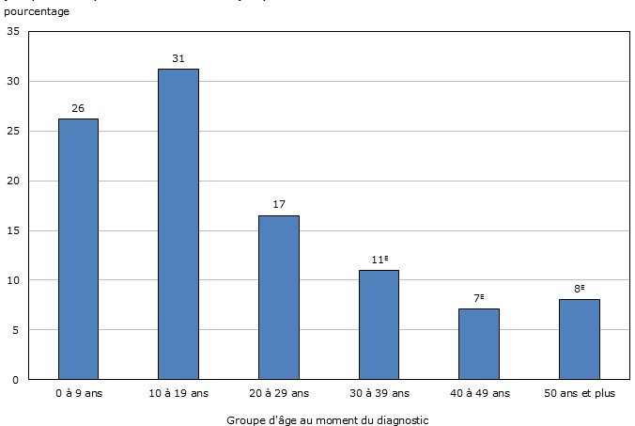
Internal Data Modeling : Text Mining
Introduction
Business Understunding
Data Preparation
Data Modeling
Deployment

Slide 15
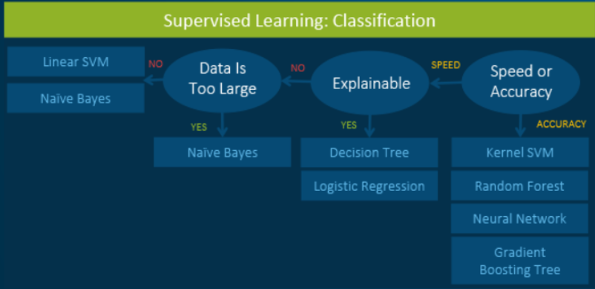
External Data Modeling
Machine Learning Algorithms Cheat Sheet
Introduction
Business Understunding
Data Preparation
Data Modeling
Deployment

Slide 16
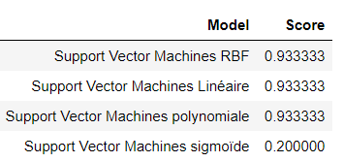
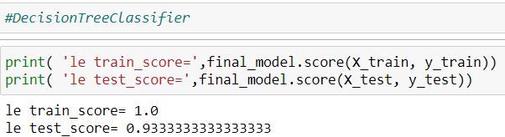
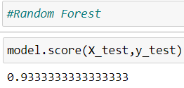
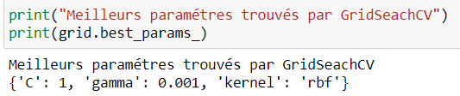
External Data Modeling
Models’ accuracies
GridSearchCV Application
Introduction
Business Understunding
Data Preparation
Data Modeling
Deployment

Slide 17

Deployment
Introduction
Business Understunding
Data Preparation
Data Modeling
Deployment

Slide 18

Thank you for your attention

