Slide 1

Tumor Recurrence Prediction After Stereotactic Radiosurgery: Multimodal Machine Learning Approaches in Imbalanced Data Contexts
Candidate: Stiven Hidri Supervisors: Santa Di Cataldo, Francesco Ponzio

Slide 2
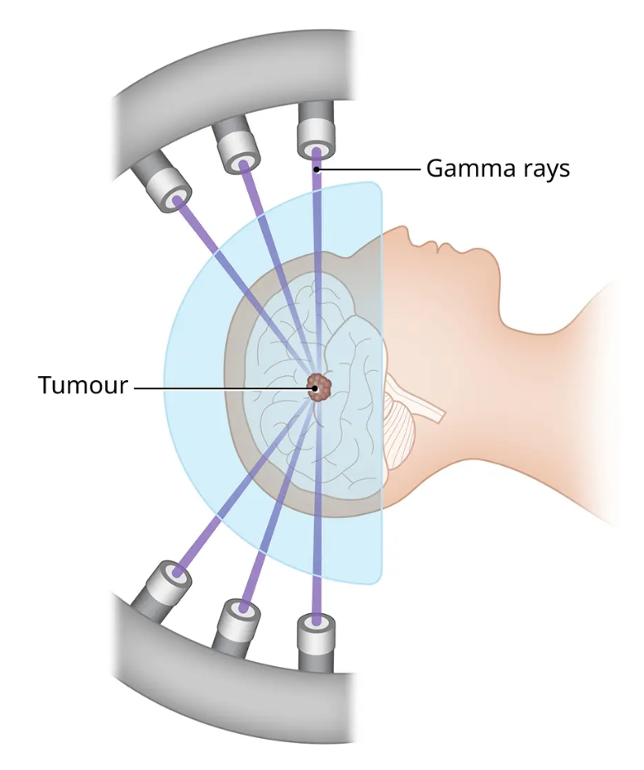
Brain tumors and Gamma Knife
Brain Tumors
Abnormal growths of cells
Can cause several health issues by applying pressure to critical structures
Gamma Knife
Stereotactic Radiosurgery (SRS) technique
High radiation dose at the focal point
Non invasive
Outcome: recurrent or stable

Slide 3
Objective and challenges
Objective:
Local tumor recurrence prediction after GK therapy
MRI, planned radiation treatment, clinical data
Challenges:
Intrinsically imbalanced domain
Individual tumors can be very small
Multimodal fusion
Only one study addressed this problem by publishing both a dataset and a baseline solution
Low F1 score

Slide 4
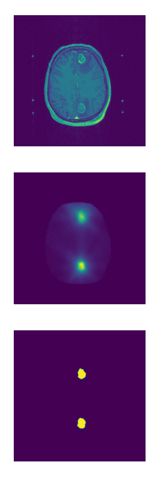
Brain MRI Dataset
Not aligned!
⁽ ¹ ⁾
⁽ ² ⁾
⁽ ³ ⁾
Yibing Wang et al.
For each patient are stored:
Pre-treatment CET1W MRI ⁽¹⁾
ROI masks ⁽²⁾
Planned radiation dose maps ⁽³⁾
Clinical information:
Primary tumor location, tumor histology, lesion location, gender, age and fractions.
IMBALANCE: 221 stable tumors and 23 recurrent tumors
Oversampling

Slide 5
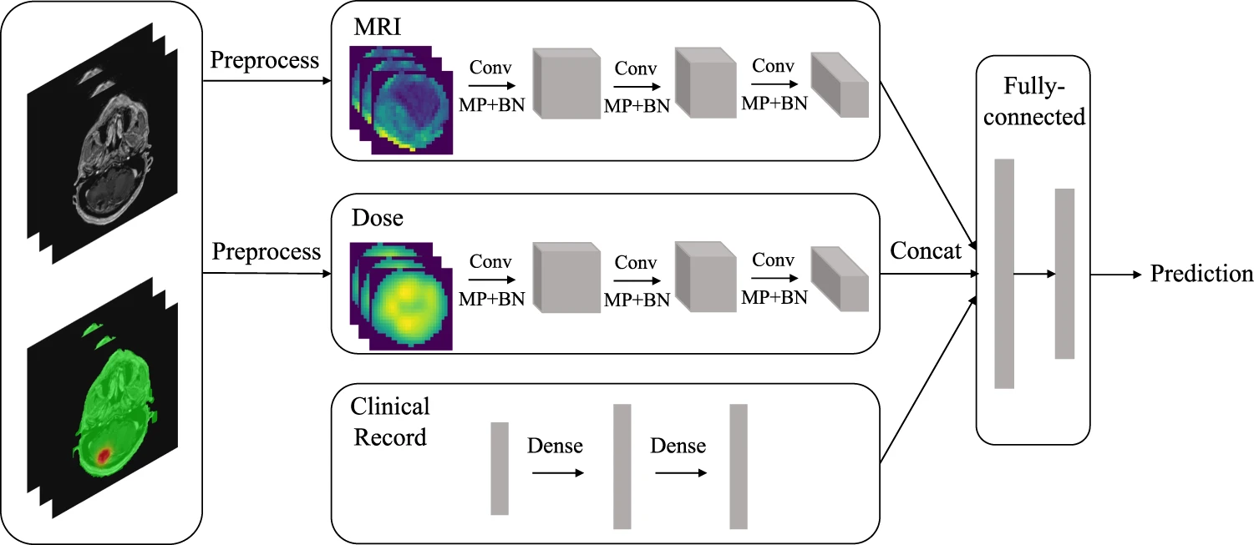
BASELINE MODEL
???

Slide 6
Strategy overview
Focal loss
1
Different preprocessing
1
2
Input fusion
2
3
LSTM-based feature fusion
3
4
Attention-based fusion
4
5
AUPRC
5

Slide 7
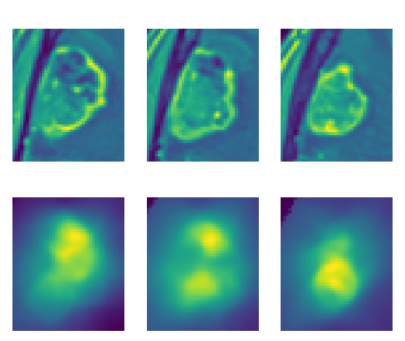
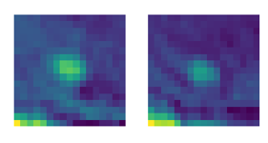
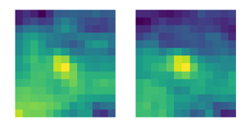
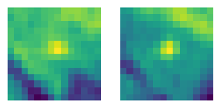
PREPROCESSING - Imaging
1
2
3
4
5
MRI are resampled to a voxel spacing of 1mm³
Follow along ROI masks and Radiation Dose Maps
Isolation by exploiting the ROI mask
Zero padding
Numerous small lesions

Slide 8
PREPROCESSING - Clinical data
1
2
3
4
5
Inhomogeneous categorical values:
String manipulation
Too fine grained lesion location values:
Generalization:
Brain lobe, cerebellum
Left or right
Categorical: One-hot encoding
Numerical: Min-max scaling
MLP CD
47
128
64

Slide 9
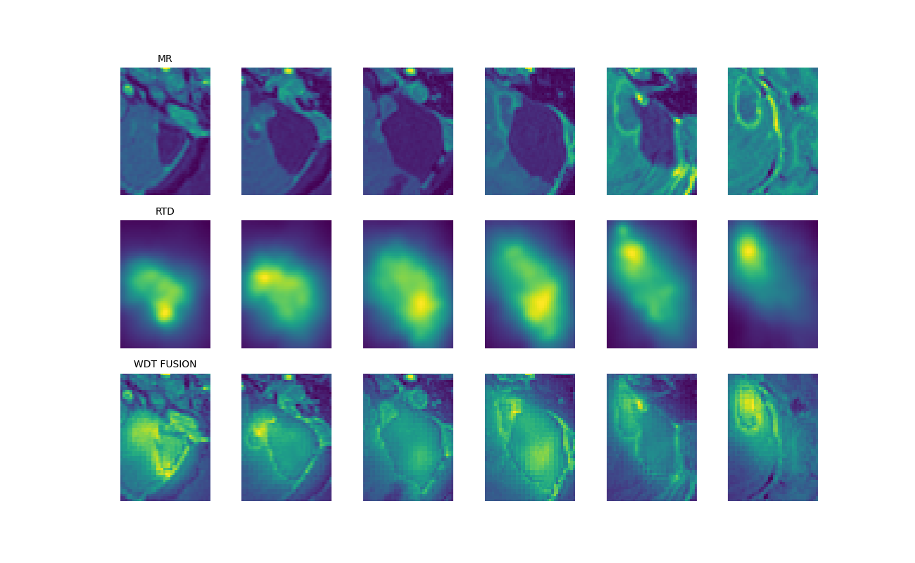
Discrete Wavelet Transform Fusion
1
2
3
4
5
Input fusion through Discrete Wavelet Transform (DWT)
Lowest frequency component: take the average
Higher frequency components: take the ones with highest energy
Inverse DWT to obtain the fused representation

Slide 10
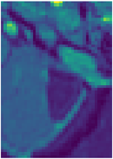
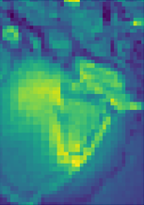
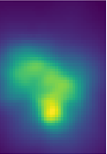
DWT CONV
1
2
3
4
5
MRI
DWT Fusion
3D CNN
RTD
Clinical features concatenation

Slide 11
CONV LSTM
1
2
3
4
5
MRI RTD
slice coupling
Feature vector list
MRI
ResNet18
LSTM
RTD
Clinical features concatenation

Slide 12
TRANSMED - Patch sequence
1
2
3
4
5
Modalities concatenation
3-channel slices
Patches extraction
MRI
Patch sequence
RTD

Slide 13
TRANSMED
1
2
3
4
5
Class token
POSITIONAL EMBEDDINGS
Patch sequence
ResNet18
DeiT
Clinical features concatenation

Slide 14
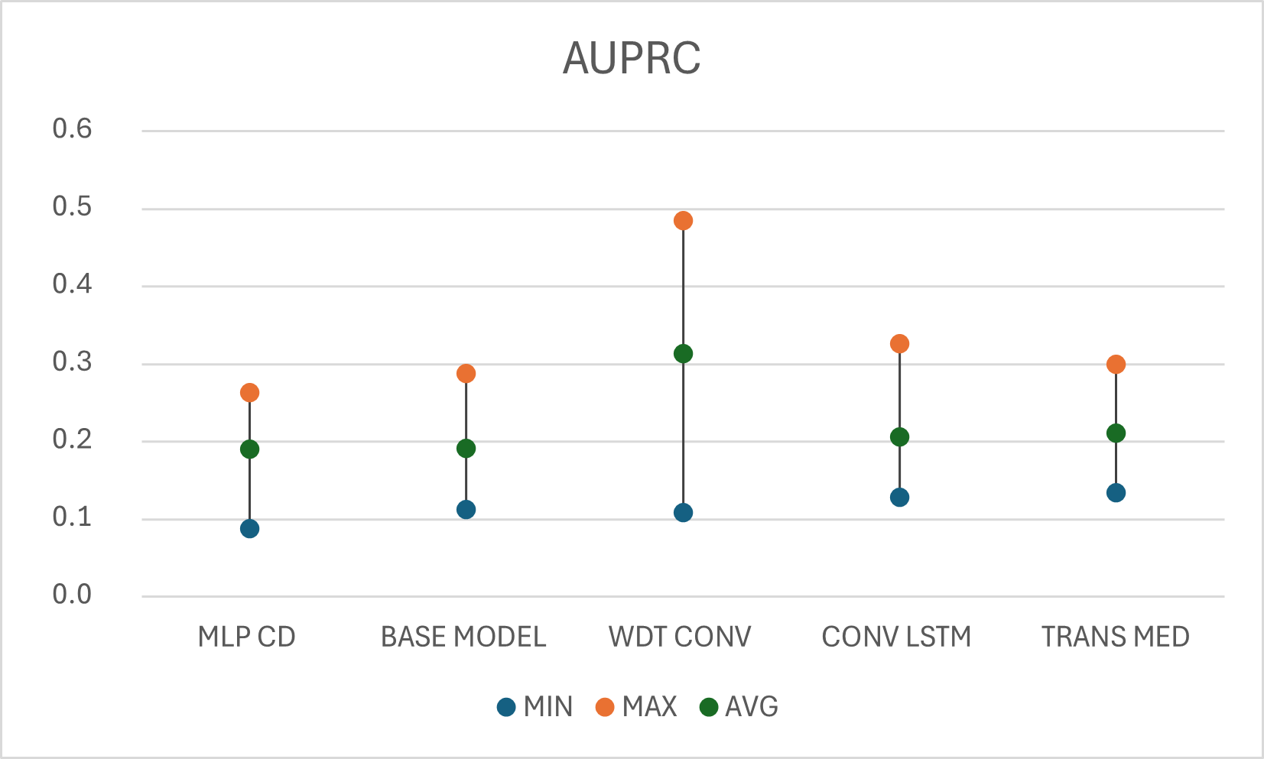
Models comparison
1
2
3
4
5

Slide 15
Final considerations
The dataset posed several challenges:
Data imbalance, scarce minority class, limited spatial resolution
The input fusion strategy was the most performant
Future works might keep exploring more advanced and complex solutions
Future areas for improvement
Superior preprocessing, transfer learning
Advances within such challenging context may incentivize the creation of more richer datasets
Additional imaging modalities, additional clinical features, less imbalance…

Slide 16
Thank you for the attention!

