Slide 1

Crime/Justice factors
Hypothesis: Socioeconomic factors influence on creating Safe societies
Tiwari, Sanjay
STAT-150 Intermediate Statistics
Harvard University Extension School
Karyn Gunnet-Shoval
@Marina Popova

Slide 2
Summary
The goal of this Demo is to provide an overview of the following two question:
How will we obtain the data – Sanjay
  Random responses and data gathering
How large a sample will we use - Melissa & Sanjay
Presentation video:
https://youtu.be/6ueMgcRWaQc
@Marina Popova

Slide 3
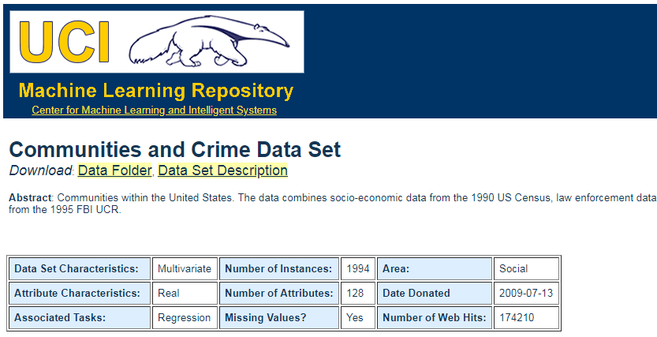
How will we obtain the data?
Primary focus: Random sampling
Why Random?
Our Source:
Outcome:
Violent Crimes/capita
@Marina Popova

Slide 4
How large a sample will we use
Our problem set: "Multiple Linear Regression"
As per the book (pg. 538) there are several rules of thumb and simpler the better would be obvious choice, which comes out to 10 per predictors.
We know our k, N and effect sizes we can also estimate an appropriate value using k/(N-1) formula. Here, k is # of predictors, N is sample size.
For k = 127, N = 1994, This gives us expected R for random data = 0.06, closer to 0 would be ideal.
@Marina Popova

Slide 5
How large a sample will we use…
Right Sample Size
Factors to Consider
Existing Information
Difficulty of Data Collection
Precision of Final Estimates
Necessary Sample Size :
Necessary Sample Size = (Z-score) * SD*(SD) / (margin of error)
With 95% confidence level, .5 standard deviation, and a margin of error (confidence interval) of +/- 5%.
We get 385 minimum respondents
@Marina Popova

Slide 6
References
Importance and effect of sample size: http://docs.aws.amazon.com/amazonswf/latest/awsflowguide/welcome.html
Sample Size for Multiple Regression Accurate, Not Simply Significant: https://www3.nd.edu/~kkelley/publications/articles/Kelley_Maxwell_2003.pdf
clamvj lib written by Phil Varner: https://github.com/philvarner/clamavj
ClamAV virus scan tool: http://www.clamav.net/index.html
ClamAV Installation on Ubuntu:
http://www.ehowstuff.com/how-to-install-and-manage-clamav-on-your-ubuntu-14-04-vps-or-dedicated-server/
@Marina Popova

