Slide 1
Grad Project
@Sanjay Tiwari

Slide 2
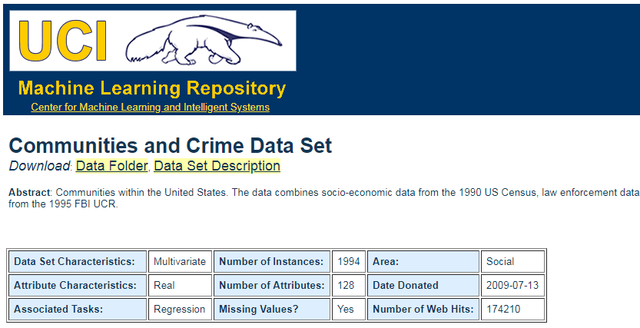
How will we obtain the data?
Primary focus: Random sampling
https://archive.ics.uci.edu/ml/datasets/communities+and+crime
Why Random?
Our Source:
Outcome:
Violent Crimes/capita
@ Sanjay Tiwari

Slide 3
How large a sample will we use
Our problem set: "Multiple Linear Regression"
As per the book (pg. 538) there are several rules of thumb and simpler the better would be obvious choice, which comes out to 10 per predictors.
We know our k, N and effect sizes we can also estimate an appropriate value using k/(N-1) formula. Here, k is # of predictors, N is sample size.
For k = 127, N = 1994, This gives us expected R for random data = 0.06, closer to 0 would be ideal.
@ Sanjay Tiwari

Slide 4
How large a sample will we use…
Right Sample Size
Factors to Consider
Existing Information
Difficulty of Data Collection
Precision of Final Estimates
Necessary Sample Size :
Necessary Sample Size = (Z-score) * SD*(SD) / (margin of error)
With 95% confidence level, .5 standard deviation, and a margin of error (confidence interval) of +/- 5%.
We get 385 minimum respondents
@ Sanjay Tiwari

Slide 5
References
Importance and effect of sample size:
Sample Size for Multiple Regression Accurate, Not Simply Significant: https://www3.nd.edu/~kkelley/publications/articles/Kelley_Maxwell_2003.pdf
@ Sanjay Tiwari

