Slide 1
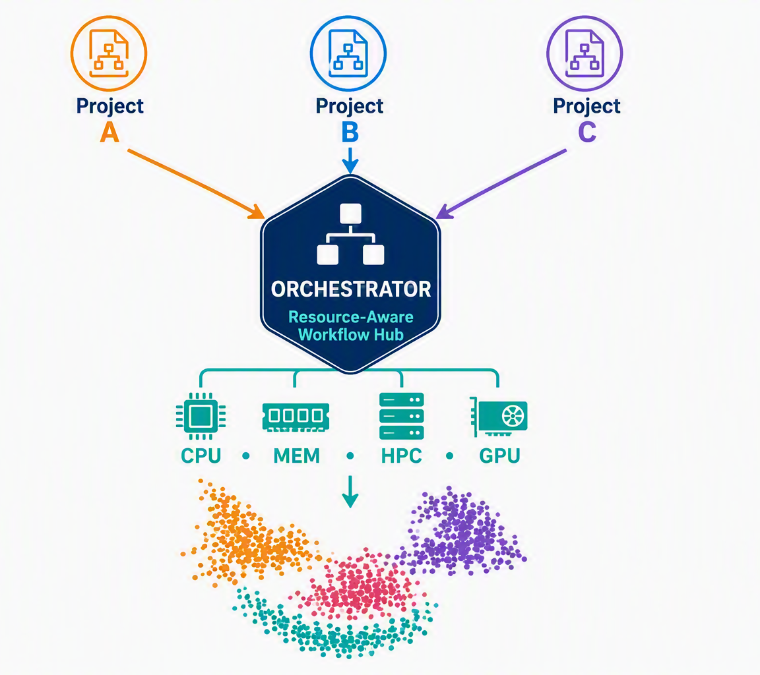
ResMetis
Resource-Aware Multi-Project Orchestrator for Single-Cell Analysis
St. Jude BioHackathon 2026 Project
Kids26 Team 15
September 16-18, 2026

Slide 2
Today’s Agenda Items
St. Jude BioHackathon 2026 Project Kids26 Team 15
Confirm access to tools, apps etc
Project: scope, timeline, responsibilities
Tools and resources

Slide 3
Kids26 Team 15 – let’s get to know each other!
Antonia Chroni, PhD, Technical Contributor and Project Lead. Lead Bioinformatics Research Scientist, Department of Developmental Neurobiology, St. Jude Children's Research Hospital.
Sarthak Sunil Dhanke, Technical Contributor. Research Assistant, University of Chicago.
A. S. M. Tanjim Hassan, Technical Contributor. Undergraduate Student, University of Dhaka.
Rachana Pandey, Technical Contributor. Graduate Research Assistant, University of Minnesota, Twin Cities.
Rojina Sapkota, Data Explorer, Technical Contributor. Bioinformatics Analyst, St. Jude Children's Research Hospital.
Jason Vu, Technical Contributor. St. Jude Children's Research Hospital.
Lindsey Warren, Technical Contributor. Enterprise Architect. International Paper.
For more information, see BioHackathon list.

Slide 4
Kids26 Team 15 – pending tasks due 09/04/2026
In Person Attendance
Accepted your GitHub invitations?
Added in the Slack channel of team15? This will be used for our communication moving forward.
Added in the GitHub team and repo: https://github.com/stjude-biohackathon/KIDS26-Team15
Technical skills - go through them on excel file with everyone
Explain pairs and responsibilities
GitHub experience
sc-rna-seq data analysis experience
For more information, see dropbox excel file.

Slide 5
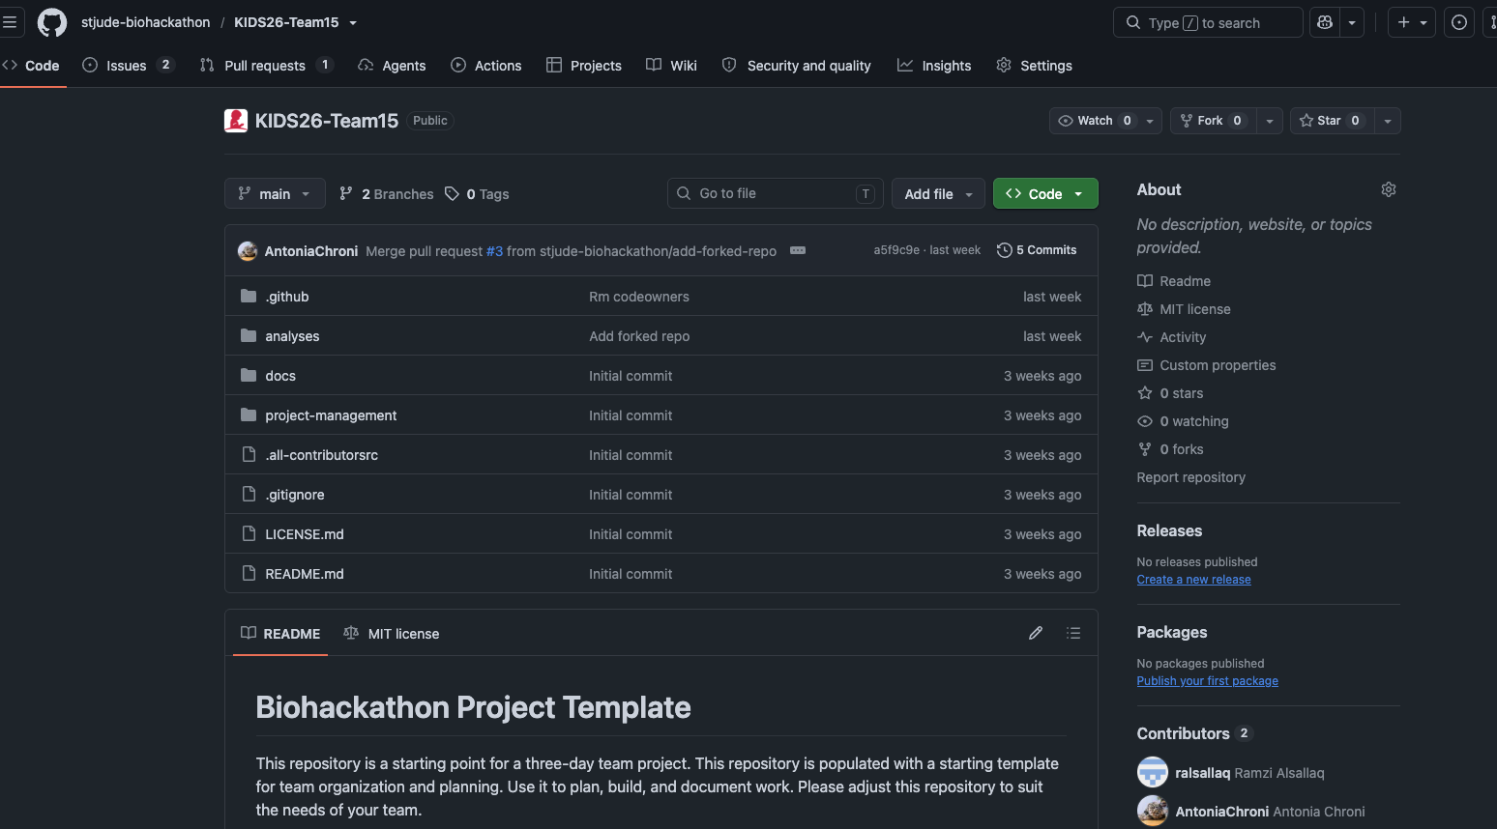

GitHub repo: https://github.com/stjude-biohackathon/KIDS26-Team15

Slide 6
GitHub repo: https://github.com/stjude-biohackathon/KIDS26-Team15
docs – resources and tools we will use during the event – go through it and let me know if you have any questions by 09/10/2026
project-management – follow-up with you by 09/10/2026.
https://github.com/stjude-biohackathon/KIDS26-Team15/pull/7

Slide 7
Tools and resources
vm-local-only-setup.md – follow-up with you by 09/10/2026. Everyone will have to test access to the VM and dry-test software/tools as needed by 09/15/2026 to allow for troubleshooting.
Personal laptops
HPC-StJude User

Slide 8
BioHackathon Project Timeline
Day 1 | 4 hours: Project Setup and Planning
Align on project goals and expected demo outcome
Define team roles and responsibilities
Finalize the technical approach
Set up the development environment and begin implementation
Day 2 | 8 hours: Core Development and Testing
Implement the main project components
Integrate team contributions
Test and troubleshoot the workflow
Document key decisions, limitations, and results
Start preparing the demo
Day 3 | 4 hours: Finalize, Demo, and Present
Complete final testing and documentation
Prepare the demo and required 3-slide presentation
Select 2 to 4 team members to present
Practice the 2-minute lightning presentation

Slide 9
BioHackathon Project Timeline
Day 1 | 4 hours: Project Setup and Planning
Align on project goals and expected demo outcome
Define team roles and responsibilities
Finalize the technical approach
Set up the development environment and begin implementation
Day 2 | 8 hours: Core Development and Testing
Implement the main project components
Integrate team contributions
Test and troubleshoot the workflow
Document key decisions, limitations, and results
Start preparing the demo
Day 3 | 4 hours: Finalize, Demo, and Present
Complete final testing and documentation
Prepare the demo and required 3-slide presentation
Select 2 to 4 team members to present
Practice the 2-minute lightning presentation
3:00–4:00 PM | Project Demo
Deliver a 2-minute lightning presentation to the judges
Move to the assigned room for the project demonstration
Answer questions and receive feedback
4:00–6:00 PM | Demo Lightning Session
Present what the project was about and what was accomplished
Judges provide additional feedback

Slide 10
ResMetis: Smarter Resources. Faster Workflows. Scalable Science. 🚀🧬
Resource-Aware + Metis (Greek goddess of wisdom and strategy)
Wisdom-Driven Resource Orchstration for Single-Cell Analysis
Inspired by Metis (Μῆτις), the Greek goddess of wisdom and strategic planning, ResMetis intelligently coordinates computational resources to optimize and scale multi-project single-cell workflows.

Slide 11

Any ideas are on the name, logo, or other are welcome!
ResMetis: Smarter Resources. Faster Workflows. Scalable Science. 🚀🧬
Resource-Aware + Metis (Greek goddess of wisdom and strategy)
Wisdom-Driven Resource Orchstration for Single-Cell Analysis
Inspired by Metis (Μῆτις), the Greek goddess of wisdom and strategic planning, ResMetis intelligently coordinates computational resources to optimize and scale multi-project single-cell workflows.

Slide 12
Current Workflow Landscape and Key Limitations
1. Current Pipeline Workflow
Demonstrate the sc-rna-seq-snap pipeline through GitHub
Focus on one or two representative modules:
Upstream analysis
Integrative analysis
2. Resource Allocation Challenges
LSF resource requests are based on pipeline defaults and may not be optimal for every project
Current sc-rna-seq-snap defaults are designed for approximately:
8 samples
50,000 cells
Projects with different dataset sizes or algorithmic requirements may encounter resource bottlenecks
Individual steps may fail when memory, CPU, or runtime requirements exceed the default allocations
Resource requirements are difficult to predict because they depend on the dataset and the single-cell algorithms used

Slide 13
Current Workflow Landscape and Key Limitations
3. Current Configuration Approach
Resource parameters are defined as global values in YAML configuration files
Future direction: use an R package to support more adaptive, project-specific resource estimation
4. Pipeline Execution Options
Run a single project or pipeline
Module-level execution: root_dir/analyses/<module_name>/lsf-script.txt
Full-pipeline execution: root_dir/launch_full_pipeline.sh
Run multiple projects
launch_project_multiple.sh
Run multiple pipelines
Not currently supported
5. Demonstration Dataset. Use the Victoria Knockout project as the initial test case
Notes:
The current workflow supports single-pipeline and multi-project execution, but resource allocation remains static and pipeline-specific, limiting scalability and reliability across heterogeneous single-cell projects.

Slide 14
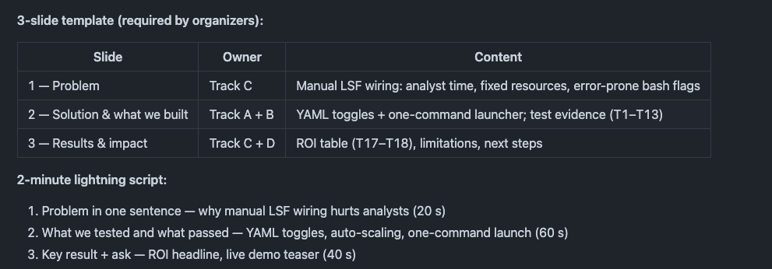
Lightning presentation

Slide 15
Example slide 1
Problem: Manual LSF wiring slows single-cell analysis
KIDS26 Team 15 — Resource-Aware SNAP + Sprocket Orchestrator
Running SNAP downstream today means manual LSF jobs: separate bsub calls, hand-wired dependencies, and per-module resource guessing
Analysts spend ~6–8 hours per run on setup, retries, and YAML edits (lsf-script.txt, future.globals)
Resources are fixed (e.g. 16 CPU / 30 GB) even when the cohort needs less — leading to wasted cores or failures
No pre-submit validation — errors surface only after jobs are queued on HPC
Notes:
Slide 1 — Problem (~30 sec)
Track C opens
"Hi everyone — I'm [name] from Track C. Our project asks a simple question: can we replace manual LSF wiring for SNAP single-cell analysis with something faster and more reliable?
Today, running SNAP downstream means separate bsub jobs, hand-wired dependencies, and guessing CPU and memory. That costs analysts six to eight hours per run, and fixed resources like sixteen cores often waste cluster capacity or cause OOM failures. There's no validation before submit — you find out something's wrong only after the job is queued.
That's the problem we're here to fix."

Slide 16
Example slide 1
Problem: Manual LSF wiring slows single-cell analysis
KIDS26 Team 15 — Resource-Aware SNAP + Sprocket Orchestrator
Running SNAP downstream today means manual LSF jobs: separate bsub calls, hand-wired dependencies, and per-module resource guessing
Analysts spend ~6–8 hours per run on setup, retries, and YAML edits (lsf-script.txt, future.globals)
Resources are fixed (e.g. 16 CPU / 30 GB) even when the cohort needs less — leading to wasted cores or failures
No pre-submit validation — errors surface only after jobs are queued on HPC
Can a resource-aware SNAP + Sprocket orchestrator replace manual LSF wiring for scalable single-cell analysis?
This is an analyst time + cluster waste, not just a tooling upgrade.

Slide 17
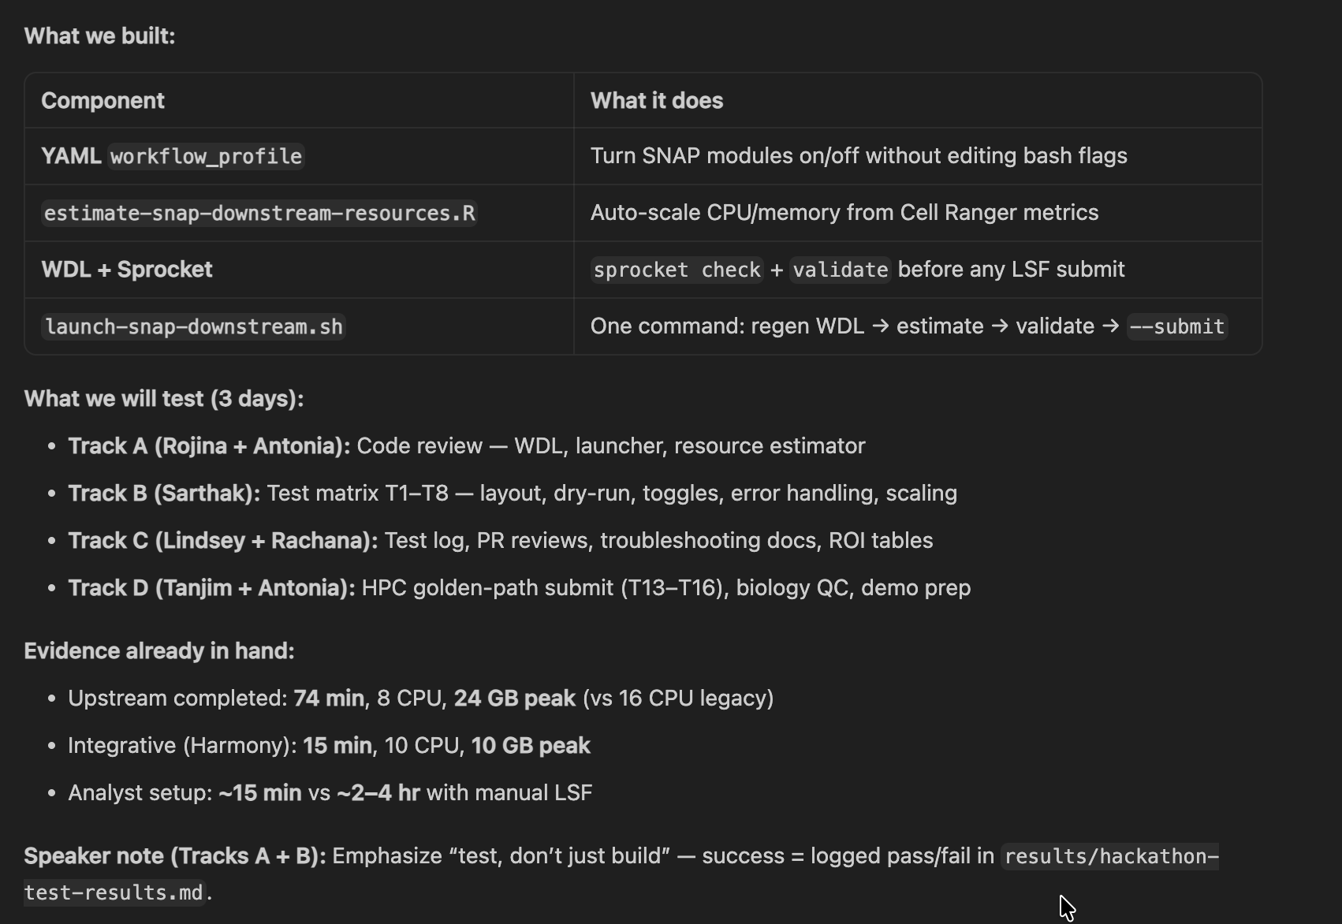
Example slide 2
Solution & What We Built: One YAML + one command — validated before submit
launch-snap-downstream.sh on Victoria Knockout cohort (4 samples · ~21k cells)
Notes:
Slide 2 — Solution & What We Built (~30 sec)
Tracks A + B — split or one speaker
"I'm [name] from Track [A/B]. We built launch-snap-downstream.sh — one command that reads a YAML workflow_profile, auto-scales resources from Cell Ranger metrics, regenerates WDL, and runs sprocket validate before anything hits LSF.
On Victoria Knockout — four samples, about twenty-one thousand cells — upstream already ran in seventy-four minutes on eight cores with twenty-four gig peak memory, versus sixteen fixed cores in the legacy path.
Over three days, each track has a job: Rojina and Antonia review the code, Sarthak runs the test matrix, Lindsey and Rachana own docs and the test log, and Tanjim plus Antonia handle HPC submit and the demo. Success means every test logged with pass or fail evidence."

Slide 18
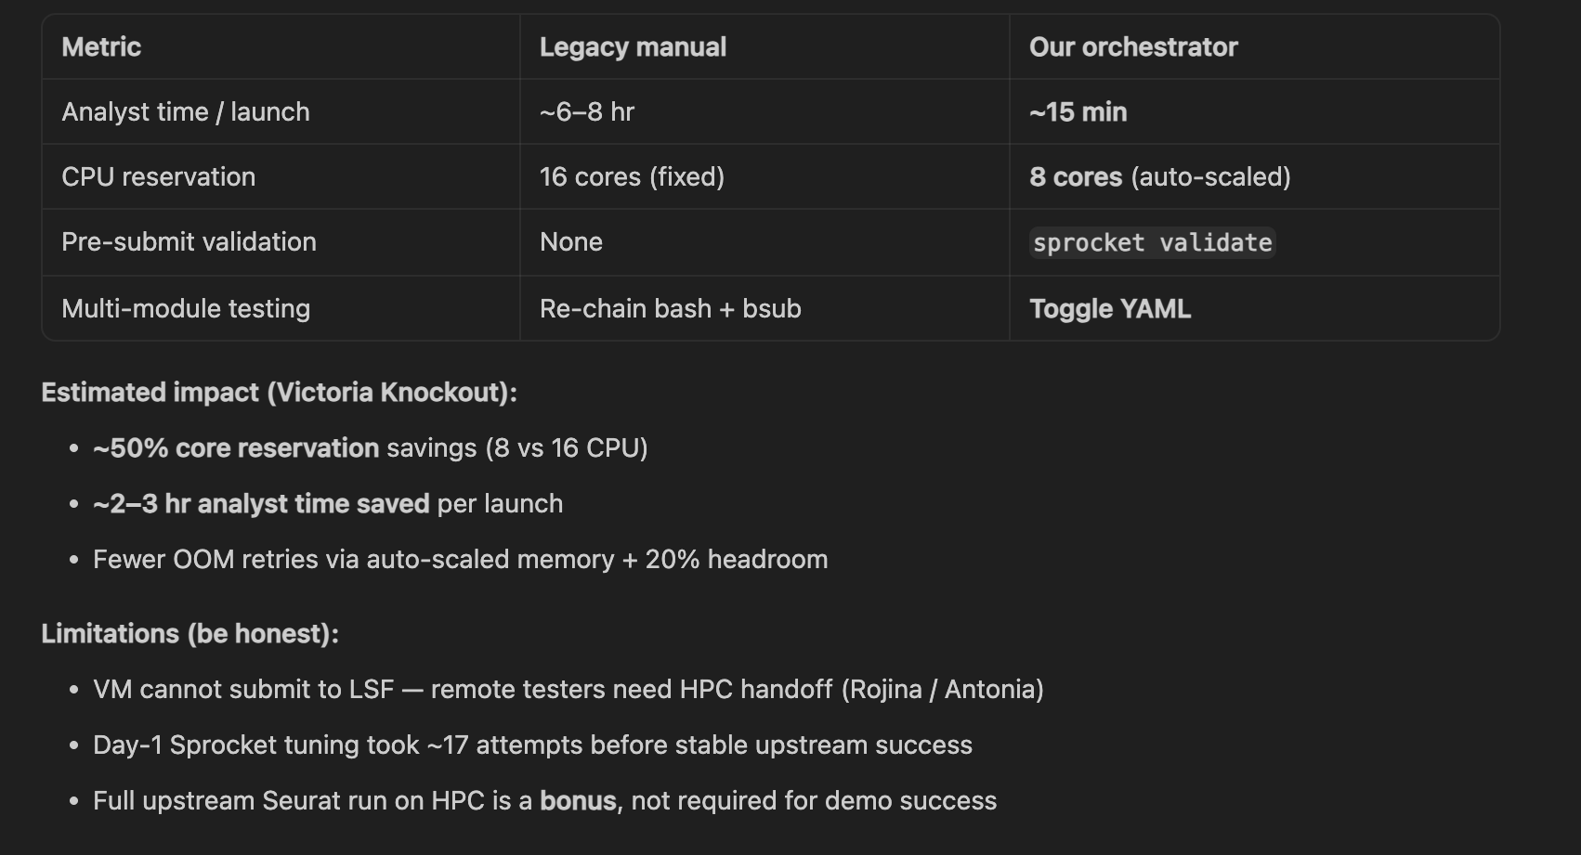
Example slide 3
Results & Impact: ROI, limitations, and next steps
Results we aim to show judges (Day 3, 3:00–6:00 PM):
Next steps
Other SNAP modalities — extend to automated sc-ATAC, sc-PARSE, and other pipelines (validated here on sc-RNA-seq)
Multi-omics — combined workflows, e.g. sc-RNA-seq + sc-ATAC, under one resource-aware launcher
Multiple projects — parallel cohort runs via snap_multi_project.wdl
Production — CI layout check; rollout to additional SNAP projects at St. Jude
Notes:
Slide 3 — Results & Impact (~30 sec)
Tracks C + D close
Slide 3 — Speaker script (~30 sec, updated)
I'm [name] from Track [C/D]. If our tests hold up, analyst setup drops from hours to about fifteen minutes, core reservations cut roughly in half, and YAML toggles replace re-chaining bash jobs.
We'll be honest about limitations — VMs can't submit to LSF, and our first Sprocket runs needed tuning. A full Seurat finish on HPC is a bonus, not required.
Looking ahead: this workflow is tested on our automated sc-RNA-seq pipeline, but the same pattern extends to sc-ATAC, sc-PARSE, and other modalities — plus multi-omics runs like sc-RNA with sc-ATAC, and multiple projects in parallel. Day three at three PM we present to judges. Log everything in hackathon-test-results.md and flag blockers early.

Slide 19
3-day plan:
Day 1 (4 h): Clone, smoke tests (T1–T2), confirm pairs
Day 2 (8 h): Full test matrix, docs, draft this deck
Day 3 (4 h + demo): Finalize 3 slides, 2-min lightning talk, live demo for judges
Speaker note (Tracks C + D): Slide 3 is partly aspirational for kickoff — update numbers from hackathon-test-results.md before the judge session.

