Slide 1
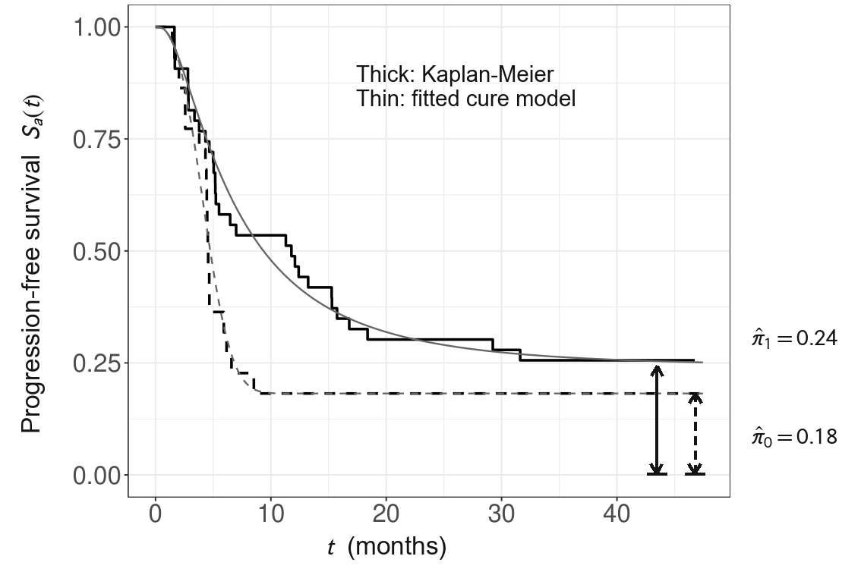
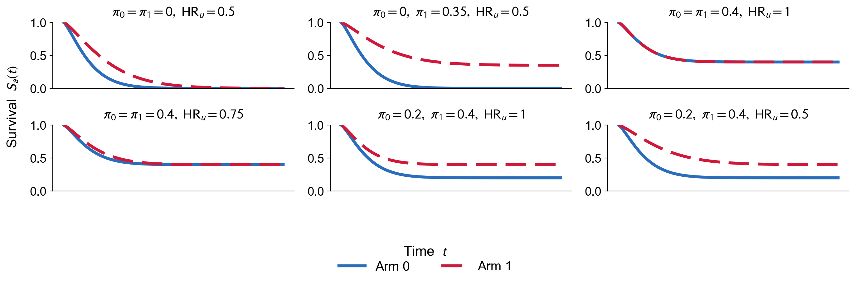
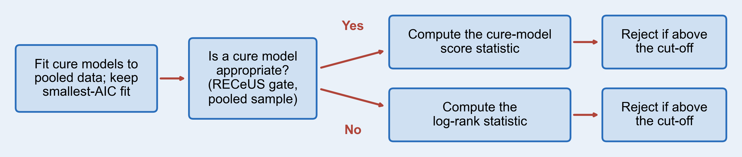
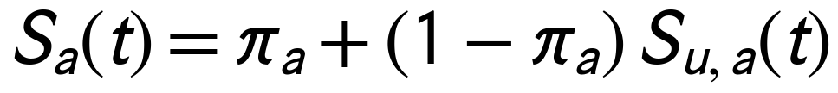
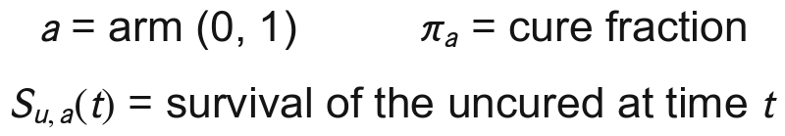

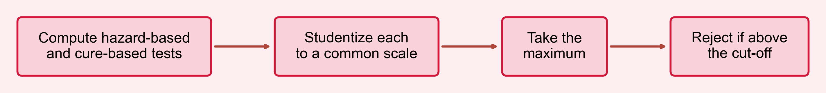
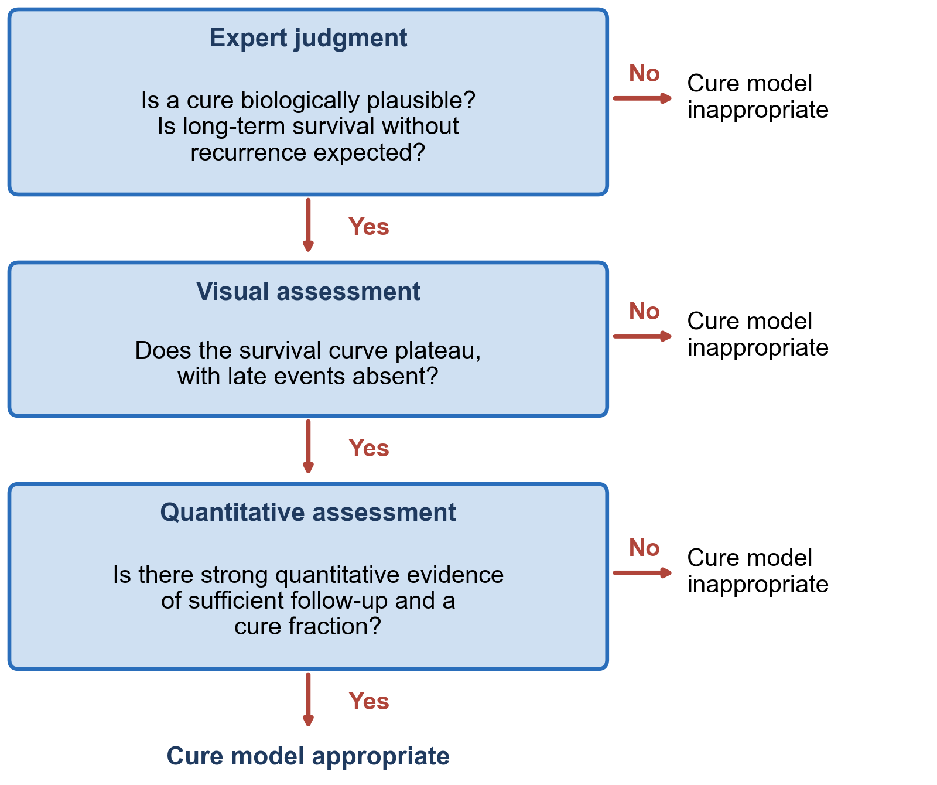
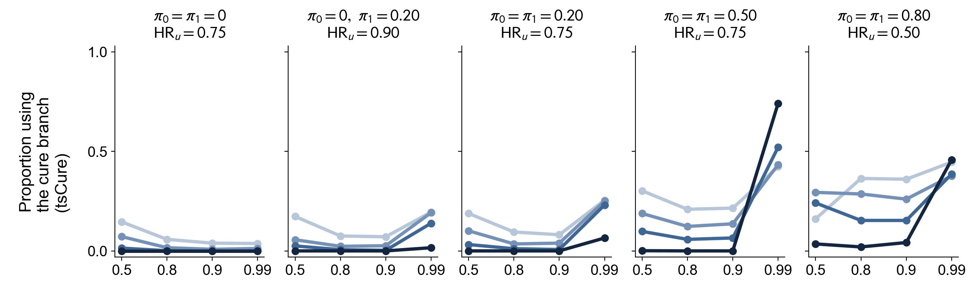
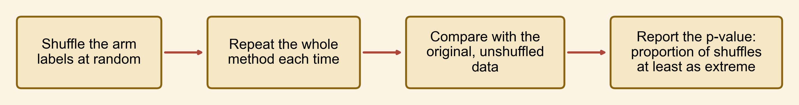
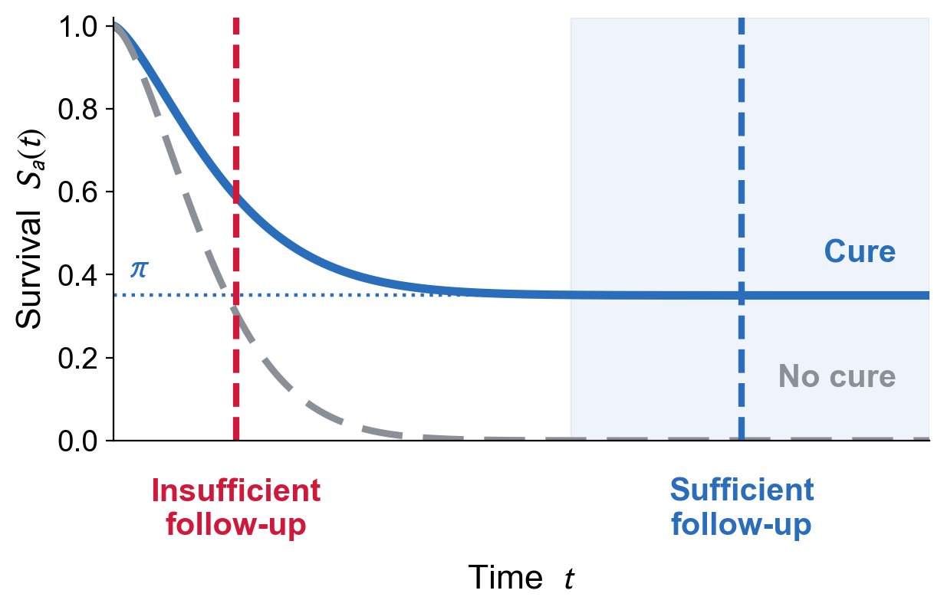
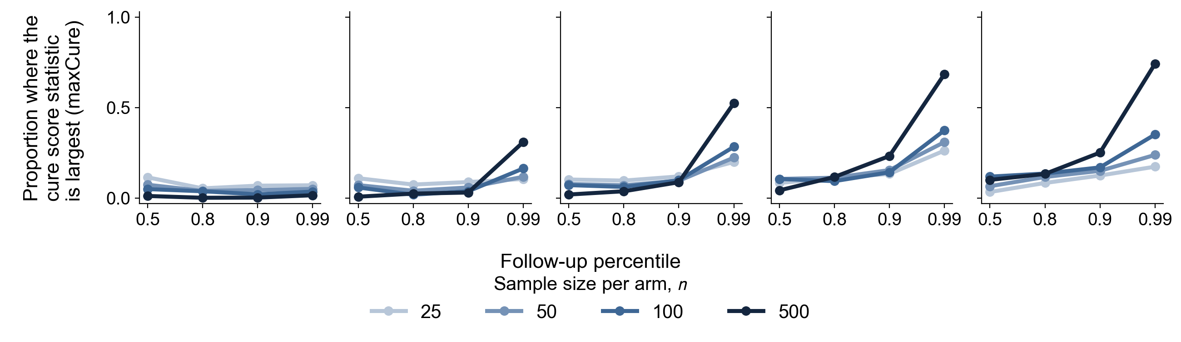
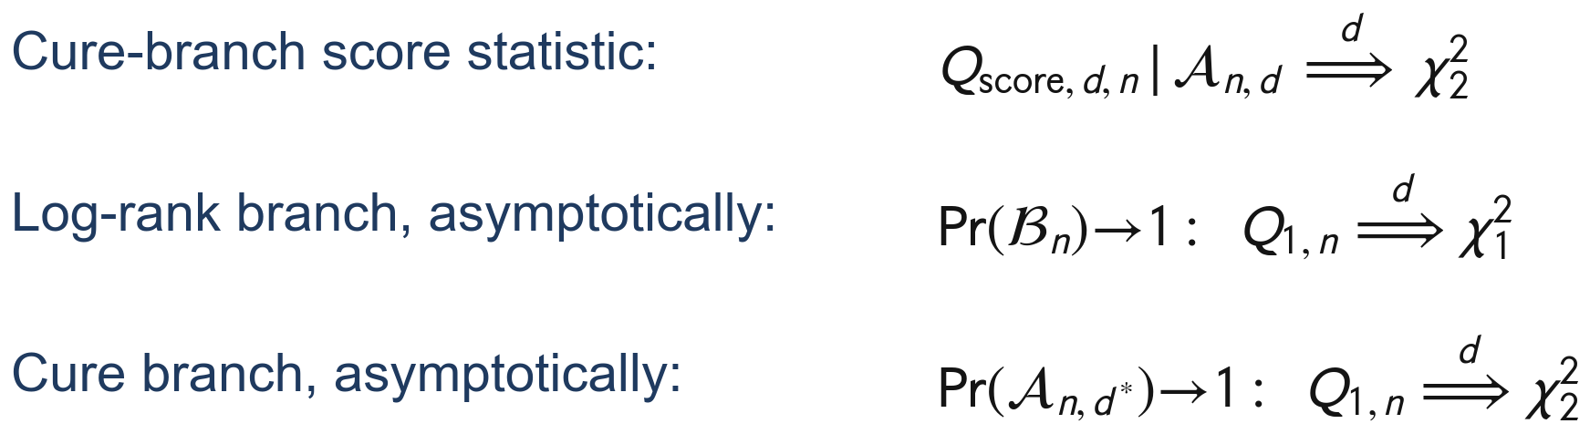

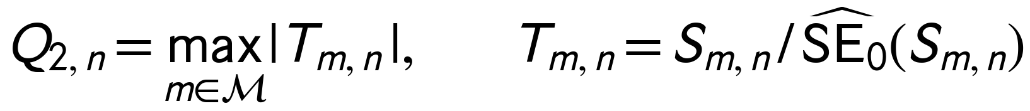
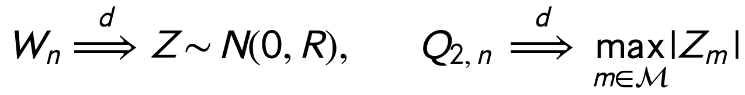
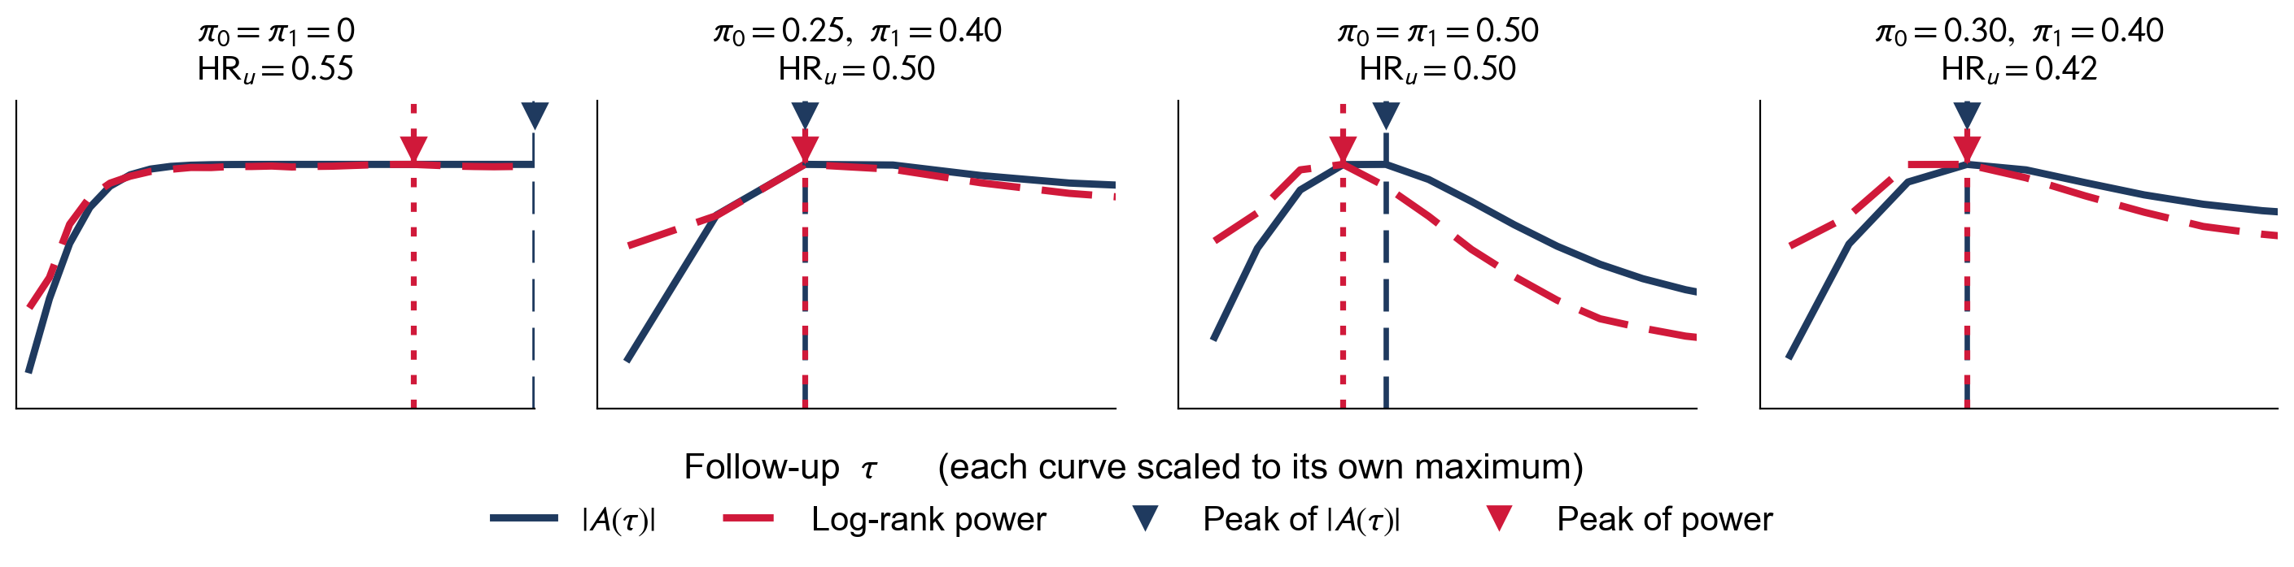
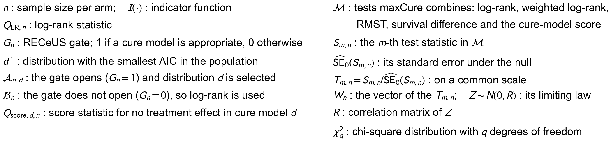

Two-Sample Inference with Long-Term Survivors
Department of Biostatistics, St. Jude Children’s Research Hospital, Memphis, TN
Durbadal Ghosh, Yu Bi, Subodh Selukar
LONG-TERM SURVIVORSHIP IN PEDIATRIC ONCOLOGY
PROPOSED METHODS
SIMULATION DESIGN: SELECTED SETTINGS
• Long-term survivors are common in pediatric oncology.
▪ CNS germinoma: 3-year event-free survival near 95% (COG ACNS1123).
▪ Relapsed neuroblastoma: BEACON-Immuno trial, shown at right.
• Standard survival methods may not appropriately model data with long-term survivors.
• Cure models estimate the cure fraction and the survival of the uncured separately.
Method 1 · Two-stage Cure (tsCure)
Mixture cure model
Design at a glance
• Cure fraction: 0 to 0.80 in each arm; uncured hazard ratio 0.50 to 1.
• Sample size: 25 to 500 per arm; follow-up at the 0.5 to 0.99 uncured-survival percentiles.
• Candidate uncured distributions: exponential, Weibull, log-normal.
• Replicates: 1,000 per setting, each with 1,000 permutations.
• Benchmarked against: log-rank; early and late weighted log-rank; optimal log-rank; adaptive Yang-Prentice; correctly specified mixture-cure test.
KEY ASSUMPTIONS FOR CURE MODELS
Method 2 · Standardized Maximum (maxCure)
• Cure models add two assumptions to those of standard survival models:
▪ A non-zero fraction of the population never experiences the event.
▪ Follow-up is long enough to identify the cure fraction.
• Violating either assumption gives misleading results:
▪ With short follow-up, the estimated cure fraction and mean survival are biased.
▪ If the uncured-survival distribution is wrong, predictions beyond the observed data are unreliable.
Cure-model appropriateness
PRELIMINARY RESULTS
Calculate p-values by permutation testing (both methods)
MATHEMATICAL DETAILS AND JUSTIFICATION
Method 1 · Two-stage Cure (tsCure)
EXISTING TESTS FOR DATA WITH LONG-TERM SURVIVORS
Goal: two-sample hypothesis test
DISCUSSION AND FUTURE WORK
Method 2 · Standardized Maximum (maxCure)
• Full simulation results and a data application are in progress.
• The gate can misclassify borderline datasets, so performance depends on selecting the gate and the model correctly.
• The permutation test needs further study, especially in small samples.
• A(τ) could be used to choose between log-rank-based and cure-based tests for a given dataset.
• Extending to covariate adjustment and unequal allocation is a natural next step.
Key finding: no method is uniformly best
A(τ) predicts the shape of log-rank power
• Hazard-based tests gain power up to a moderate follow-up, then lose it when both arms contain long-term survivors.
• A correctly specified cure-model test instead gains power monotonically with follow-up.
• A(τ) is a weighted mean difference between hazards that approximates the expectation of the log-rank test statistic.
REFERENCES AND ACKNOWLEDGMENTS
Notation
• Special thanks to Dr. Subodh Selukar, my supervisor.
• Thanks to all my coauthors.
• Mentoring committee: Dr. Tomi Mori, Dr. DeoKumar Srivastava, Dr. Sedigheh Mirzaei, Dr. Akshay Sharma, Dr. Gabriela Maron.
• Funding: ALSAC.
• References are in the manuscripts linked by the QR codes.

