Slide 1

Swetank Kakarla

Slide 2
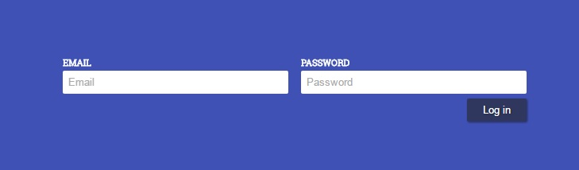
Username: <Your personal email id>
Password: Password@2016
<‘P’ uppercase>

Slide 3
Closed items: Items that are closed.
Resolved items: Items that are resolved.
All: Shows all items in the bucket that are reliable on you.
Assigned to You: Shows all items that you are responsible for [Subordinates, Under your hierarchy].
Cancel edits: Every cell you edit, there will be a red flag on your top left of the cell. Save or cancel will remove that flag.
Save changes: Save every time you make changes to the rows
Create New Record: Ideally not required.

Slide 4
Grid header names | Purpose
Name | Name of the item
ExternalUId | A unique Id <TicketNo.>
Manager | Manager of that item
CreatedDate | Creation date of the item
WorkType | The type of request it is
Duration | Estimated duration in minutes to meet Current Review Date
CurrentReviewDate | Dynamic estimated review date
OriginalReviewDate | Originally estimated review date
Status | Current status of the item
CurrentTargetDate | Dynamic estimated target date
OriginalTargetDate | Originally estimated target date
DelayCause | Cause of delay, mandatory if duration is increased and review/target dates are postponed.
QualityAnalyst | The manager responsible for QA
QAStatus | The Status of QA
HandoverTo | The item is handed over to
Requester | The requester
Business | Business category of the item
Shift | Shift that item belongs to
Country | Country the item belongs to

Slide 5
Shift | Requesters | Coordinators | Assignees
APAC | Samiksha <samiksha.more08@gmail.com> | Neeraj <neerajshah1703@gmail.com> | Purnima <dhokepurnima@gmail.com>
 |  |  | Shefali <shefalilad@gmail.com>
EMEA | Anuja <sinkaranuja@gmail.com> | Amit <aarth.dude@gmail.com> | Dinesh <dineshk.rana@hotmail.com>
 |  | Nitin <nits2284@yahoo.com> | Swetank <stk26kakarla@gmail.com>
 | Mandar <mandardalvi2005@gmail.com> | Sagar <sagargaikwad90@gmail.com> | Purva <purvapsk14@gmail.com>
 |  |  | Nikita <nikitagambhirrao@gmail.com>
NA | Vaibhav<vvmestry@gmail.com> | Sunil<snl.kesarkar@gmail.com> | Rahul <chaudharirahuls14@gmail.com>

Slide 6
Requester (Role of Client/Stake holders) | Coordinator (Role of Shift/Team leads) | Assignee (Role of Executioner)
Portray all case scenarios that has been experienced
Raise new requests using personal email ids provided to www@nieto.in
Do not use any confidential content provided by Shell
Dummy documents to be used as attachments
 | Assign new requests based on shift/urgency/availability.
 | Acknowledge client
 | Mark shift lead's personal email ids in CC (as followed)
 |  | Portray to complete the execution of request
 |  | Pass on for QA
 |  | Reply to acknowledgement to get approved by requesters

Slide 7
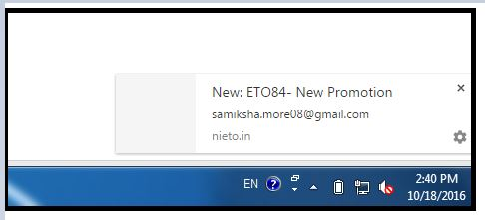
Desktop Notifications
New request in Eto

Slide 8
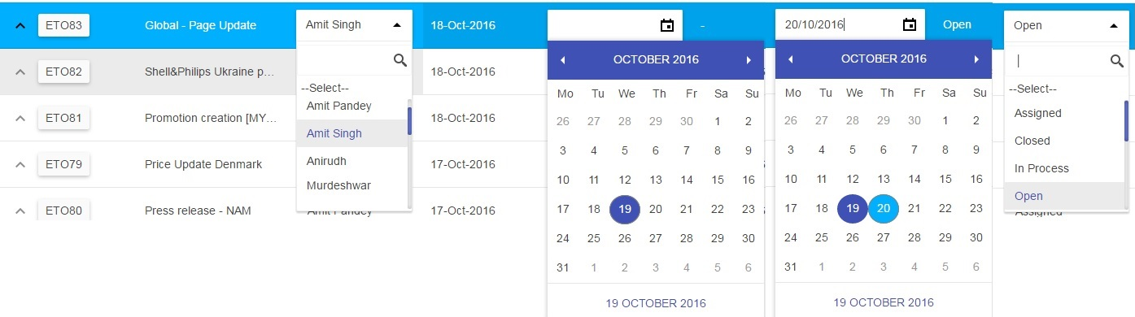
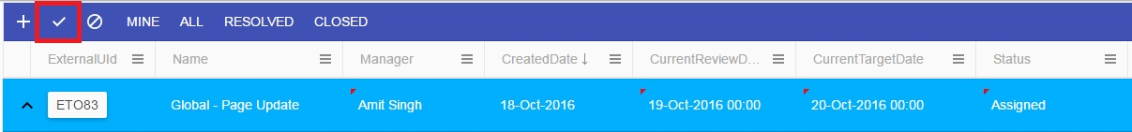
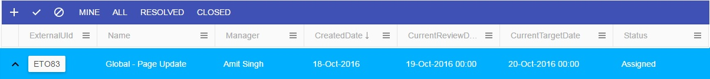

Slide 9
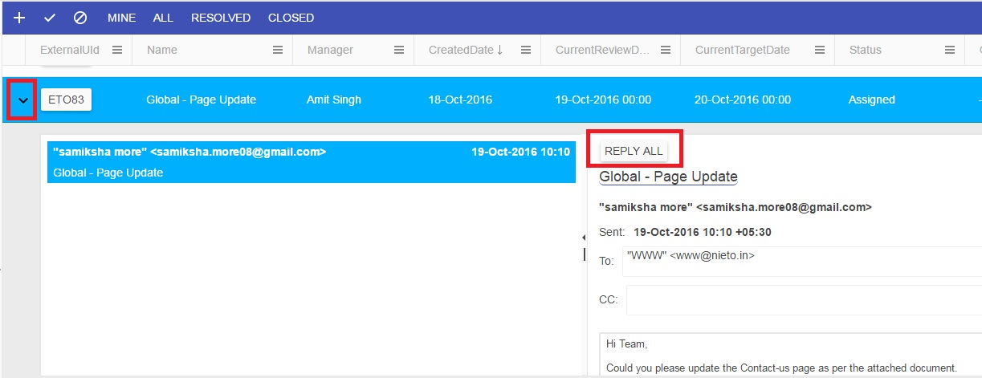

Slide 10
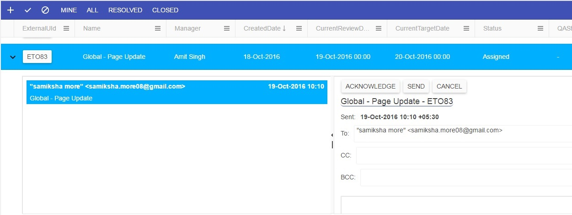

Slide 11
