Slide 1
How Do Developers' Profiles and Experiences Influence their Logging Practices? An Empirical Study of Industrial Practitioners
Guoping Rong¹, Shenghui Gu^{1,*}, Haifeng Shen², He Zhang¹, Hongyu Kuang¹
1. The State Key Laboratory for Novel Software Technology, Nanjing University, Nanjing, China.
2. The HilstLab, Peter Faber Business School, Australian Catholic University, Sydney, Australia.
Notes:
Good afternoon, everyone.
I'm delighted to be here today to present our research on an important topic in software engineering: logging practices.
As you may know, logging is an essential part of software development as it helps developers identify and fix code issues.
However, developers' intentions and concerns in logging may not be effectively implemented in source code due to individual variations.
Through our empirical study involving industrial practitioners, we aim to explore how developers' profiles and experiences impact their logging practices in real-world industrial projects, with a focus on logging intentions and concerns.
In this presentation, I'm gonna provide an overview of our research and share our main findings.
We hope that our study can shed light on the factors that shape logging practices in industry and provide insights into how developers and organizations can improve their logging practices to boost software quality and developer productivity.

Slide 2
01
Introduction
02
Research Method
03
Results & Discussions
04
Conclusions
Notes:
To give you a preview, I'm gonna start by introducing the background and motivation of our research, as well as our research methodology, including our research questions and process.
Then, I'm gonna dive into our main findings and offer suggestions for improving logging practices.
Finally, I'm gonna summarize our study and draw a conclusion.
So, let's get started!

Slide 3



Background
1. Introduction
I&Cs
Troubleshooting
Monitoring
…
Logging
Intentions
Engineer
I/O overhead
CPU overhead
…
Concerns
Notes:
As a common type of software runtime data, logs record how a software system behaves and they are crucial for development and operations.
Usually, developers create logs by adding log statements in the code, which is known as logging practice.
Developers have clear intentions for logging, such as detecting faults or monitoring system status, but they also consider concerns associated with logging, such as performance overhead like I/O overhead and CPU overhead.
Both intentions and concerns should be considered to balance between the benefits and costs of carrying out logging practices.

Slide 4

Background
1. Introduction
I&Cs
?
Logging
Intentions
Engineer
Source Code
Concerns
Notes:
However, even with advanced logging frameworks and tools, developers may not fully realize their logging intentions and concerns in the code.
The mainstream logging practices still require developers to manually inject log statements, which can vary depending on an individual's profile and experience.

Slide 5


Background
1. Introduction
I&Cs
Role
Working years
Intentions
Profile
Timing of conducting logging practices
Whether to follow logging guidelines
Concerns
Experience
Notes:
For example, developers should determine the context and content of a log statement.
The developer's profile may refer to their roles within the team or the number of years they have been working.
And their experience may influence decisions on when to perform logging practices and whether to follow established logging guidelines.

Slide 6



Motivation
1. Introduction
?
Generalize
Single Company
Multiple Companies
?
Influence
Profile
Understand
Logging Practices
Research
Experience
Notes:
To solve this problem, some researchers have suggested that logging should adopt the best practices.
This highlights the need to understand how developers inject log statements in terms of their thinking process, design, and implementation.
Because practical experience demonstrated that merely addressing the problems does not significantly improve the current situation.
But, unfortunately, there have been only a few empirical studies conducted to investigate developers' logging practices in industry.
These studies have only surveyed developers from a single company, which limits their generalizability to other settings.
Furthermore, no research has been done to explore how developers' logging practices are affected by their individual profiles and experiences, particularly regarding their logging intentions and concerns.
We aim to establish a more comprehensive understanding, providing insights for the improvement of future logging practices.
This is precisely the motivation behind our research endeavor.

Slide 7

Motivation
1. Introduction
?
Logging Practices
Generate
High-quality logs
?
Single Company
Generalize
Multiple Companies
?
Profile
Research
Understand
Logging Practices
Influence
Experience
Notes:
As a consequence, the effectiveness and quality of the generated logs can vary widely with manual logging practices.
And there is a widespread acknowledgment that the quality of logging practices is inadequate.
To solve this problem, some researchers have suggested that logging should adopt the best practices.
This highlights the need to understand how developers inject log statements in terms of their thinking process, design, and implementation.
Because practical experience demonstrated that merely addressing the problems does not significantly improve the current situation.
But, unfortunately, there have been only a few empirical studies conducted to investigate developers' logging practices in industry.
These studies have only surveyed developers from a single company, which limits their generalizability to other settings.
Furthermore, no research has been done to explore how developers' logging practices are affected by their individual profiles and experiences, particularly regarding their logging intentions and concerns.
We aim to establish a more comprehensive understanding, providing insights for the improvement of future logging practices.
This is precisely the motivation behind our research endeavor.

Slide 8
01
Introduction
02
Research Method
03
Results & Discussions
04
Conclusions

Slide 9
Research Questions
2. Research Method
RQ1: How do developers' profiles influence their logging I&Cs?
RQ2: How do developers' experiences influence the way their logging I&Cs are fulfilled?
RQ2.1: How much are logging I&Cs satisfied in log statements?
RQ2.2: How do development stages in which logging I&Cs are fulfilled influence the degree of satisfaction?
RQ2.3: What role do logging guidelines/coding conventions play in the fulfillment of logging I&Cs?
Notes:
To reach our research goal, we formulated two research questions.
The first question investigates how developers' profiles impact their logging intentions and concerns.
And the second question looks at how developers' experiences shape their fulfillment of logging intentions and concerns.

Slide 10













Research Process
2. Research Method
Questionnaire: 91 responses from 42 companies
Refine
Survey questions
Pilot questionnaire
distribution
Questionnaire
assessment
Questionnaire
distribution
Questionnaire data
Research goals
Research questions
Data synthesis
and analysis
Findings
Interview script
Pilot interview
Interview script
assessment
Interview execution
Interview transcript
Refine
Interview: 20 interviewees from 12 companies
Code review
Follow-up interview
Notes:
In this research, we employed a mixed-method study that combined a structured questionnaire survey, a series of semi-structured interviews, and code analyses.
The questionnaire survey received 91 valid responses across 42 companies, while the interviews involved 20 interviewees from 12 different companies.

Slide 11
01
Introduction
02
Research Method
03
Results & Discussions
04
Conclusions
Notes:
Now let's move on to our main findings.

Slide 12
Relationship between developers’ profiles and their logging I&Cs
3. Results & Discussions
Developers with specific roles may have additional intentions.
NO clear relationship between developers' concerns and their roles, however, the focus of each role’s concerns is NOT consistent.
Novice (<1 year) hardly consider any security risk.
Non-novice (>1 year) are more concerned about all types of identified logging side effects.
Notes:
First, let me share with you the main findings on developers' logging intentions and concerns and how they relate to developers’ profiles.
We find that the majority of developers have two main logging intentions: troubleshooting and monitoring.
In addition, their primary concerns when logging are related to storage and I/O overhead.
To understand whether developers' intentions and concerns are influenced by their profiles, we analyzed the data by their roles and years of working.
We find that although the primary intentions are consistent among developers, those with specific roles, such as user experience designers, may have additional logging intentions, like analyzing user behavior.
However, there is no clear relationship between logging concerns and roles.
On the other hand, novice developers tend to overlook security risks, while those with more experience are more concerned about various types of logging side effects.
Overall, our research shows that developers' logging intentions and concerns are mostly consistent, but their profiles can influence additional logging intentions and specific concerns.

Slide 13
Extent to which log statements are in line with developers' logging I&Cs
3. Results & Discussions
Over half of the respondents thought log statements were fairly consistent with expectations.
The implementation of log statements differed from developers' previous statement.
Common inconsistencies including:
Missing log statements
Redundant log statements
Wrong level/content of log statements
Security issues
Notes:
Let's talk about how developers perceive the extent to which their logging intentions and concerns are met.
We find that more than half of the developers believed that the information recorded in log statements was consistent with their expectations.
However, our code analysis shows that the actual implementation of log statements in the code was often different from what they had stated before.
So basically, what this means is that developers' log statements might not actually meet their intentions and concerns as well as they think they do.
We also find some common inconsistencies in the code, including missing log statements, redundant log statements, incorrect levels or content of log statements, and even security issues.

Slide 14
Timing of conducting logging practices by developers
3. Results & Discussions
Experienced developers (>10 years) prioritize logging practices in early development stages, resulting in higher satisfaction of fulfilling I&Cs.
Notes:
Now, let's take a look at how developers' experiences affect the fulfillment of their logging intentions and concerns.
When it comes to the timing of conducting logging practices, most developers tend to fulfill their intentions and concerns during the coding stage.
Interestingly, we find that more experienced developers tend to consider logging practices earlier in the development process, and in more stages, than less experienced developers.
In general, the earlier logging is considered, the better the logging practices align with developers' expectations.
This suggests that experience plays an important role in the effective implementation of logging practices.

Slide 15
Role of logging guidelines/coding conventions
3. Results & Discussions
Novice (<1 year) and experienced (>3 years) developers are more prone to accepting logging guidelines than intermediate developers (1~3 years).
Notes:
Then move on to the role of logging guidelines.
We find that almost three quarters of developers followed logging guidelines to a large extent.
The tendency to follow these guidelines is affected by years of experience, as shown in the right figure.
Novice developers recognize the usefulness of logging guidelines more than those with more experience, but, this attitude tends to decrease first and then increase sharply with accumulated years of working experience.

Slide 16
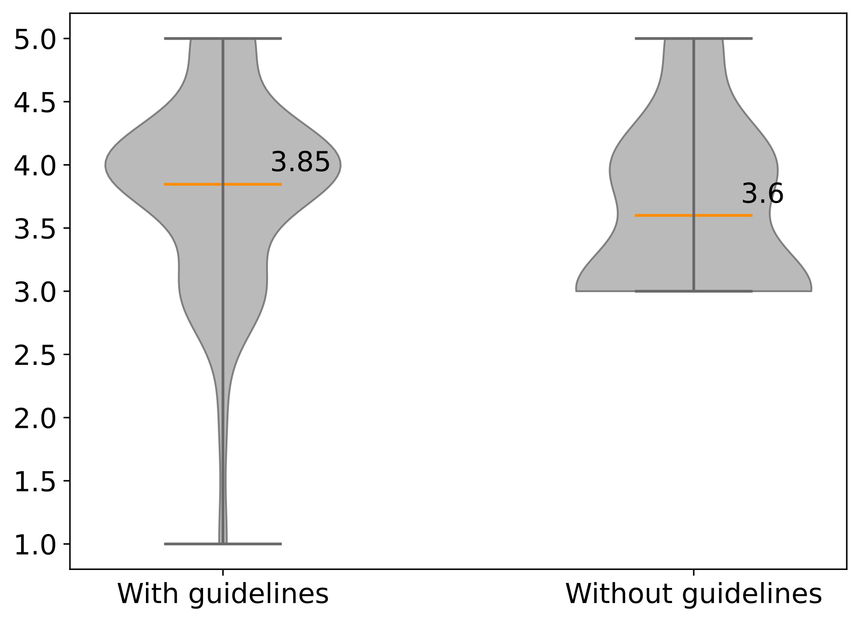
Role of logging guidelines/coding conventions
3. Results & Discussions
Influence of adopting logging guidelines on the fulfillment of I&Cs
Developers who adopt logging guidelines better fulfill their logging I&Cs.
Notes:
This figure illustrates the influence of using logging guidelines on the fulfillment of logging intentions and concerns.
Our analysis shows that developers who use logging guidelines fulfill their intentions and concerns better than those who don't.

Slide 17
Recommended good logging practices
3. Results & Discussions
Create a habit of considering logging in early software development stages.
Adopt available logging guidelines.
Provide appropriate training of logging practices to novice developers.
Provide relevant training or specific guidelines to:
Increase awareness of other side effects for junior developers (1~3 years).
Enhance awareness of security issues for novice developers (<1 year).
Highlight other logging intentions for developers with specific roles.
Notes:
Based on our study, we have several recommendations for improving logging practices.
First, it's important to consider logging early in the development process, for example, starting with requirements engineering.
The earlier logging is considered, the more likely it is to meet developers' expectations.
Second, adopt available logging guidelines such as those that define the severity of a log statement.
Third, provide appropriate training in logging practices to novice developers so they can establish a comprehensive awareness of the importance of logging intentions and concerns.
Fourth, provide relevant training or specific guidelines to raise awareness of other side effects of logging for junior developers in addition to I/O and storage overheads.
It's also important to highlight security issues for novice developers and other logging intentions for developers with specific roles, such as user experience designers.

Slide 18
Recommended good logging practices
3. Results & Discussions
Consider logging in the early stages instead of coding.
Guidelines and training are indeed valuable.
Provide appropriate training of logging practices to novice developers.
Enhance awareness of security issues for novice developers.
Yet we should notice the diminishing marginal effect they may have.
Highlight other logging I&Cs for more experienced developers and developers with specific roles.
Notes:
Based on our study, we have several recommendations for improving logging practices.
First, it's important to consider logging early in the development process, for example, starting with requirements engineering.
The earlier logging is considered, the more likely it is to meet developers' expectations.
Second, adopting available logging guidelines and providing appropriate training in logging practices is indeed valuable, as it helps developers establish a comprehensive awareness of the importance of logging intentions and concerns.
Third, we should notice the diminishing marginal effects of guidelines and training.
Additionally, it is significant to highlight not only the primary logging intentions and concerns but also other relevant ones for non-novice developers and those with specific roles.

Slide 19
01
Introduction
02
Research Method
03
Results & Discussions
04
Conclusions

Slide 20
4. Conclusions
Common I&Cs change over time, such as security risks becoming a major concern. However, prior research has only covered this factor in a small amount of work.
Logging I&Cs are not fully met in industrial projects and depend on early logging practices and adherence to logging guidelines.
Advanced logging practices can be incorporated into logging guidelines to address more sophisticated intentions and concerns effectively.
Supporting tools should also work with certain rules in line with logging guidelines.
Notes:
In summary, our research shows that logging intentions and concerns are not fixed and can change over time.
For example, security risks have become a more common concern recently, yet recent secondary studies indicate that this factor has only been covered in a small amount of work.
Additionally, logging intentions and concerns are only partially fulfilled in industrial projects, and the extent to which they are fulfilled depends on the timing of logging practices and the adoption of logging guidelines.
Logging guidelines serve as a manifestation of logging intentions and concerns during software development, but they may struggle to address advanced requirements.
So, advanced logging practices can be incorporated into these guidelines to address more sophisticated intentions and concerns effectively.
Finally, our survey revealed that most developers believe automatic logging tools and pragmatic logging guidelines can help them fulfill intentions and concerns more easily.
These remarks to a certain degree point out future research directions and research priorities regarding logging tools.

Slide 21
4. Conclusions
A notable gap exists between logging I&Cs and their actual implementation in source code, potentially exceeding expectations.
Common I&Cs change over time.
The fulfillment of I&Cs depends on the timing of logging practices and the adoption of logging guidelines.
While there is no panacea, guidelines and tools are generally recognized as valuable. However,
Existing guidelines and tools may struggle to address advanced requirements.
Limited impact from a management perspective.
Notes:
In summary, our research highlights a notable gap between logging intentions and concerns and the actual implementation in the code.
It is important to note that logging intentions and concerns are not fixed but can change over time.
Moreover, logging intentions and concerns are only partially fulfilled in industrial projects, and the extent to which they are fulfilled depends on the timing of logging practices and the adoption of logging guidelines.
However, despite these challenges, our survey indicates that developers generally recognize the value of logging guidelines and tools.
They serve as a means to express logging intentions and concerns during software development, but it is worth mentioning that they may encounter difficulties in addressing advanced requirements.
Besides, limited impact is observed from a management perspective.
Therefore, it is essential to incorporate advanced logging practices into these guidelines and support them with appropriate tools.

Slide 22
How Do Developers' Profiles and Experiences Influence their Logging Practices? An Empirical Study of Industrial Practitioners
Shenghui Gu: shenghui.gu@smail.nju.edu.cn
Notes:
That's all. Thank you for your attention.

