Slide 1
How is Logging Practice Implemented in Open Source Software Projects?
A Preliminary Exploration
Guoping Rong, Shenghui Gu, He Zhang, Dong Shao, Wanggen Liu
State Key Laboratory of Novel Software Technology
Nanjing University Software Institute
ASWEC, November 26-28, 2018

Slide 2
01
Background
02
Method
03
Results
04
Conclusion

Slide 3
Motivation & Goal
Can current logging practice
provide necessary and reliable support
to produce logs for further analysis?
To explore the logging statements in real-world software projects in a quantified manner so as to understand how logging practice is implemented.

Slide 4
Research Questions
RQ1
What is the density and distribution of logging statements in these projects?
RQ2
What is the distribution of log level in these projects?
RQ3
What is the distribution of the context of logging statements?

Slide 5
01
Background
02
Method
03
Results
04
Conclusion

Slide 6
Method

Slide 7
Data Extraction
Content of each logging statement
Corresponding contributor of each logging statement
Log level of each log statement
Context of each log statement
Lines of code (LOC) of each project
Type of each project

Slide 8
Data Retrieval

Slide 9
Metrics
1
2
3
The density
of logging
statements
The log level
of logging
statements
The context
of logging
statements

Slide 10
01
Background
02
Method
03
Results
04
Conclusion

Slide 11
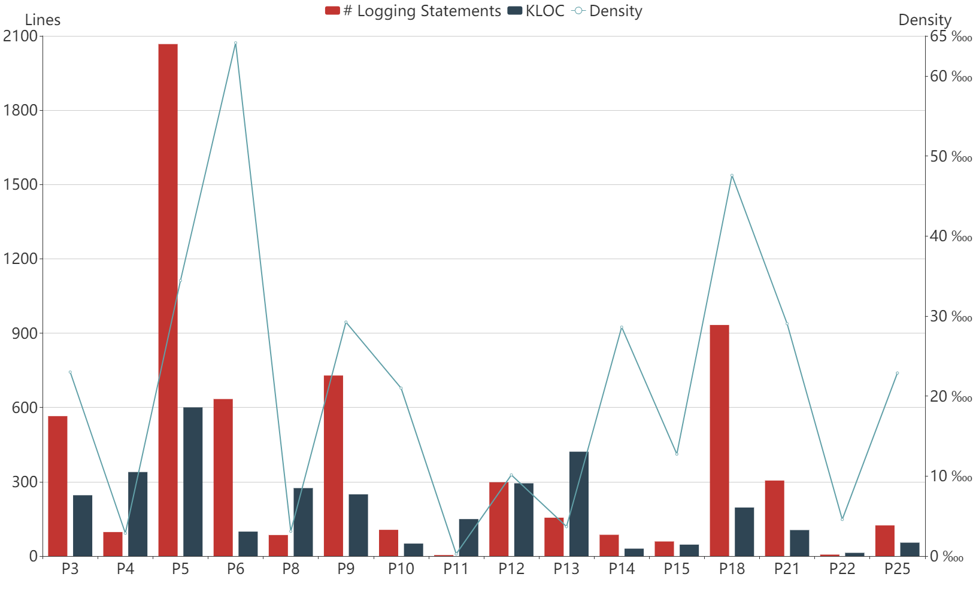
Results – Across Projects
Density & Distribution of Logging Statements

Slide 12
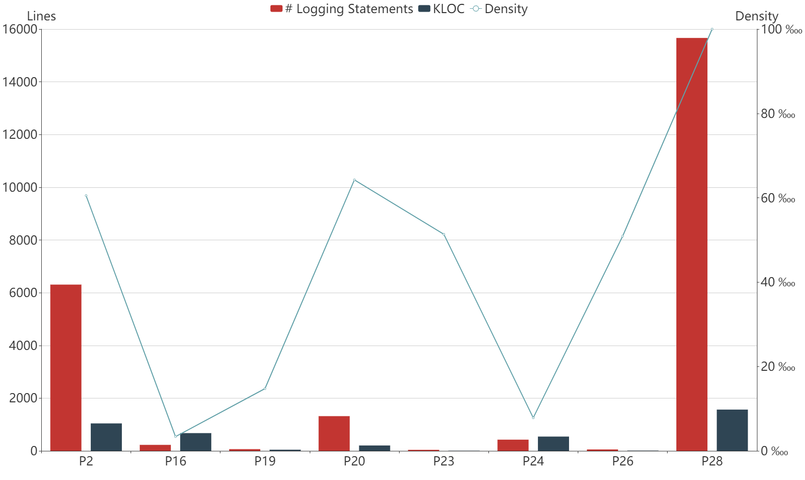
Results – Across Projects
Density & Distribution of Logging Statements
The density of logging statements is generally low and varies tremendously across different projects.

Slide 13
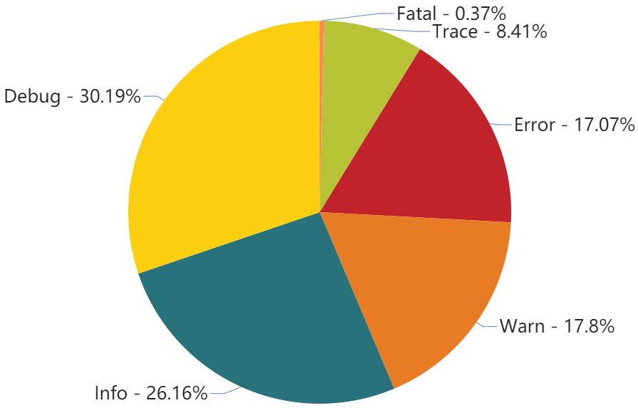
Results – Across Projects
Distribution of Log Level

Slide 14
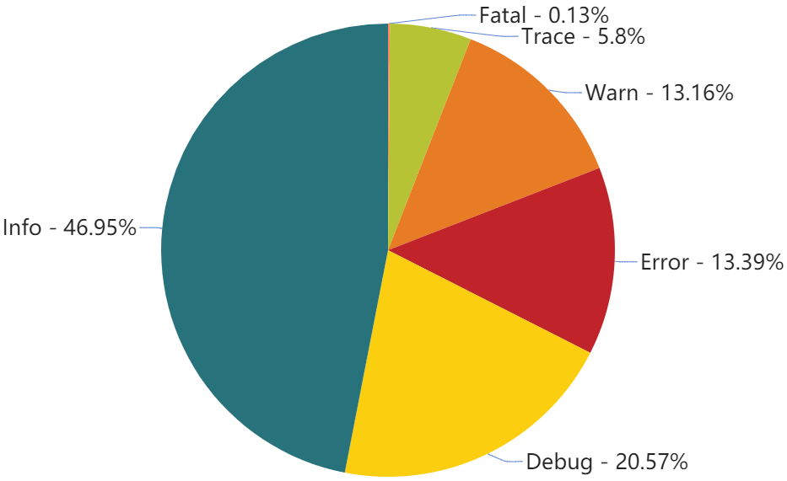
Results – Across Projects
Distribution of Log Level
The distribution of major log levels are different among various projects.

Slide 15
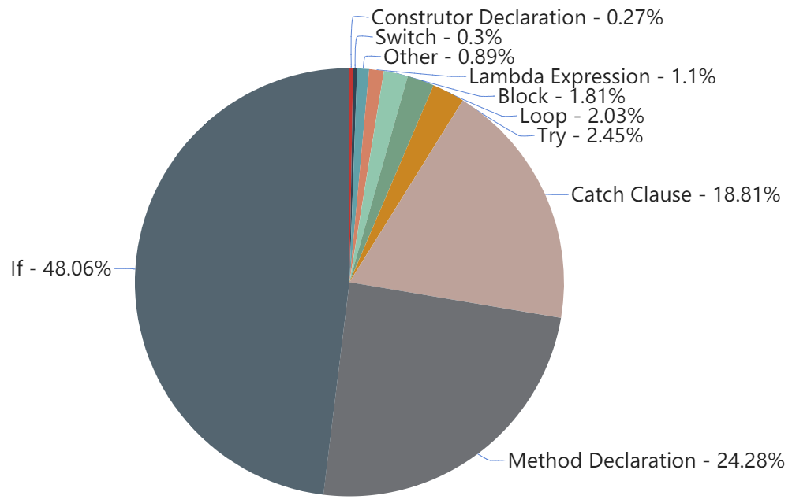
Results – Across Projects
Distribution of Log Context

Slide 16
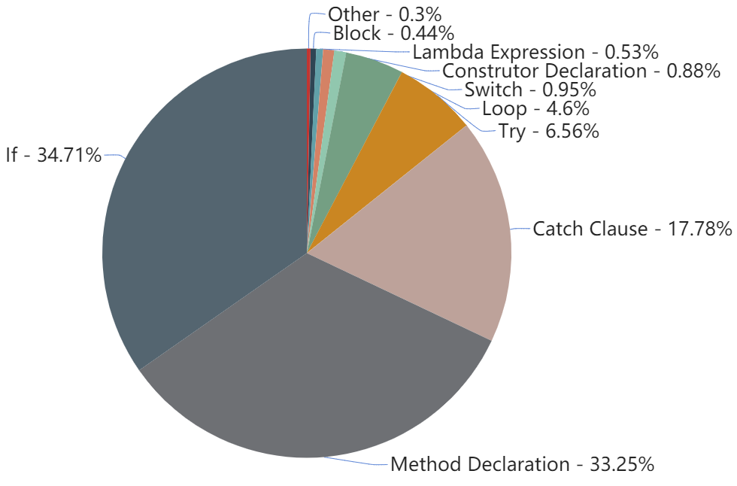
Results – Across Projects
Distribution of Log Context
Developers tend to add log statements to code snippets that have branches.

Slide 17
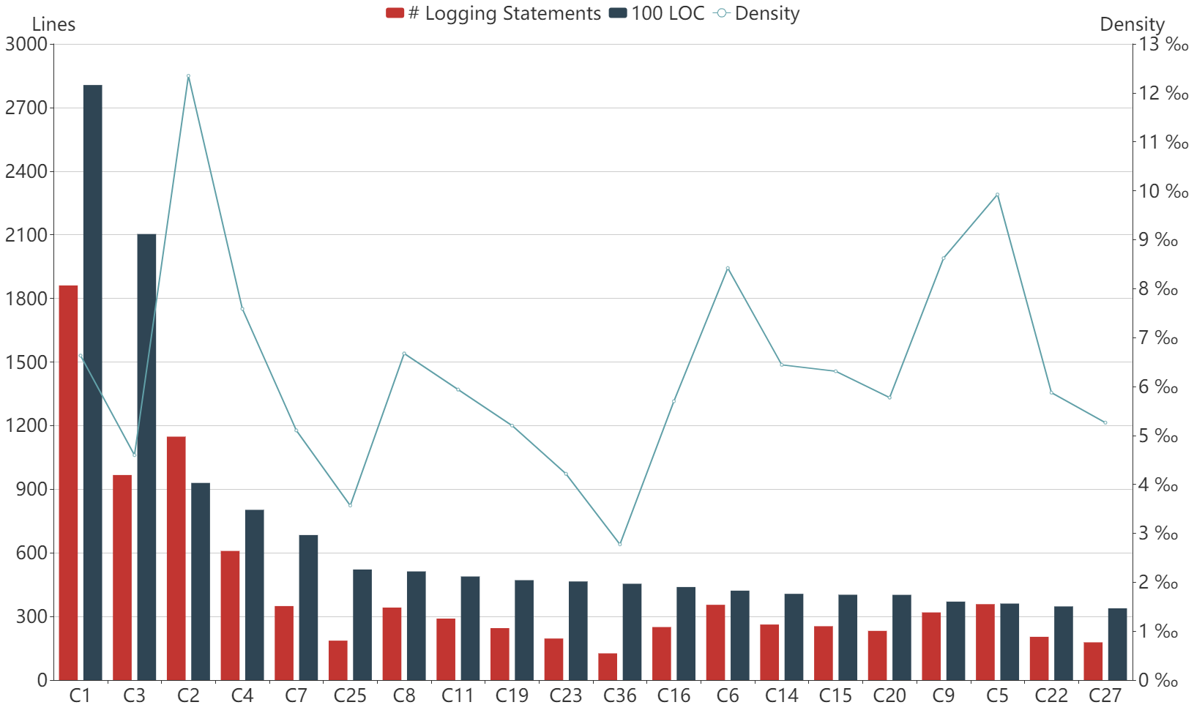
Results – Within One Project
Density of Logging Statements
The density of logging statements from distinct contributors is different among various contributors within the same project.

Slide 18
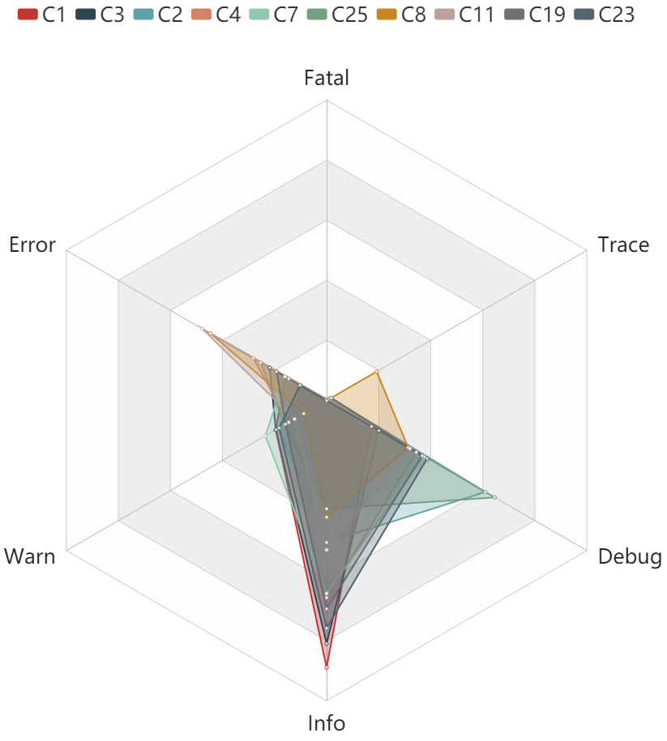
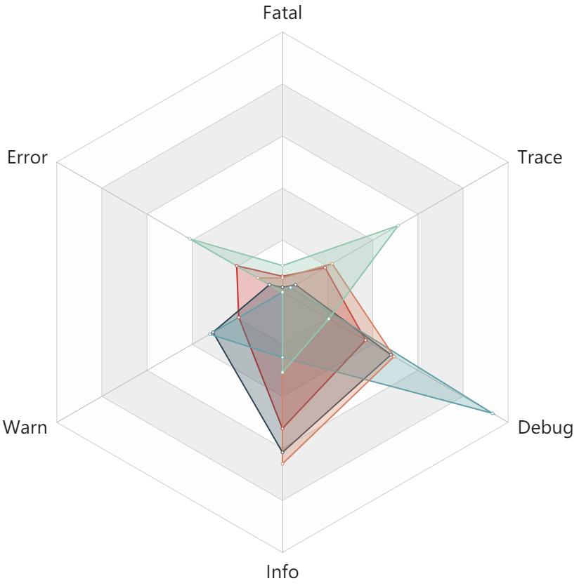
Results – Within One Project
Distribution of Log Level
Even within a project, the log level of distinct contributors is different in most cases.

Slide 19
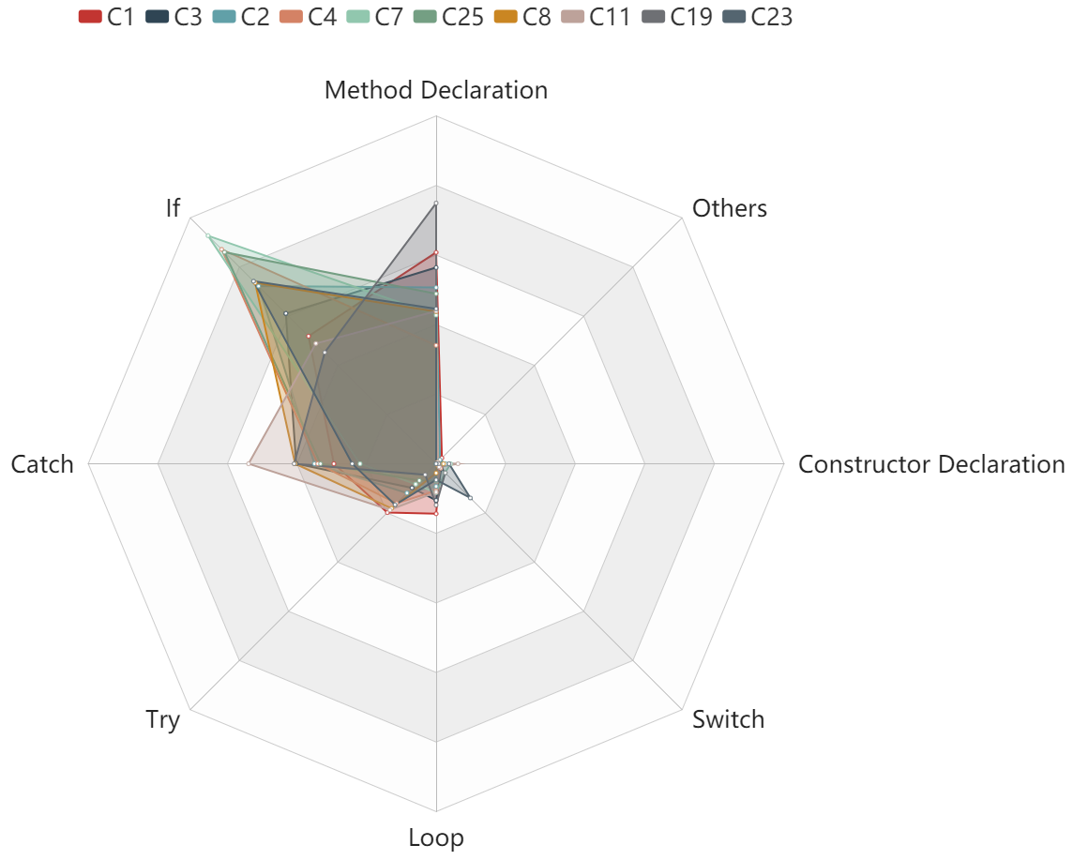
Results – Within One Project
Distribution of Log Context
Within a project, the distribution of log context seems to be similar among different contributors.

Slide 20
01
Background
02
Method
03
Results
04
Conclusion

Slide 21
Implications
1
Ad-hoc logging
2
Balance and trade-off of logging practice
3
Research on Log analysis

Slide 22
Problems to be solved
1
Lacking awareness to perform logging practice
2
Lacking practical guidelines
3
Lacking suitable tools

Slide 23
How is Logging Practice Implemented in Open Source Software Projects?
A Preliminary Exploration
Guoping Rong, Shenghui Gu, He Zhang, Dong Shao, Wanggen Liu
Guoping Rong ronggp@nju.edu.cn
Shenghui Gu dz1732002@smail.nju.edu.cn
He Zhang hezhang@nju.edu.cn
Dong Shao dongshao@nju.edu.cn
Wanggen Liu wayne.liu@transwarp.io

