Slide 1
Recommending New Genres for Music Listeners
Stewart Knox
Capstone Project
Data Science Immersive
General Assembly SF, Fall 2017

Slide 2
Building a Music Genre Recommender
Why?
Target a music listener with a wide range of tastes to help find entire new (high quality) genres to listen to
Roughly 25% of music listeners account for 80% of music sales - trying to target (or expand!) this group
How?
Need to build a genre “fingerprint” for each user and compare to other users
Using Last.fm dataset, both publicly available and custom built
360k users, 324k genres, 186k artists...about 50 million rows in total!
User-provided data: variable number of genres per artist and votes per genre
Weigh genres to reduce popular bad tags and increase less popular good tags
Notes:
Many music recommenders out there are focused on the short term: what song does a user want to listen to right now, or what artist?
last.fm - a music tracker and aggregator,
weigh genres using a custom-built algorithm

Slide 3
Measures of Success
What does a "good" recommendation look like? Remove "junk" genres without removing obscure genres
No macro-genres (Rap, Rock, Alternative)
No "junk" genres (Seen Live, this is great)
Micro-genres in between: Hard Trance, Japanese Synthpop, Sleaze Rock, Post-Hardcore
2. Testing static data over different time periods: can we predict what a user will listen to next year?
Yes!
Hit ratio - (# of users who listened to our predictions / total # of users)
Top 20 predictions: 60% of the time
Top spot prediction: 2% of users
Notes:
Since this is static data, we can't put it in front of a user and see if they like the new genre, so testing will occur using different time periods - did a user listen to a genre in the latter time period that we predicted they would like?
in 60% of cases, one of our top 20 recommendations showed up in the top 20

Slide 4
Building a Fingerprint in Noisy, Lopsided Data
How to get a good fingerprint of a user’s genre preferences from Last.fm data?
Genre1
Votes1
Genre2
Votes2
Genre3
Votes3
Artist1
Plays1
Genre4
Votes4
User1
Artist2
Plays2
Genre5
Votes5
Artist3
Plays3
Genre6
Votes6
Genre7
Votes7
Genre8
Votes8
Naive approach = (Genre 1)(Plays 1)(Votes 1) +...+(Genre 8)(Plays 8)(Votes 8)
Then filter out low values (junk)

Slide 5
Building a Fingerprint in Noisy, Lopsided Data
Cannot filter out the low end (<1k) with real data!
Pop
100
Canada
25
NKIBK
20
Bieber
20
Fem Voc
100
User1
Alanis
20
Rock
85
Stamina
20
Canada
25
Metal
20
Finnish
9
Naive approach = (Pop: 2k) + (FemVoc: 2k) + (Rock: 1.7k) + (Canada: 1k)
+ (NKIBK: 400) + (Metal: 400) + (Finnish: 180)
Notes:
NKIBK problem

Slide 6
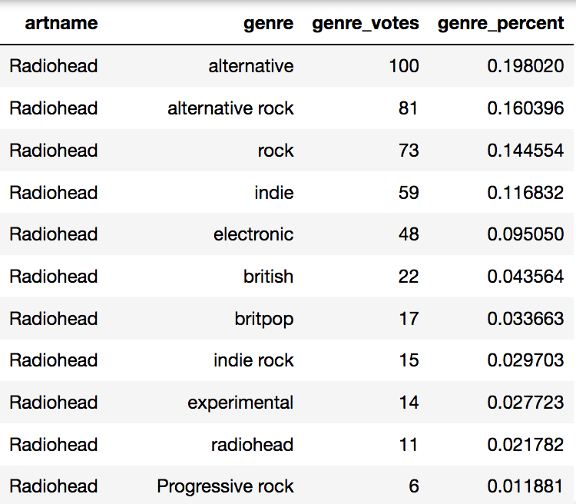
How Do We Emphasize Signal and Reduce Noise?
Percent-weighted data is better...now we can throw away the low end (<5)
Pop
100
68%
= (Pop Votes) / (Total)
Canada
25
17%
NKIBK
20
14%
Bieber
20
Fem Voc
100
48%
User1
Alanis
20
Rock
85
40%
Stamina
20
Canada
25
12%
Metal
20
68%
Finnish
9
31%
Genre Fingerprint = (Pop: 14) + (Metal: 14) + (Canada: 12) + (FemVoc: 9.6)
+ (Rock: 8) +(Finnish: 6.2) + (NKIBK: 2.8)
Notes:
Systematically de-emphasize popular bad tags
and
emphasize less popular good tags

Slide 7
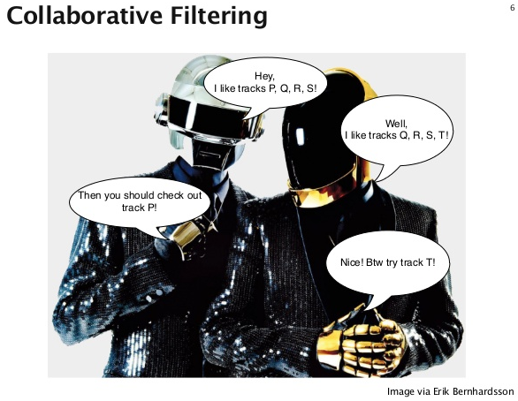
Model & Example Results
Set a threshold to eliminate junk genres
Generate target user fingerprint from over 11,000 genres
Compare fingerprint to 500 sample users to identify 10 most similar
Find the genres they share that our target user has not heard
Recommend!
Notes:
Threshold of 20-50. Lower threshold means more hits but more junk, higher threshold means fewer hits but less junk
Number of users to compare: 10 gives better results than 5, since it helps reduce some of the noise that comes with misnamed genres
Easier said than done with 40 million rows of data to work from, but eventually it was done
Image credit: https://image.slidesharecdn.com/spark-meetup-140509143826-phpapp02/95/collaborative-filtering-with-spark-6-638.jpg?cb=1399647647

Slide 8
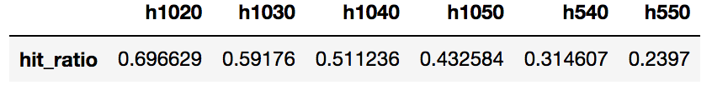
Model & Example Results
Fingerprint Recommendations
Fingerprint Recommendations
Genre | Weight
Punk | 1200
Hardcore | 500
Alternative | 300
Indie | 300
Melodic Hardcore | 250
Genre
Progressive Metal
Melodic Death Metal
Soundtrack
Stoner Rock
Genre | Weight
Rock | 500
Pop | 430
80s | 400
New Wave | 250
Dance | 225
Genre
Pop punk
Gothic
Folk metal
IDM
Notes:
There are some macro-genres that get into recommendations, mostly due to variance in the names that can occur when comparing one user's profile to many users' profiles, but they are manageable.
And very few junk genres get in to our results

Slide 9
Limitations and Future Work
Hard to test with static data
A value of zero is “not heard” rather than “didn’t like”
More plays = more likes
Time-based test skews to longevity and assumes no significant new genres
Need to run on actual users to validate recommendations
Future Features
Give an artist “deep dive” of a genre - biggest names, up-and-comers, cult hits
Further curation of genre data
German hip hop, German hip-hop, German hiphop, Deutscher hip-hop
Questions?
Notes:
Value of zero - did they listen in the past?
More listens - variable song or album length?
Problems can arise when comparing prolific users with low-listen users, since most of a low-listen user's genres will be wiped out when comparing to their prolific colleagues
Cult hits - high listens among a small cluster of users
Curation - does no one have a canonical list of music genres?

Slide 10
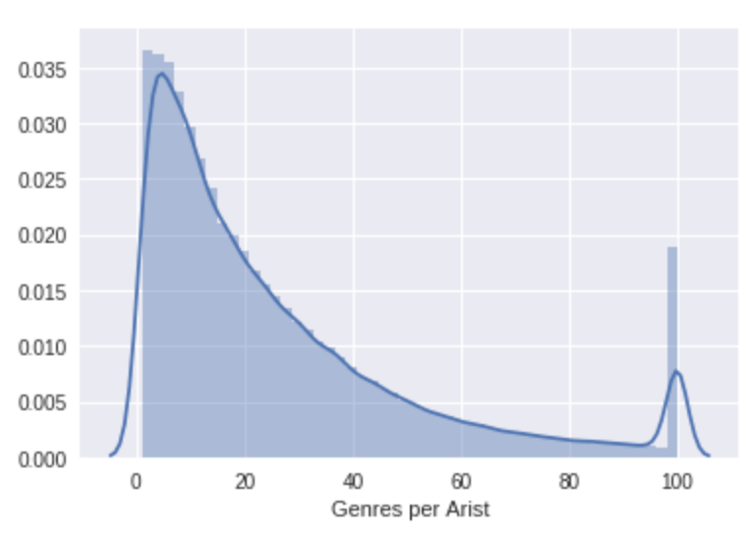
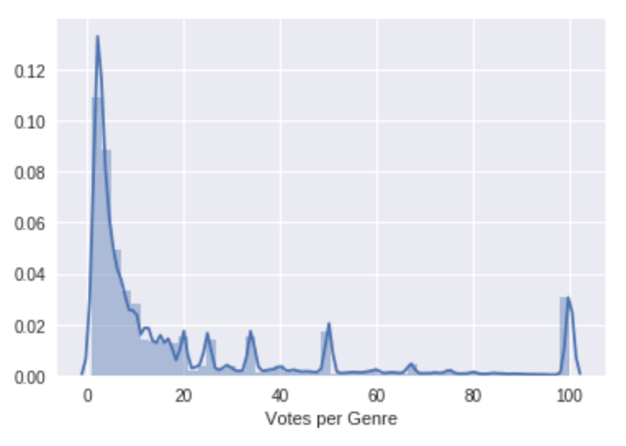
Extra Slides: Genres/Artist, Votes/Genre

Slide 11
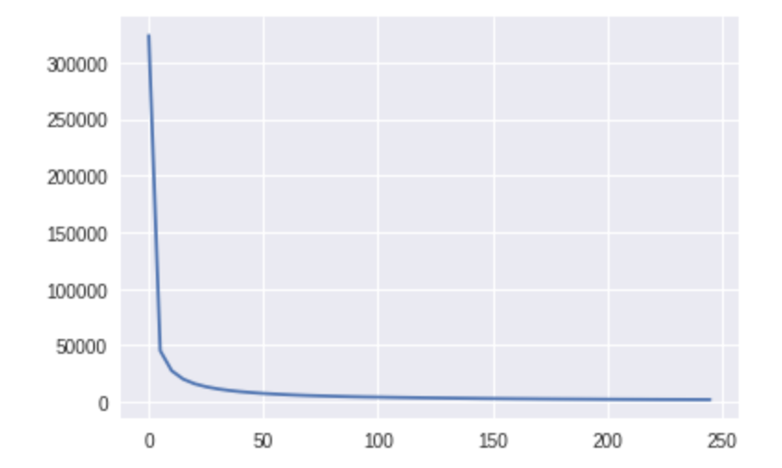
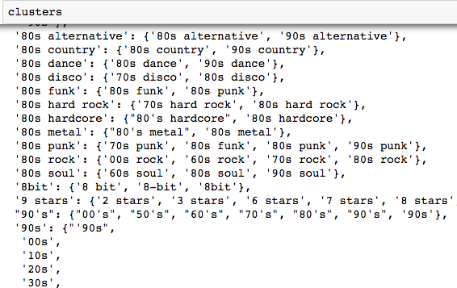
Extra Slides: Further Filtering
Unique Genres Remaining
Threshold

