Slide 1
Digital Signatures for Newbies
Digital Signatures are a clever approach of using complex mathematics in real life work
Let‘s see how it works…

Slide 2


Setup Step 1 : Genererate your own key
First you create a Key pair containing a Public Key and a Secret Key.
The access to your Secret Key is protected by a passphrase
Public Key
Secret Key

Slide 3

Setup Step 2 : Publish the Public Key
Email the Public Key to the „Key Masters“

Slide 4
Setup Step 3 : Verify & Sign new Keys
The „Key Masters“ verify your Public Key with your Key Certificate
If it matches, they sign your key as valid
?=
pub 1024D/6702661F 2003-05-04
Key fingerprint = A2E8 8737 3654 D5E2 031F 02B5 BCDE B096 6702 661F
uid Steffen Köehler (SY CS1 E)
uid Steffen Koehler
sub 1024g/FA8259DC 2003-05-04

Slide 5

Setup Step 4 : Distribute the Public Key
The Key Masters distribute the verified Key to all other users

Slide 6
Setup Step 5 : Store received Keys
The users add the received Public Keys to their Public Key Ring

Slide 7
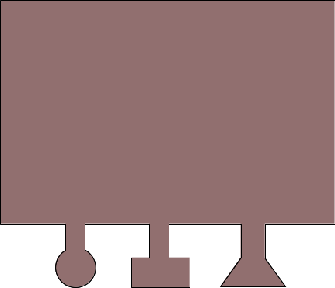


Creating a Digital Signature
To sign a file, you create a Signature out of your Secret Key and the file checksum
File
File Checksum
+
=
File Checksum
Signature

Slide 8
Content of a Digital Signature
Signature
A digital signature contains the following data:
A checksum of the file it belongs to
The anonymus ID of the user, who signed the file (the users name can only found when having his public key)
The local date and time when the signature was made
Checking WSR4340.pdf.sig ...WSR4340.pdf.sig checked:
gpg: Signature made 07/14/08 13:46:47 using DSA key ID 5281A72F
gpg: Good signature from “xxxxxxxxx (xx CS1 E) <xxx.xxx@xxxtech-eu.com>"
gpg: Signature made 07/14/08 16:18:47 using DSA key ID F0F2F3EA
gpg: Good signature from yyyy yyyy (yy CS1 ME) <yyy.yyyy@sxxtech-eu.com>"
gpg: Signature made 07/15/08 12:44:15 using DSA key ID A6C128F6
gpg: Good signature from “zzzz zzzz (zzzz EESE) <zzzz@zzzzz.com>"

Slide 9
Distributing a Digital Signature
Distribute the Signature to whoever needs it
Signature
Signature
Signature
Signature
Signature

Slide 10

Verifying a Digital Signature
The other users validate the Signature by compare it to the file checksum of their local file and the Public Key, stored in their Public Keyring
Only if both matches, the Signature is valid
File
Signature

Slide 11
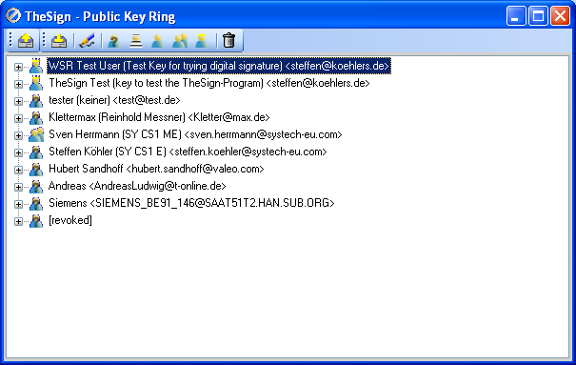
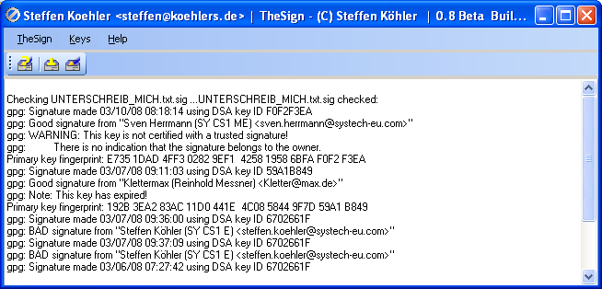
TheSign – the Tool to do all this
To perform all these tasks, TheSign is been made to make it simple
more information can be found at http://www.koehlers.de/wiki/doku.php?id=thesign:index

