Slide 1

NYC Airbnbs
Characteristics of an Optimal Listing
Data Bootcamp Final Project
Jessica Guo (jqg214) | Spencer Libbing (stl327) | Harry Wu (zw1869)

Slide 2
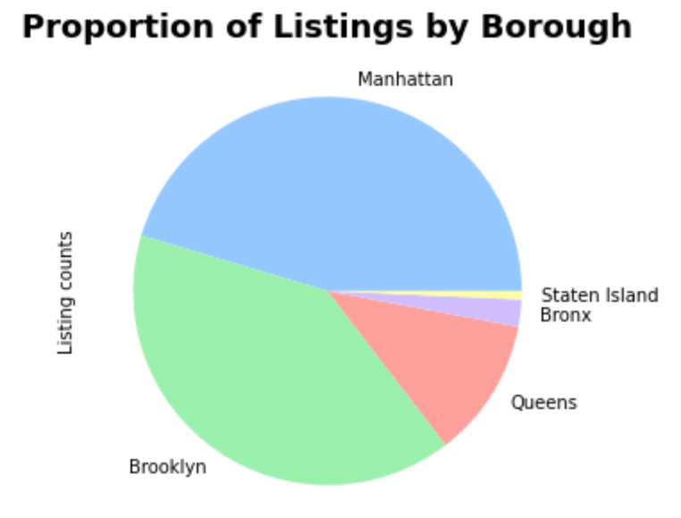
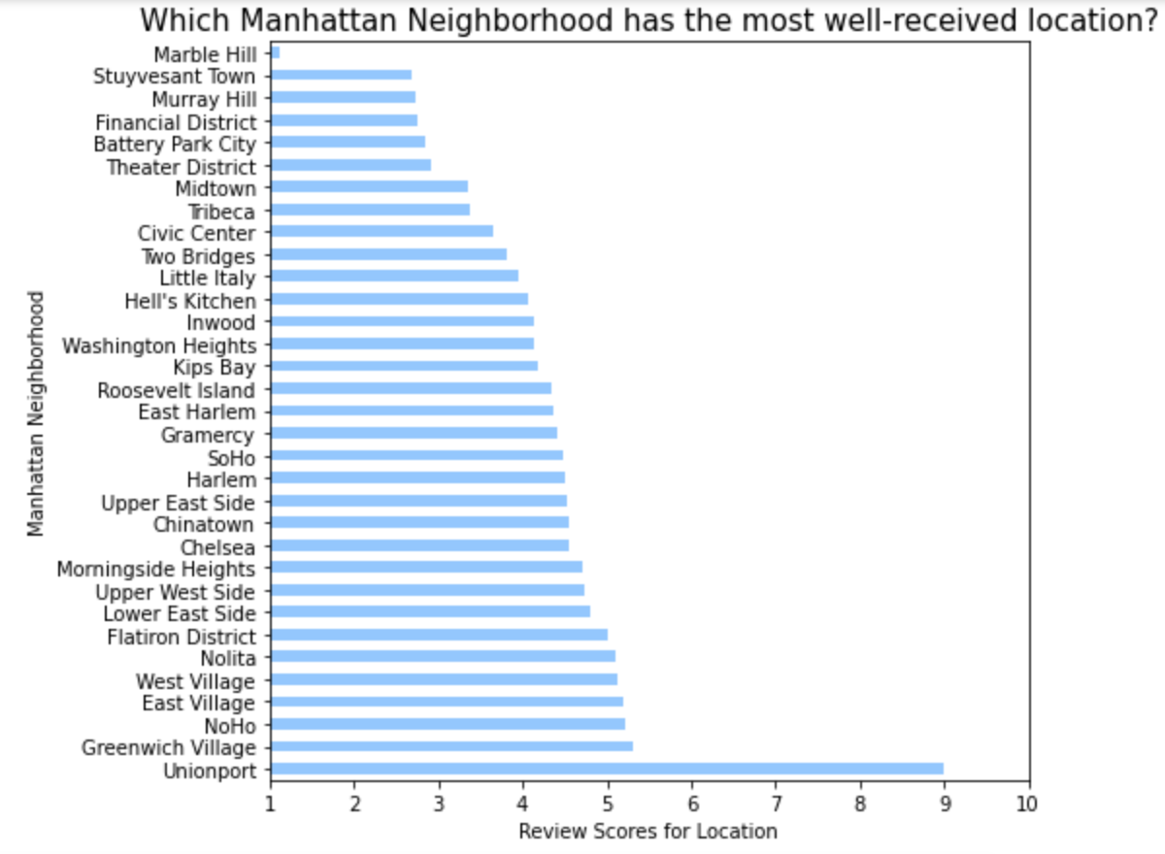
Most Popular Neighborhoods
We focused primarily on Manhattan listings, as it had the most listings in the dataset.
Among Manhattan neighborhoods with the most Airbnb listings, Unionport followed by Greenwich Village had the best reviews for location

Slide 3
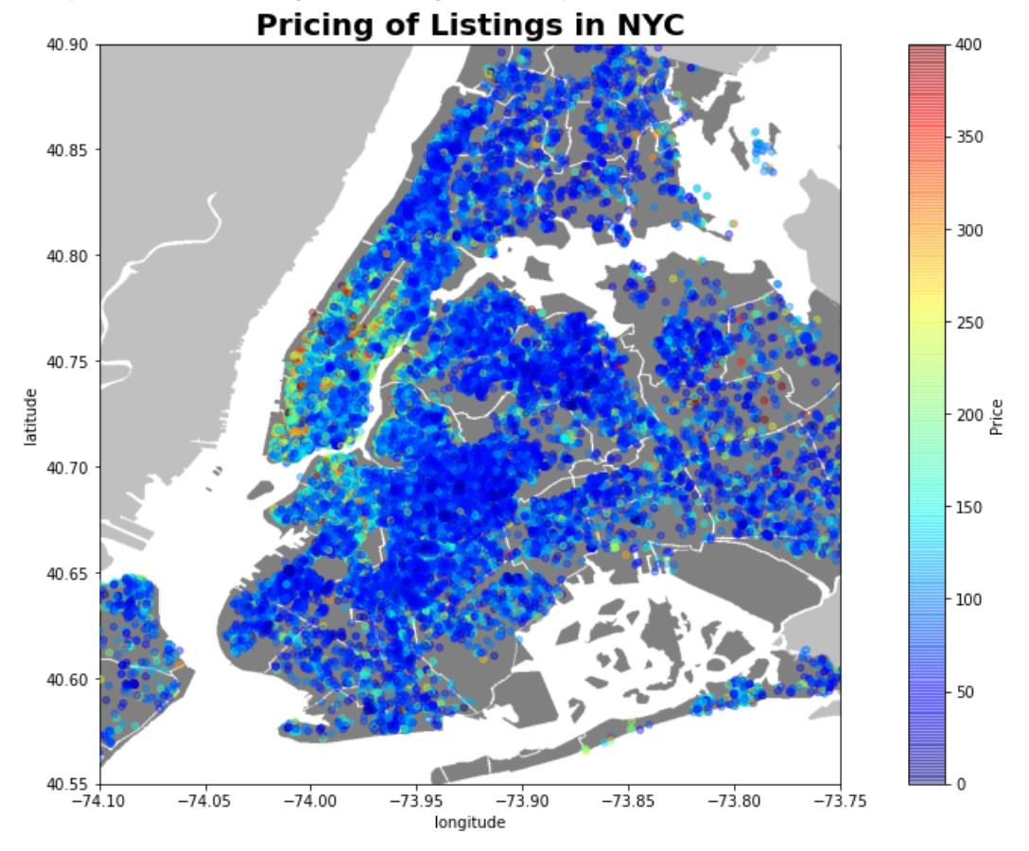
Heatmap
The heatmap of NYC Airbnb listings shows that more expensive listings cluster in lower Man
Plotted latitude and longitude of listings onto a map of NYC
Heatmap where different colors show the variety of prices of listings throughout NYC

Slide 4
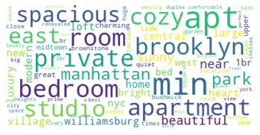
Top Keywords in Listing Description
WordCloud of the top 50 keywords in the listing description:
Prevalence of each keyword depicted through size of word
Locations, amenities, type of room, adjectives (spacious, cozy, etc)

Slide 5
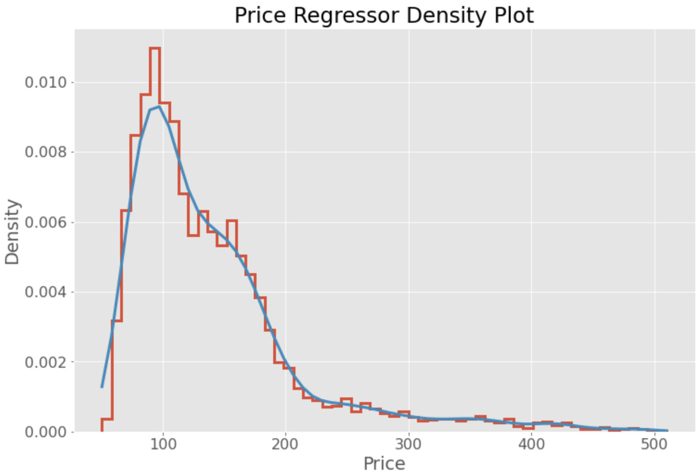
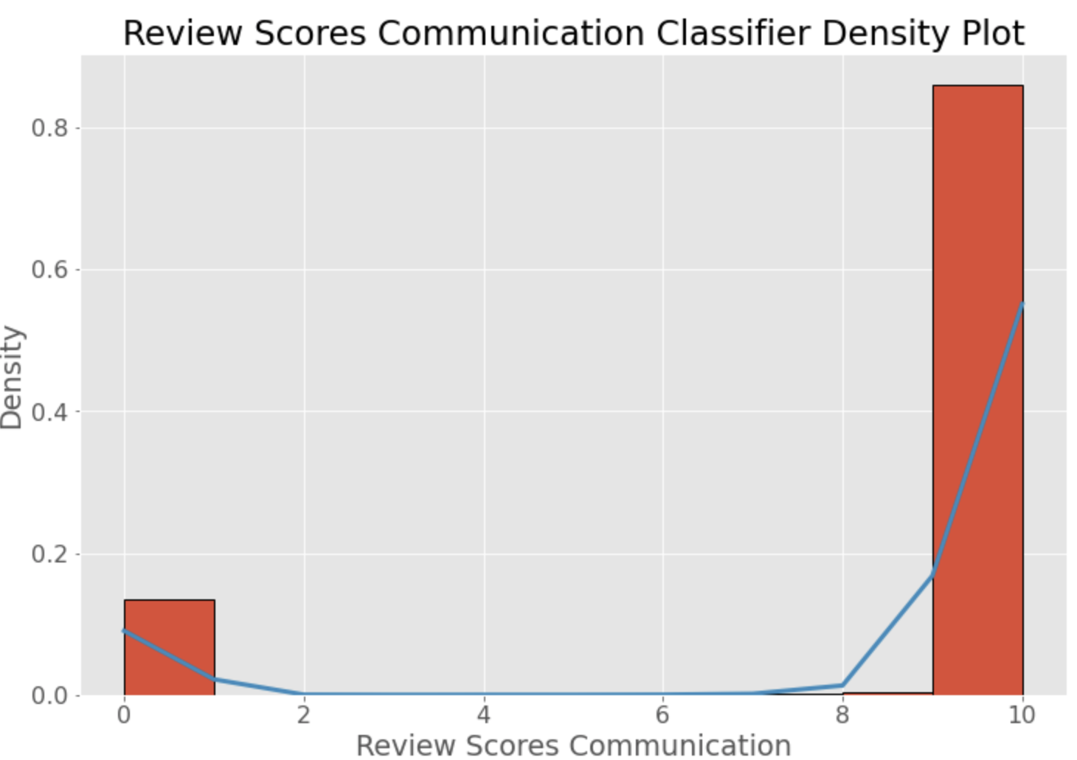
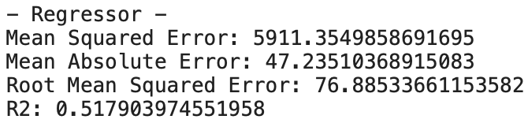
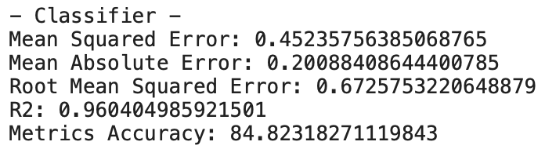
ML Predictions: Complex vs. Simple
The KNN Regressor model was more useful for complex data predictions such as price, whereas the KNN Classifier model worked well for heavily skewed and simpler variables like communication.

