Slide 1
AUDIOPROOF
“A network of music, experiences, and people”
March 7th, 2016
Product owner: Norberto Sanchez
Scrum master: Stella Lee
Team members: Ryan Fulscher, Nick Church

Slide 2
Project Overview
In a sea of blogging sites...
Simple and focused UI
Amalgamation of our favorite features from similar sites
Goals
Model: Blog with a music focus
Unobtrusive UI
Ease of use
Scalability
Ease of administration
Continuous integration and testing
Security and validation

Slide 3
Project Management
Slack, with Github and Trello integration
Trello
Scrum board and burnup chart
Google Drive

Slide 4
Challenges and Accomplishments
Challenges
Time management
Learning Ruby on Rails

Slide 5
Challenges and Accomplishments
Accomplishments
Well organized views and site models
Ease of browsability
User account security and data validation for all data sent to the server
Regression-proof test harness
Well documented views and future plan
Cross platform development environment

Slide 6
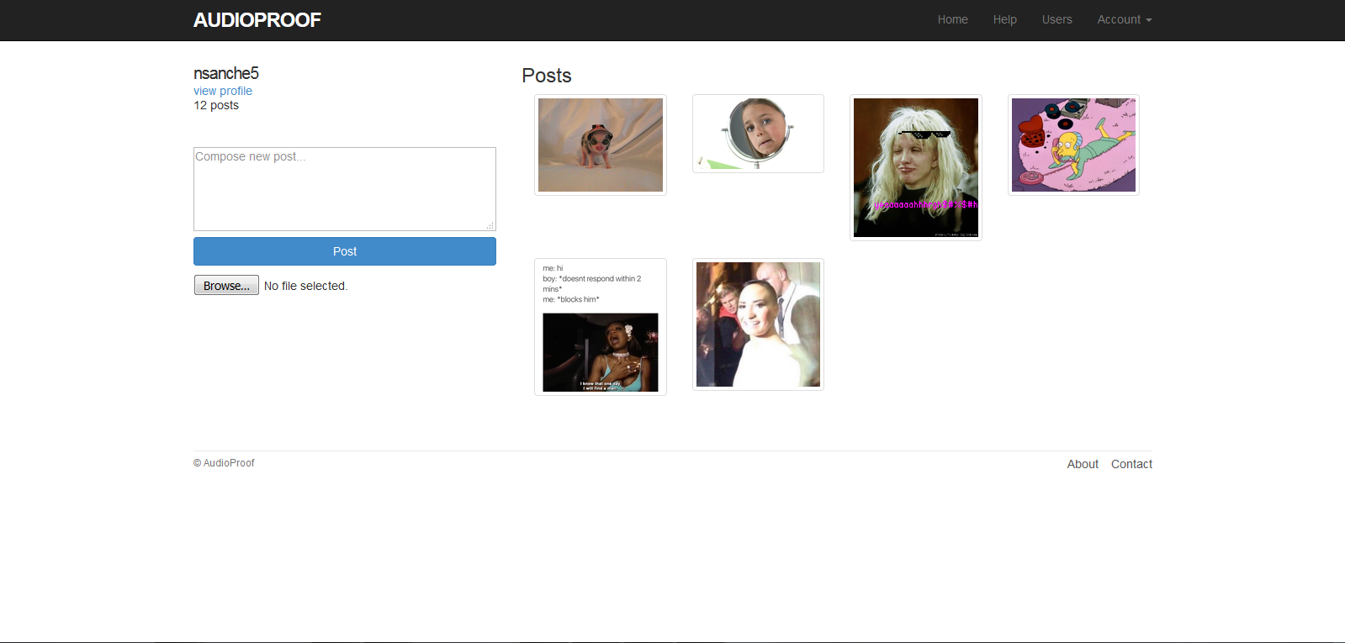
Sample Profile

Slide 7
Project Reflections
Enjoyed
Learning a new framework and language
Didn’t Enjoy
Time management on top of other demanding classes/work

Slide 8
Project Reflections
What Worked Out
Ruby on Rails
Testing
Models
What Didn’t Work Out
Time

Slide 9
Questions?
https://github.com/stlalee/audioproof

