Slide 1
Applied Machine Learning Practise
Tan Han Rong
Prediction of King County House Sales, USA

Slide 2
Table of Contents
Description of data
Background research
Start of Code
Data Exploration
Feature Engineering
Train Test Split
Model Building
Evaluation
Improvements
References

Slide 3
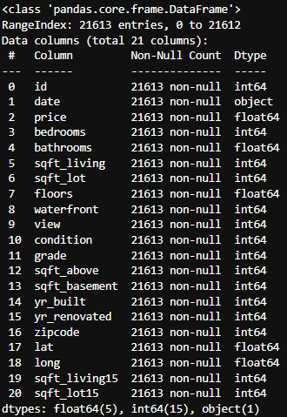
Description of data
Data set contains House Sale Prices in King County which includes homes sold From May 2014 to May 2015.
Data has 21,613 entries, with 21 columns.
Notes:
12 features, with the test set removing the survived column

Slide 4
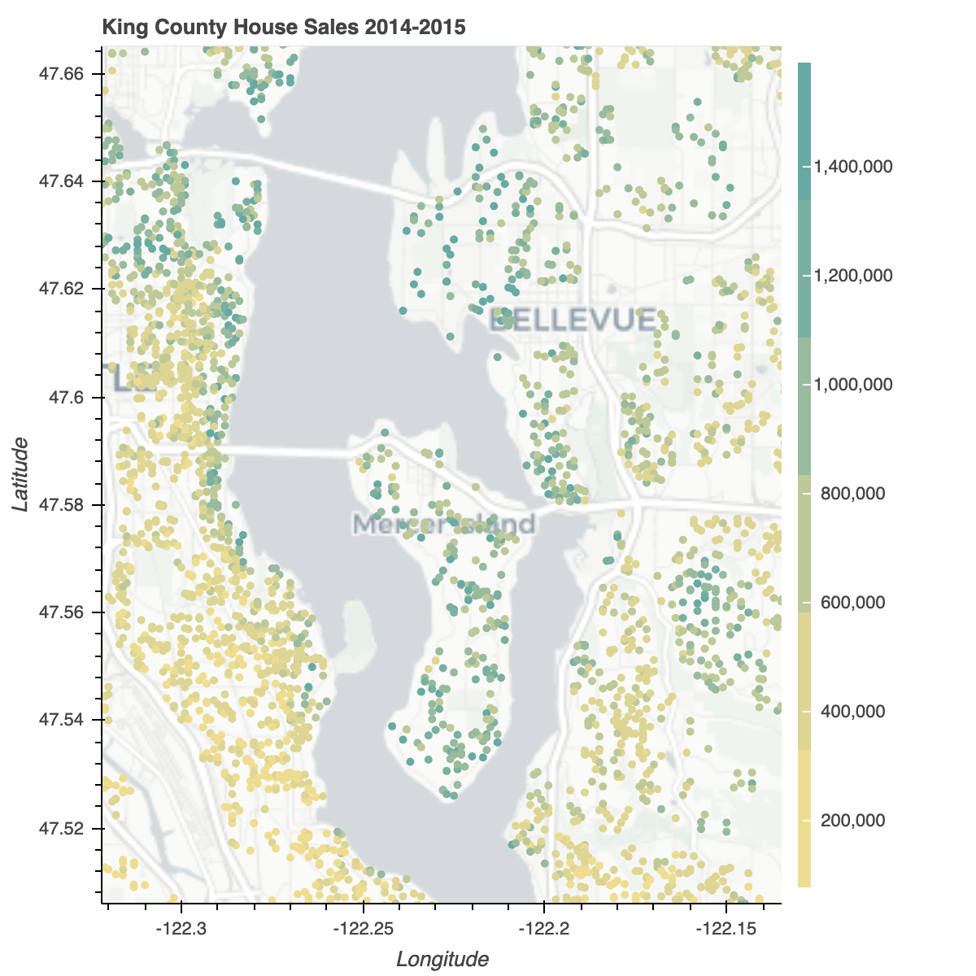
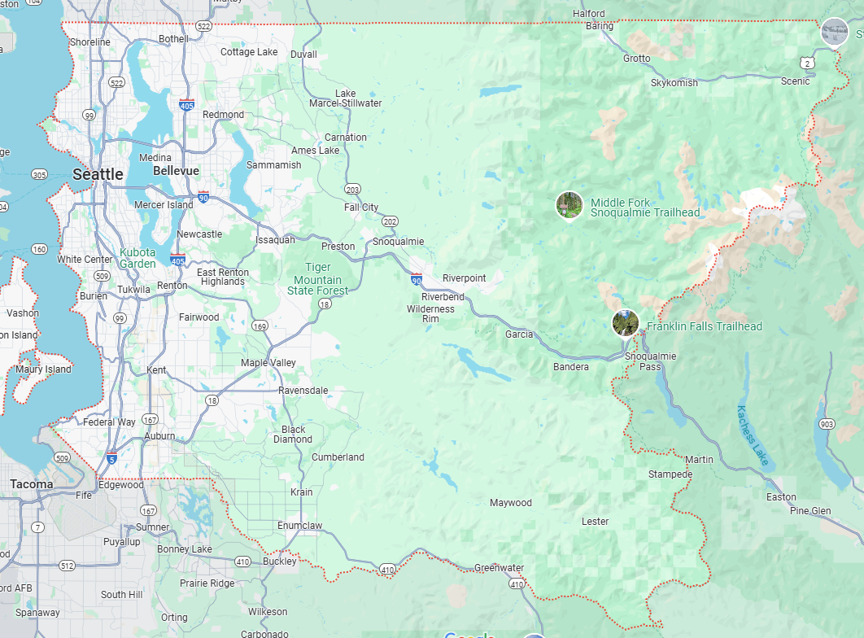
Background research
Went to search up more details on the King County
Median
Prices
Seatle, Washington Area (Googlemaps)
One of the most wealthiest zipcodes
Notes:
Location within King County is important with a noticeable disparity amongst zipcodes. The median house price ranges from $235,000 in 98002 up to $1,260,000 in 98039. (https://github.com/nadinezab/kc-house-prices-prediction)

Slide 5
Background research
Property is usually about location, location, location.
Putting on a thinking cap to have similar mindset for what contributes to value in Singapore
Bedrooms, Bathrooms, Condition of the property, Zipcode and perhaps the View from the property
Notes:
Country, City/ state, and where you are facing

Slide 6
Background research
Date
I am aware that the date at times do affect the property (be it black swan events like Covid, or sudden introduction of house policy, to even the hottest time of house sales).
Due to the difficulty of handling this data, I have chosen to exclude it from the dataset to train the model.

Slide 7
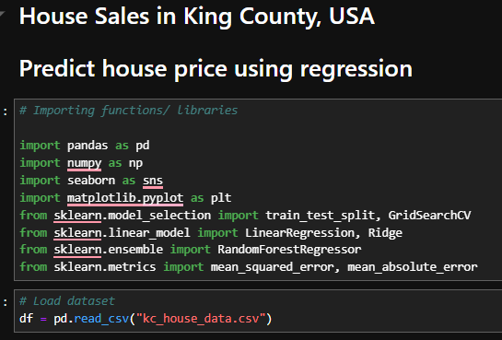
Start of Code

Slide 8
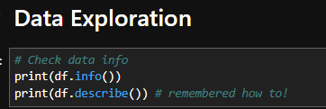
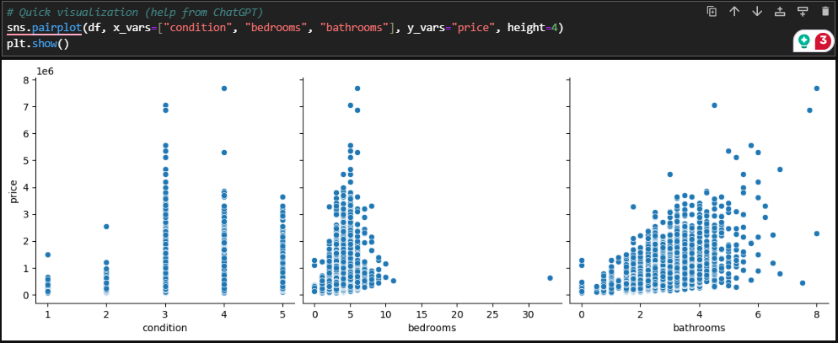
Data Exploration
Notes:
Explaination of the variables chosen, better condition, more rooms likely commands higher price sold

Slide 9
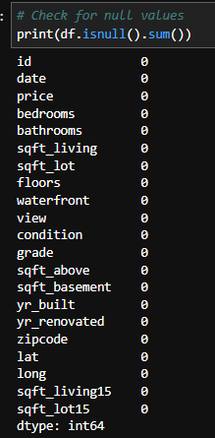
Data Exploration
Surprisingly no missing values!

Slide 10
Data Exploration
Coming to which models to use
Since Part B was titled Regression
Also, because multiple linear regression is most commonly used in predicting property sales price.
With more focus on interpretability, I believe a simple linear regression works and it can also serve as a baseline.
Random forest regressor was also chosen as it is robust to outliers and can estimate feature importance.

Slide 11
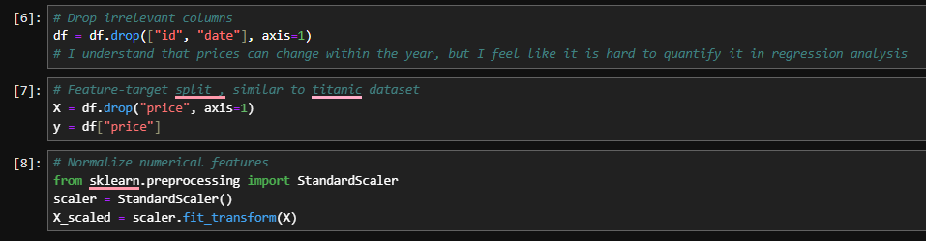
Feature Engineering
Removed the date as discussed earlier

Slide 12
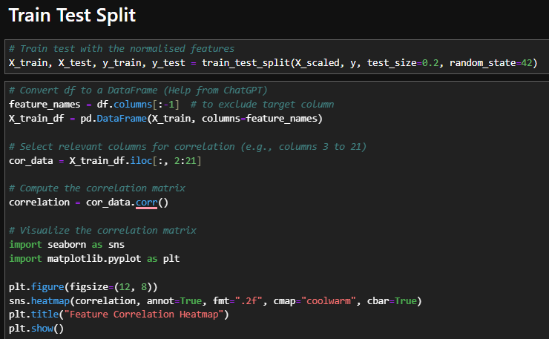
Train Test Split

Slide 13
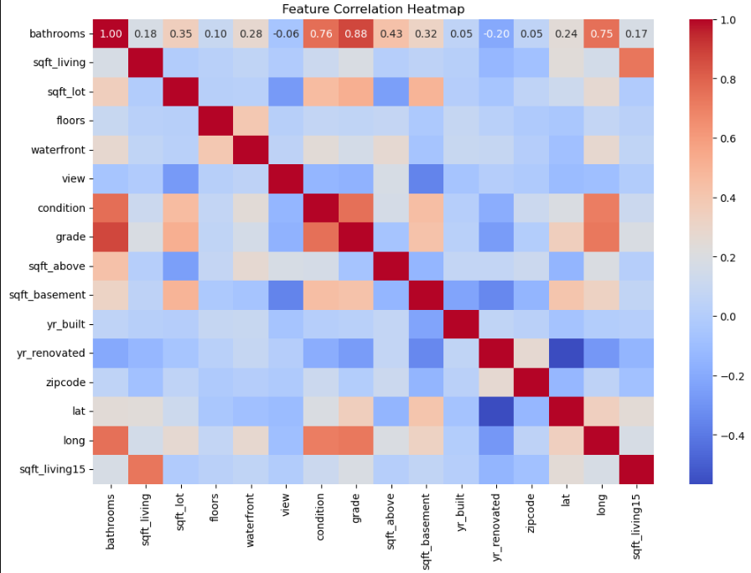
Train Test Split
Notes:
Looking from the Bathrooms side, it has higher correlation with condition, grade, and for some reason longitude
Condition and Grade also seem to be closely related to each other

Slide 14
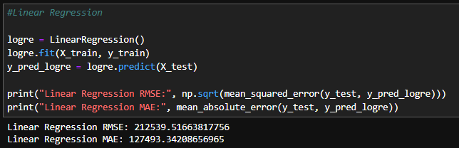
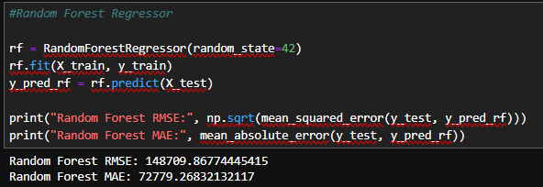
Model Building
Used Logistic Regression and
Random Forest Regression
Lower RMSE and MAE

Slide 15
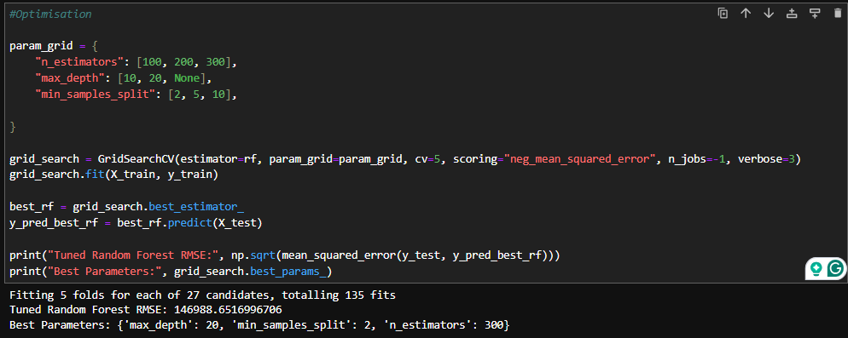
Model Building
Optimising the model

Slide 16
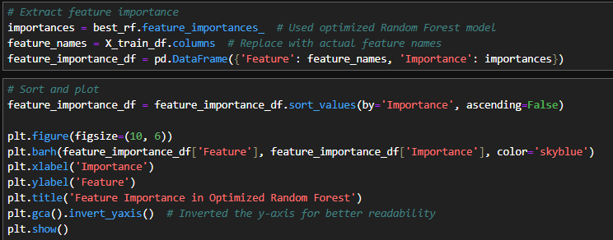
Evaluation
Feature importance

Slide 17
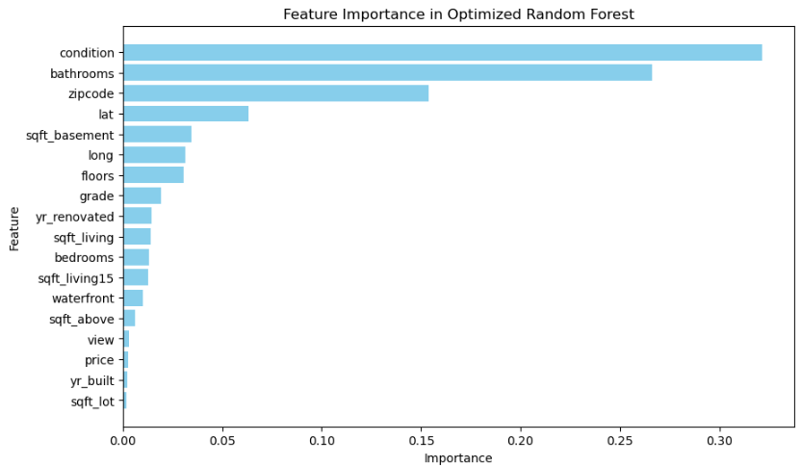
Evaluation
Feature importance
Notes:
Although from here it seems like view really is not as well sought after compared to Singpore in this instance.

Slide 18
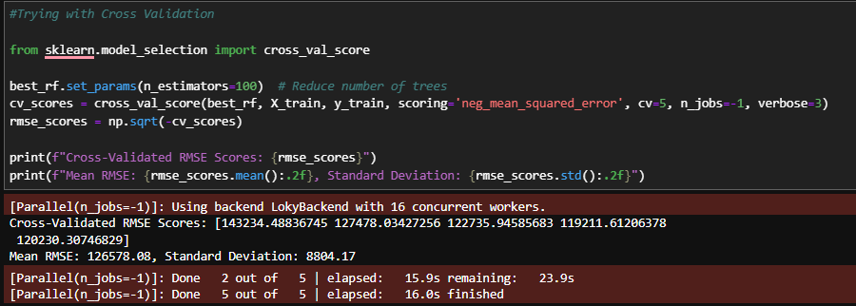
Evaluation
Cross Validation

Slide 19
Improvements
On hindsight
Could have further tried to include more detailed items such as month and day from the dates. I could use it to possible represent trends
Rerun of the model after finding out the feature importance, removing features of a lower importance in hopes to make the model better.
Notes:
Tune: (number of trees, depth) using grid search or random search with cross-validation.
Ensemble methods combine predictions from multiple models to create a more accurate and robust predictive model. The idea is that different models may make errors on different parts of the data, so combining their predictions can cancel out individual weaknesses
Ensemble can be like boosting and strapping (What we have learn in the other module as well) Ai Human interfaces

Slide 20
References
https://www.kaggle.com/datasets/harlfoxem/housesalesprediction/data
https://www.seattlepi.com/local/seattlenews/article/These-are-the-20-wealthiest-ZIP-codes-in-King-12561838.php (The zipcodes are in the just under the slideshow/pictures)
https://bestdiplomats.org/richest-cities-in-washington/#:~:text=2.-,Mercer%20Island,median%20home%20price%20of%20%242%2C241%2C153.
https://www.google.com/maps/place/King+County,+WA,+USA/@47.5677791,-122.2193224,11.25z/data=!4m10!1m2!2m1!1s980039+king+county!3m6!1s0x54905c8c832d7837:0xe280ab6b8b64e03e!8m2!3d47.5480339!4d-121.9836029!15sChI5ODAwMzkga2luZyBjb3VudHmSAQl1c19jb3VudHngAQA!16zL20vMG1tcHo?entry=ttu&g_ep=EgoyMDI0MTEyNC4xIKXMDSoASAFQAw%3D%3D
https://github.com/nadinezab/kc-house-prices-prediction
https://towardsdatascience.com/regression-using-sklearn-on-kc-housing-dataset-1ac80ca3d6d4
https://rpubs.com/shalmali2501/492324
https://www.kaggle.com/code/rinichristy/kc-data-exploration-and-visualization
Notes:
One thing to note that yes, I understand these sources have full models, but I mostly use them to try and understand which model were to try and understand their data processing better.

Slide 21
Thank you

