Slide 1
APPLIED LEARNING PRACTISE
Tan Han Rong
Stocked up

Slide 2
Contents Page
Description of data
Data Exploration
Trendlines
ADF Test
Differencing
Holt-Winters Exponential Smoothing model
ARIMAX
SARIMAX
Params Tuning
Conclusion
Sources

Slide 3
Description of data
Stock Price data from Politemall.
1257 instances
Excluding the data, it belongs to 3 stocks, Amazon, Apple and DBS

Slide 4
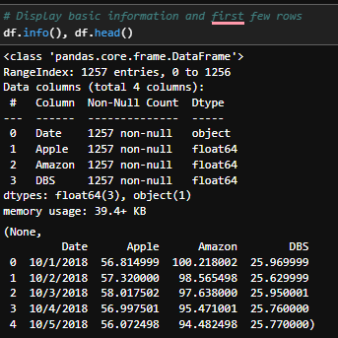
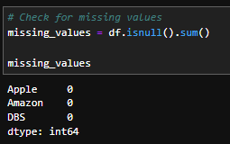
Data Exploration
0 Missing values.

Slide 5
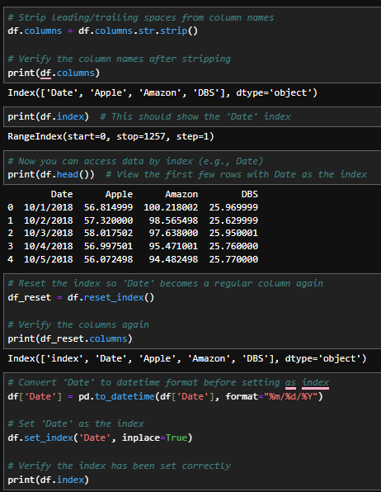
Data Exploration (small hiccup)
Was initially unable to define ‘Date’. Likely due to my own error when trying to turn the Date into the index.

Slide 6
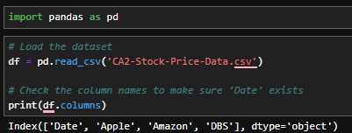
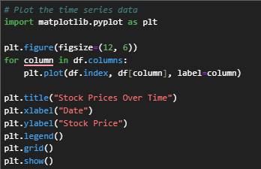
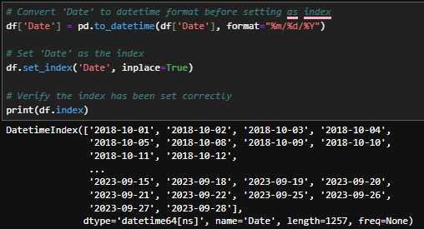
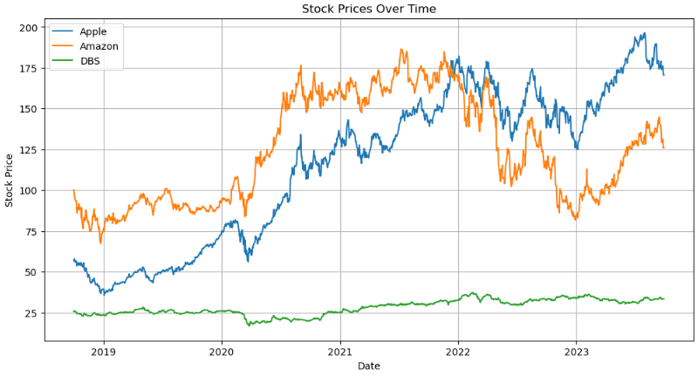
Start of code
Notes:
Scaler centers data around 0 and scales it to unit variance

Slide 7
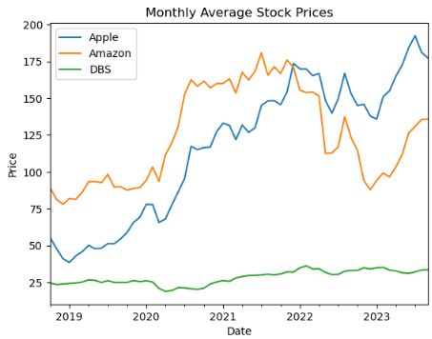
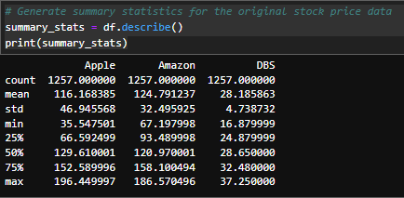
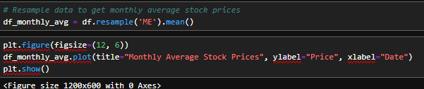
Data Exploration
Monthly Average
Compared with Original data
Notes:
Using a model previously learn that fits multiple decision trees to learn which features are most important.

Slide 8
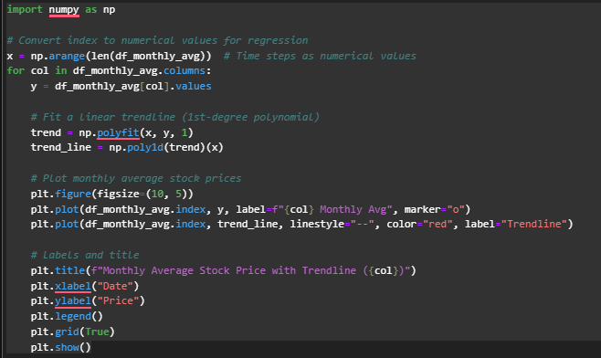
Trendlines
Notes:
Reduces high-dimensional data to 2D for visualization
Applies PCA transformation to the standardized data
Inertia: Measures how tightly data points are clustered. Lower being better.

Slide 9
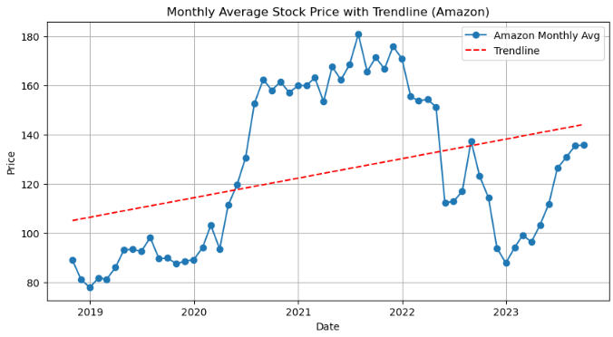
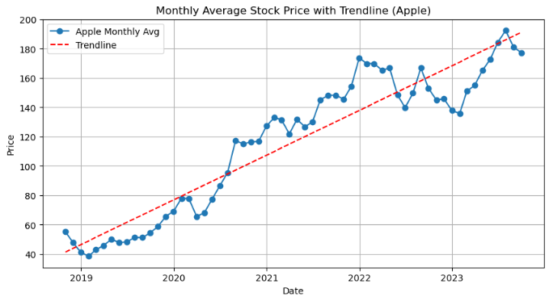
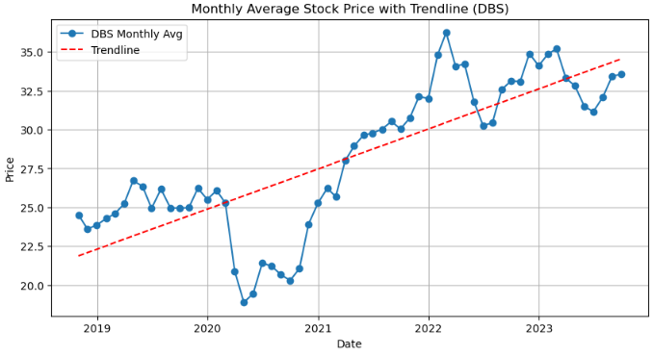
Trendlines

Slide 10
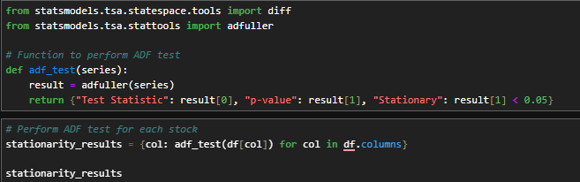
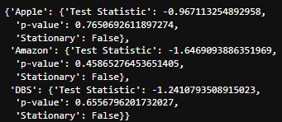
ADF Test

Slide 11
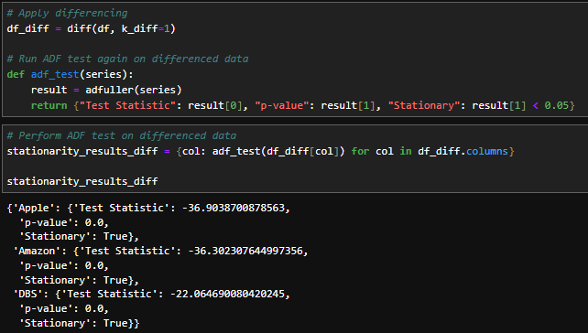
Differencing
Notes:
n_neighbours = 5 being an arbritary number. As I felt any lower might be overfitting the model.

Slide 12
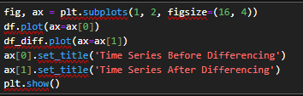
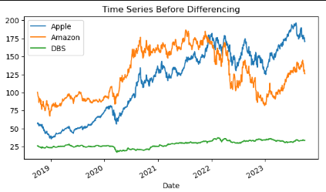
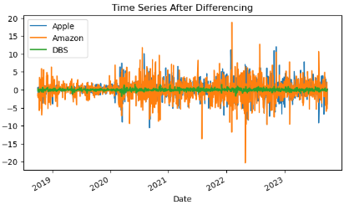
Differencing
Notes:
The Davies-Bouldin Index is a validation metric that is used to evaluate clustering models. It is calculated as the average similarity measure of each cluster with the cluster most similar to it. In this context, similarity is defined as the ratio between inter-cluster and intra-cluster distances. As such, this index ranks well-separated clusters with less dispersion as having a better score.
Advantages of the Davies-Bouldin Index
The DBI is a relative metric, which means that it can be used to compare the clustering results of different algorithms on the same dataset.
The DBI has a clear interpretation: a lower DBI value indicates more compact and well-separated clusters.
It is a relatively simple metric to calculate.
It provides a global measure of the quality of a clustering solution.
It is relatively insensitive to the choice of distance metric.
Limitations of the Davies-Bouldin Index
The Davies-Bouldin Index is sensitive to outliers and noise in the data.
The Davies-Bouldin Index does not take into account the structure or distribution of data, such as clusters within clusters or non-linear relationships.
The Davies-Bouldin Index only considers the pairwise distances between cluster centroids and cluster members.
The DBI can be computationally expensive to calculate for large datasets.
The DBI is not suitable for all clustering tasks. For example, it is not well-suited for clustering tasks where the clusters are not well-separated.

Slide 13
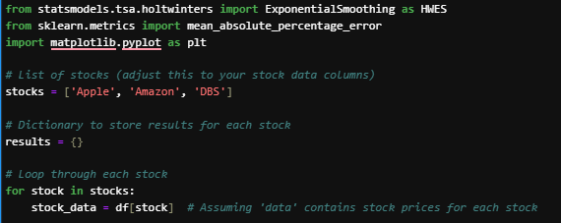
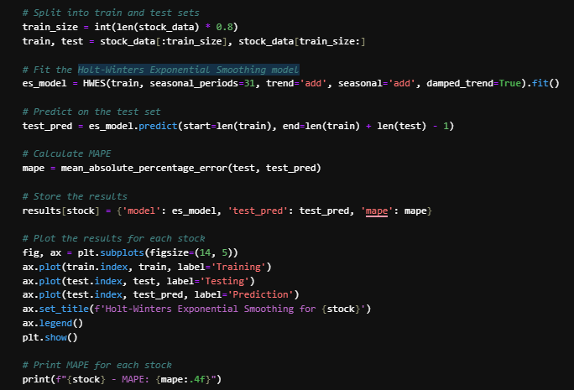
Holt-Winters Exponential Smoothing model

Slide 14
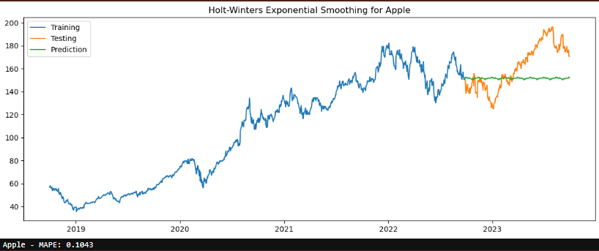
Holt-Winters Exponential Smoothing model (Apple)

Slide 15
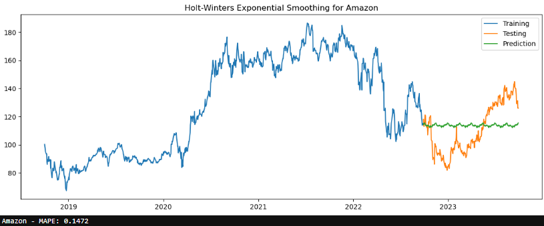
Holt-Winters Exponential Smoothing model (AZ)

Slide 16
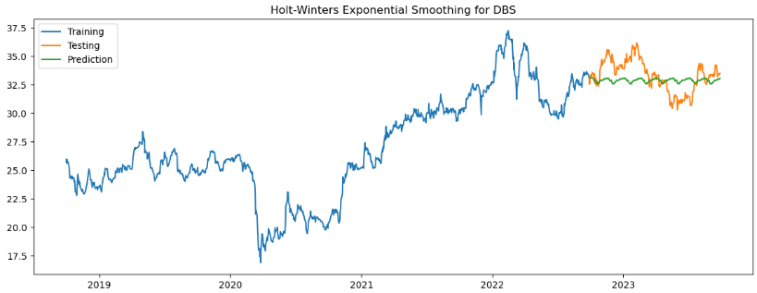
Holt-Winters Exponential Smoothing model (DBS)

Slide 17
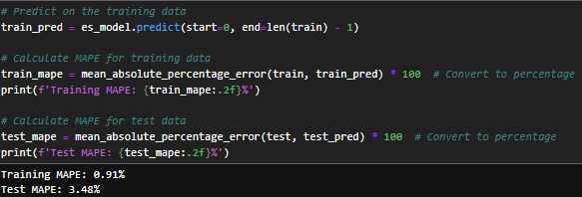
MAPE score (HWES)

Slide 18
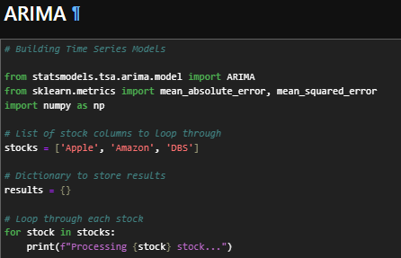
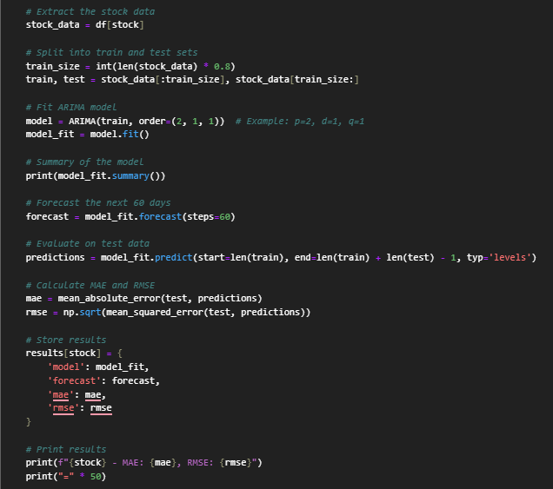
ARIMA

Slide 19
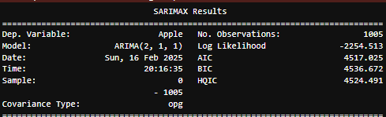
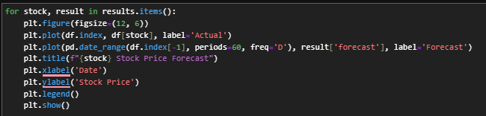
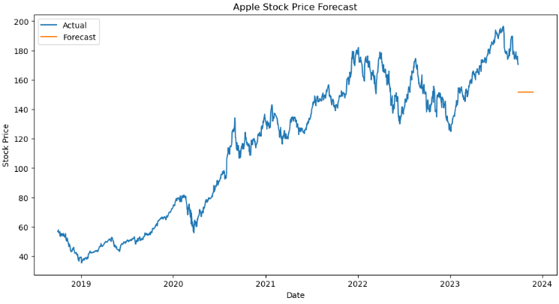
ARIMA (Apple)

Slide 20
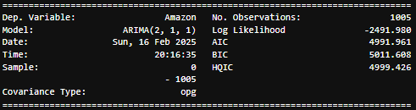
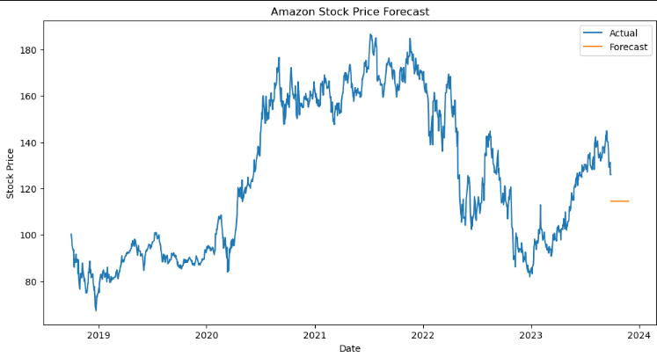
ARIMA (AZ)

Slide 21
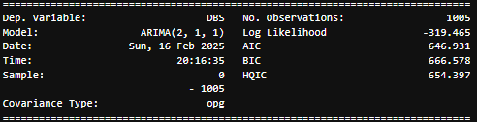
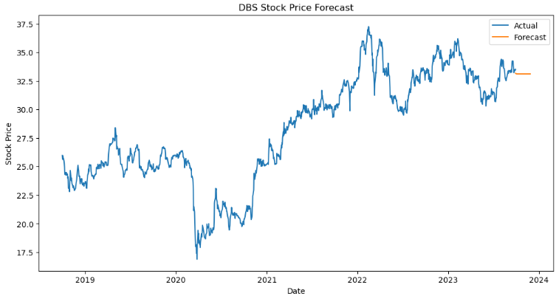
ARIMA (DBS)

Slide 22
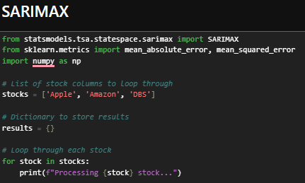
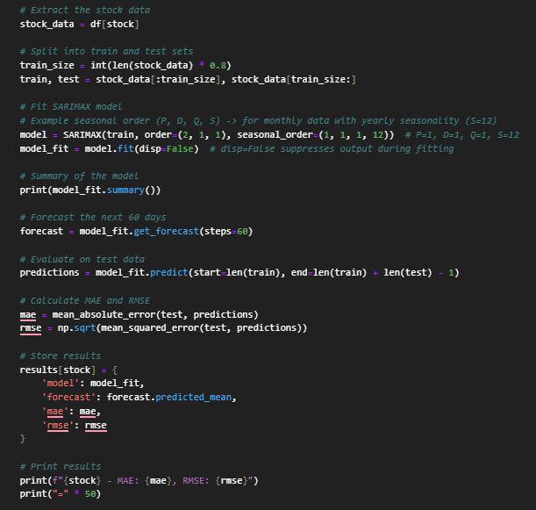
SARIMAX

Slide 23
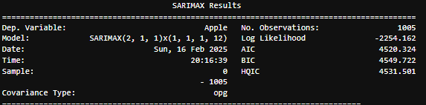
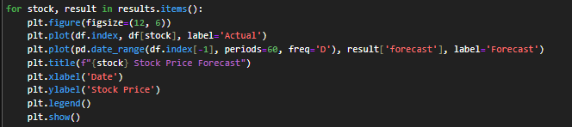
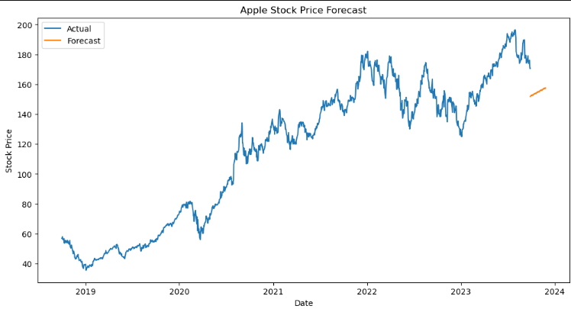
SARIMAX (Apple)

Slide 24
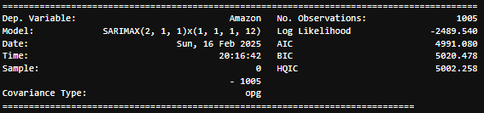
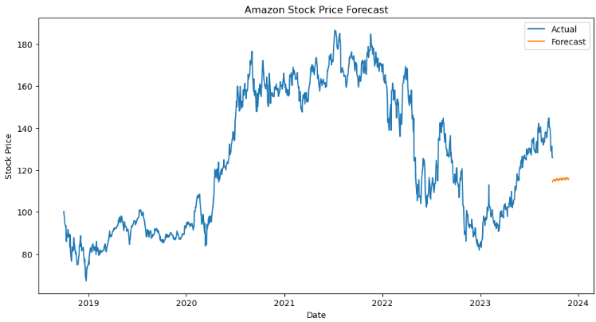
SARIMAX (AZ)

Slide 25
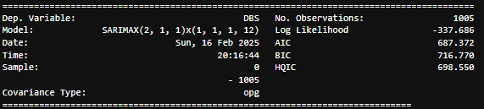
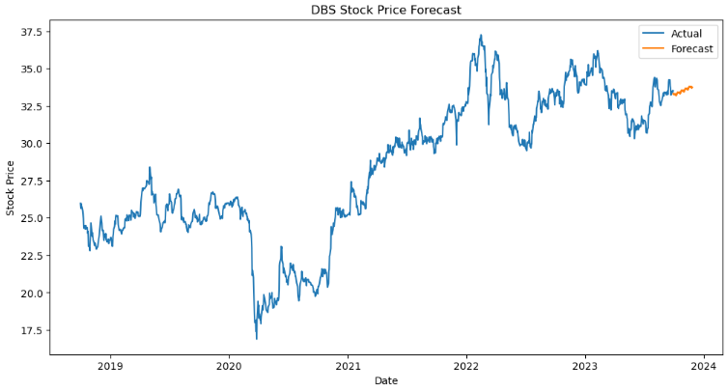
SARIMAX (DBS)

Slide 26
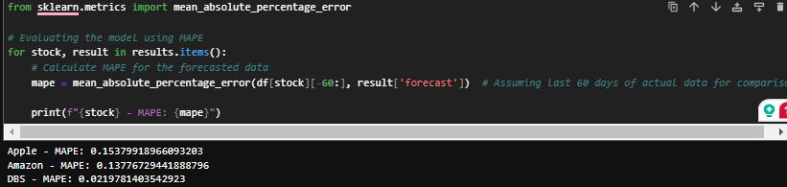
MAPE

Slide 27

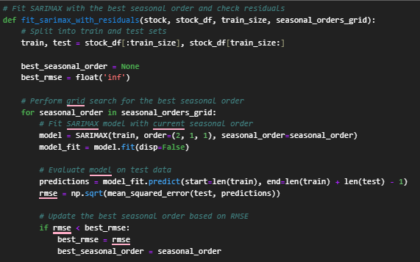
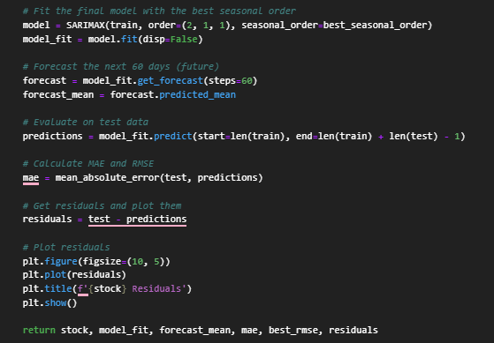
SARIMAX Params Tuning (1)

Slide 28
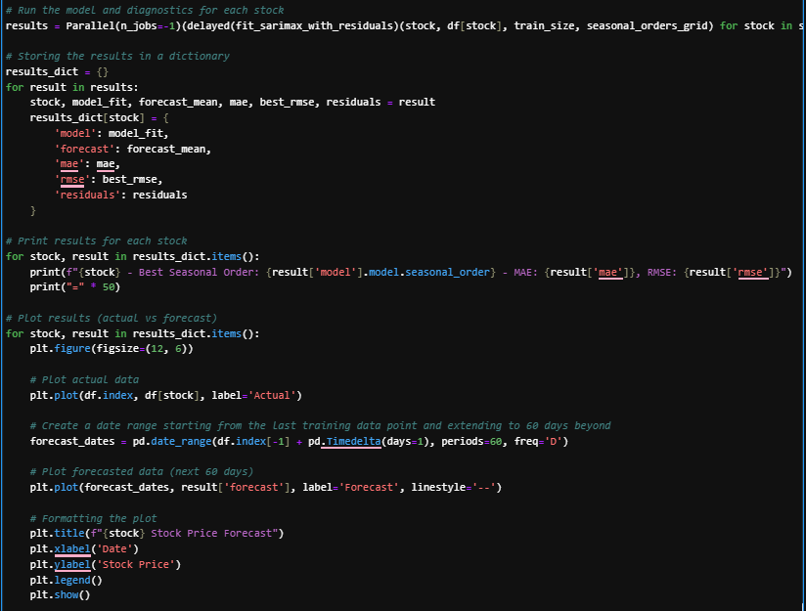

SARIMAX Params Tuning (2)

Slide 29
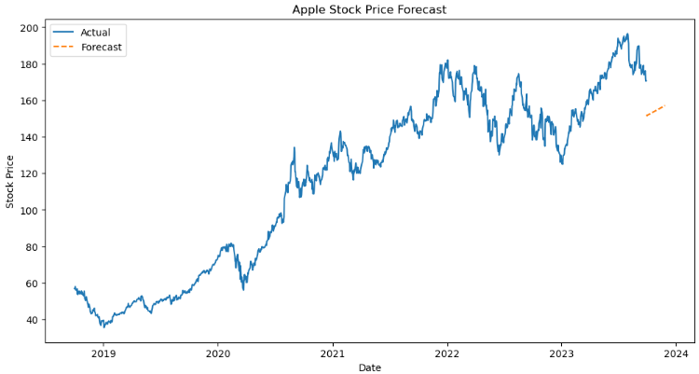
SARIMAX Params Tuning (3) Apple
After Tuning
Before Tuning

Slide 30
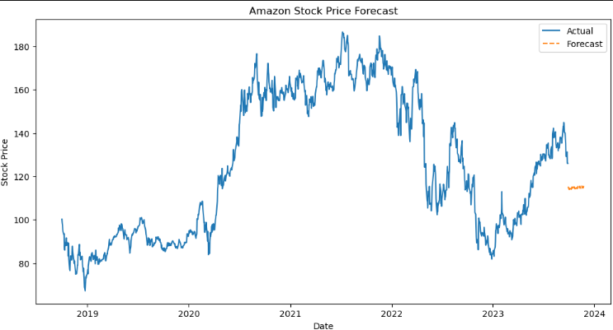
SARIMAX Params Tuning (4) AZ
After Tuning
Before Tuning

Slide 31

SARIMAX Params Tuning (5) DBS
After Tuning
Before Tuning

Slide 32

MAPE Score

Slide 33

Residuals

Slide 34


Residuals
Notes:
Interpreting the residuals from a SARIMAX model (or any time-series model) involves looking for patterns or abnormalities that may indicate the model’s performance and any potential improvements. Here's how you can interpret the results from the residual plots:
1. Residuals Plot
Expected Behavior: The residuals should resemble white noise, meaning they should be randomly scattered around zero with no apparent pattern. This indicates that the model has captured the underlying structure of the data.
Ideal Interpretation: If the residuals are randomly distributed and show no clear trend or seasonality, your model is doing a good job.
What to look for:
Patterns: If you see a pattern, like systematic upward or downward movements, or periodic spikes, it suggests that the model has not fully captured some aspect of the data, such as seasonality or trend. This might mean the model requires further adjustments (e.g., adjusting seasonal periods, adding/removing terms in the SARIMAX specification).
Outliers: Large spikes or outliers in the residual plot may suggest a poor model fit for certain data points. In this case, you might need to investigate those specific instances to understand why the model is underperforming.
2. Zero Line (Horizontal Line at 0)
Expected Behavior: Residuals should oscillate around zero. This means your model isn't systematically over or under-predicting. It should ideally have an equal number of residuals above and below zero.
Interpretation: A strong bias in the residuals (e.g., all the residuals are above or below zero) indicates that the model has a tendency to overestimate or underestimate the values. This could be resolved by adjusting the model, adding a trend, or reconsidering the order of differencing (for SARIMAX).
3. Histogram of Residuals
Expected Behavior: The histogram should ideally resemble a normal distribution. If the residuals are normally distributed, this suggests that the model is capturing the underlying data structure well.
Interpretation:
Normal Distribution: If the residuals are approximately normally distributed (bell-shaped), this indicates the model is performing well and errors are random.
Skewed Distribution: If the histogram shows skewness (e.g., a long tail to the right or left), it may indicate that the model has trouble predicting extreme values and needs adjustments.
Heavy Tails (Kurtosis): If the histogram has fat tails, it suggests that the model might not handle outliers effectively, and some data points are being poorly predicted.
4. Autocorrelation of Residuals (ACF/PACF Plots)
Optional: To further evaluate the residuals, you can plot the autocorrelation function (ACF) or partial autocorrelation function (PACF) of the residuals.
Expected Behavior: If the model is correctly specified, the residuals should be uncorrelated, meaning that there should be no significant correlations at any lags.
Interpretation:
No Significant Correlation: If the ACF/PACF plots of the residuals show no significant correlation at any lags (i.e., the bars are within the confidence intervals), then the model is likely well-specified.
Significant Correlation at Lags: If you see significant autocorrelation at certain lags, this suggests the model has missed important temporal structure (seasonality, trend, or cyclic patterns). This would indicate a need for adjusting the model by adding more terms or rethinking the seasonal/ARMA specifications.
5. Statistical Tests for Residuals
Optional Tests: You can perform certain statistical tests to evaluate the residuals further:
Shapiro-Wilk Test or Jarque-Bera Test: These tests assess whether the residuals are normally distributed.
Ljung-Box Test: This test checks if there is any significant autocorrelation at multiple lags.
Interpretation: If the p-value of these tests is low (typically below 0.05), it suggests that the residuals are not behaving like white noise, and you may need to revisit the model.
Summary:
Good residuals: Random scatter around zero, no discernible pattern, no significant autocorrelation, and approximately normal distribution.
Poor residuals: Any systematic pattern, non-random oscillations, or significant autocorrelation. Skewed or non-normal histograms may also indicate a need for model refinement.
If your residuals are not showing random behavior, you may need to:
Adjust the model’s parameters (e.g., change the seasonal periods or the type of trend).
Add more complexity (e.g., additional lags or seasonal components).
Investigate if the data has some other underlying feature not captured by the model.
By interpreting the residuals carefully, you can determine whether your SARIMAX model is working effectively or if adjustments are needed.

Slide 35
Conclusion
MAPES | HWES | SARIMAX (Before) | SARIMAX (After)
Apple | 10.43% | 15.37% | 15.64%
Amazon | 14.72% | 13.77% | 14.43%
DBS | 3.48% | 2.19% | 1.97%
AIC | ARIMAX | SARIMAX | Variance
Apple | 4,517.02 | 4,520.32 | 0.07%
Amazon | 4,991.96 | 4,991.08 | -0.02%
DBS | 646.93 | 687.37 | 6.25%
BIC | ARIMAX | SARIMAX | Variance
Apple | 4,536.67 | 4,549.72 | 0.29%
Amazon | 5,011.60 | 5,020.47 | 0.18%
DBS | 666.57 | 716.77 | 7.53%

Slide 36
Sources
Help from both ChatGPT and DeepSeek

