Slide 1
Wine Dataset
Tan Han Rong
Let’s wine about it.

Slide 2
Contents Page
Description of data
Background Research
Data Exploration
Start of code
Elbow method
Silhouette Score
Clustering Methods
Evaluation Metrics
Scatter plot to better show the features
Conclusion
Sources

Slide 3
Description of data
Wine data updated by C.Blake in 1998.
178 instances
With 13 features donated by Riccardo Leardi.
1) Alcohol
2) Malic acid (too much: sour and tart, too little: flat taste)
3) Ash
4) Alcalinity of ash
5) Magnesium
6) Total phenols
7) Flavanoids (antioxidents, bitterness and astrigency of wine)
8) Nonflavanoid phenols (mostly derived from oak barrels the wine is stored in)
9) Proanthocyanins (responsible for colour change during aging, aroma, flavour, mouth-feel)
10)Color intensity
11)Hue
12)OD280/OD315 of diluted wines (Higher concentration, makes wine more bitter, but there is more protein)
13)Proline (affects viscosity, sweetness and flavour. It intensifies after taste, but elevated levels reduces wine quality.)

Slide 4
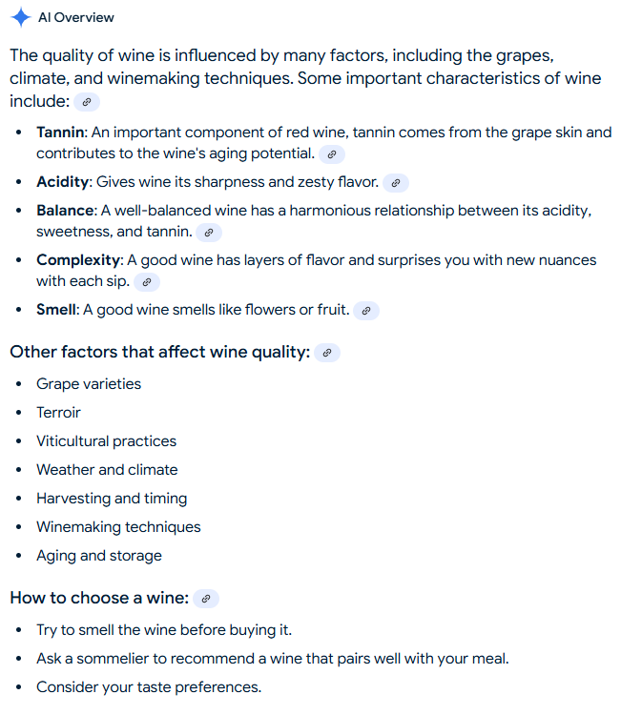
Background Research

Slide 5
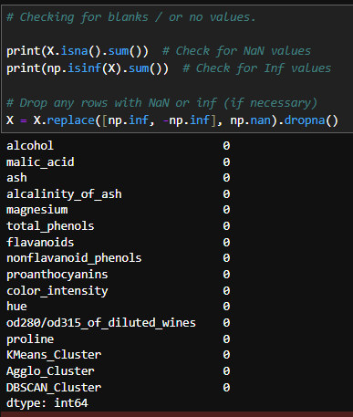
Data Exploration

Slide 6
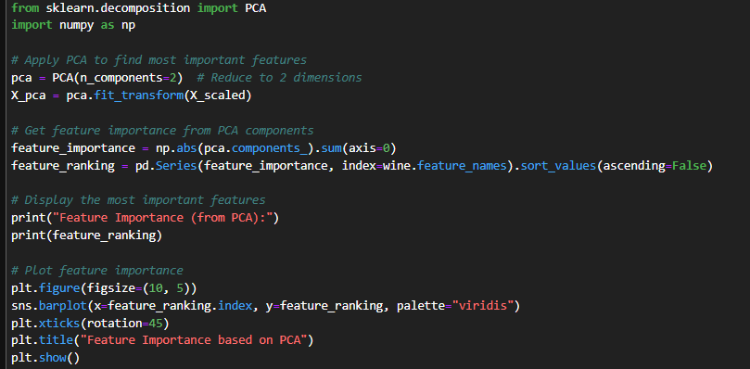
Data Exploration

Slide 7
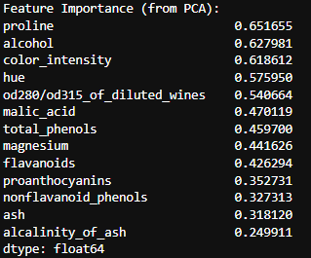
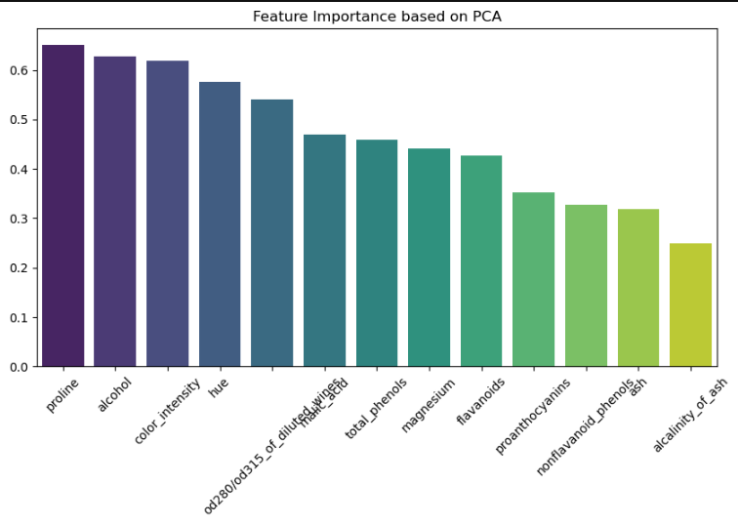
Data Exploration

Slide 8
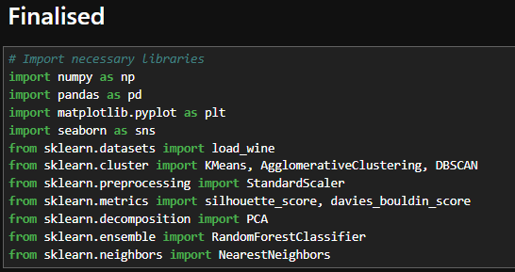


Start of code
Notes:
Scaler centers data around 0 and scales it to unit variance

Slide 9
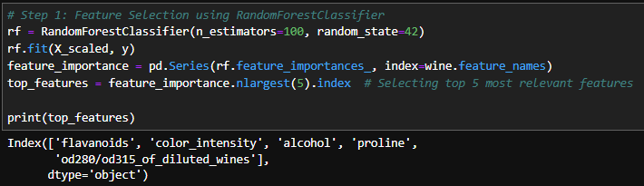
Data Exploration (with a different method)
Different from PCA rankings?!
Notes:
Using a model previously learn that fits multiple decision trees to learn which features are most important.

Slide 10
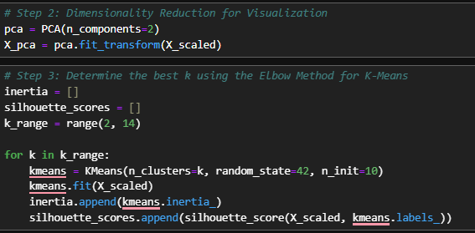
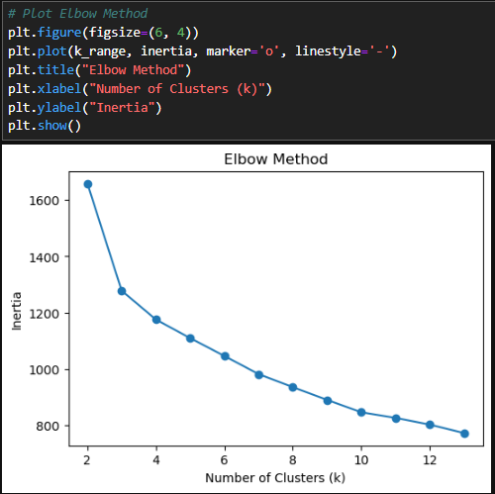
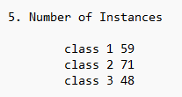
Elbow method
Sharpest decline is when k = 3
Post edit: coincidentally the same as in the data description.
Notes:
Reduces high-dimensional data to 2D for visualization
Applies PCA transformation to the standardized data
Inertia: Measures how tightly data points are clustered. Lower being better.

Slide 11
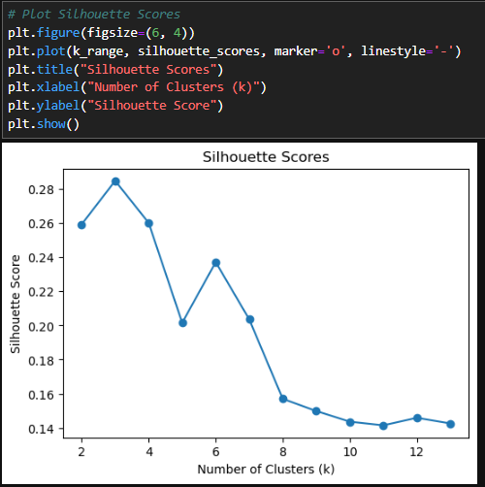

Silhouette Score
Highest silhouette score is also when k = 3.
Confirming k should be 3.

Slide 12

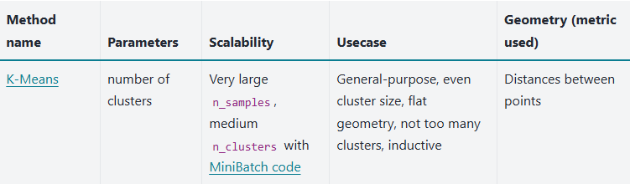

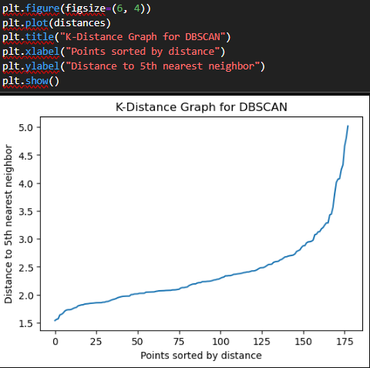
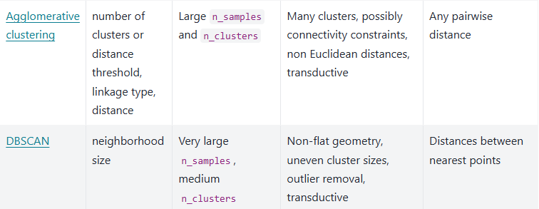
Clustering Methods
Source: https://scikit-learn.org/stable/modules/clustering.html#silhouette%02coefficient%20,
Notes:
n_neighbours = 5 being an arbritary number. As I felt any lower might be overfitting the model.

Slide 13
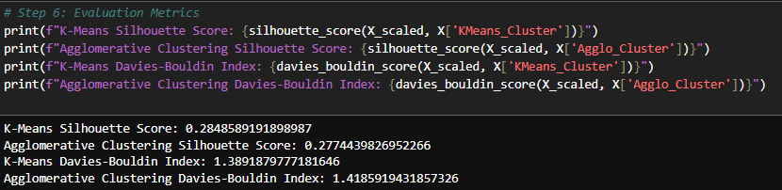
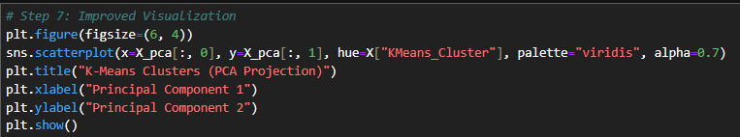
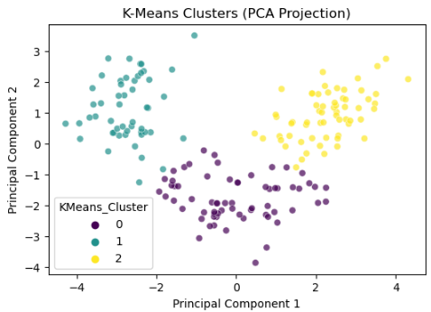
Evaluation Metrics
In terms of silhouette score, the higher silhouette score means that the model is better.
K-means is the higher of the two.
Used Davies- Bouldin Index to evaluate the clustering models.
In essence: Lower index indicates that the clusters are well-separated and compact, which is often a good indication of a successful clustering solution.
Between K-Means and Agglo,
K-means is the lower of the two in this scenario.
Source: https://www.geeksforgeeks.org/davies-bouldin-index/
Notes:
The Davies-Bouldin Index is a validation metric that is used to evaluate clustering models. It is calculated as the average similarity measure of each cluster with the cluster most similar to it. In this context, similarity is defined as the ratio between inter-cluster and intra-cluster distances. As such, this index ranks well-separated clusters with less dispersion as having a better score.
Advantages of the Davies-Bouldin Index
The DBI is a relative metric, which means that it can be used to compare the clustering results of different algorithms on the same dataset.
The DBI has a clear interpretation: a lower DBI value indicates more compact and well-separated clusters.
It is a relatively simple metric to calculate.
It provides a global measure of the quality of a clustering solution.
It is relatively insensitive to the choice of distance metric.
Limitations of the Davies-Bouldin Index
The Davies-Bouldin Index is sensitive to outliers and noise in the data.
The Davies-Bouldin Index does not take into account the structure or distribution of data, such as clusters within clusters or non-linear relationships.
The Davies-Bouldin Index only considers the pairwise distances between cluster centroids and cluster members.
The DBI can be computationally expensive to calculate for large datasets.
The DBI is not suitable for all clustering tasks. For example, it is not well-suited for clustering tasks where the clusters are not well-separated.

Slide 14
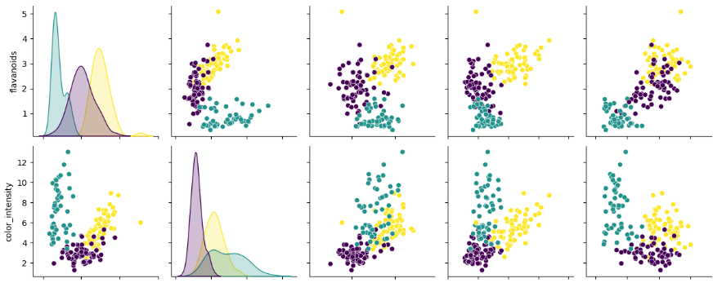

Scatter plot to better show the features (1)

Slide 15
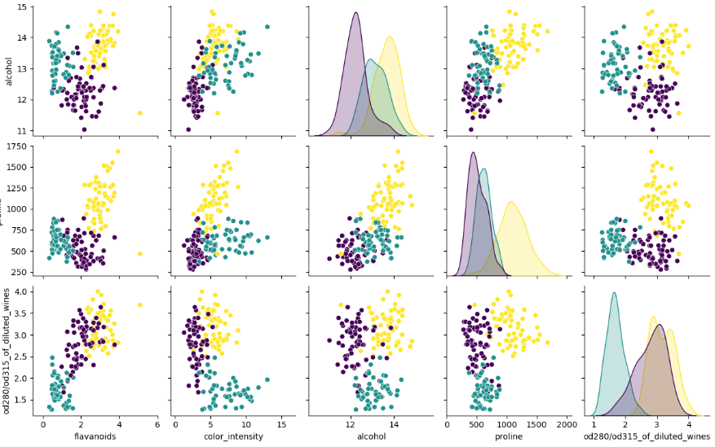
Scatter plot to better show the features (2)

Slide 16
Conclusion
Using feature selection by means of random forest classifier, the top 5 more important features are:
- flavanoids
- color_intensity
- alcohol
- proline
- od280/od315_of_diluted_wines
Out of the two clustering methods chosen, K-means is the better of the two for having a higher silhouette score and a lower Davies- Bouldin Index.

Slide 17
Sources
https://archive.ics.uci.edu/dataset/109/wine
https://www.google.com/search?q=od280%2Fod315+of+diluted+wines&rlz=1C1CHBF_enSG1000SG1000&oq=OD280%2FOD315+of+diluted+wines&gs_lcrp=EgZjaHJvbWUqBwgAEAAYgAQyBwgAEAAYgAQyDQgBEAAYhgMYgAQYigUyDQgCEAAYhgMYgAQYigUyDQgDEAAYhgMYgAQYigUyDQgEEAAYhgMYgAQYigUyDQgFEAAYhgMYgAQYigUyBggGEEUYOtIBBzk5M2owajmoAgCwAgE&sourceid=chrome&ie=UTF-8
https://www.rarewineinvest.com/news/2020/the-5-factors-that-are-important-for-the-development-of-wine/
https://scikit-learn.org/stable/modules/clustering.html#silhouette%02coefficient%20,
https://www.geeksforgeeks.org/davies-bouldin-index/

