Slide 1
Applied Machine Practice Report
Tan Han Rong
Prediction of survival of
Passengers in RMS Titanic

Slide 2
Table of Contents
Description of data
Prelimary Research and Refresher
Background research
Start of Code
Data Cleaning
Feature Engineering
Model Building
Evaluation
Submission of the Kaggle predictions
Improvements
References

Slide 3
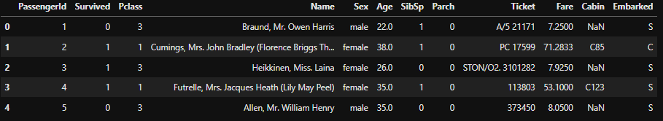
Description of data
RMS Titanic sank on April 15, 1912.
1,502 out of 2,224 passengers and crew passed on due to the lack of life boats.
Data is separated into 2 sets, one for training, and one for test and Kaggle submission.
Notes:
12 features, with the test set removing the survived column

Slide 4
Prelimary Research and Refresher
While looking through Kaggle, I found a tutorial by Alexis Cook.
Tutorial used Random Forest Classfier and mainly used Sex to train the model. (Other features included were Pclass, SibSp, Parch)
Ended with an accuracy score of 0.77511
Notes:
Did a tutorial and used it as a basis to serve as a benchmark/baseline

Slide 5
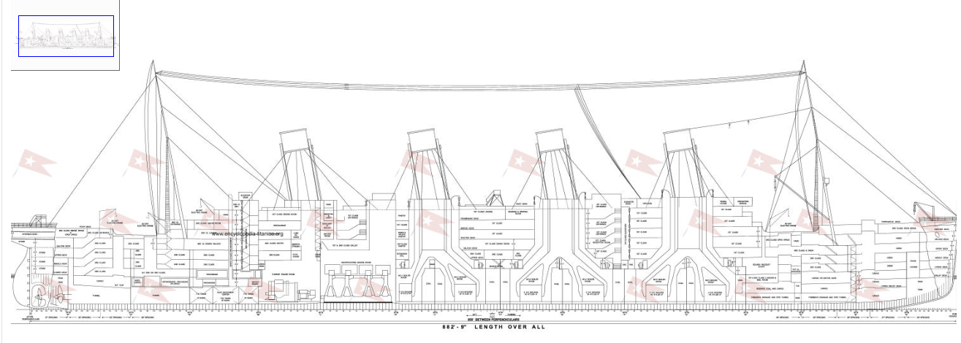
Background research
Went to search up more details on the Titanic

Slide 6
Background research
Classes: Purple - 1st Class, Green - 2nd, Black - 3rd
Cabin: It was abit too complex with the number of missing data
Notes:
It is noted that the first class are usually nearer to the top floor/ deck.
2nd Class is near the back/ aft/ stern of the ship, but still relatively close to the top decks.
3rd Class mixes with the crew and often seen near Store, Cargo / more dangerous areas of the ship. or even under the dining area of 1st Class
Cabin: It was abit too complex and time consuming to determine where each cabin was.

Slide 7
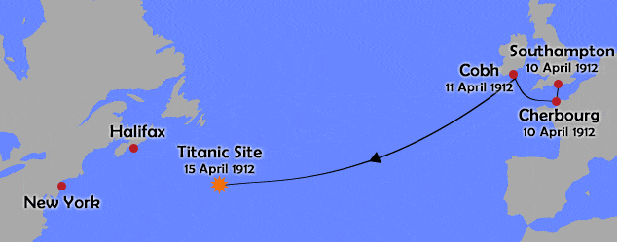
Background research
Embarkation sites
Considered finding out which town was richer, which will increase the likelihood of them buying the more expensive tickets.
After thinking about it, it will be reflected in the Pclass and likely reflected in the price of the ticket.
I do agree to a certain extent it will affect survivalbility

Slide 8
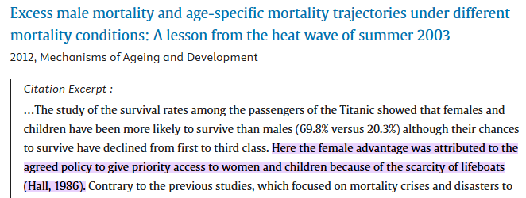
Background research
Gender and Age
On the faithful incident on the Titanic the women and children to be evacuated first order was enforced by the crew, and accepted by the passengers.
Onto the code...

Slide 9
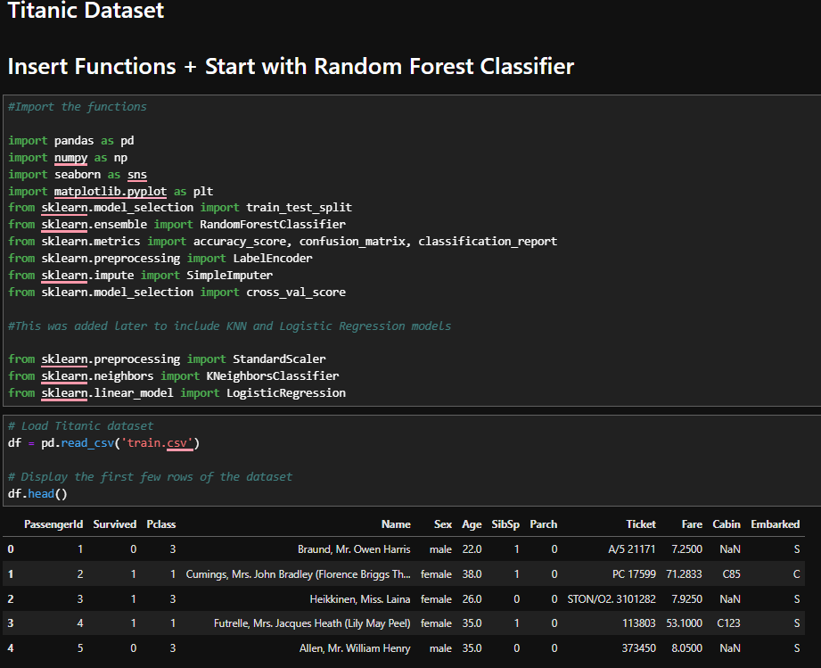
Start of Code

Slide 10
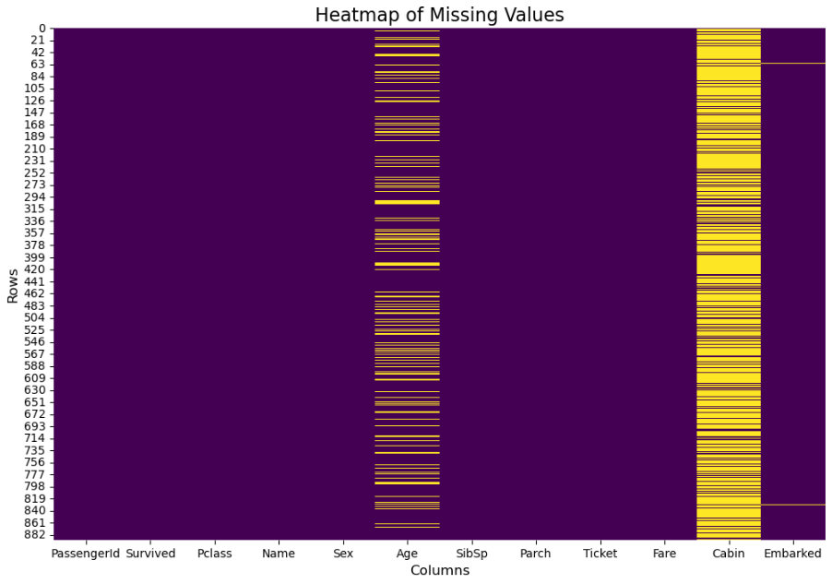

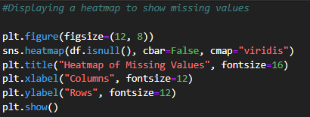
Data Cleaning
Checking for missing data

Slide 11
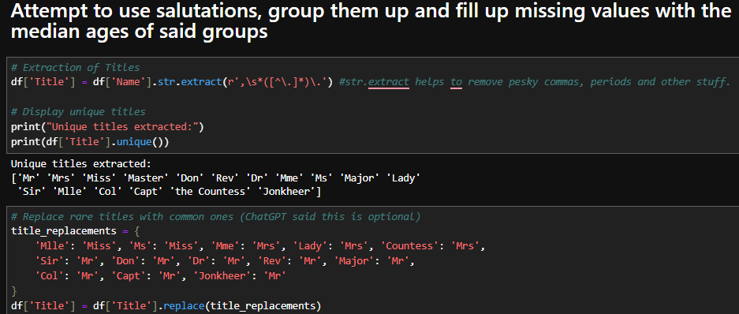
Feature Engineering
Started to group up names to get hints on their missing passenger ages

Slide 12
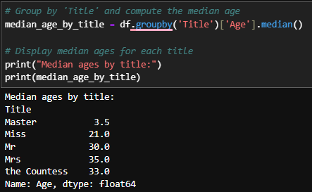
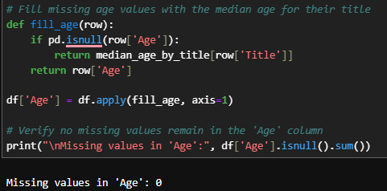
Feature Engineering
Used Median Age to prevent the age from being skewed if I used average.

Slide 13
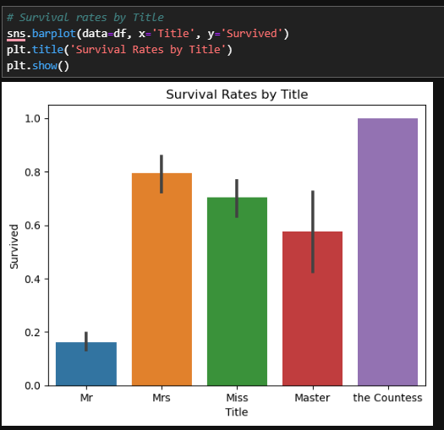
Feature Engineering
Sneak Peak at survival based on Titles

Slide 14

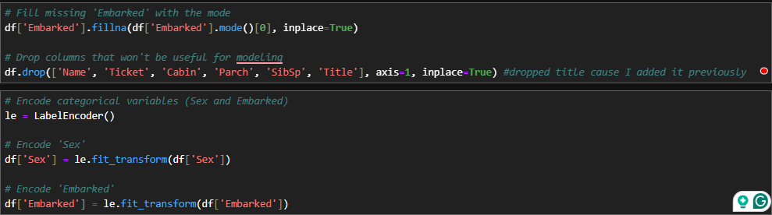
Feature Engineering
Embarkation
Encode to better fit the model

Slide 15
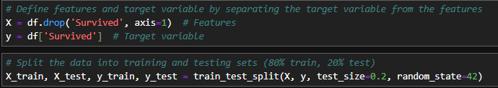
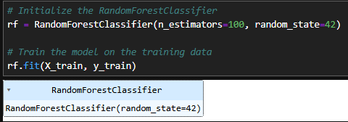
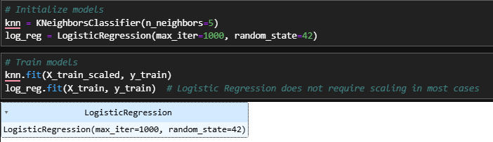
Model Building
Used Random Forest Classifier, KNeighbours Classifer and Logistic Regression
Notes:
Didn’t choose n_neighbours as 5 since it overfits as seen in classes/ labs

Slide 16
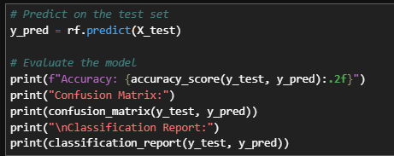
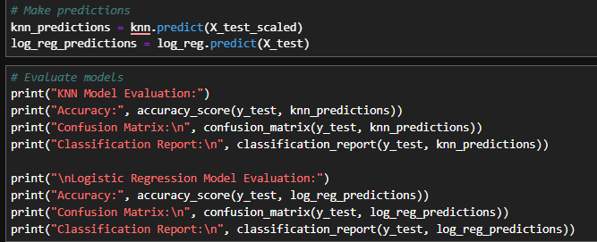
Evaluation
Making predictions

Slide 17
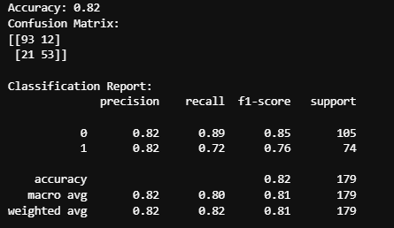
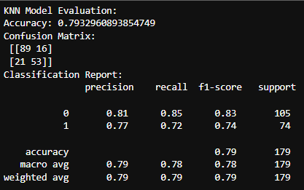
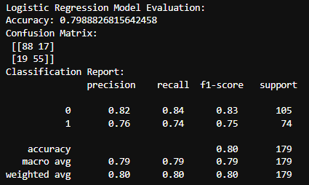
Evaluation
Random Forest / KNN / Logistic Regression (Respectively)

Slide 18
Evaluation
Random Forest / KNN / Logistic Regression (Respectively)
Going based on highest accuracy and better confusion matrix results

Slide 19
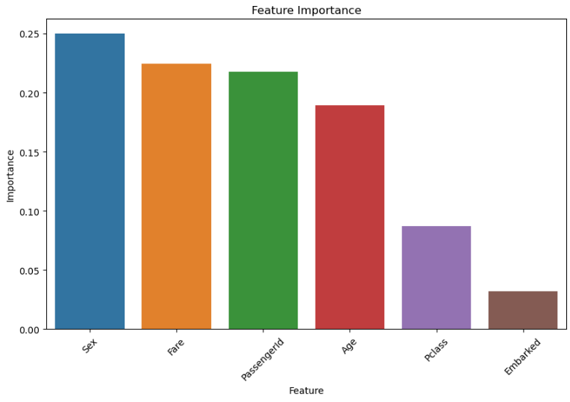
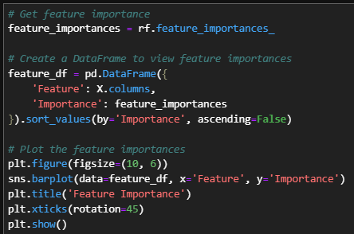
Evaluation
Feature Importance
Notes:
With the help of chatGPT

Slide 20
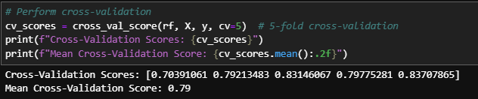
Evaluation
Cross Validation

Slide 21
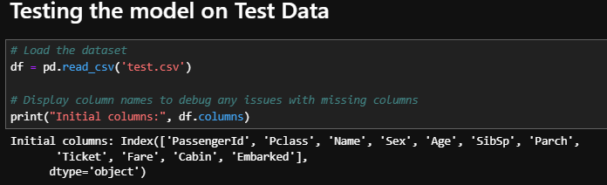
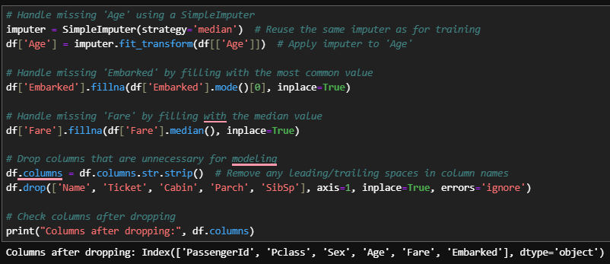
Submission of the Kaggle predictions
Loading and preparing the data to be similar conditions as in the train.csv

Slide 22
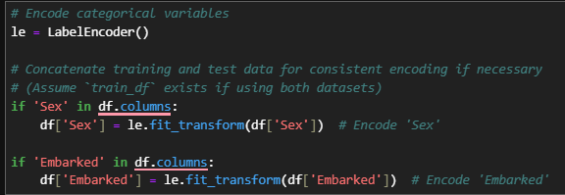
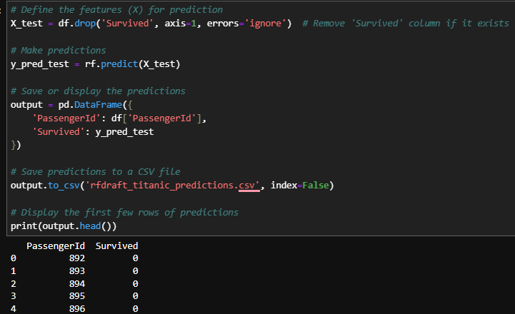
Submission of the Kaggle predictions
Encoding, Prediction and Output before upload to Kaggle

Slide 23
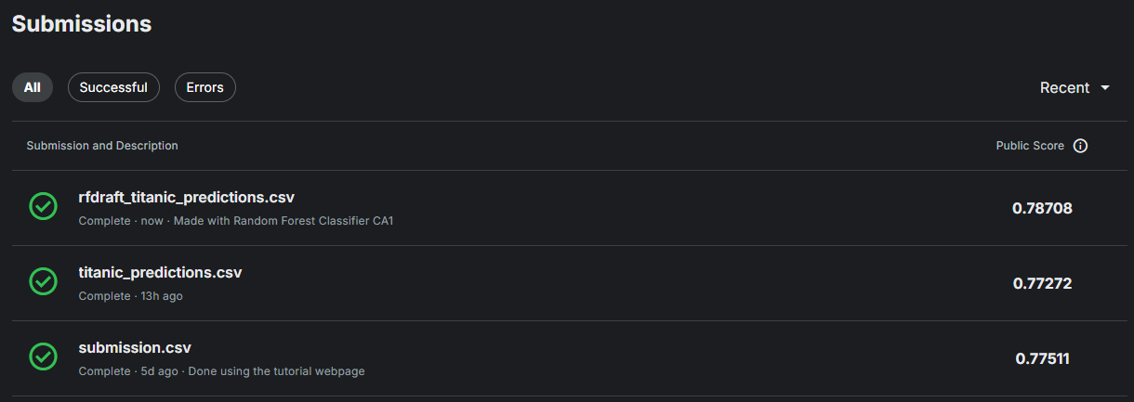
Submission of the Kaggle predictions
Results

Slide 24
Improvements
On hindsight
Tune hyperparameters (e.g changing the no. of neighbours)
Other types of feature engineering (e.g combining or making bands for age or price of tickets)
Ensemble methods (from ChatGPT)
Notes:
Tune: (number of trees, depth) using grid search or random search with cross-validation.
Ensemble methods combine predictions from multiple models to create a more accurate and robust predictive model. The idea is that different models may make errors on different parts of the data, so combining their predictions can cancel out individual weaknesses
Ensemble can be like boosting and strapping (What we have learn in the other module as well) Ai Human interfaces

Slide 25
References
https://www.kaggle.com/competitions/titanic/overview
https://www.kaggle.com/code/alexisbcook/titanic-tutorial/notebook
https://www.encyclopedia-titanica.org/titanic-deckplans/
https://www.linkedin.com/pulse/who-survived-titanic-data-exploration-journey-andy-lau/
https://rpubs.com/vpim/1144040
https://www.linkedin.com/pulse/titanic-route-data-set-albert-anthony-d-gavino-mba/
https://titanicfacts.net/titanic-maiden-voyage/
https://www.sciencedirect.com/science/article/abs/pii/0277953686900419#:~:text=Here%20the%20female%20advantage%20was,lifeboats%20(Hall%2C%201986).
https://www.theguardian.com/science/2010/mar/02/titanic-lusitania-women-children-survival
https://www.etymonline.com/word/master

Slide 26
Thank you

