Slide 1
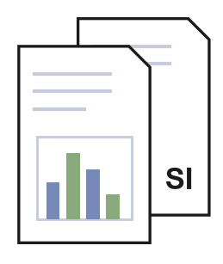
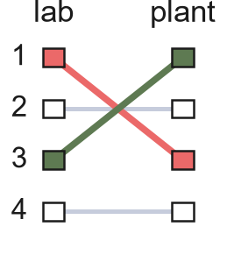
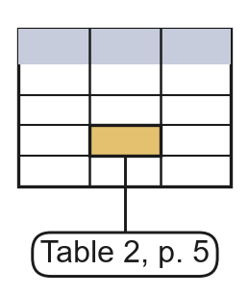
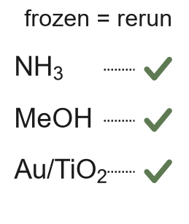
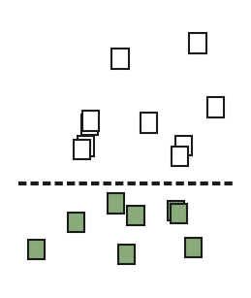
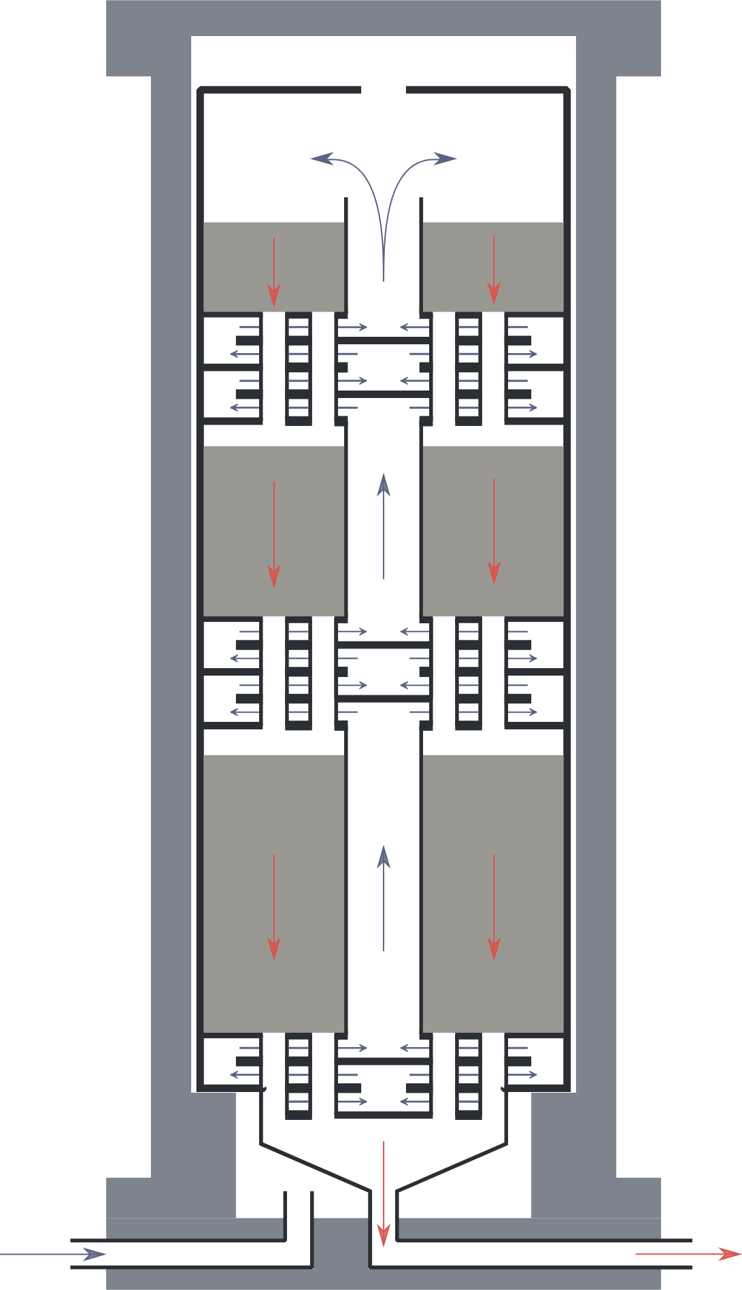
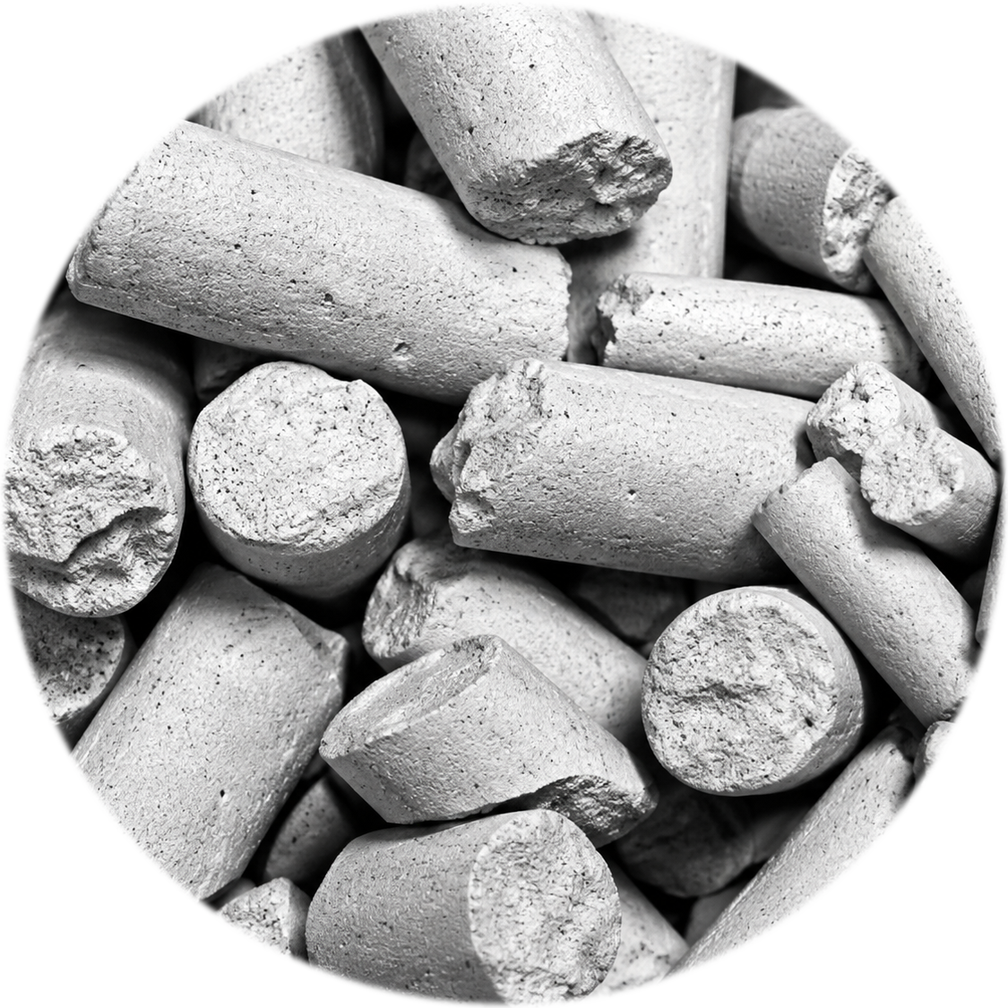
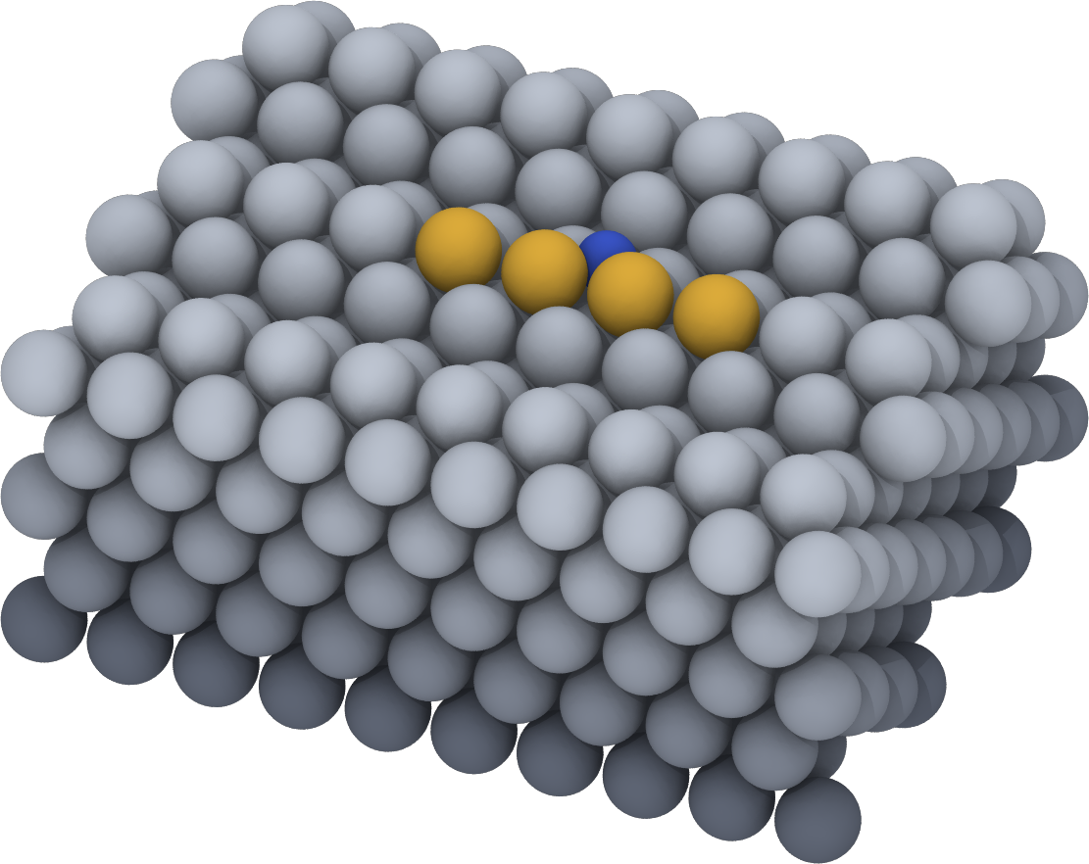
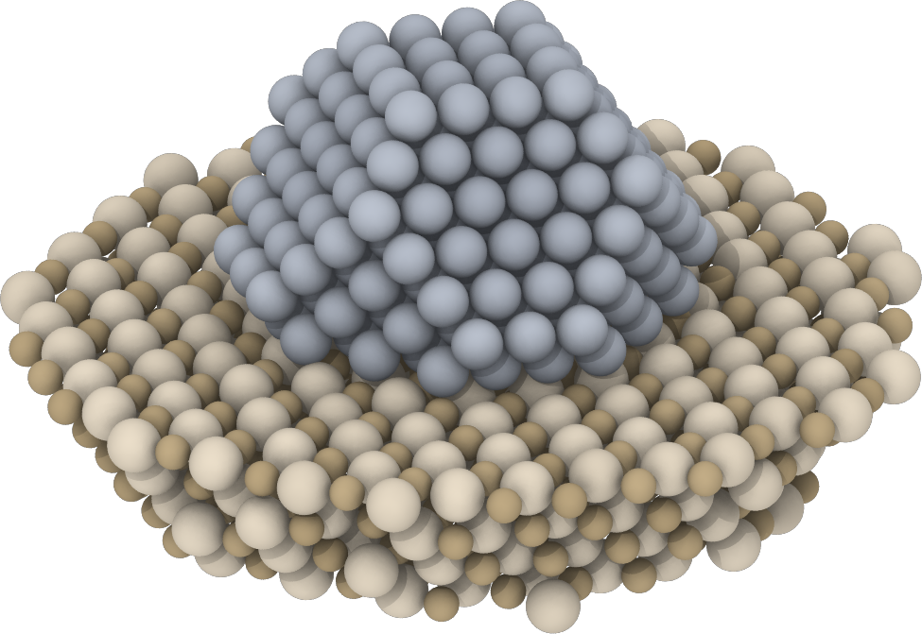
ACSA
language model
code
code
Literature
Leaderboards
Extract
Self-check
Bound
papers and SI:
90 methanol
52 ammonia
laboratory leader
vs plant-cost
leader (b, c)
every value with
unit and page
hand-built results
reproduced first
full optimization
only where needed
every candidate
plant cost
active site
supported particle
catalyst pellets
multibed converter
synthesis loop
cost per tonne
flows, duties and
catalyst inventory
T, P, separator
and purge optimized
catalyst 1
catalyst 2
~1 nm
~10 nm
~5 mm
~10 m
USD or EUR t⁻¹
kinetics: descriptor turnover or measured rate law
process optimization
catalyst-dependent cost

