Slide 1
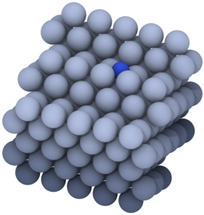
a
Atomic optimum
Laboratory optimum
Plant-level optimum
Descriptor, intrinsic turnover
Activity, STY at test conditions
Lowest cost after process optimization
Ammonia synthesis
atomic → plant
CO
2
-to-methanol
laboratory → plant
Au/TiO
2
control
laboratory → catalyst requirement
recycle
USD t⁻¹
TOF
E
NH
3
(l)
N
Atomic descriptor
Microkinetics
Laboratory test
Catalyst inventory
Synthesis loop
Economics
N* at the step,
E
N
TOF at 673 K
Measured rate, STY
V
bed
≤ 90 m
3
T
,
P
,
T
sep
catalyst-dependent
reoptimized
cost
Backward design

