Slide 1


Welcome to STM32WBA55 workshop Hands-on #2 Build basic p2pServer application and connect
Workshop team

Slide 2
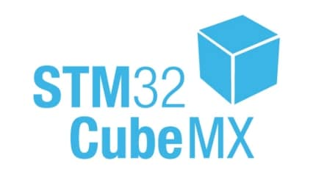

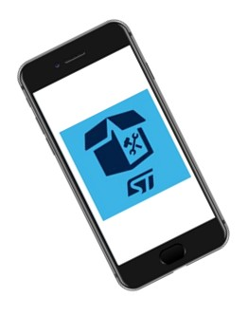
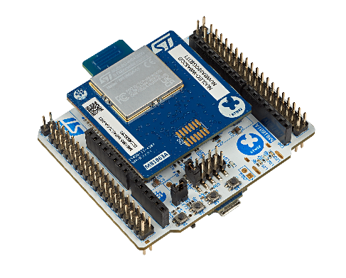
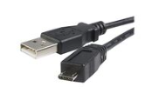

Prerequisites Refresh
SW prerequisites
STM32CubeWBA MCU package v1.2.0
IDE: STM32CubeIDE 1.14.0
A serial terminal (e.g. TeraTerm)
ST BLE ToolBox Smartphone application
Dedicated “cheat sheet”
NUCLEO-WBA55
USB A to Micro-B Cable
MB1863
HW prerequisites
MB1801
ST BLE Toolbox

Slide 3
Agenda
1
Hands-on Presentation
3
Step 2 : Application code
2
Step 1 : Profile creation demystification and details

Slide 4
Hands-on presentation

Slide 5


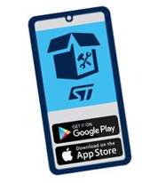
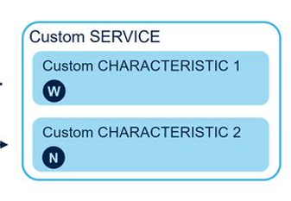
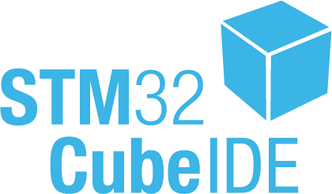

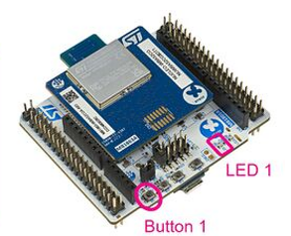

Purpose
The purpose is to start from WBA55 chipset level and build a basic server (p2pServer) application using STM32CubeMX and associated STM32CubeIDE
In this second part, focus is to enhance existing application code (Hands-on #1) to control device and share data
Attribute Table
STM32WBA55
BLE server/peripheral exposing data
Enhance application code to enable a Bluetooth® Low Energy Application Profile (p2pServer)

Slide 6
Legenda
Slides including following symbol are purely theoretical ones
Source code for development is included inside blue boxes
HAL_Delay(500);

Slide 7
Step1 : GAP/GATT custom application configuration : Profile creation

Slide 8
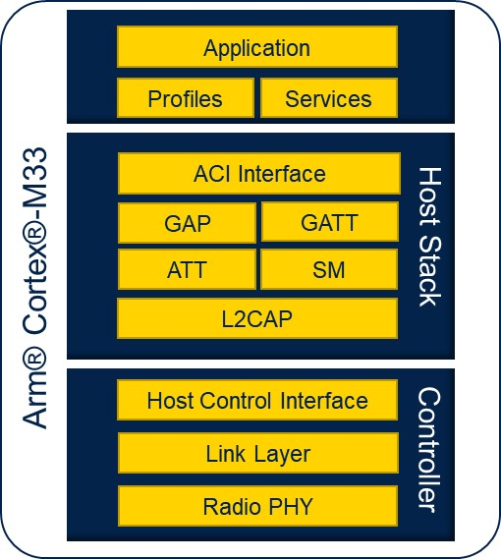
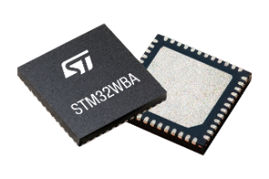
What is a Bluetooth Low Energy Profile Attribute Protocol (ATT)
Define Client - Server architecture
« I am looking for data »
Client
« I have data to share» (sensors, raw data...what you want !)
Server
Logical data structure – « How to access data » : Attribute table
user data is accessible trough attribute
UUID
service
UUID | value
value = user data
characteristic
data
UUID | value
value = user data
Notes:
The Attribute Protocol (ATT) defines how data is represented in a BLE server database but also the methods by which that data can be read or written.
It defines :
- Server/Client architecture.
- How to access data (Attribute table) : attributes are types (service .characteristic ID, associated permissions and of course data field.
ATT protocol defines also method to access those attributes. Hence this ATT protocol will allow to exchange data over BLE (basically : we are talking about write, read functionalities)

Slide 9
What is a Bluetooth Low Energy Profile ?
A profile is a collection data (attributes) exposes by device trough associated Service and Characteristic
Profile
All attributes have a type which is identified by a UUID (Universally Unique Identifier)
Characteristic can take 3 types of propreties: READ, WRITE, NOTIFY
Profile can be defined by Bluetooth® SIG
Profile can be a custom (proprietary) profile
Service
UUID
Characteristic
R
UUID
Service
UUID : 16 bits
Service Heart Rate 0x180D
Characteristic Heart Rate Measurement 0x2A37
UUID
Characteristic 1
W
UUID
Characteristic 2
UUID : 128 bits
Service P2P 0000FE40-cc7a-482a-984a-7f2ed5b3e58f
Characteristic LED 0000FE41-cc7a-482a-984a-7f2ed5b3e58f
R
N
UUID
Notes:
What is a BLE profile ?
- A BLE profile (application layer level) establish how to exchange user data over a BLE connection. This is a collection of attributes exposes by devices through associated Service and Characteristics.
BLE profile will defie the the way we want to expose and exchange data for our specific application
Attributes are the smallest addressable data entity. We will come to it in coming slide.
A profile can contains one or more services, each service can have one or more characteristics. All services and characteristics are identified by a UUID.
This UUID can be 16 bits (standard profile defined by BT SIG) or 128 bits (custom profile)
Then each characteristics can have different properties :
- READ : It means that the characteristic value can be Read by client.
- WRITE : it means client can modify and write into this characteristic.
- Notify : It means client can register to notification on this characteristic to be “notified” each time characteristic is modified by Server.

Slide 10
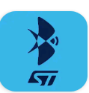
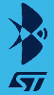
Bluetooth® Low Energy standard profile vs. proprietary profile
Standard Heart Rate Profile
Proprietary ST P2PServer Profile
Heart Rate Service
P2P Service
0x180D
0x0000FE40CC7A482A984A7F2ED5B3E58F
Heart Rate Measurement
Characteristic
My_LED_Char
0x2A37
0x0000FE41CC7A482A984A7F2ED5B3E58F
Body sensor Location
Characteristic
SWITCH_C
0x2A38
0x0000FE42CC7A482A984A7F2ED5B3E58F
Define by the SIG, define the role, requirements, behavior and the structure of Attribute Table of each entity (central & peripheral)
Define your own behavior using your own Attribute Table based in 128 bits UUID
Any standard smartphone App will be able to communicate
Only your own App will be able to communicate
Notes:
SIG : Bluetooth Alliance
What is the main interest of standard profile ? A standard profile ensure interoperability with any standard smartphone App (make sense for medical) like heart rate.
As we speak about standard define by BT SiG => I you want to use standard profile, you need to go for profile certification (on top of BT and RF certification). ST is providing a collection of standard profile (ready to use) , but ST is no more certifying standard profile as here only few very few (2) customers are using it.
Most of the case, customers are using “proprietary profile”. interoperability is usually not a strong concern (most of the case you want to avoid this interoperability). Each customer can define its own profile as he want.
IN case of proprietary profile, you need to handle both Server and client side – If client is a smartphone, you need to develop your own Smartphone app which support this proprietary profile.

Slide 11

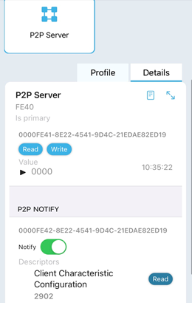
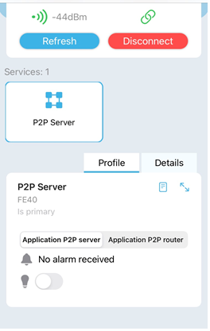
Proprietary profile ST Toolbox App
ST ToolBox App knows that My_LED_Char proprietary UUID is defined to toggle led .
As consequence App displays nice toggle button
Notes:
In case of proprietary profile like here with “ST P2P Server profile”, both client and sever must implement this proprietary profile. If not, it can not interpret data exchange.
Using smartphone Application “ST BLE toolbox” connected to “P2P Server example” running on STM32WBA52.
As they both implements same “ST P2P Server profile” . “ST BLE toolbox” recognize this proprietary profile thanks to UUIDs.
It can then propose a smart interface to exchange data. As an example, Modifying LED characteristics is displayed by application using a toggle button.

Slide 12
Data exchanges what is the magic behind ?
WBA55 - Attribute Table (RAM)
As soon as connected client will discover server attribute table (handle), it will be able to access (write/read) data
#2
#1
At profile initialization and entry point (handle @ ) will be created in RAM to expose data to client
@ Serv
@ Char
@ Char +1
service UUID
W
R
N
user data
char UUID
BLE write, read, notify procedures using the right attribute handle make data exchange possible
#3
Application will update data (ie : push button), client will receive notification with data updates
@ Char
@ Char +1
@ Serv
W
R
N
update data
Notes:
Going one step forward.. How it works to exchange data between server and client ?
Most of you already heard about “Attribute table”. This attribute table is created in Server RAM and it is used to exposed data to client.
It can be seen as a “big table” with entry point to access data.
Once connected, client will discover this “attribute table” exposed by Sever. After that, Client will be able to access data (read/write operation) thanks to discovered attribute handles

Slide 13


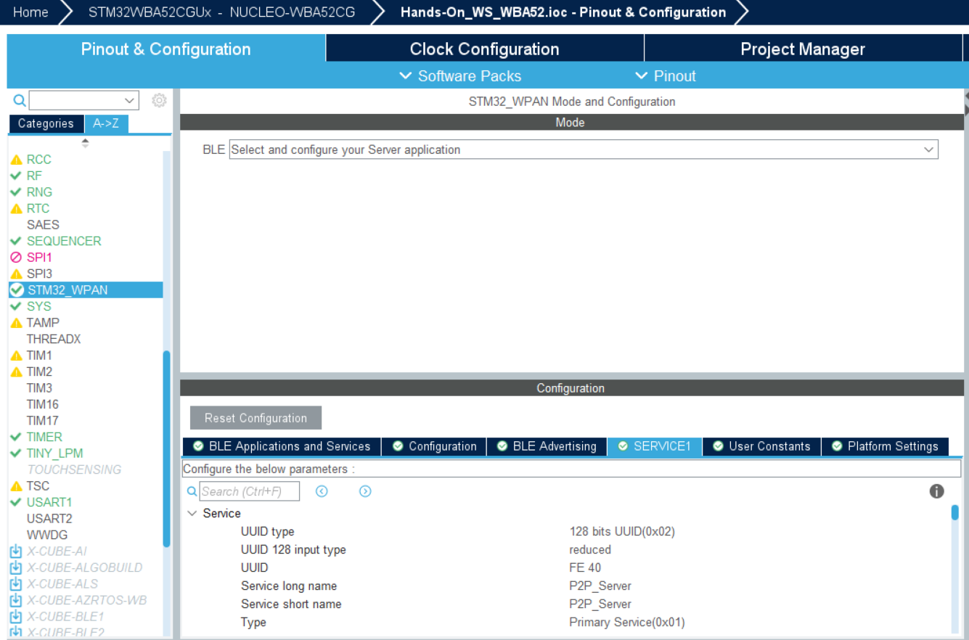
Profile Creation
You succeed
More or less…
Hands-on #1
Hands-on #1
start back from running .ioc
load Hands_On_WBA55_backup.ioc
Notes:
Let’s practice a bite now…. What is the final status of your HandsOn#1 ?
Success => Let’s continue using same CubeMX project (.ioc)
If not, we propose a recovery procedure using Hands-On_WS_WBA52_complete.ioc

Slide 14
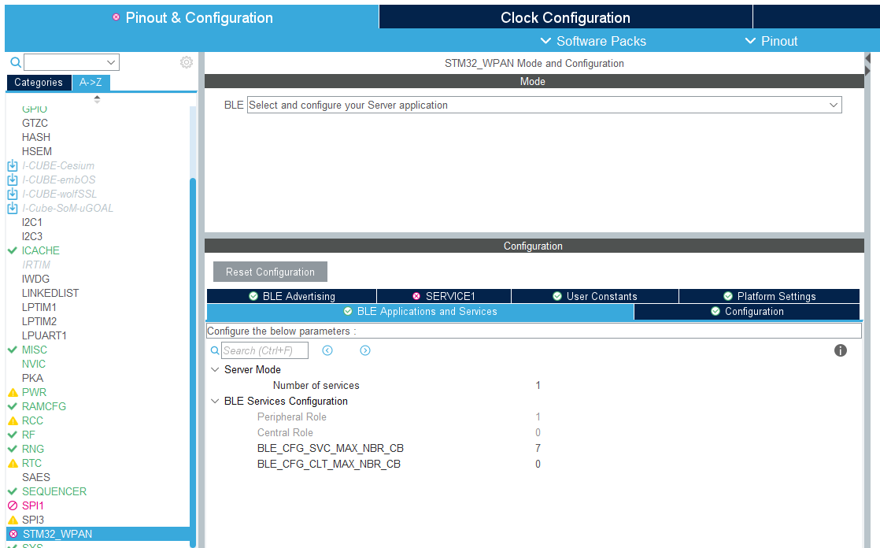

Profile Creation Service
3
P2PServer Profile
1
2
P2P Service
My_LED_Char
SWITCH_C
Notes:
Let’s go … back to CUbeMx

Slide 15
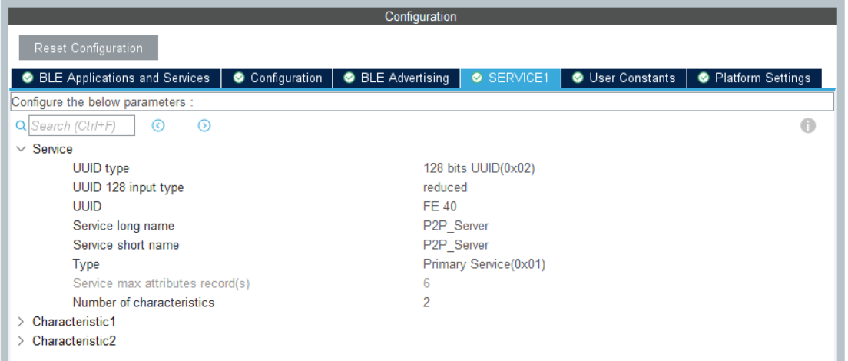
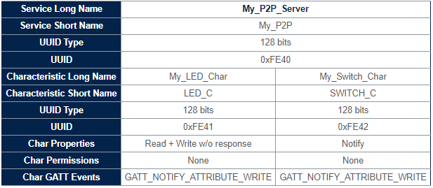

Profile Creation Configure my P2P Service
1
2
service & characteristic naming used to name function at code generation
Use : “P2P_Server”
UUID : FE 40
The application code will append 112 bits ( based on UUID generator) to have a complete 128 bits UUID
Notes:
Take care of the name her : Must be P2P_Server as this name is used in code generation – Otherwise, you will have to adapt application code in second part of this handson !
Long name used into comment section on generated code
Short name used for file name, function name into code genaration

Slide 16
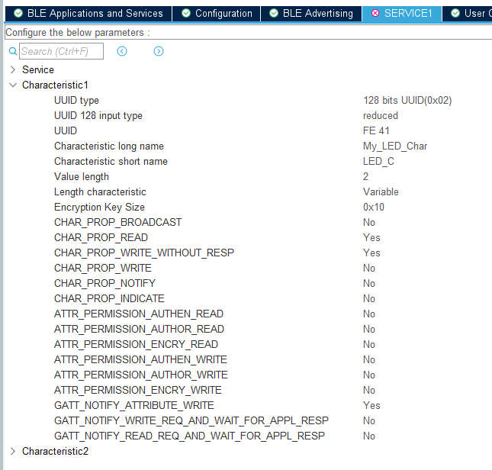
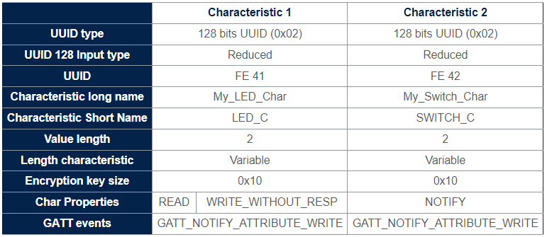
Profile Creation Configure 1st Characteristic
UUID : FE 41
Application code will complete to have a complete 128 bits UUID
1
Properties
Data (2 bytes) can be read and write.
The purpose of characteristic 1 is to write data in order to control LED
Permission
Thanks to notify write, application is informed that attribute has been modified and can accordingly process expected use case
2
Characteristic short name used at code generation
Use : “LED_C”
Notes:
Take care of the Char name here as names are used in code generation – Otherwise, you will have to adapt application code in second part of this handson !

Slide 17
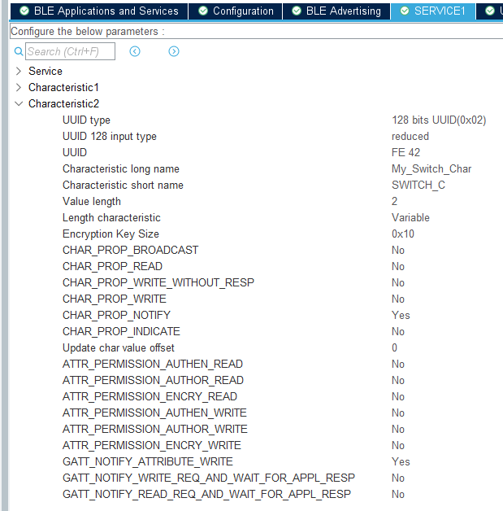
Profile Creation Configure 2nd Characteristic
UUID : FE 42
Application code will complete to have a complete 128 bits UUID
1
Properties
Data (2 bytes) as a notify characteristic
Each time user press button over NUCLEO, information sent to client
Permission
Here permission has not impact. The server is here sending data to client
2
Characteristic short name used at code generation
Use : “SWITCH_C”
Notes:
Take care of the Char name here as names are used in code generation – Otherwise, you will have to adapt application code in second part of this handson !

Slide 18
Configuration completed What’s next - Yes code generation
HW configuration
BLE parameters configuration
Profile creation
Code generation
Application code

Slide 19
Step 2 : Code generation and user application code

Slide 20

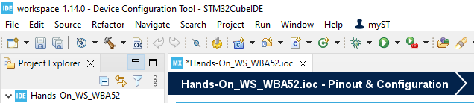
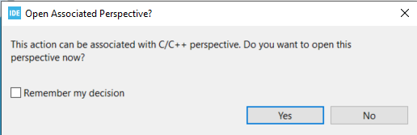
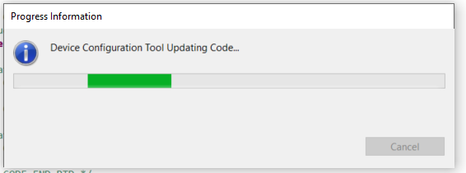
Code Generation
1

Slide 21
Configuration completed What’s next - Yes code generation
HW configuration
BLE parameters configuration
Profile creation
Code generation
Application code
Notes:
We generated profile.. But this is not enough for a complete application. We need to add application code attached to the different BLE operation.

Slide 22

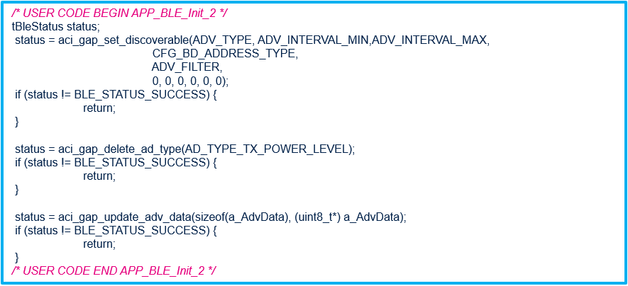

Remove previous code
Why should I remove previous functional code ?
As we have created profile, STM32CubeMX generated new skeleton code with more friendly APIs
Let’s use this API to move to discoverable !
X
Search for “APP_BLE_Init_2”
X
Search for “EVT_DISCONN_COMPLETE ”

Slide 23
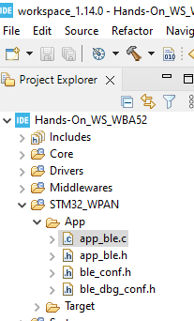
Add application code to move to discoverable
(ADV_MIN+ADV_MAX)/2
Set device discoverable at init :
In app_ble.c > function APP_BLE_Init()
/* USER CODE BEGIN APP_BLE_Init_2 */
APP_BLE_Procedure_Gap_Peripheral(PROC_GAP_PERIPH_ADVERTISE_START_FAST);
/* USER CODE END APP_BLE_Init_2 */
Search for “APP_BLE_Init_2”
Set device discoverable at disconnection :
In app_ble.c > SVCCTL_App_Notification - HCI_DISCONNECTION_COMPLETE_EVT_CODE
/* USER CODE BEGIN EVT_DISCONN_COMPLETE */
APP_BLE_Procedure_Gap_Peripheral(PROC_GAP_PERIPH_ADVERTISE_START_FAST);
/* USER CODE END EVT_DISCONN_COMPLETE */
Search for “EVT_DISCONN_COMPLETE ”
At disconnection, stack is not moving back to advertising, this is an application decision
Open Project
Add application code to move to discoverable
Build& Flash
Please refer to cheatsheet for copy/paste
Notes:
Please open & share as well cheatsheet STM32WBA Workshop (rristm.github.io)

Slide 24
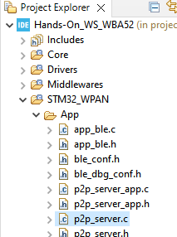
Add application code Toggle LED from client
write to My_LED_Char (FE 41)
write client procedure triggers an ACI_GATT_ATTRIBUTE_MODIFIED_VSEVT_CODE at server application level
in p2p_server_app.c / function P2P_SERVER_Notification()
/* USER CODE BEGIN Service1Char1_WRITE_NO_RESP_EVT*/
HAL_GPIO_TogglePin(GPIOB, LD2_Pin|LD3_Pin|LD1_Pin);
/* USER CODE END Service1Char1_WRITE_NO_RESP_EVT */<
Search for “Service1Char1_WRITE_NO_RESP_EVT”
Notes:
1st application code is to toggle LED when client is writing into LED characteristic.
For this, as soon as Client write data into LED characteristic (UUID : 0xFE 41) => BLE stack on server side will receive an ACI_GATT_ATTRIBUTE_MODIFIED_VSEVT_CODE event.
Here, we will simply toggle the LEDs when this characteristic is modified.

Slide 25
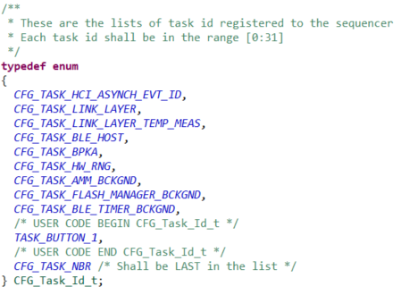
How to add a task in sequencer ?
#1
Define a TaskID for your « new task » :
In app_conf.h
define a new ID in enum CFG_Task_Id_t (USER code section)
#2
UTIL_SEQ_RegTask() to register your task in the sequencer
It associates a callback to your Task.
To be done only Once
UTIL_SEQ_RegTask(1U << TASK_BUTTON_1, UTIL_SEQ_RFU, APPE_Button1Action);
#3
UTIL_SEQ_SetTask() to notify the sequencer shall execute the registered task
It notify the sequencer that the task must be triggered.
It will generate a call to registered function
(here : APPE_Button1Action() )
UTIL_SEQ_SetTask(1U << TASK_BUTTON_1, CFG_SEQ_PRIO_0);
Notes:
We need now to handle “Button” - proper manner is to handle button push into a dedicated task of the sequencer.
A callback function is any reference to executable code that is passed as an argument to another piece of code;

Slide 26
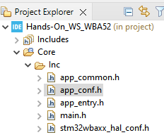
Add application code Raise an alarm from device to Smartphone(1/3)
notify peer device trough SWITCH_C (FE 42)
press button
#1
need to define specific task for button press
In app_conf.h
On press button use notify procedure use to push data to client
/* USER CODE BEGIN CFG_Task_Id_t */
TASK_BUTTON_1,
/* USER CODE END CFG_Task_Id_t*/
Search for “CFG_Task_Id_t ”
#2
register a « button task »
in p2p_server_app.c / function P2P_SERVER_APP_Init
/* USER CODE BEGIN Service1_APP_Init */
UTIL_SEQ_RegTask( 1U << TASK_BUTTON_1, UTIL_SEQ_RFU, P2P_SERVER_Switch_c_SendNotification);
/* USER CODE END Service1_APP_Init */
Search for “Service1_APP_Init ”
Function generated by CubeMx as per as Characteristic Short Name
Notes:
Let’s do it now for a “ButtonPress”.
In app_conf.h => Add new ID for this new task “button”
Rgister this task, and define P2P_SERVER_Switch_c_SendNotification as callback function.
It means that as soon as button task is triggered => It will call this “P2P_SERVER_Switch_c_SendNotification“

Slide 27
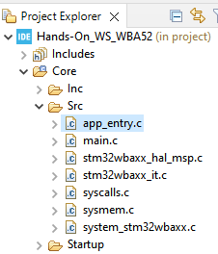
Add application code Raise an alarm from device to Smartphone(2/3)
notify peer device trough SWITCH_C (FE 42)
press button
#3
Manage Button1 interrupt : implement IRQ callback
In app_entry.c / function HAL_GPIO_EXTI_Rising_Callback
/* USER CODE BEGIN FD_WRAP_FUNCTIONS */
void HAL_GPIO_EXTI_Rising_Callback(uint16_t GPIO_Pin)
{
if (GPIO_Pin == B1_Pin)
{
UTIL_SEQ_SetTask(1U << TASK_BUTTON_1, CFG_SEQ_PRIO_0);
}
return;
} /* USER CODE END FD_WRAP_FUNCTIONS */
Copy function (weak) at end of file – under FD_WRAP_FUNCTIONS tags
Notes:
Now, we need to trigger the button task owhen Button B1 is pressed.
Just redefine weak function HAL_GPIO_EXTI_Rising_Callback() into app_entry.c
=> This is the GPIO IRQ function. On B1 press … simply trigger the Button task

Slide 28
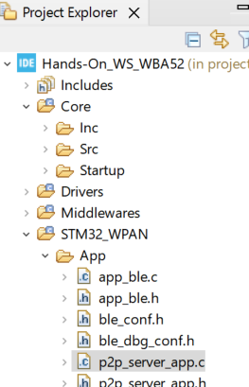
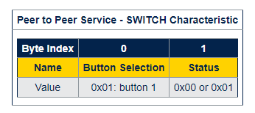

Add application code Raise an alarm from device to Smartphone(3/3)
notify peer device trough SWITCH_C (FE 42)
#4
Manage BLE notification procedure
In p2p_server_app.c/ function P2P_SERVER_Switch_c_SendNotification
/* USER CODE BEGIN Service1Char2_NS_1*/
a_P2P_SERVER_UpdateCharData[0] = 0x01; /* Device Led selection */
a_P2P_SERVER_UpdateCharData[1] = 0x00;
/* Update notification data length */
p2p_server_notification_data.Length = (p2p_server_notification_data.Length) + 2;
notification_on_off = Switch_c_NOTIFICATION_ON;
/* USER CODE END Service1Char2_NS_1*/
STM32WBA Bluetooth® LE – Peer 2 Peer Applications - stm32mcu
Search for “Service1Char2_NS_1 ”
P2P_SERVER_UpdateValue
aci_gatt_update_char_value
BLE stack API
Notes:
We also need to complete “P2P_SERVER_Switch_c_SendNotification” .
Idea is to push data on this switch characteristics on button press.

Slide 29
Time to build, flash and execute !
1
Build
2
Flash & Run
Open Project
Add application code to move to discoverable
Build& Flash

Slide 30
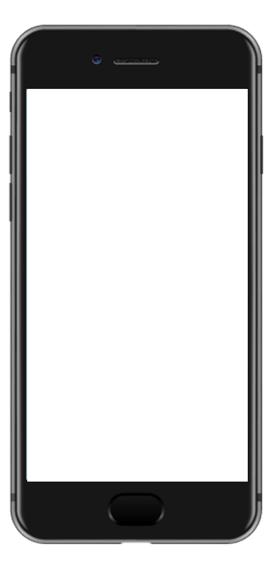


Open your App and Connect
ST BLE Toolbox

Slide 31
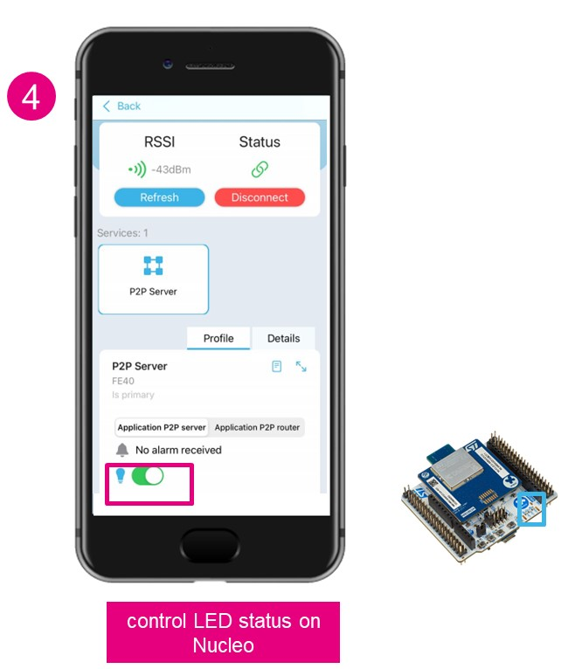
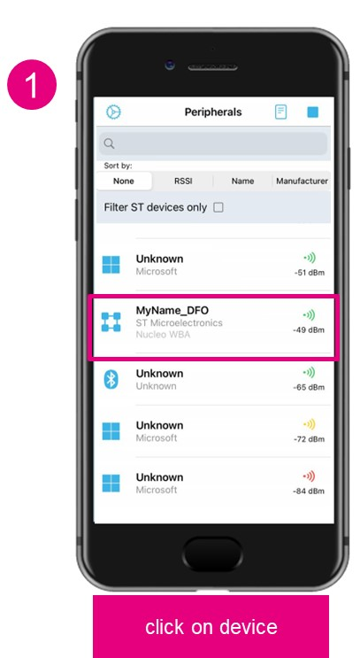
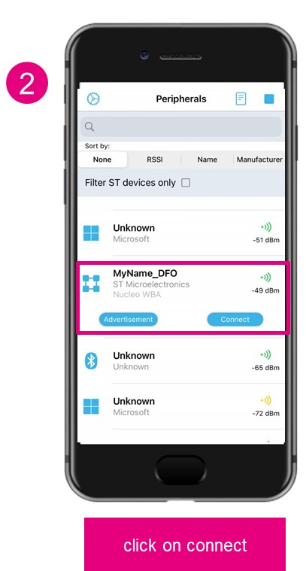
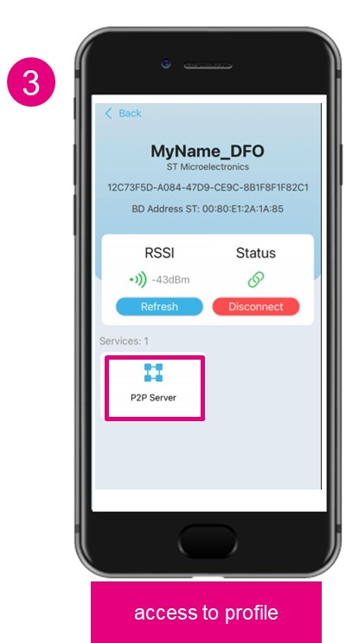
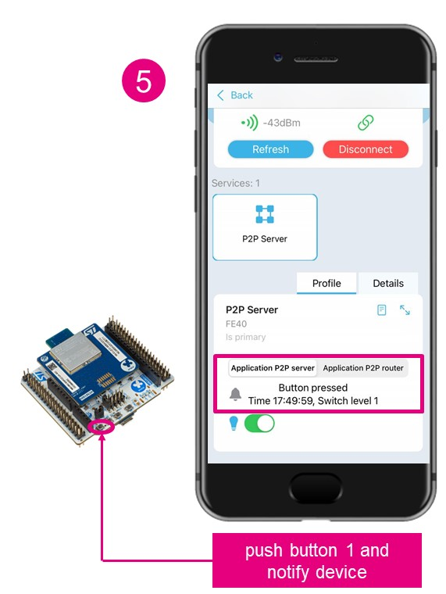
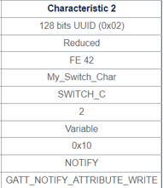
Open your App and Connect (1/2)
write client procedure control LED
notify procedure use to push data to client

Slide 32
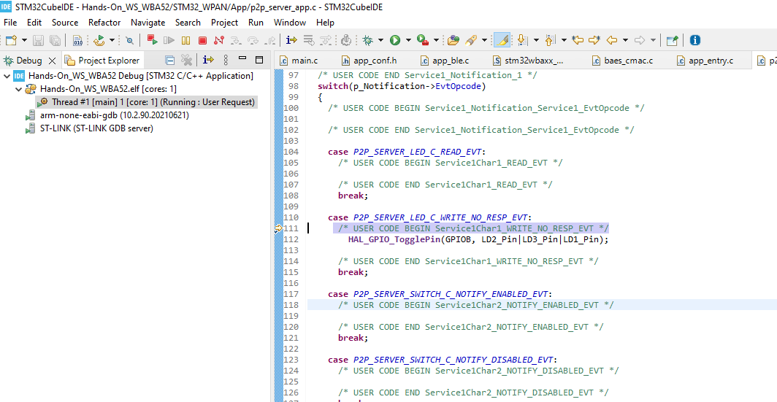
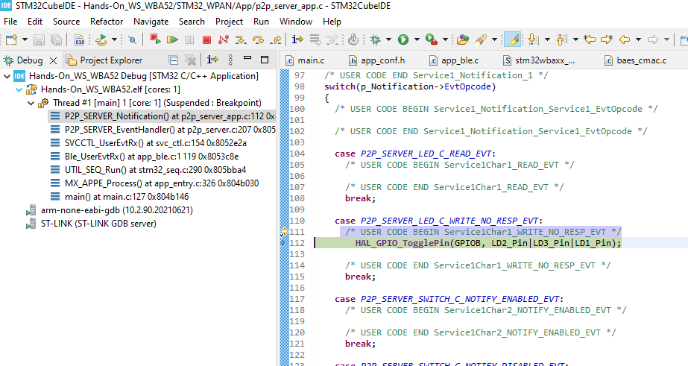
Bonus : Open your App and Connect call stack
3
2
1
4
Add break point line here
BLE write procedure initiated by client
ACI_GATT_ATTRIBUTE_MODIFIED event received at application level
Notes:
Of course, on single core device – Hitting breakpoint will break RF link

Slide 33
Takeaways What’s next
Hands-on#2 – Build a BLE advertising device
Evaluate, prototype & customize your own project with your own BLE proprietary profile requirements.
Build and optimize you PCB and move to certification
HW guideline, what are the available resources what I should focus on.

