Slide 1
Working With Databricks
A term project tutorial on some of the many facets an analyst can use in making sense of data

Slide 2
Agenda
What is Databricks?
Accessibility of Getting Libraries
Learning By Example
Disadvantages
Conclusion

Slide 3


What is Spark?
Why Spark?
Spark is a distributed computational framework of interconnected platforms for Big Data projects.
Versatile
Allows common, familiar languages such as:
Python
Java
R
SQL
Scala
Supports:
Machine Learning
Graphics
Can be integrated on just about any file system including:
Hadoop HDFS
MongoDB
Amazon S3
Fast
Parallel Processing
Stores immediate datasets in distributed memory, which is 100x faster than Hadoop

Slide 4
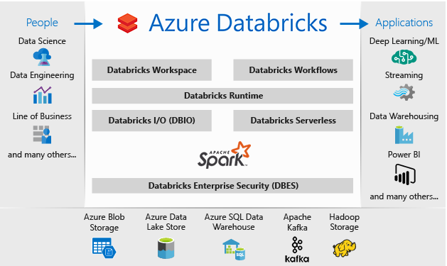
What is Databricks?
“Azure Databricks is an Apache Spark-based Analytics Platform” ¹
Databricks is an interactive workspace enabling collaboration between data scientists, data engineers, and business intelligence developers

Slide 5


Why Databricks?
Since it is Spark based, Python, R, Java, and SQL run native
“These languages are converted in the backend through APIs, to interact with Spark. This saves users having to learn another programming language, such as Scala, for the sole purpose of distributed analytics.”⁴
^{Higher Productivity}
Databricks provides workspaces that allows for collaboration that are interactive and allow for data model creation, machine learning and data extraction
Version Control is also built in: No more worry whether you saved your code as it not only saves it automatically, but also keeps track of your versioning

Slide 6

Why Databricks? (continued)
It integrates well with the Microsoft Stack, which includes:
Azure SQL Database, IoT Hub, Stream Analytics, Machine Learning, Data Lake, Power BI
Extracts data easily from many data sources such as:
SQL servers, CSV files, JSON files, MongoDb, Couchbase,…etc.
Suitable for smaller jobs: No need for separate VMs or environments
Each job can just spin up another cluster, each with its own libraries
Extensive documentation and support available
Databricks has many tutorials and docs to help get started

Slide 7
Useful Libraries In The Databricks Python Toolbox
First off, the Pandas library comes native with Databricks, so that will be left off the list
collections: For Counters
os: To locate files on your operating system
wordcloud: to create word clouds when analyzing data
matplotlib.pyplot: For graphical analyses
pyspark.sql: To help in converting Pandas data frame to Spark
pyspark.sql.functions: For aggregations

Slide 8
Installing Packages
Installing packages is simple enough for anyone who has ever done it outside pip or Conda, for example
Rather than having to create different environments for each instance of Python, for example, people can simply add libraries to the cluster they are working on.
In my opinion, this can make things much easier to deal with. Rather than spending lots of time trying to figure out which application runs in which environment, I can select the cluster and instantly know which libraries are running on them

Slide 9
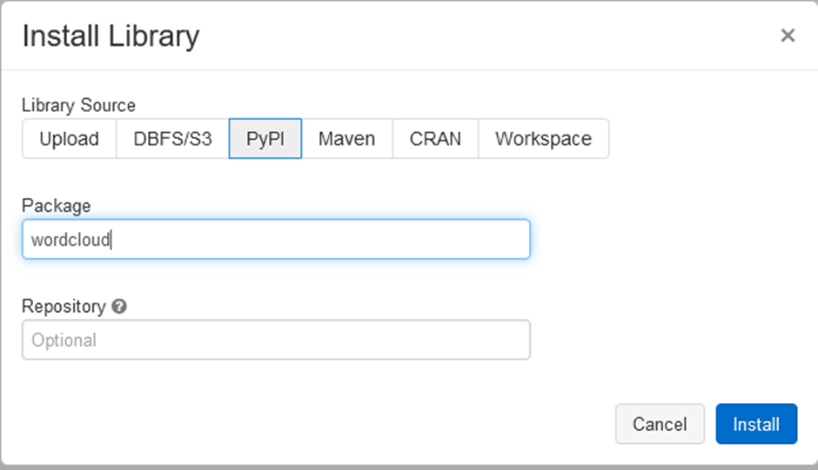
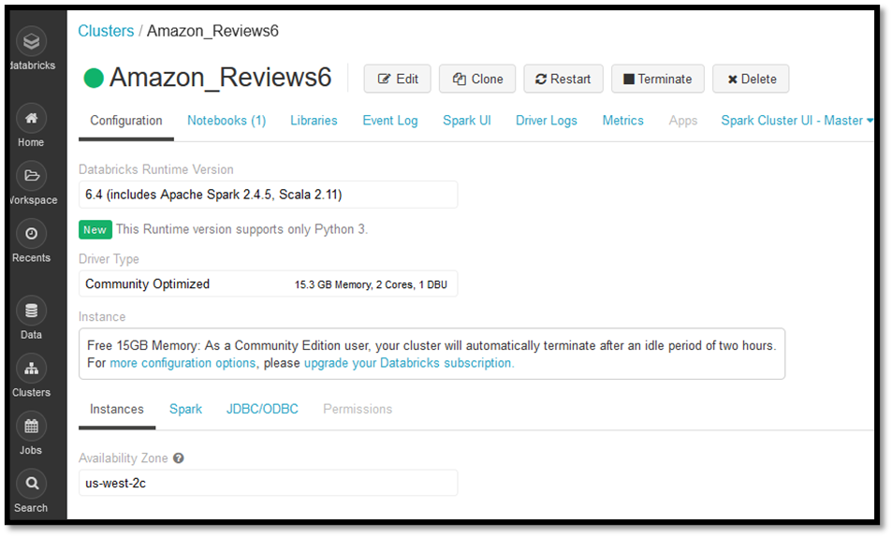
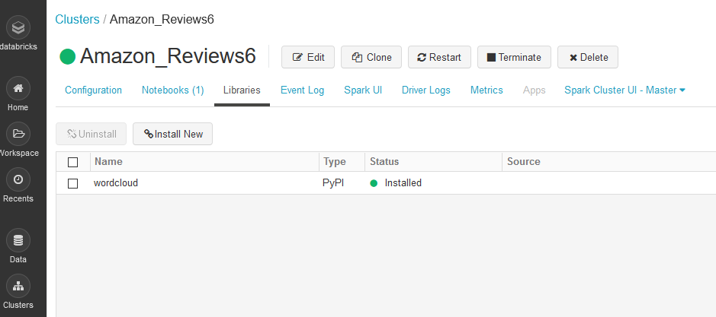
Installing Packages

Slide 10
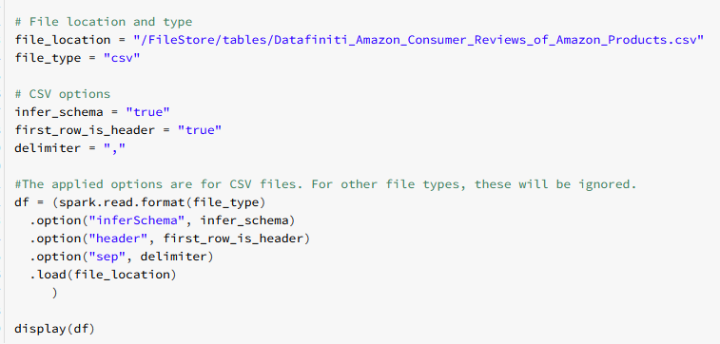
Read in CSV using PySpark And Create a Data Frame

Slide 11

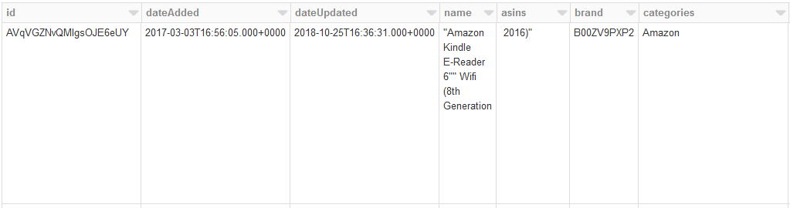
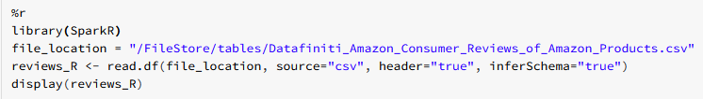
Read in CSV using R

Slide 12
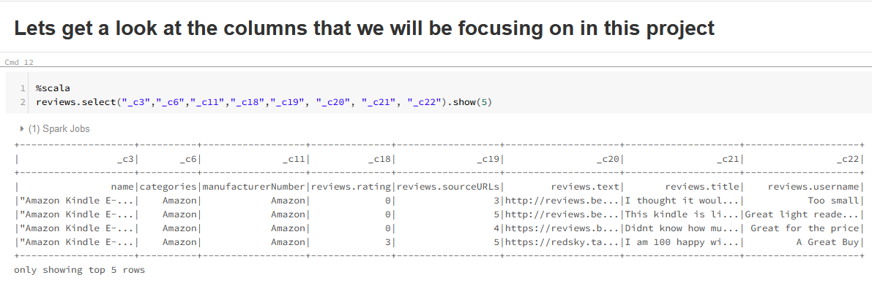
Read in CSV using Scala

Slide 13
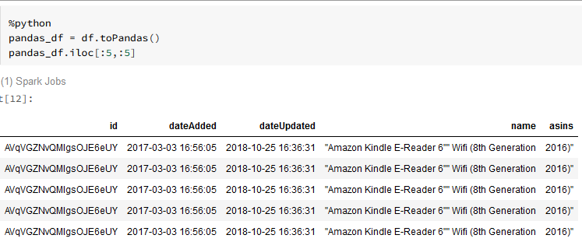
Transforming Data With Python Convert PySpark Data Frame to Python Pandas

Slide 14
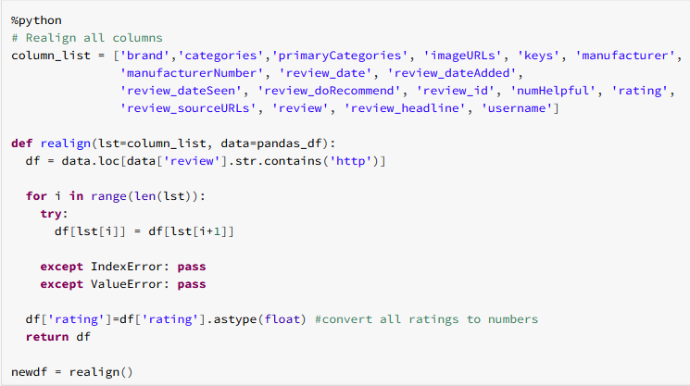
Transforming Data With Python Fix Column Misalignment
Notes:
After a few analyses, I found that some of the columns were misaligned, so I put together a python function to detect where the columns started diverging
Explain what the function is doing

Slide 15
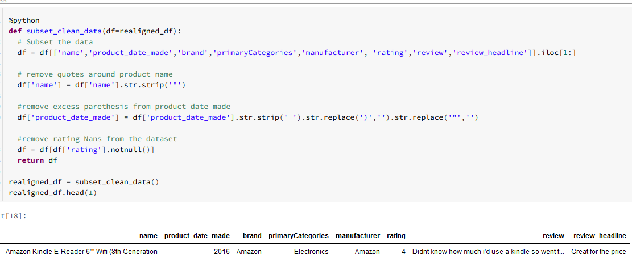
Transforming Data With Python Clean Up Columns
Notes:
After a few analyses, I found that some of the columns were misaligned, so I put together a python function to detect where the columns started diverging
Explain what the function is doing

Slide 16
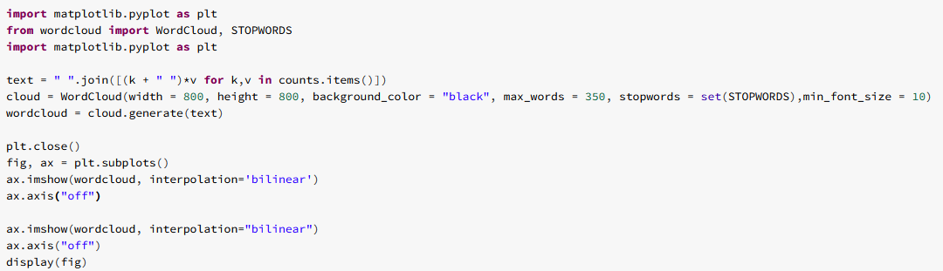
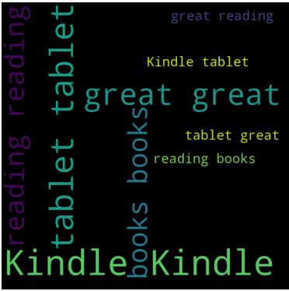
Word Clouds
Notes:
After a ton of frustration with Matplotlib working on Databricks, and finding nothing online, I managed to punch through a “Eureka” moment, with the right syntax to make the word cloud to work.

Slide 17
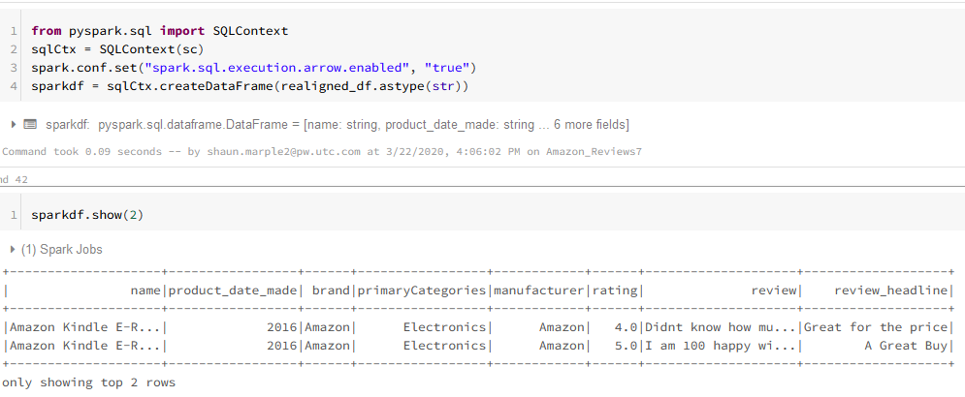
Python To Spark Data Frame
Notes:
Here, we can see that I had to first convert all columns to string before Spark would allow the data frame to transfer. This is a disadvantage I will talk about later.
This became a frustrating reality as it took forever to figure out how to change the column data types back, so that I can aggregate it.

Slide 18
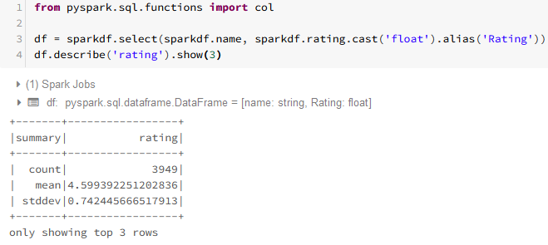
Converting Data Types Using PySpark And Displaying Summary Data
Notes:
Although the data type conversion seems simple, it was not very clear in getting to this point. Now that I know how, this won’t be too bad to remember.

Slide 19
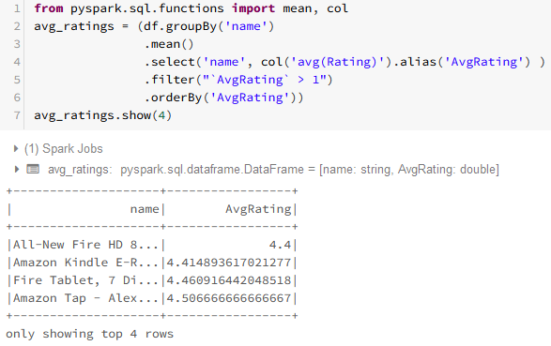
Aggregating Data in PySpark
Notes:
Aggregating functions must be imported to use here. There doesn’t seem to be any native aggregation functions in PySpark

Slide 20
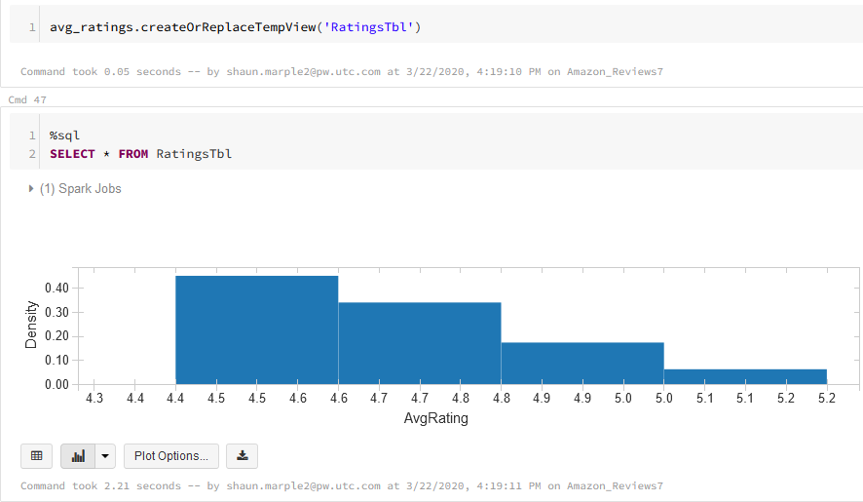
Using SQL to Add Graphics First Create Table, Select All From the Table, Then Select Histogram from the Plot Options

Slide 21
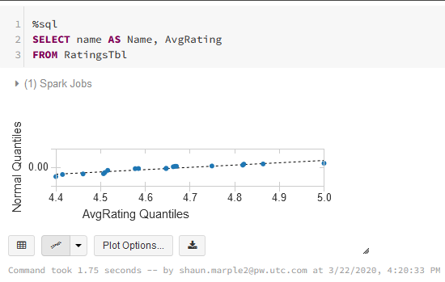
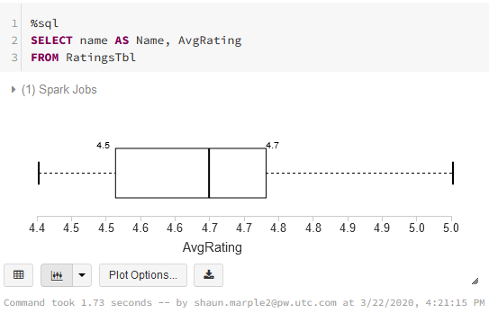
Using SQL to Add Graphics (Continued)
Q-Q Plot
Box and Whisker Plot

Slide 22
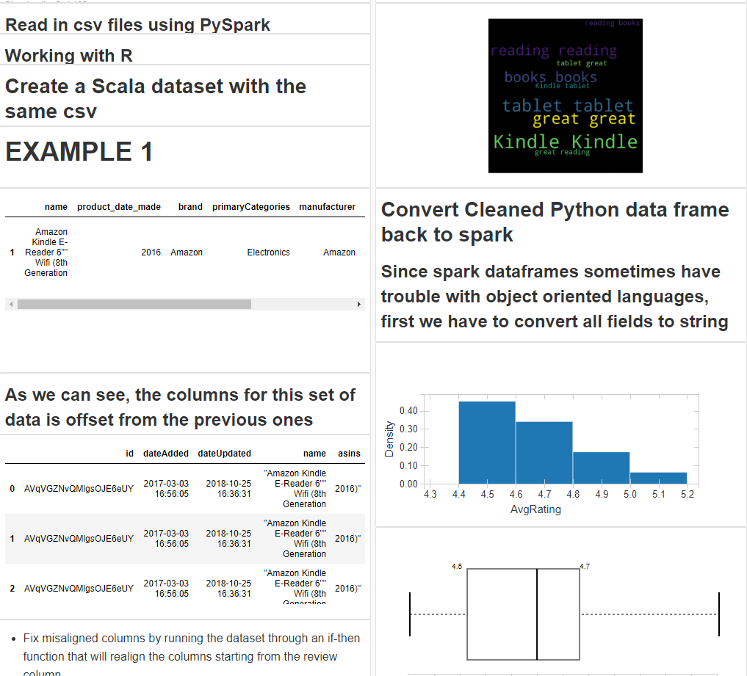
Dashboarding
Within a couple clicks, the script can turn into a dashboard with tables and graphics displayed
Notes:
Within a couple clicks, the script can turn into a dashboard with tables and graphics displayed

Slide 23
Disadvantages Problems Moving Switching Between Technologies
Though I found it nice to move from one language to another, using strengths of each to accomplish various parts of the analysis process, I found it difficult to switch back and forth.
It was simple to create data frames and tables directly from the source CSV, but when it came to switching from a python data frame to getting it back to Spark or SQL, I found some of the quirkiness to be a bit problematic.

Slide 24
Drawbacks : Problems Moving Switching Between Technologies
Spark has issues in dealing with object-oriented languages.
In order to convert a Pandas data frame from Python to Spark:
I had to first convert all fields to string objects. This was problematic because then I had to figure out how to convert all the ratings to numeric in Scala or Spark before I could aggregate the data from visualizations

Slide 25
Drawbacks : Problems Displaying Visualizations
Spark has issues in dealing Matplotlib and would not display figures
Word Cloud kept failing to produce visualizations

Slide 26

Drawbacks : Problems Importing Spark Libraries
Libraries like org.apache.spark.sql.functions contain functions that are important when aggregating data.
However, I’ve had much difficulty when importing them into Databricks, though they seem to be very popular outside of the Databricks environment.

Slide 27
Drawbacks: Cloning Clusters Doesn’t Include Libraries
Every time I’ve had to stop work on a cluster, using the community version, I’ve had to clone the cluster, only to find that the clone didn’t contain the libraries I installed

Slide 28

References
[1] Microsoft Azure (2019). “What is Azure Databricks?”. Microsoft. Retrieved from: https://docs.microsoft.com/en-us/azure/azure-databricks/what-is-azure-databricks
[2] Marr, Bernard (2019). “What Is Spark in Big Data?” Bernard Marr & Co. Intelligent Business Performance. Retrieved from: https://www.bernardmarr.com/default.asp?contentID=1079
[3] Polnar, Jack (2020). “Big Data & NoSQL DBs”. Boston University. CS779.
[4] Nanua, Roshan (2019). “6 Reasons to Use Azure Databricks Today”. Hitachi Solutions. Retrieved from: https://us.hitachi-solutions.com/knowledge-center/6-reasons-to-use-azure-databricks-today/
[5] IntelliPatt (2020). “What is Apache Spark” IntelliPatt. Retrieved from: https://intellipaat.com/blog/what-is-apache-spark/

