Slide 1
ARL Application
Pragati Prasad and Stephen Mayne

Slide 2
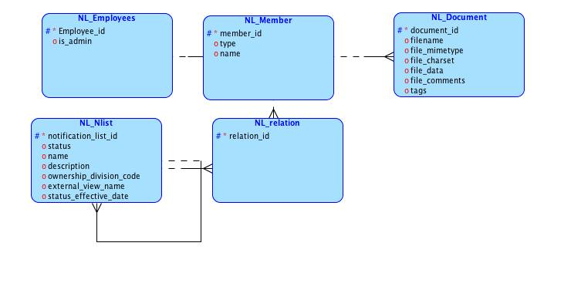
Logical Model

Slide 3
Implemented
File Upload/Download
Data Loading
Group Select List
Shortcut
Tree
E-Mail
Undo

Slide 4
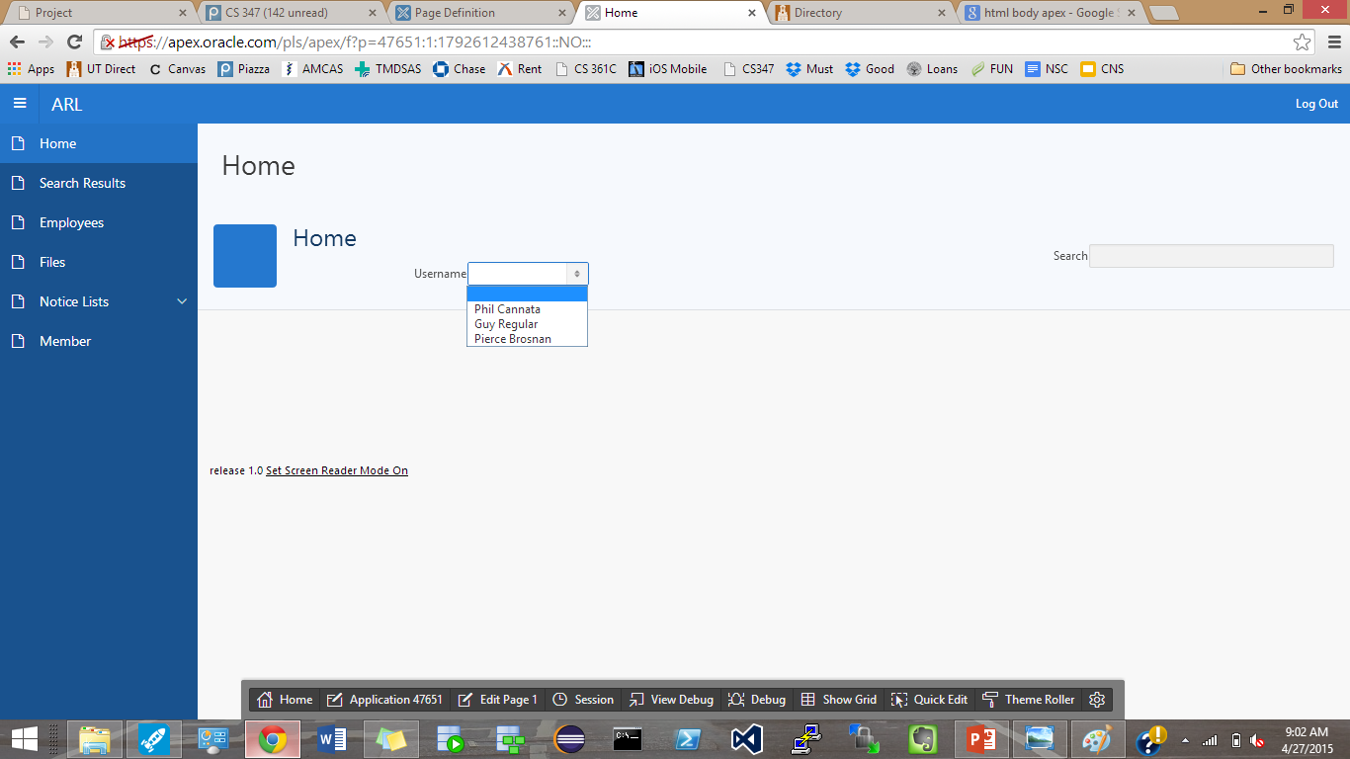
Application

Slide 5
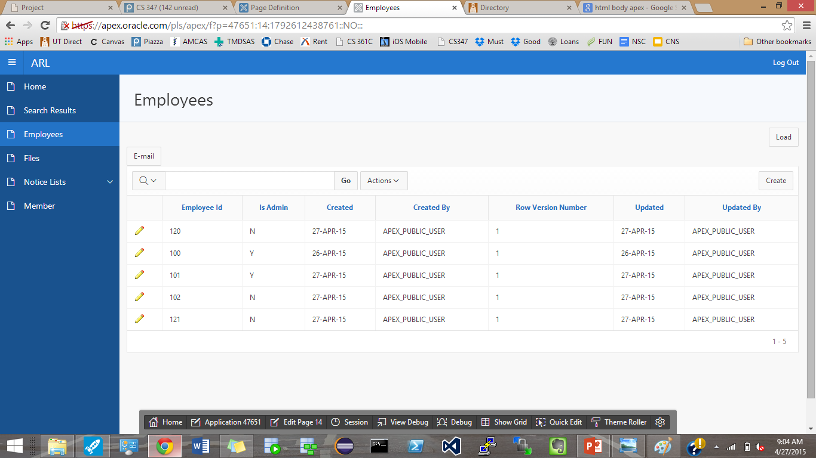
E-mail, Data Load

Slide 6
Email & Data Load
Currently set to email us asking if the employee table has been updated.
Can import new employee information given that the csv is appropriately formatted (column names in the first row).

Slide 7
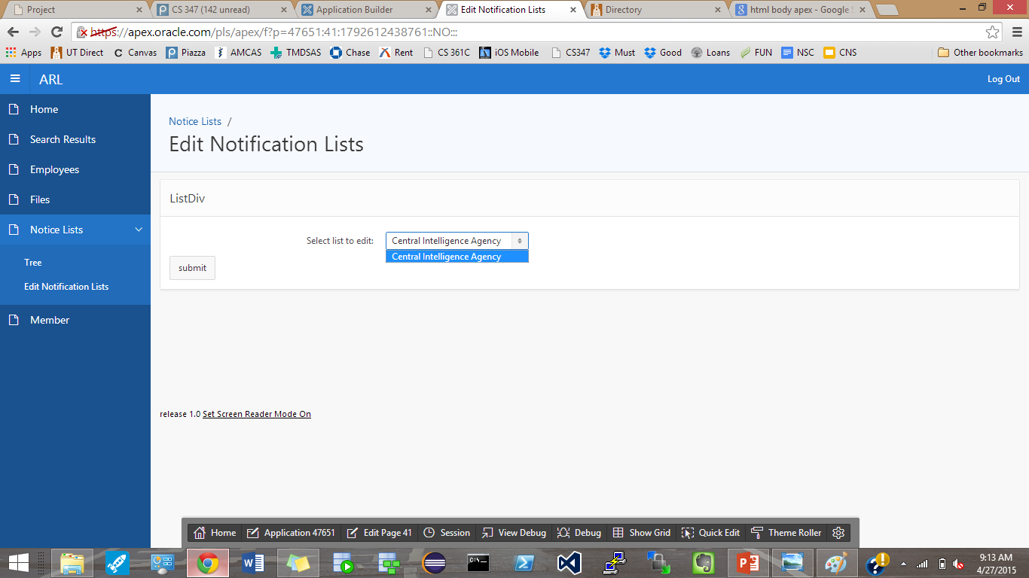
Notification Lists

Slide 8
Notification Lists
Because we are currently under the user “Phil Cannata,” we are only able to edit the notification lists that this user is a part of:
Central Intelligence Agency

Slide 9
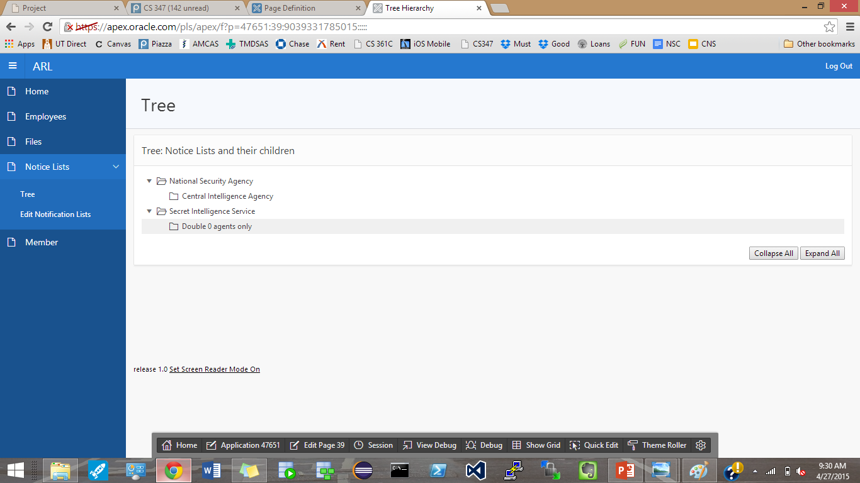
Notification list tree

Slide 10
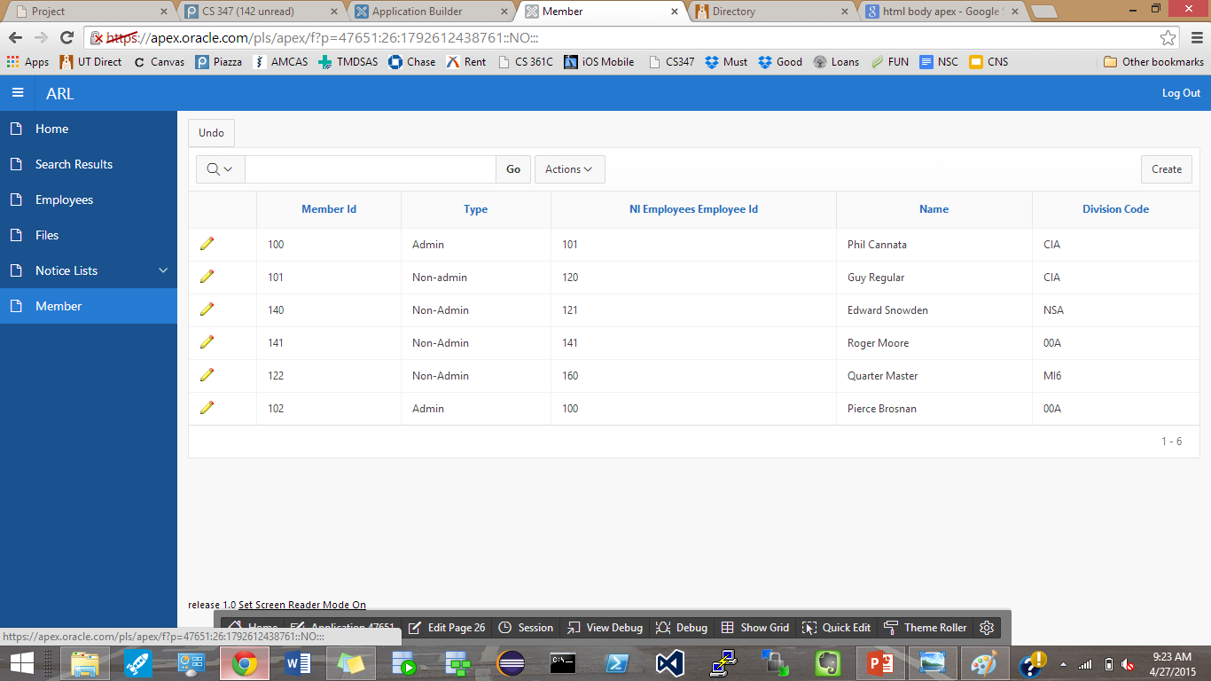
Member table with the Undo button

