Slide 1
Predicting House Prices with Linear Regression
Author: Sohaib Mian

Slide 2
Introduction
- Linear Regression depending on the input data is an effective way to make a predictive model.
- In this project:
python modules are used to perform exploratory data analysis, data visualization, and data cleaning/preparation.
Histogram of sales price is plotted to understand the distribution of the dependent variable.
Datatype of each column is checked to separate numerical columns from categorical as well as the null values in each column are visualized and the correlation of each column with Sale Price is determined to ascertain important features.
Multiple different LR models are trained to understand the effect of different numerical variables on the performance of the predictive model.
Two models are tested on the testing data to evaluate the performance difference on the training set and the testing set. Th performance metric used throughout the project is R^2.
- Result show that when training data is representative of the testing data then adding more features will improve performance.
*Please add slides as required.

Slide 3
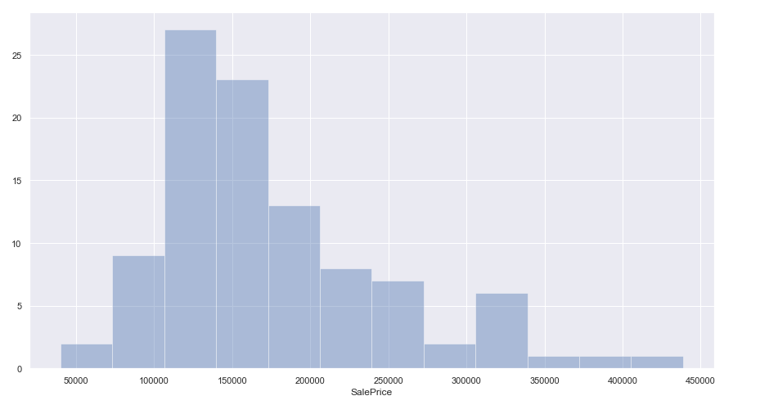
The Data
-Pandas, NumPy, matplotlib, and seaborn is used in data extraction, exploration, visualization, and cleaning and prep.
Histogram showing saleprice

Slide 4
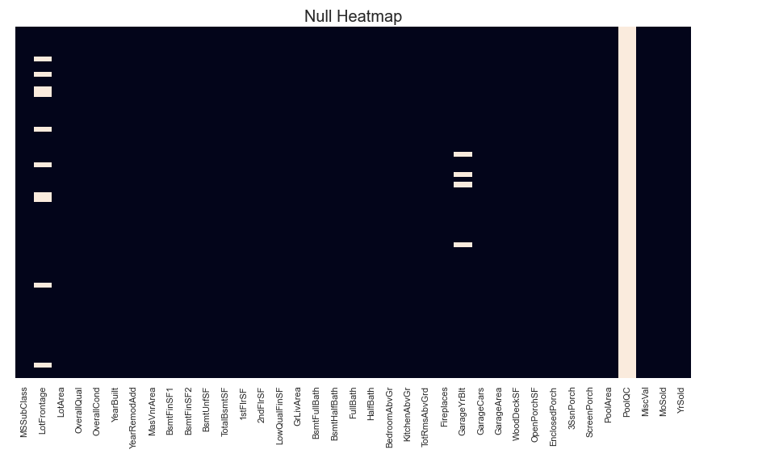
Data Exploration
Heatmap Showing Null Values

Slide 5
Data Preparation
Import all data to Data frame
Split data between testing and training set
Remove columns containing null values after checking correlation
Exclude all categorical variables
Drop ID and unknown columns
*Please add slides as required.

Slide 6
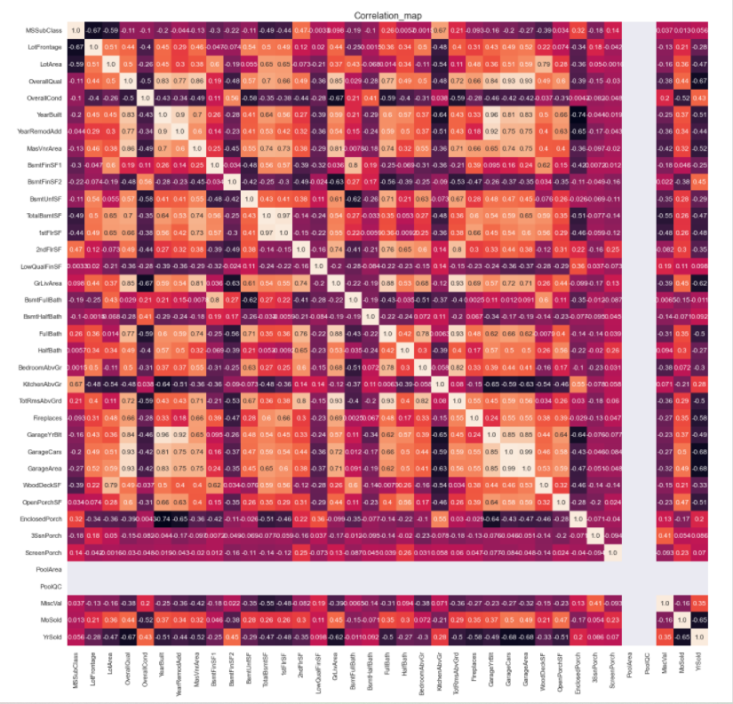
Correlation Heat Map

Slide 7
Project Description
Most relevant features must be selected in order to have model that performs.
Features are selected based on correlation with sale price
5 different models are tested with different number of features and different features
The models are evaluated based on R^2 score
Two models are tested on testing data
*Please add slides as required.

Slide 8
Analysis and Results
Model | Number of features | Performance
Model_1 | 10 | 85
Model_2 | 15 | 88
Model_3 | 20 | 88
Model_4 | 25 | 89
Model_5 | 30 | 91
Model_6 | All | 92
*Please add slides as required.

Slide 9
Results
Six different models were tested that used different number of features
The performance parameter used is R^2 value
The performance of the models increase as more variables are added regardless of correlation
Adding additional terms will make the model overfit on training data and the performance of the models are only evaluated on training data.
That’s why a validation and testing set is required to ensure that the model does not over fit or underfit and optimum number of variables are selected.

Slide 10
Verification
Model | Number of Features | Performance
Model_6 | All | 79
Model_3 | 20 | 74
The model_6 performs better than the model_3, the one with more features.
This result is like the results found on the training set.
Training data comes from similar distribution as the testing data.
The better the model fits on training data the better it performs on testing data.

Slide 11
Conclusion
-Linear Regression gives a descent benchmark model.
-There are number of ways in which this model can be improved:
More training data can gathered
Categorical variables can be tested by one hot encoding them
Hyperparameters such as the learning rate can be tuned
Other models such as SGD regressor can be used
Feature selection technique like PCA can be used
- Project demonstrates a scientific approach to performing exploratory analysis, visualizing insights, cleaning/preparing data, and building a predictive model.
*Please add slides as required.

Slide 12
References
Use this as a sample for articles:
Burkov, A (2019). The Hundred Page Machine Learning Book, pp.84-85
*Please add slides as required.

