Slide 1
Denoising Autoencoders: Use on Gaussian Noise
Steven Millett

Slide 2
Scope of Topic
Development of autoencoders
Type of noise
Denoising Autoencoders
Comparable Methods of Denoising

Slide 3
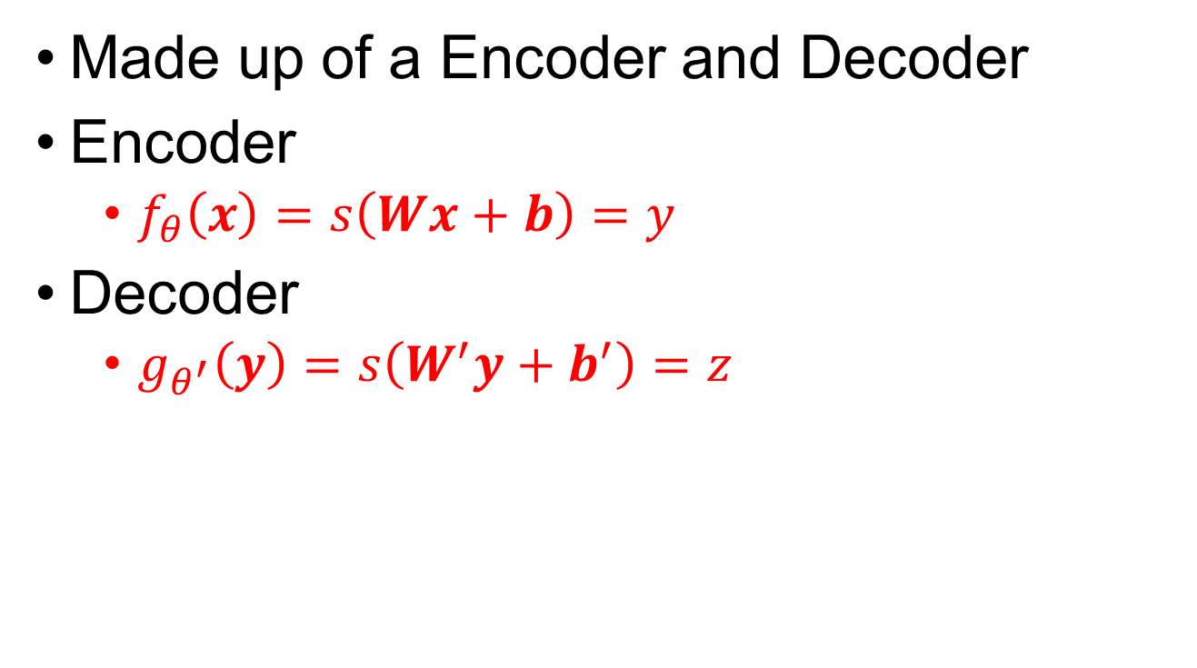
Basic design of Autoencoders
Made up of a Encoder and Decoder
Encoder
$f_{θ}\left(x\right)=s\left(Wx+b\right)=y$
Decoder
$g_{θ^{′}}\left(y\right)=s\left(W^{′}y+b^{′}\right)=z$

Slide 4
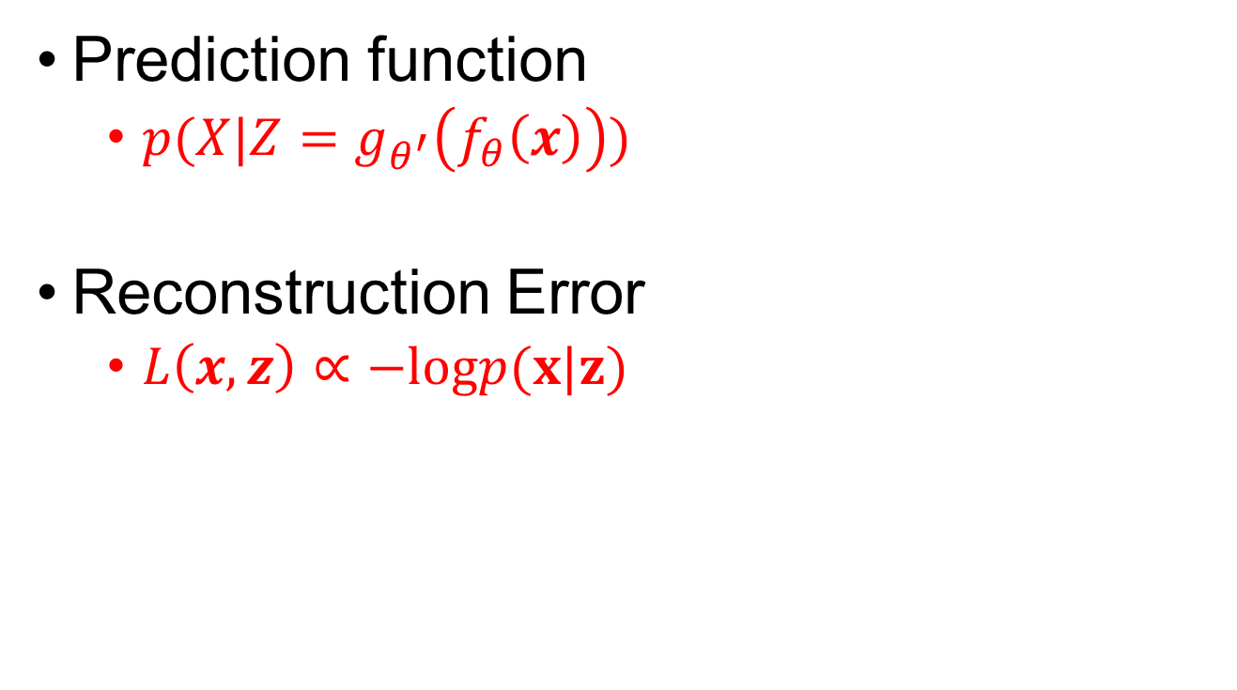
Autoencoder training
Prediction function
$p(X|Z=g_{θ^{′}}\left(f_{θ}\left(x\right)\right))$
Reconstruction Error
$L\left(x,z\right)∝−logp(x|z)$

Slide 5
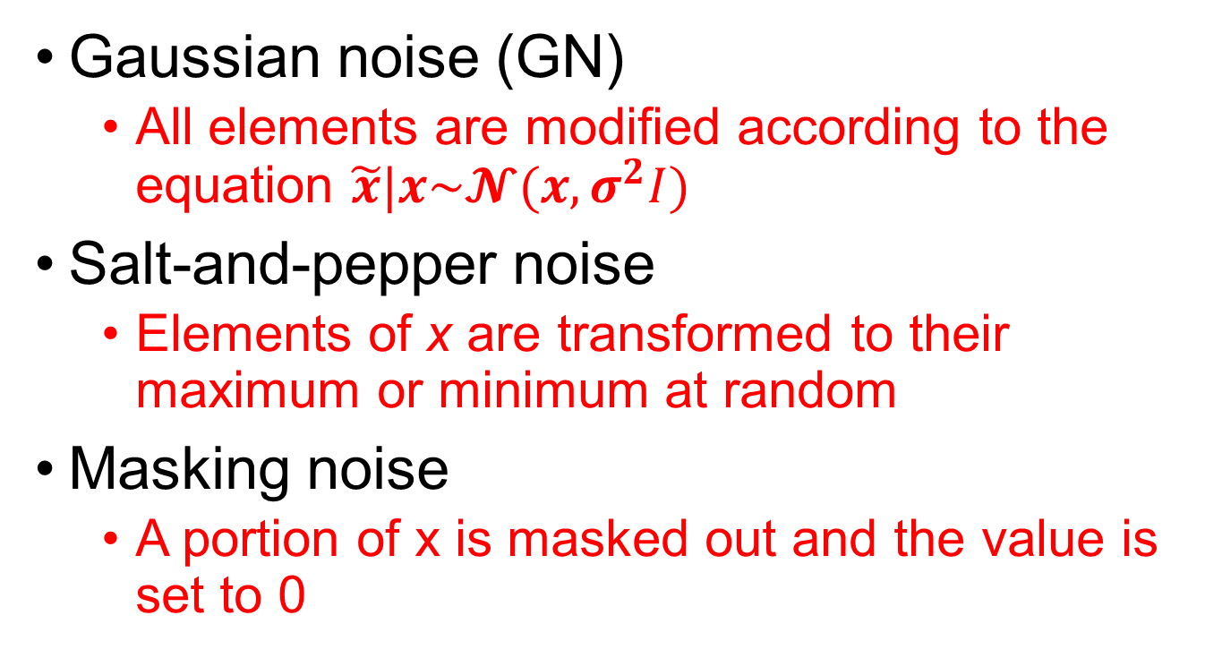
Noise
Gaussian noise (GN)
All elements are modified according to the equation $\tilde{x}|x\sim 𝓝(x,σ^{2}I)$
Salt-and-pepper noise
Elements of x are transformed to their maximum or minimum at random
Masking noise
A portion of x is masked out and the value is set to 0

Slide 6
Denoising Autoencoder
Transition to this slide on first mouse click
From here until end of presentation all slides are on a 15 second timer
At the end of 15 seconds, the next slide will automatically appear

Slide 7
Convolutional Denoising Autoencoder
Transition to this slide on first mouse click
From here until end of presentation all slides are on a 15 second timer
At the end of 15 seconds, the next slide will automatically appear

Slide 8
Stacked Denoising Autoencoder
Transition to this slide on first mouse click
From here until end of presentation all slides are on a 15 second timer
At the end of 15 seconds, the next slide will automatically appear

Slide 9
Alternate methods of denoising
Transition to this slide on first mouse click
From here until end of presentation all slides are on a 15 second timer
At the end of 15 seconds, the next slide will automatically appear

Slide 10
References

