Slide 1

Product Overview
No install. No login.
Just launch it on your own PC —
real-time Oracle DB monitoring
OraPulse
Oracle DB Monitor
v1.0049
September 2026

Slide 2
CONTENTS
Table of Contents
01
Overview
06
Tuning Tab
What OraPulse is, and why it exists
A rule-based tuning advisor
02
Architecture
07
Obj View / SQL Tab
How the local app works
Object exploration and query execution
03
Key Features
08
Reporting, Favorites & Security
The whole feature set at a glance
Weekly report, encrypted storage
04
DashBoard Tab
09
Packaging, Requirements & Tech Stack
Real-time instance & session monitoring
Distribution and system design
05
Ops & Recovery Tabs
Operational and recovery diagnostics
OraPulse
02 / 23

Slide 3
OVERVIEW
Overview — Why OraPulse Exists
The Old Way
OraPulse's Approach
✗
Heavyweight commercial monitoring tools
✓
No login of its own, single-user by design
Needs a dedicated server, agent installs, and license fees
The Oracle account/password you type in is the only credential, and it never leaves this machine
✗
Desktop clients like SQL Developer / Toad
✓
Binds to 127.0.0.1 only
Installed per PC, one at a time, with no connections remembered
The server only listens on the local loopback — there is no path to reach it from outside this PC
✗
Shared accounts and shared servers
✓
Works on 12.1+, any edition
Everyone reuses the same credentials and the same central server
Built entirely on plain V$/DBA_ views — no Diagnostics or Tuning Pack license needed
OraPulse
03 / 23

Slide 4
ARCHITECTURE
Architecture — How It Works
Browser
(Dashboard UI)
OraPulse Local Server
127.0.0.1 : auto-assigned port
FastAPI + python-oracledb
Oracle Database
12.1 or later
•
A single Python backend
main.py (FastAPI) serves both the REST API and the static frontend in public/
•
Thin-mode driver
Uses python-oracledb's pure-Python implementation only — no Oracle Instant Client install needed
•
Legacy Node.js kept for reference
The original Express implementation, developed in parallel early on, is archived under legacy-nodejs/ and is no longer built, run, or tested
OraPulse
04 / 23

Slide 5
KEY FEATURES
Key Features at a Glance
DashBoard
Ops
Recovery
Instance info, CPU/memory, sessions/blocking/long-running sessions, table stats, scheduler failures, account security, alert log
Key parameters, Undo, Instance Efficiency, Load Profile, TEMP, Redo, tablespace I/O, Top-5 SQL & wait events
Recent DML (top 50), Fast Recovery Area overview and usage by file type
Tuning
Obj View / SQL
Weekly DB Health Report
A rule-based advisor — no AWR/Tuning Pack needed, compares against an encrypted local snapshot
A SQL-Developer-style object explorer with DDL, plus a read-only SELECT-only query runner
A 15-minute background snapshot collector feeds a self-contained HTML report with inline SVG charts
Favorites
Reducing DB Load
Desktop Packaging
Connection details (password included) encrypted locally with AES-256-GCM, one-click connect
Tiered auto-refresh intervals, pauses when hidden, leader election, a 15-second server-side cache
A tray icon, relaunch detection that jumps to the running instance, an isolated browser profile
OraPulse
05 / 23

Slide 6
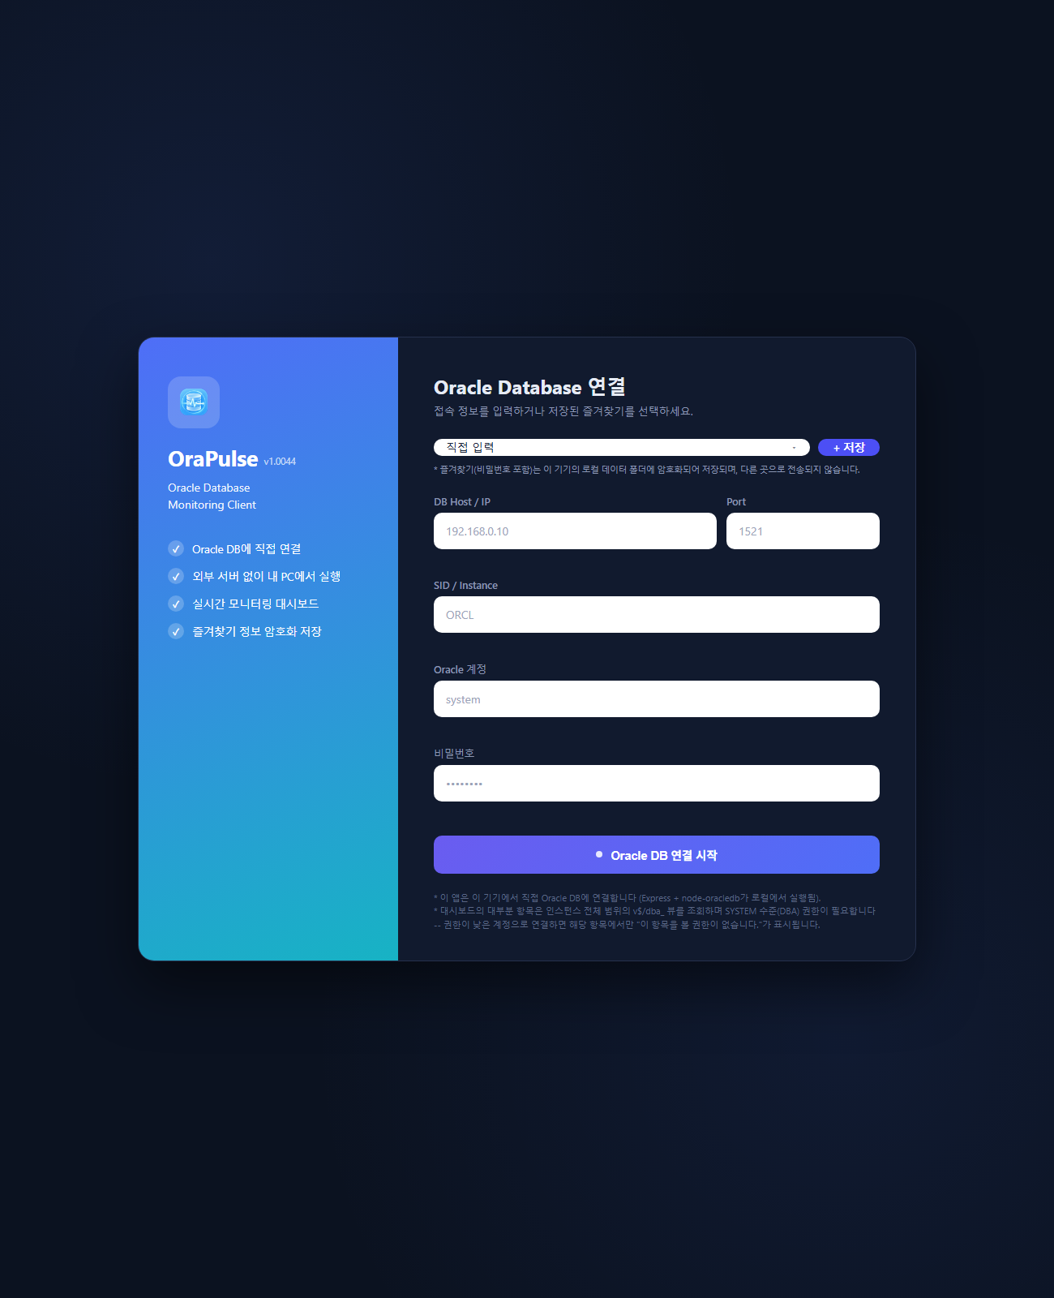
SCREEN · 01
Screen Preview — Connect Screen
•
No login screen of its own
Just type in the Host/Port/SID and an Oracle account/password to connect
•
Favorites dropdown
Pick a saved connection and it connects immediately, no extra click needed
•
AES-256-GCM encrypted storage
Favorites — password included — are encrypted and stored on this machine
•
Any Oracle account works
SYSTEM-level access is recommended but not required; under-privileged cards simply show their own permission notice
OraPulse
06 / 23

Slide 7
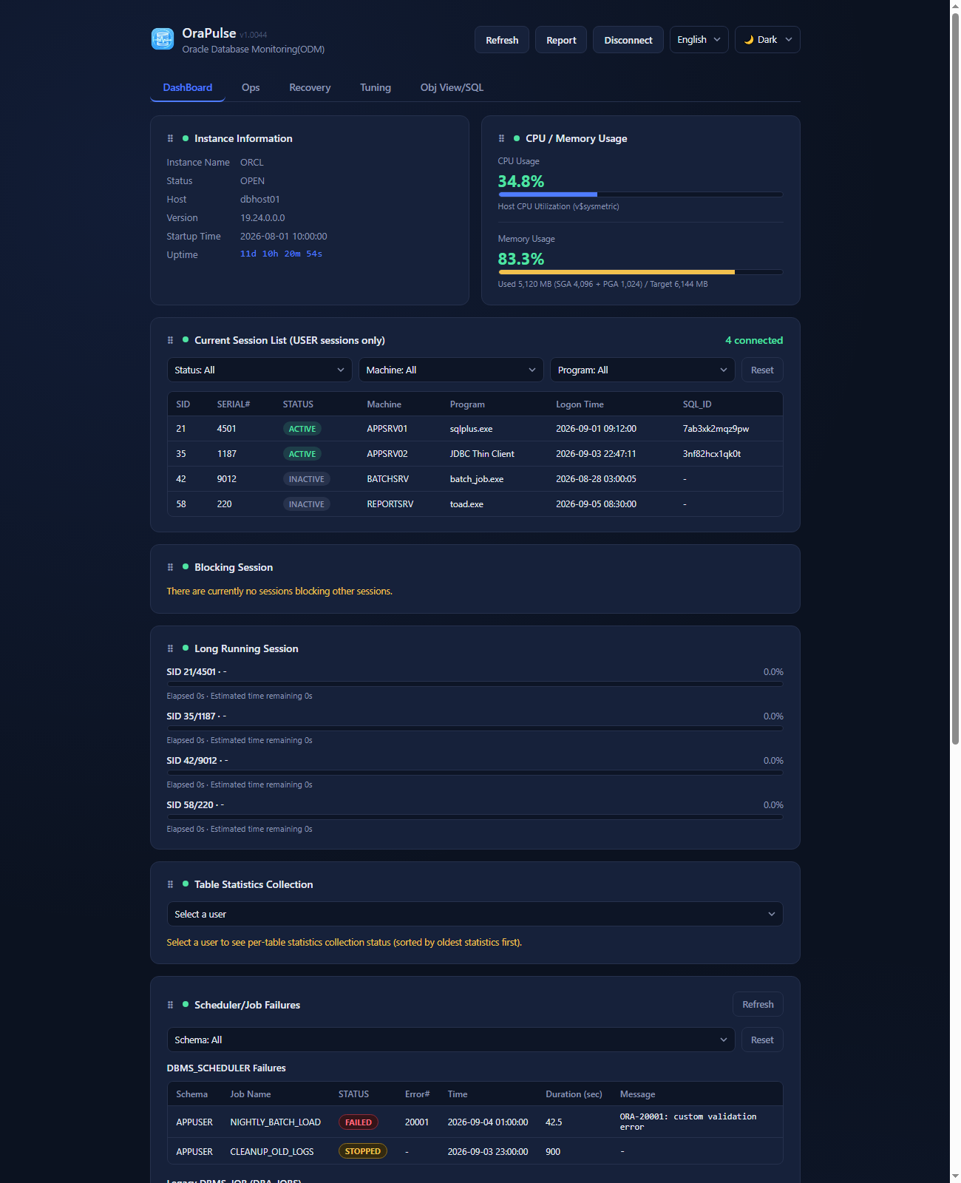
SCREEN · 02
DashBoard Tab — Live Status
•
Instance Information
Name, status, host, full version (V$INSTANCE.VERSION_FULL), startup time, uptime
•
CPU / Memory usage
Live gauges kept up to date automatically
•
Current Session List
ACTIVE sessions first; Status/Machine/Program filters; right-click to kill a session, view its SQL, or view wait detail
•
Blocking & Long Running Sessions
A blocking session list plus progress bars from V$SESSION_LONGOPS
OraPulse
07 / 23

Slide 8
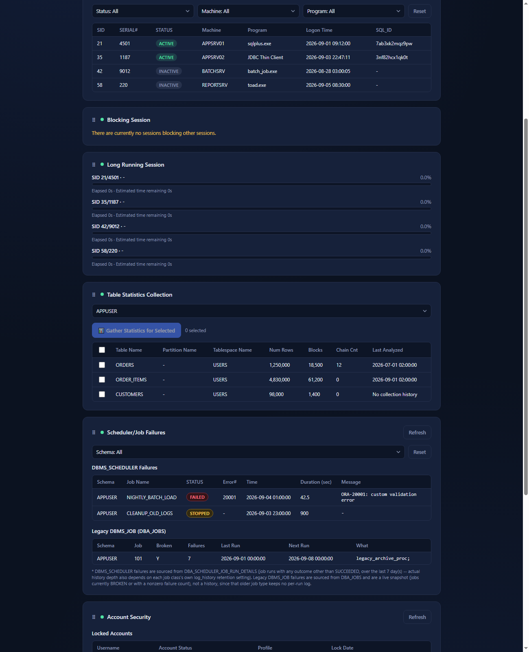
SCREEN · 03
DashBoard Tab — Stats & Jobs
•
Table Statistics Collection
Gather stats for several selected tables at once; a right-click Table Properties view (columns, indexes)
•
Scheduler / Job Failures
DBMS_SCHEDULER run history for any non-SUCCEEDED outcome, plus a live snapshot of broken legacy DBMS_JOB jobs, with a schema filter
•
Own connections excluded
OraPulse's own brief monitoring connections are automatically excluded from the session list/count
OraPulse
08 / 23

Slide 9
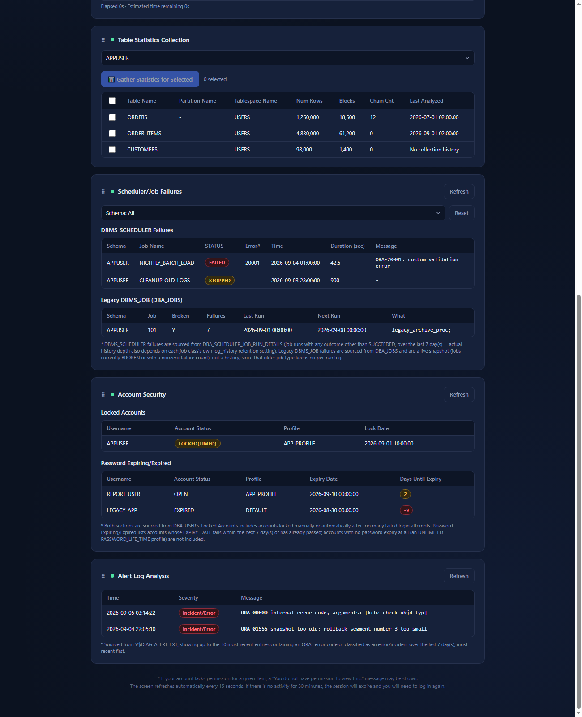
SCREEN · 04
DashBoard Tab — Security & Alert Log
•
Account Security
Currently locked accounts, and accounts whose password has already expired or is expiring soon, from DBA_USERS
•
Alert Log Analysis
Recent anomalies surfaced from V$DIAG_ALERT_EXT
OraPulse
09 / 23

Slide 10
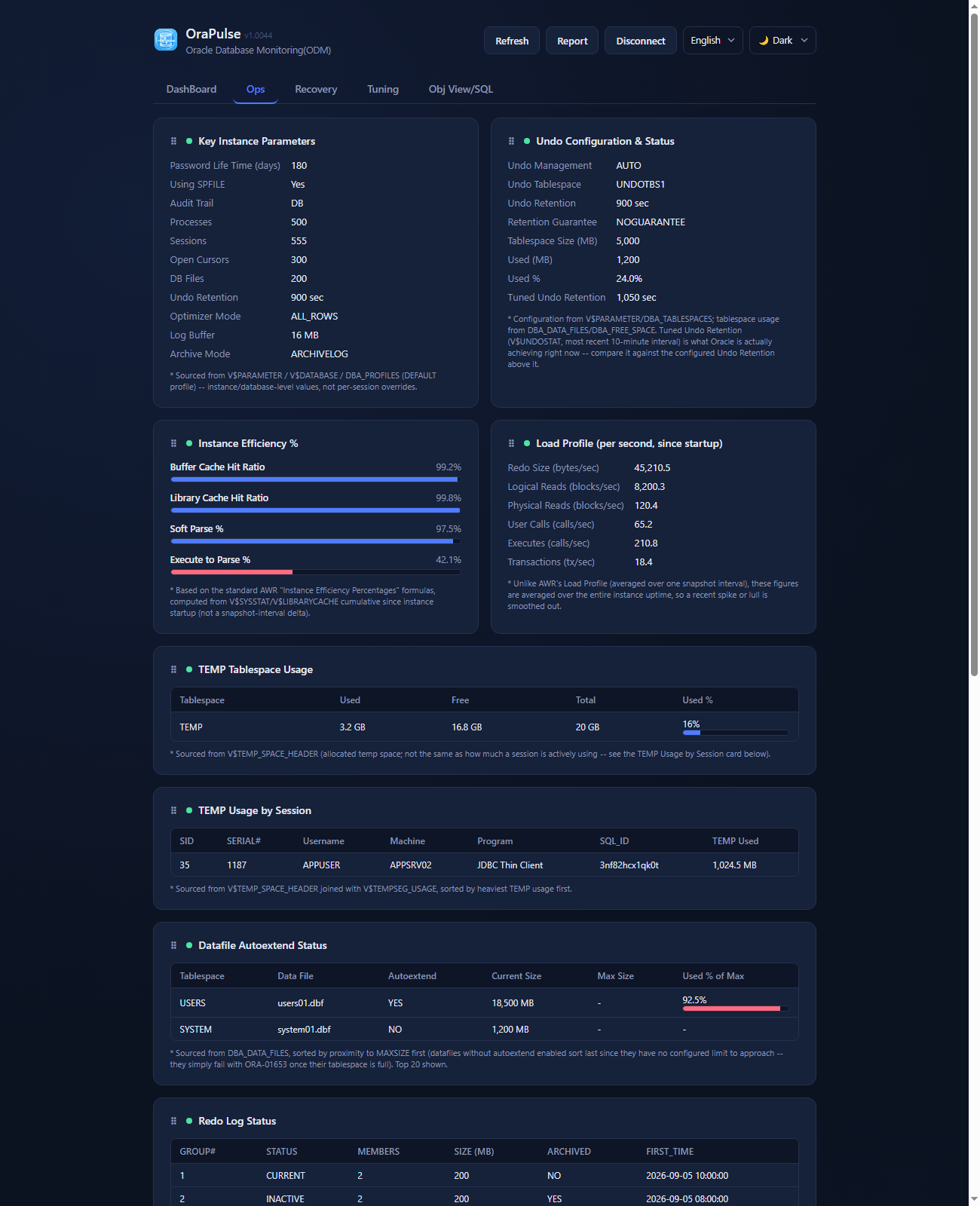
SCREEN · 05
Ops Tab — Parameters & Efficiency
•
Key Parameters & Undo
Key Instance Parameters shown side by side with Undo Configuration & Status
•
Efficiency & Load Profile
Instance Efficiency % shown side by side with Load Profile
•
TEMP usage
TEMP Tablespace Usage and TEMP Usage by Session
•
Datafile & Redo
Datafile Autoextend Status (MAXSIZE proximity) and Redo Log Status
OraPulse
10 / 23

Slide 11
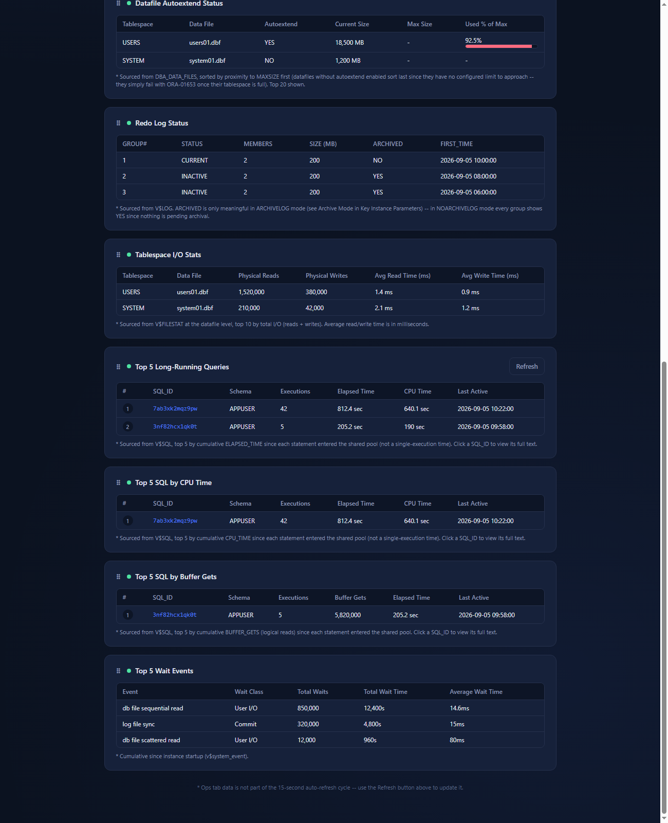
SCREEN · 06
Ops Tab — Top SQL & Wait Events
•
Tablespace I/O Stats
Sorted by physical reads
•
Top-5 SQL
By execution time, by CPU time, and by buffer gets
•
Top-5 Wait Events
The five most significant current wait events
•
Freely reorderable cards
Every card is drag-and-drop reorderable, even across tabs — saved to localStorage and merged with the app's own default order
OraPulse
11 / 23

Slide 12
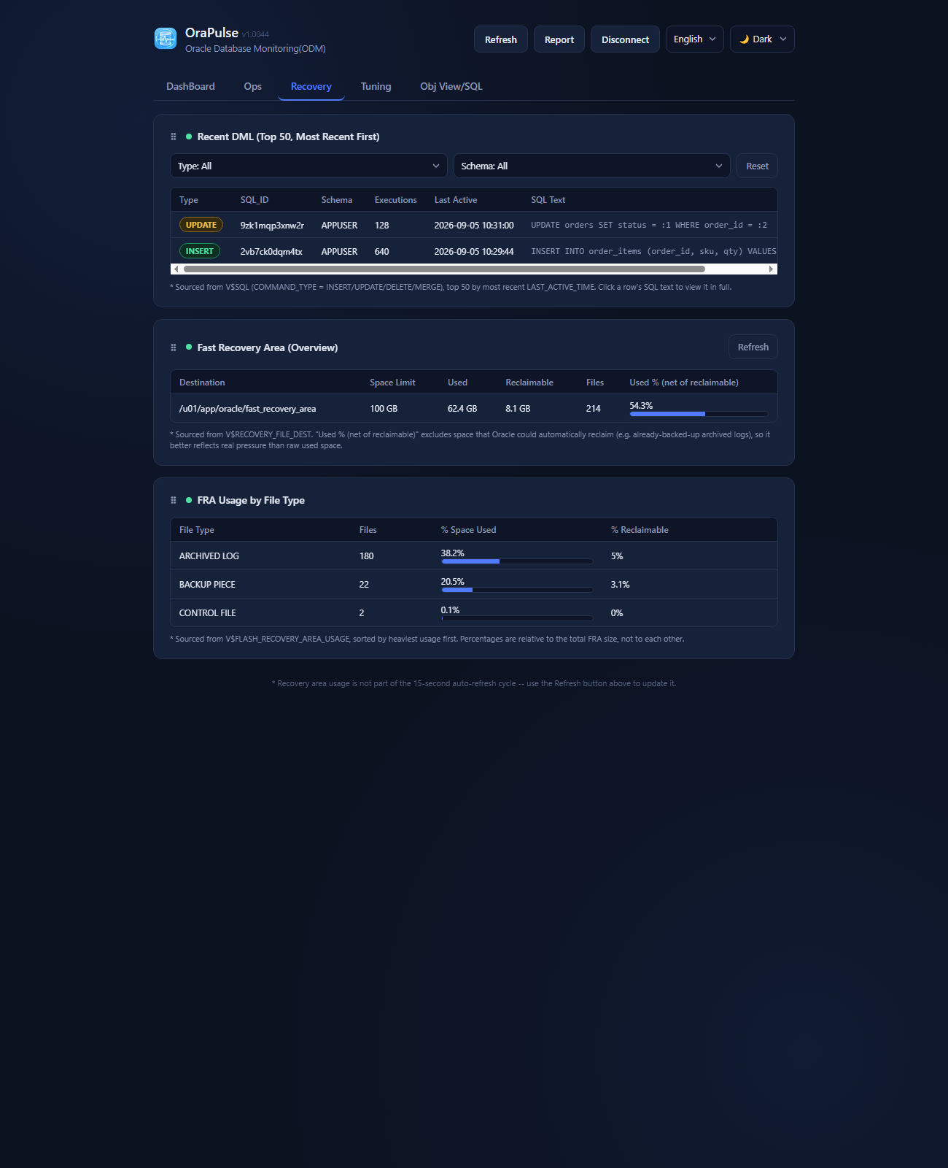
SCREEN · 07
Recovery Tab — Recent DML & FRA
•
Recent DML
Top 50, most recent first, with Type/Schema filters
•
Fast Recovery Area overview
The FRA's overall usage at a glance
•
FRA usage by file type
Usage broken down by file type
OraPulse
12 / 23

Slide 13
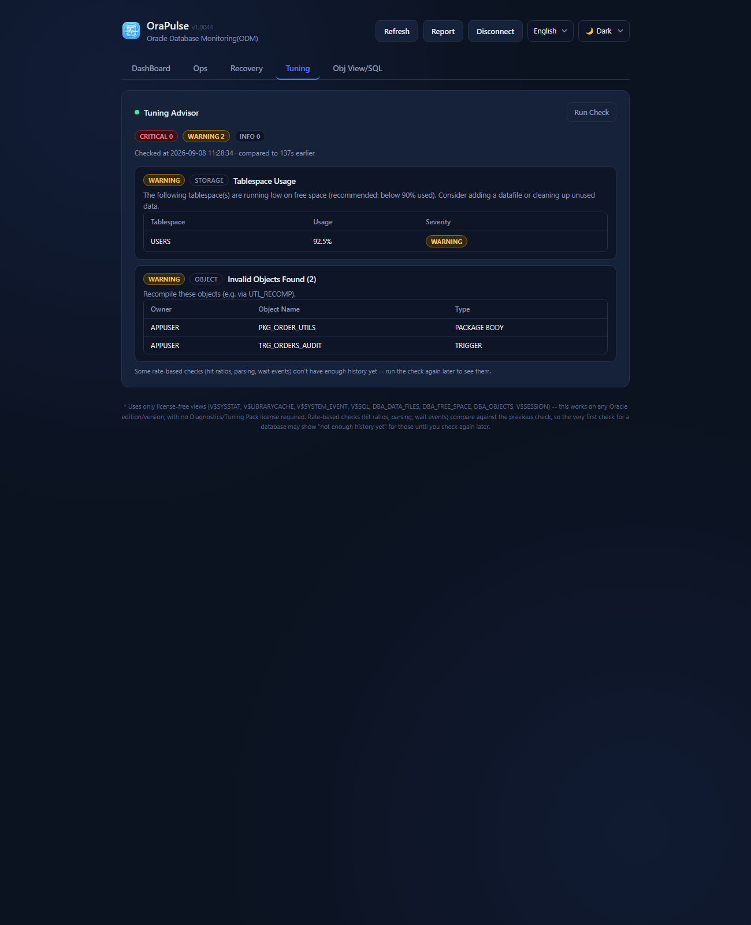
SCREEN · 08
Tuning Tab — Rule-Based Advisor
•
No extra license needed
Runs without AWR/ASH or a Diagnostics/Tuning Pack license
•
Checks performed
Buffer/library cache hit ratio, hard parse ratio, disk sorts, wait event increases, free-space usage, invalid objects, blocking sessions, slow SQL
•
Encrypted snapshot comparison
Rate-based checks compare against the previous check — the first run shows 'not enough history yet'
•
Grouped findings & SQL detail
Same-type findings are grouped into one table, and a Slow SQL row's SQL_ID is clickable for the full query text
OraPulse
13 / 23

Slide 14
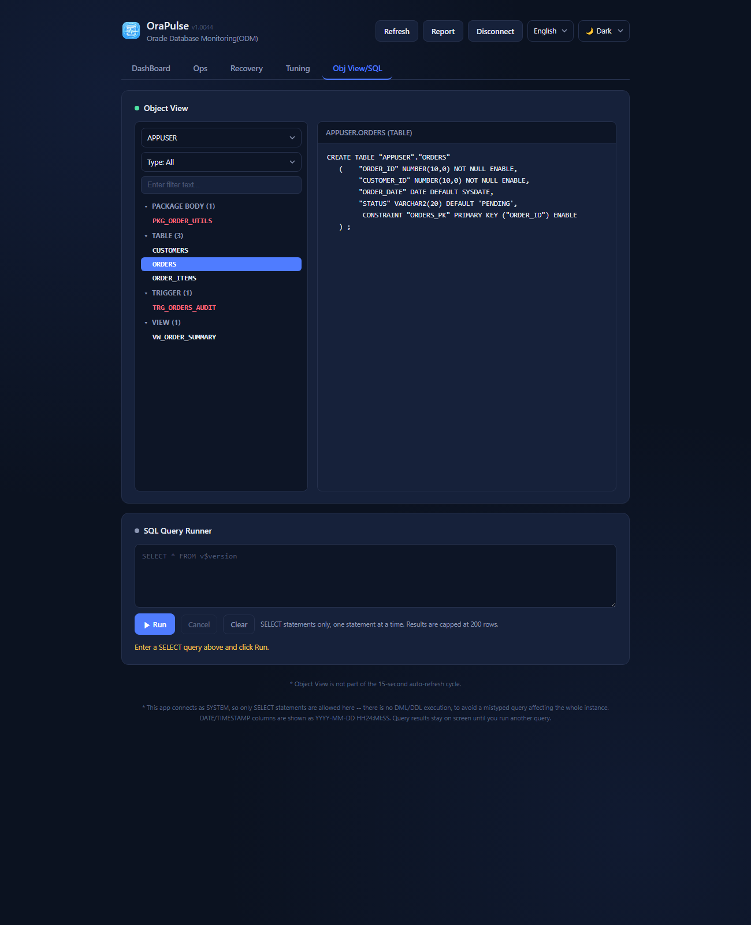
SCREEN · 09
Obj View/SQL Tab — Object Explorer
•
SQL-Developer-style explorer
Owner dropdown, type filter, text filter, and a tree grouped by object type
•
DDL on demand
Clicking an object fetches its DDL via DBMS_METADATA.GET_DDL and shows it on the right
OraPulse
14 / 23

Slide 15
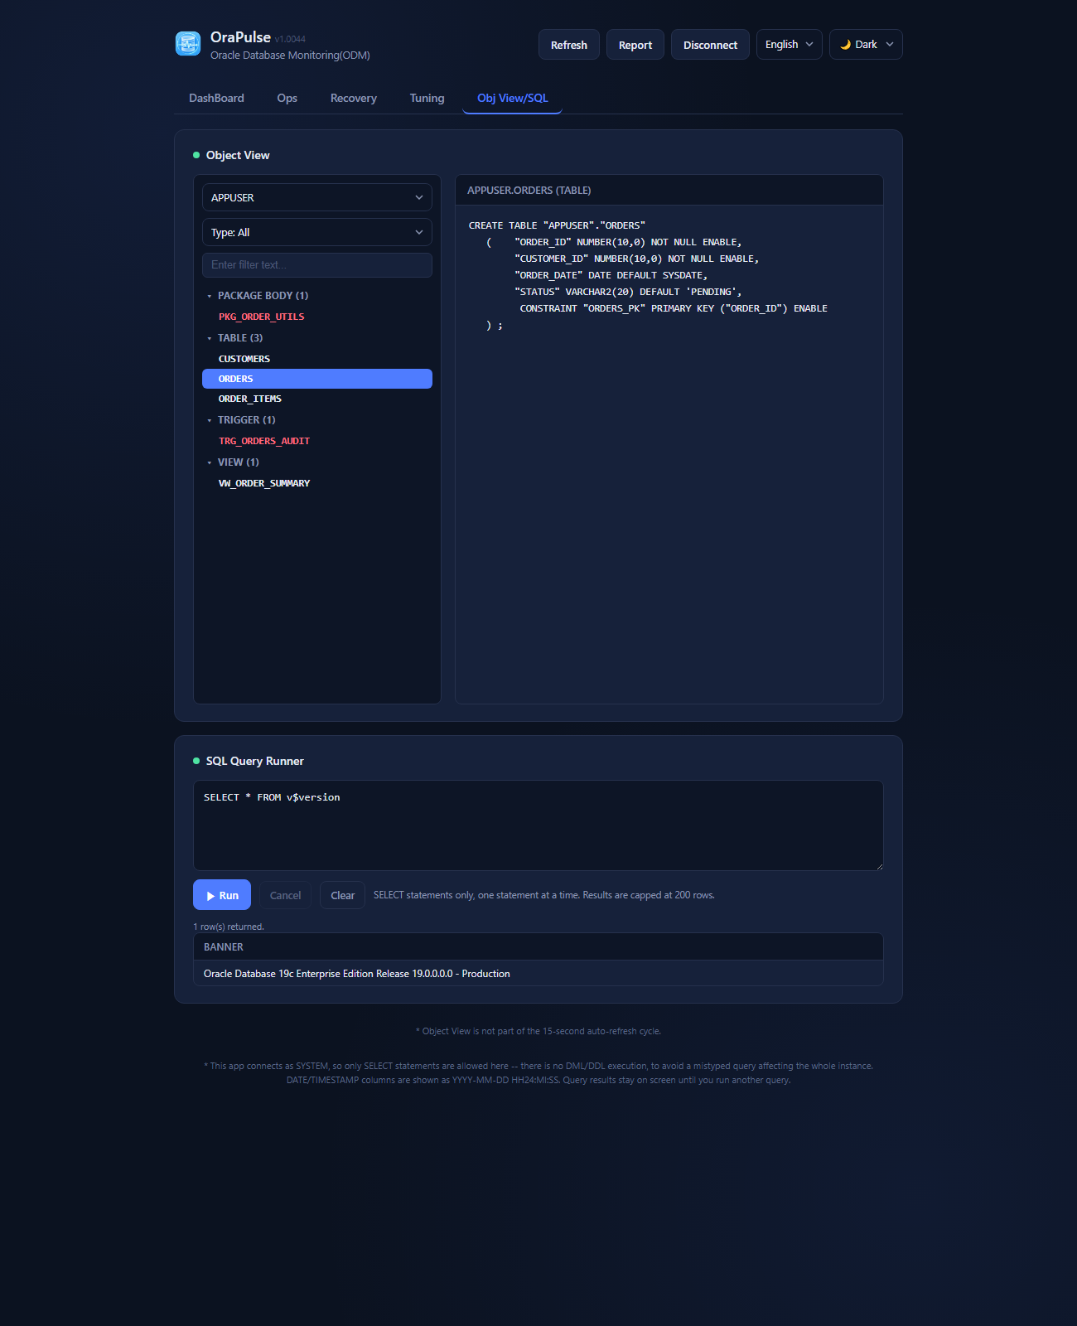
SCREEN · 10
Obj View/SQL Tab — SQL Query Runner
•
Read-only
Only a single SELECT statement can be executed
•
Capped at 200 rows
Large result sets are bounded from the start, by design
•
CLOBs rendered as text
CLOB columns render as text; BLOB columns are out of scope
OraPulse
15 / 23

Slide 16
REPORTING
Weekly DB Health Report
📄
⏱
🔒
📁
Self-contained HTML report
A 15-minute background collector
An encrypted history file
report/<YYYY-MM-DD>/ folder
Inline SVG charts, no external dependencies — the trailing N days of DB status in a single file
Starts as soon as a connection succeeds and keeps running even if the browser isn't left open
AES-256-GCM encrypted local history — a tiny, license-free stand-in for an AWR repository
One click of the Report button writes the finished HTML next to the running app
OraPulse
16 / 23

Slide 17
FAVORITES & SECURITY
Favorites & Data Security
🔒
🌐
⚡
🗑
AES-256-GCM encryption
127.0.0.1-only binding
One-click connect
Safe to reset, any time
Favorites (IP/Port/SID/account/password) and the Tuning/Report snapshot history are stored locally, encrypted
The server only listens on the local loopback — there is no network path from outside this PC
Click a saved favorite on the connect screen to connect immediately, no extra typing
Deleting the data/ folder removes everything; each file is simply recreated empty on next use
OraPulse
17 / 23

Slide 18
PERFORMANCE
Reducing DB Load
⏱
🗂
👁
🧊
Tiered auto-refresh
Per-tab intervals
Pauses when hidden or minimized
A 15-second server-side cache
Session/blocking list every 15s, CPU/memory every 30s, instance info every 5 minutes — each on its own timer
The Ops tab refreshes every 5 minutes and the Tuning tab every 10, only while that tab is active
Auto-refresh stops while the tab is hidden; with several tabs/windows open, only one leader actually polls (Web Locks API)
An identical request against the same target is cached, so a manual refresh racing an auto-tick still queries Oracle only once
OraPulse
18 / 23

Slide 19
DESKTOP PACKAGING
Distribution Methods (Windows)
📦
🗂
🛠
A single executable
A folder distribution
A full installer
Copy one OraPulse_ver_x.xxxx.exe and run it anywhere (PyInstaller --onefile)
OraPulse_ver_x.xxxx\ (exe + lib + public) — laid out like a typical installed program
OraPulse-Setup_ver_x.xxxx.exe — built with Inno Setup, with a Start Menu entry and an uninstaller
The Runtime Experience
✓
Runs windowed, no console
✓
Auto-assigned port & relaunch detection
✓
An isolated browser profile
Just a system tray icon (Open/Exit) to reopen the window or quit
A fresh port every launch; relaunching verifies a lock file against a live /api/version call and jumps to the running instance
Opens in a dedicated Chrome/Edge --app profile with no 'save password?' prompt; falls back to the OS default browser if neither is found
OraPulse
19 / 23

Slide 20
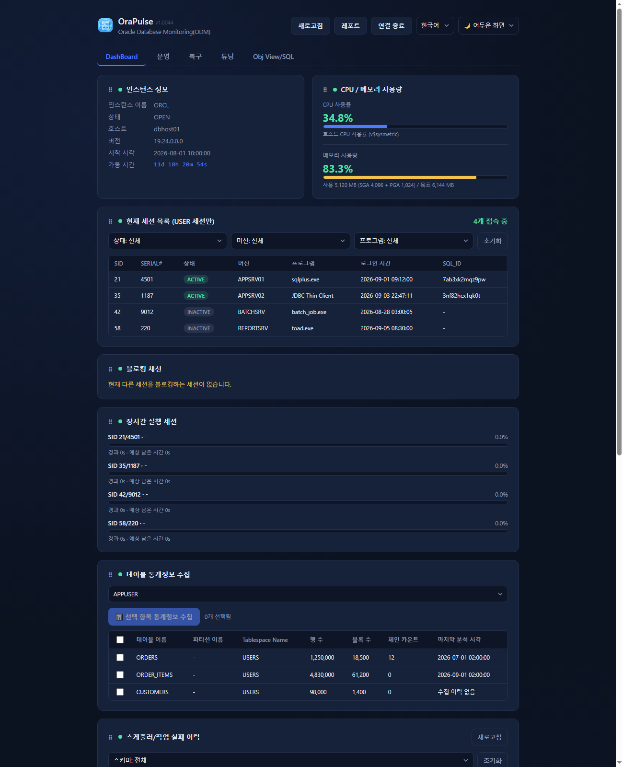
SCREEN · 11
Language, Theme & Help
•
English / Korean toggle
The choice is persisted; a few labels are deliberately kept identical in both languages
•
Dark / Light theme
A pure CSS custom-property swap, so no re-render is needed
•
A built-in user manual
A bilingual Help tab with real screenshots — no internet connection needed
•
Search within the manual
Highlights every match and steps through them with Enter or the up/down buttons
OraPulse
20 / 23

Slide 21
REQUIREMENTS
Requirements & Known Limitations
Requirements
Known Limitations
✓
Oracle Database 12.1 or later
⚠
11g and earlier are not supported
VERSION_FULL needs 12.2+; on 12.1 only that one card shows a permission-style error
A limitation of the thin-mode driver itself
✓
Network access
⚠
SQL Query Runner limits
OraPulse must be able to reach the target Oracle Listener's host and port
No bind-variable UI, and BLOB columns aren't rendered
✓
No Instant Client needed
⚠
No OS-level host metrics
Only python-oracledb's pure-Python thin mode is used
Disk/filesystem free space isn't shown — everything comes from the DB connection alone, by design
OraPulse
21 / 23

Slide 22
TECH STACK
Tech Stack & Project Structure
Backend
Frontend & Distribution
✓
main.py
✓
public/ — plain HTML/CSS/JS
The entry point — creates the app, registers routes, launches the server
i18n.js, cards.js, app-shell.js — hand-built, no framework
✓
backend/ route modules
✓
browser.py / tray.py / paths.py
core, connect, session, table_stats, object_view, sql_runner, tuning, jobs, account_security, alert_log, ops, recovery, report
The isolated browser profile, the tray icon, and path helpers
✓
report.py / favorites.py / tuning.py
✓
PyInstaller
Snapshot collection, encrypted local storage, and the rule-based tuning logic
OraPulse.spec (single file) / OraPulse-Folder.spec (folder distribution)
✓
python-oracledb thin mode
✓
build*.ps1 + installer.iss
Covers every 12.1+ version with no Instant Client install
Builds read the VERSION file automatically; installer.iss drives the Inno Setup installer
OraPulse
22 / 23

Slide 23
Thank You
OraPulse — Oracle Database Monitoring Client
v1.0049 · September 2026

