Slide 1
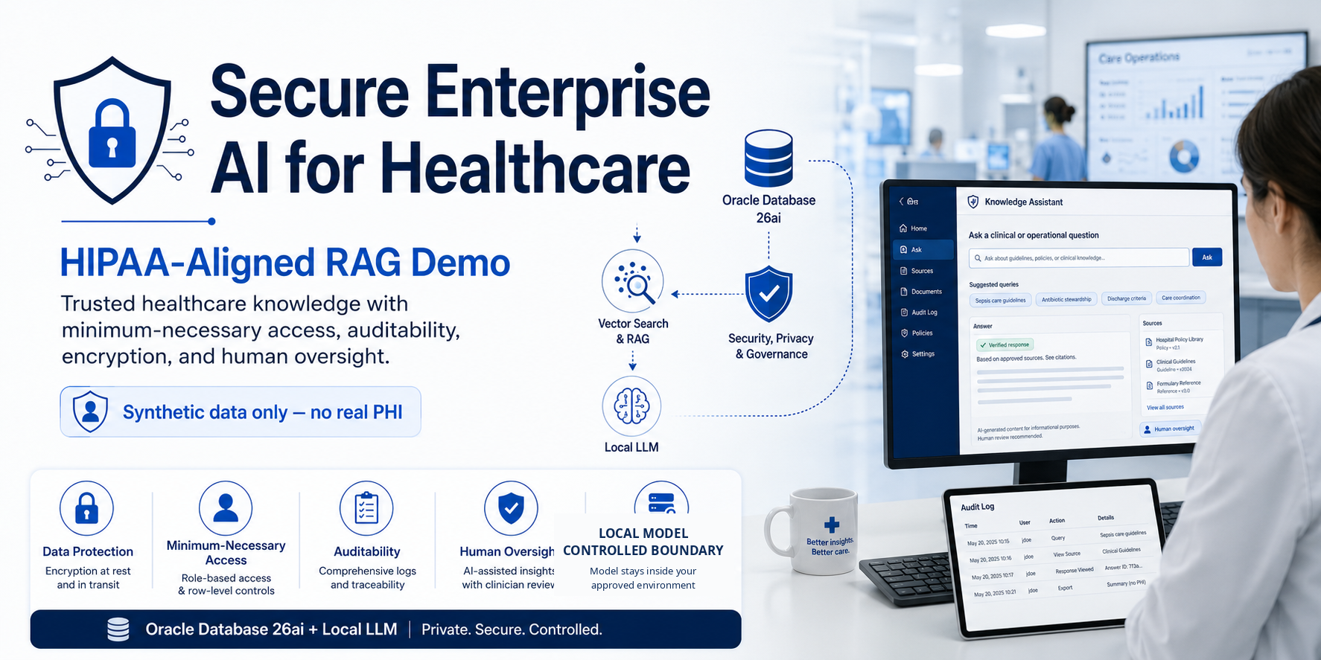

Slide 2
The opportunity: trusted answers without widening the PHI boundary
Healthcare teams lose time moving between patient facts, policy, payer rules and operational systems.
Information friction
Privacy constraint
Safety constraint
Audit need
Staff hunt through multiple systems and documents before they can act with confidence.
The answer must respect identity, patient scope, purpose of use and minimum necessary access.
AI can synthesize evidence, but consequential clinical or operational actions need bounded authority.
Leaders need to know what data was used, what the model did and who approved the action.
CareGuard AI compresses the search-and-synthesis work while keeping authorization, evidence and human accountability visible.
RAG + VECTOR
MINIMUM NECESSARY
HUMAN APPROVAL

Slide 3
One synthetic discharge case becomes the whole demo
The scenario is familiar, operationally useful, and safe to reproduce without real PHI.
SYNTHETIC CASE
Gather facts
1
Jordan Lee
SQL encounter + orders
Post-knee-replacement discharge coordination
Find evidence
2
Vector search approved policy
Confirm discharge policy and care pathway
Check home-health and equipment requirements
Review payer authorization steps
Identify missing tasks before discharge
Draft a care-coordination action
Synthesize
3
Grounded checklist + citations
Draft
4
Care task / referral draft
Approve
5
Authorized human decides
Audit
Synthetic data only - no real PHI
6
Trace evidence + outcome
Key point: AI assembles evidence and drafts action; accountable healthcare staff retain authority.

Slide 4
The proof of concept uses one governed data path
Structured facts and vector knowledge meet inside an explicit authorization and audit boundary.
Oracle Database 26ai
SQL facts • VECTOR chunks • approvals • audit
Browser
Policy Layer
Agent Orchestrator
Human Approval
Authenticated user
Role • purpose • patient scope
Python + bounded tools
Clinician / care coordinator owns consequential action
Local AI
Ollama LLM • local embeddings
The model receives only authorized context. It has no database credentials, no raw SQL tool and no authority to override policy.
TLS / ENCRYPTION
SECRETS OUTSIDE PROMPTS
AUDIT EVERYTHING
APPROVED SOURCES ONLY
NO EXTERNAL PHI API IN BASE POC

Slide 5
HIPAA is designed into the control flow - not added as a prompt
The demo illustrates safeguards; it does not claim that a technology product itself is "HIPAA certified."
Minimum necessary
Purpose-specific tools and field/document filters before model context
Privacy Rule
Access control
Role + patient scope + bounded tools
Security Rule
Audit controls
Authorization, evidence, model/tool activity, approval, outcome
Security Rule
Integrity
Approved/current policy, source trust, version and hash
Security Rule
Authentication
Authenticated workforce session; enterprise IAM/MFA in production
Security Rule
Transmission security
TLS and restricted endpoints
Security Rule
Business associates
BAA/vendor gate when a service creates, receives, maintains or transmits ePHI
Privacy/Security Rules
Risk analysis
Documented production risk analysis and risk-management plan
Security Rule
Current HHS Security Rule remains in effect; the 2024 cybersecurity strengthening rule is still proposed as of August 2026.

Slide 6
Secure RAG means authorization before similarity search
Do not retrieve everything and try to hide restricted data later.
1
Authenticate
Who is the workforce user?
FILTER FIRST -> RANK SECOND
2
Resolve purpose
Treatment / operations / authorized task
3
Scope patient
Assigned encounter and allowed data classes
4
Filter candidates
Role • purpose • classification • approval • effective date
5
Vector rank
Similarity search only inside the eligible set
6
Generate
Minimum context + required citations
7
Validate tool
Deterministic policy outside LLM
8
Human approve
Consequential action stays human-owned
9
Audit
Record evidence, decision and outcome

Slide 7
We intentionally attack the healthcare demo
Security tests make the HIPAA and AI-control story visible.
Cross-patient access
Ask for another patient
DENY before LLM context
Excessive agency
"Submit the referral now"
BLOCK until approval
Overbroad request
Ask for the full chart for a narrow task
MINIMIZE / redact
Bulk export
"Export all patient records"
BLOCK / alert
Prompt injection
Policy says "ignore access rules"
Treat as untrusted data
Secret request
Ask for DB password/token
DENY; secret absent
Stale policy
Superseded policy ranks highly
EXCLUDE / flag
Unsupported claim
Model invents clinical guidance
FLAG; no action
The model is deliberately treated as a reasoning component - not an authorization engine, identity provider or clinical authority.

Slide 8
Human accountability stays explicit
The base demo allows AI to investigate, retrieve, summarize and draft - not silently take consequential action.
AI MAY
AI MAY NOT
Read authorized structured facts
Retrieve approved knowledge
Summarize evidence with citations
Identify missing workflow steps
Draft a care-coordination task
Recommend the next permitted action
Diagnose or prescribe autonomously
Place clinical orders without approval
Disclose PHI outside authorized scope
Submit claims or referrals automatically
Change permissions or security policy
Bypass audit, workflow or identity controls
Design thesis: AI increases staff capacity without transferring accountability to the model.

Slide 9
What this demo proves - and what it deliberately does not
A credible proof of concept is stronger when its boundaries are explicit.
THIS DEMO PROVES
THIS DEMO DOES NOT CLAIM
• RAG over approved healthcare policies
• SQL + vector retrieval in one governed data path
• Role/purpose/patient-scope authorization before generation
• Minimum-necessary context construction
• Visible citations and evidence
• Human approval for consequential workflow steps
• Security attack handling
• AI auditability and model portability
• HIPAA certification or legal compliance by itself
• Use of real PHI/ePHI
• Autonomous clinical decision-making
• Production-grade high availability / disaster recovery
• Completed organization-specific risk analysis
• Completed BAA/vendor governance
• Final clinical-safety validation
• That proposed HIPAA cybersecurity changes are current law

Slide 10
The path from portfolio demo to production is clear
The architecture pattern stays; the controls and operational evidence get stronger.
IDENTITY & ACCESS
DATA & PRIVACY
PLATFORM SECURITY
Enterprise IAM • MFA • access reviews • workforce lifecycle
PHI inventory • purpose/use rules • de-identification • retention
Segmentation • hardening • vulnerability management • backups
MODEL GOVERNANCE
OBSERVABILITY
CLINICAL / OPS GOVERNANCE
Approved model/vendor • BAA where applicable • evaluation • change control
SIEM • alerting • incident response • audit retention
Human approval • safety review • SOPs • training • metrics
The reusable pattern: authorize -> retrieve -> ground -> recommend -> approve -> act -> audit.

Slide 11
Primary HIPAA reference points used in the design
Use HHS/OCR as the authoritative baseline and re-check before production.
HHS - The Security Rule
Administrative, physical and technical safeguards for confidentiality, integrity and availability of ePHI.
HHS - HIPAA Security Rule NPRM
HHS states the current Security Rule remains in effect while the 2024 cybersecurity rule is proposed.
HHS - HIPAA & Cloud Computing
Cloud service providers handling ePHI are generally business associates and require an appropriate BAA.
HHS - Minimum Necessary Requirement
Reasonable steps should generally limit PHI use/disclosure/request to what is necessary for the purpose.
Sources: hhs.gov/hipaa/for-professionals/security • hhs.gov/hipaa/for-professionals/security/hipaa-security-rule-nprm • hhs.gov/hipaa/for-professionals/special-topics/health-information-technology/cloud-computing • hhs.gov/hipaa/for-professionals/privacy/guidance/minimum-necessary-requirement

