Slide 1
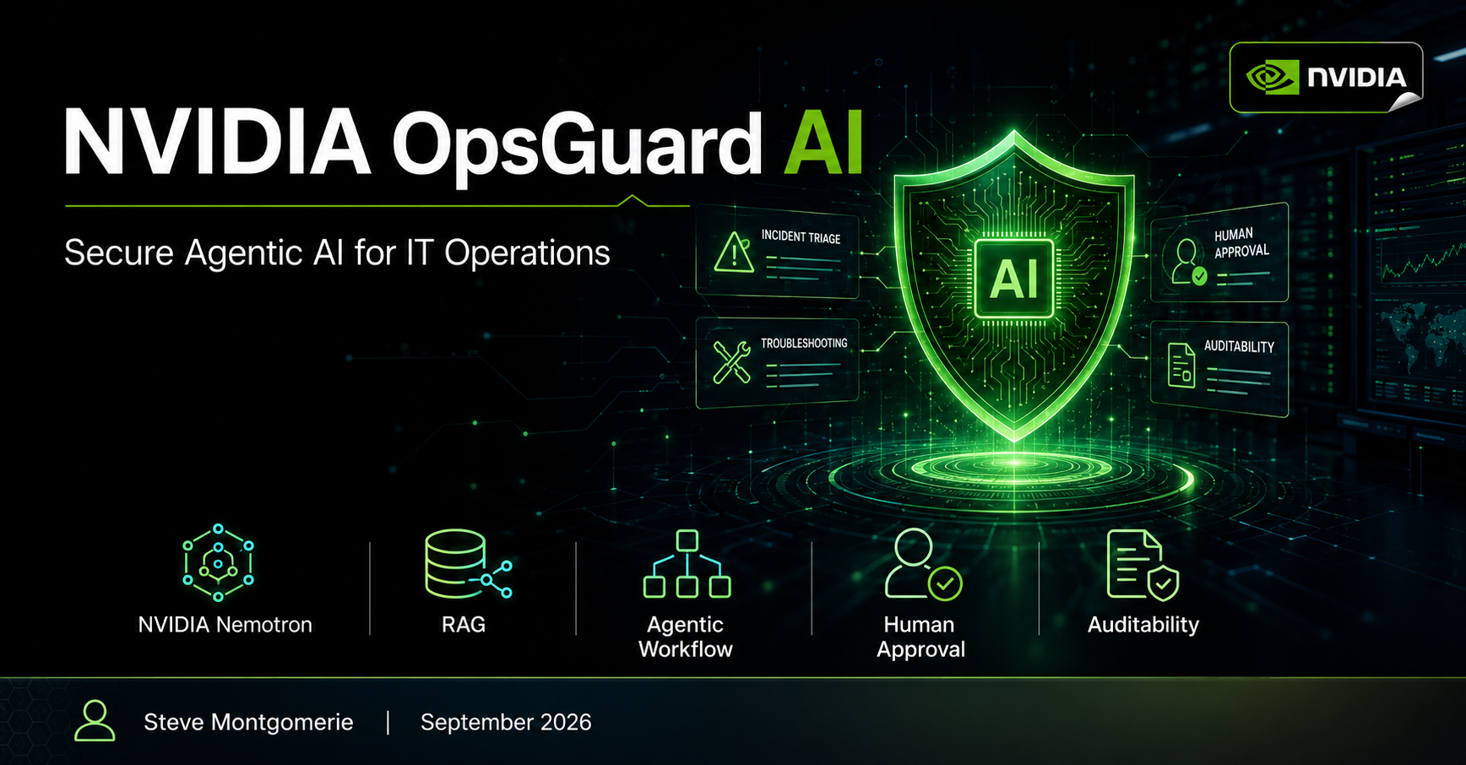

Slide 2
THE IT OPERATIONS PROBLEM
02
Support time disappears before remediation begins
The delay is often evidence assembly—not a lack of expertise.
1
2
3
4
Gather
Search
Correlate
Authorize
Endpoint, identity, VPN and service-health evidence
Approved runbooks and known remediation procedures
Symptoms, user context and infrastructure state
Separate bounded actions from privileged changes
OpsGuard automates this control loop while preserving human authority over consequential actions.
NVIDIA OpsGuard AI
Steve Montgomerie | September 2026

Slide 3
WHY CHATBOTS ARE NOT ENOUGH
03
Conversation alone does not solve the control problem
Chatbot
Governed operations agent
Explains what might be wrong
Investigates, recommends and acts within policy
Response-first
Produces guidance but does not own the investigation loop.
Evidence-first
Uses approved collectors and minimum authorized context.
Permission ambiguity
Natural-language confidence can be mistaken for authorization.
Policy-enforced
Low-risk actions are bounded; privileged actions wait for approval.
The model is not the authorization layer.
NVIDIA OpsGuard AI
Steve Montgomerie | September 2026

Slide 4
VALUE PROPOSITION
04
OpsGuard accelerates triage without widening authority
FAST
CONTROLLED
TRACEABLE
Enough to reduce mean time to resolution
Enough to protect production infrastructure
Enough to defend every consequential action
24×7 first response
Repeatable Level 1 triage
Approved knowledge retrieval
Human control of privilege
Complete decision trail
A single operating principle aligns productivity, security and accountability.
NVIDIA OpsGuard AI
Steve Montgomerie | September 2026

Slide 5
ANCHOR SCENARIO
05
One VPN ticket exercises the full control loop
1
Validate
2
Collect
INCIDENT
Request and user context
Endpoint, identity, VPN and health evidence
Corporate VPN will not connect
3
Retrieve
4
Reason
Approved runbook material only
Nemotron proposes root cause and plan
Employee request
Synthetic endpoint + identity context
5
Control
6
Record
Execute bounded action or request approval
Evidence, decision and action trail
Goal: restore access safely
NVIDIA OpsGuard AI
Steve Montgomerie | September 2026

Slide 6
REFERENCE ARCHITECTURE
06
The model reasons; deterministic policy authorizes
Ticket + identity
Authorized evidence
Minimum context
NVIDIA Nemotron
Proposed action
POLICY + RISK ENGINE
Permissions cannot be expanded by model output
LOW RISK → bounded execution
HIGH RISK → human approval
NVIDIA OpsGuard AI
Steve Montgomerie | September 2026

Slide 7
GUARDRAILS AND APPROVAL
07
Every proposed action meets a non-negotiable boundary
Identity scope
Trusted knowledge
Secret protection
Validate the requester and incident boundary
Reject poisoned or unapproved runbook content
Block credential and token exfiltration
Privilege control
No self-approval
Auditability
Queue domain-admin, root and critical-service actions
Prompt text cannot bypass deterministic policy
Record evidence, recommendation, approval and execution
MODEL OUTPUT ≠ PERMISSION
NVIDIA OpsGuard AI
Steve Montgomerie | September 2026

Slide 8
LIVE DEMO AND NEXT STEPS
08
The demo proves speed, restraint and traceability together
LIVE FLOW
WHAT TO VALIDATE NEXT
1
Submit VPN incident
Policy fit
Map organization-specific risk tiers and approval ownership.
2
Review gathered evidence
Enterprise integration
3
Inspect retrieved runbook
Connect identity, secrets, ITSM, observability and approved action tools.
4
Evaluate proposed action
Operational readiness
Approve or reject privilege
Add resilience, telemetry, evaluation and security review before production.
5
6
Review audit trail
Decision question
Which repetitive incident class offers the safest, highest-value first deployment?
NVIDIA OpsGuard AI
Steve Montgomerie | September 2026

