Slide 1
3D Convolution, Single shot detector, CFENet
Droneeye
2019. 06. 19.
김용우

Slide 2
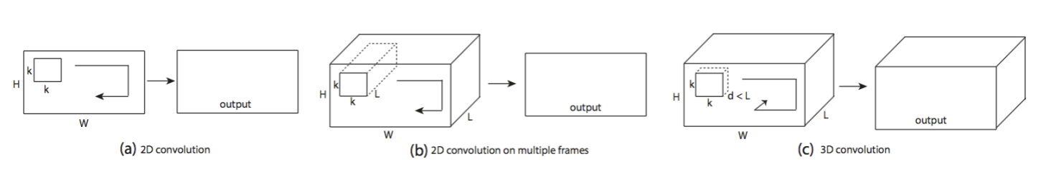
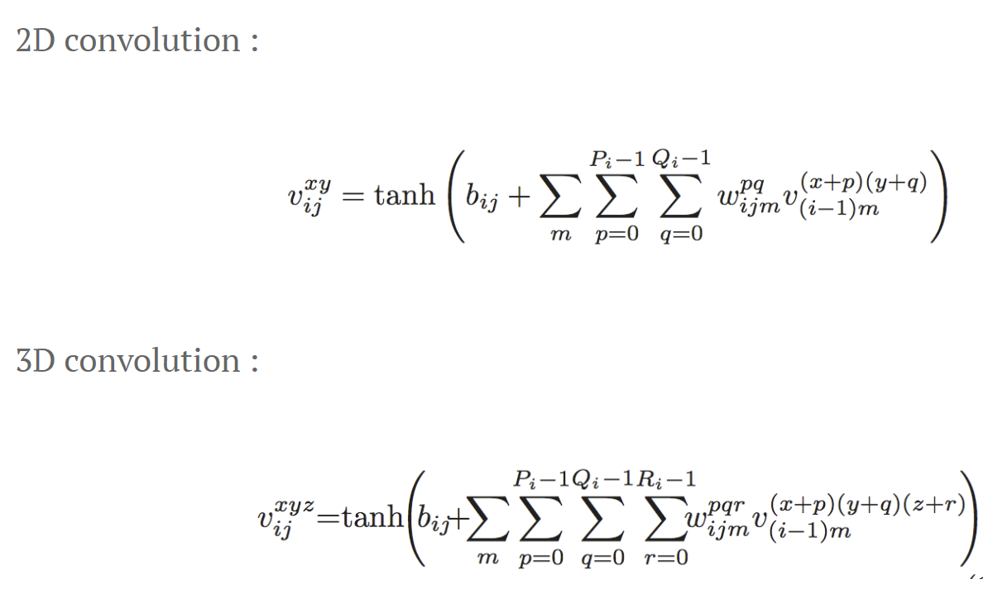
3D Convolution
3D Convolution?

Slide 3
3D Convolution
3D Convolution?
Reference : 3DSRNet

Slide 4
3D Convolution
3D Convolution?
Reference : 3DSRNet

Slide 5
3D Convolution
문제점
Scene Change 영역?
Receptive filed 보다 빠르게 움직이는 object들의 feature map들은?
구현 가능성 : VGG 와 같은 layer를 3D Convolution 형태로 변형하여 수정 가능한가?
Reference : 3DSRNet

Slide 6
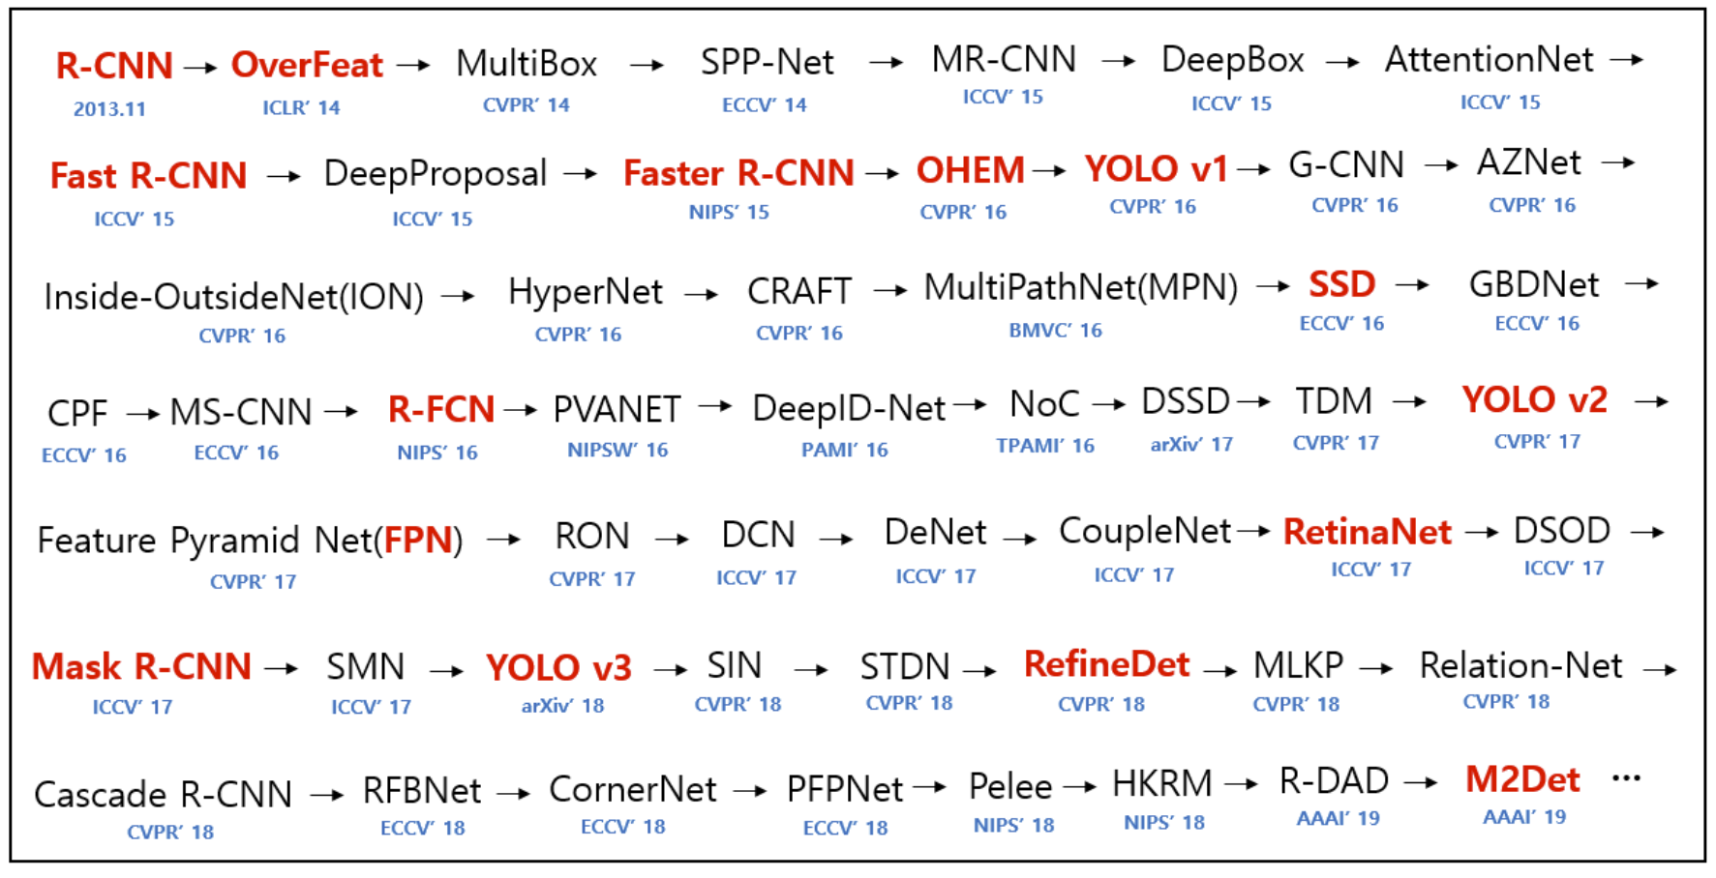
Single Shot Detect (SSD)
Position?
https://github.com/hoya012/deep_learning_object_detection

Slide 7
Single Shot Detect (SSD)
Network Model
Reference : PR12 - SSD

Slide 8
Single Shot Detect (SSD)
Network Model
Reference : PR12 - SSD

Slide 9
Single Shot Detect (SSD)
Network Model
Reference : PR12 - SSD

Slide 10
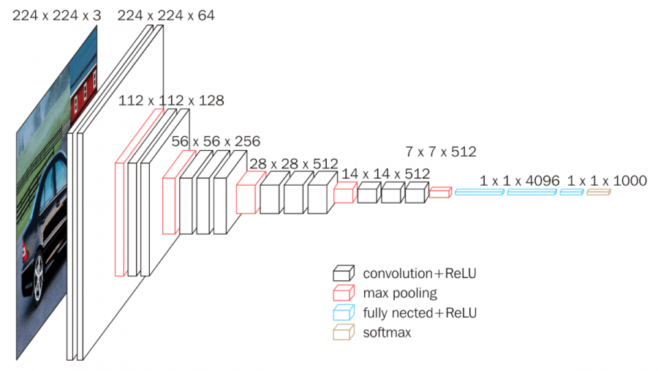
Single Shot Detect (SSD)
Network Model

Slide 11
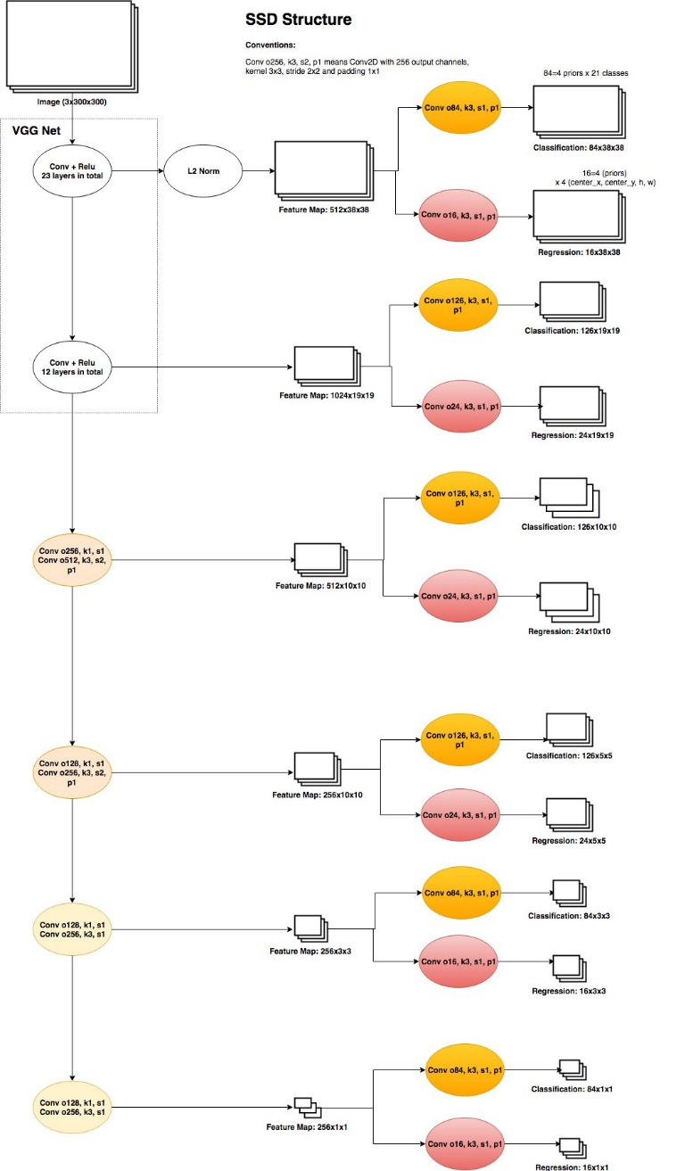
Single Shot Detect (SSD)
Network Model

Slide 12
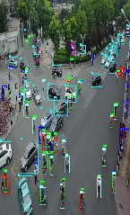
Object detection from videos
Detection results
Detection results
t0
t0+1 t0+2 t0+3
to t0+1 t0+2 t0+3
Detection
aggregation
Temporal
refinement
Seq-NMS
Object
detector
1, Optical flows
2, 3D Shallow CNN feature
3, RNN
4, Siamese fc
Context
prediction
Object
detector
..
….
..
..
….
..
Video
sequence
Video
sequence
t0 t0+1 t0+2 t0+3
t1 t1+1 t2+2
t0 t0+1 t0+2 t0+3
t1 t1+1 t2+2
(1) clip-level detection
(1) frame-level detection
Seq-NMS : http://openresearch.ai/t/seq-nms-for-video-object-detection/208
Notes:
Object detection in videos can be classified into two mainstreams, one is clip-level detection, which use image object detector to detect the key-frame and generate the detection results of adjacent frames by aggregating their computed relations. The relation may be extracted using optical flows, shallow features, RNN, or siamese fc, just like tracking problems. The other one is frame-level detection, the detector provide detection results frame by frame, and followed by a refinement processing, such as Seq-NMS to refine the sequence.

Slide 13
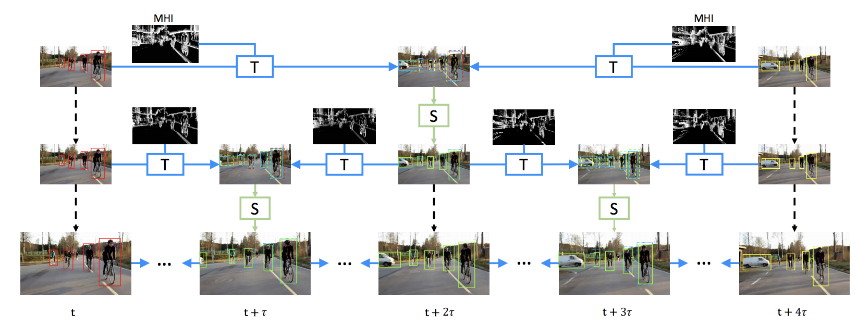
Object Detection from Videos
(1) clip-level detection:
Scale-Time lattice[1]
Each node represents a object detection step;
(base detector is Faster R-CNN with ResNet-101)
Blue edge represents a
temporal propagation step;
Green edge represents a spatial propagation step
For VisDrone dataset, dominated with small objects,
the image with the largest scale contributes most.
[1] Kai Chen et al. Optimizing Video Object Detection via a Scale-Time Lattice. CVPR2018
Notes:
I will give a short overview of an example method of Clip-level detection stream – scale-time lattice, which is composed of three main parts: just look at the graph, each node represents a object detection step, each blue edge represents a temporal propagation step and green edge represents a spatial propagation step.
As for visdrone dataset, dominated by small objects, the largest scale is the most important one. Also, its ability to detect small objects is very significant.

Slide 14
Object Detection from Videos
(2) frame-level detection:
CFENet
Based on the original fast one-stage detector – SSD.
About the inference speed of VGG-SSD300(22ms in original paper, but optimized to be faster):
Mxnet: 15.6 ms [1]
PyTorch: 12.0 ms [2]
We focus on improving it by mainly enhancing small objects detection with only sacrifice little efficiency. (keep the fast speed)
[1] https://github.com/zhreshold/mxnet-ssd
[2] Songtao Liu et al. Receptive Field Block Net for Accurate and Fast Object Detection. ECCV2018
Notes:
Then, about the frame-level detection, the stream that we have choosed.
Our method CFENet is based on the original SSD. As known, with the recent optimization of deep learning framework, it can even run much faster than the result from original paper. Our target is to improve it by mainly enhancing small objects detection with only sacrifice little efficiency.

Slide 15
CFENet
How to improve SSD / construct a stronger single-shot detector:
(1) U-shape modules. E.g., DSSD, RefineDet, RetinaNet.
(2) Additional modules. E.g., rfbnet, pyramidbox.
(3) loss functions. E.g., IoU loss(Unitbox), RetinaNet(focal loss).
…
Notes:
We begin to construct CFENet by thinking how to improve the accuracy of SSD. There are four different methods: the first is to connect a U-shape modules
The second is to add other new modules 3) modify the loss functions.
Both 1) and 2) is aimed to enhance feature, but 2) influence less for the detection speed, this is why we consider it.

Slide 16
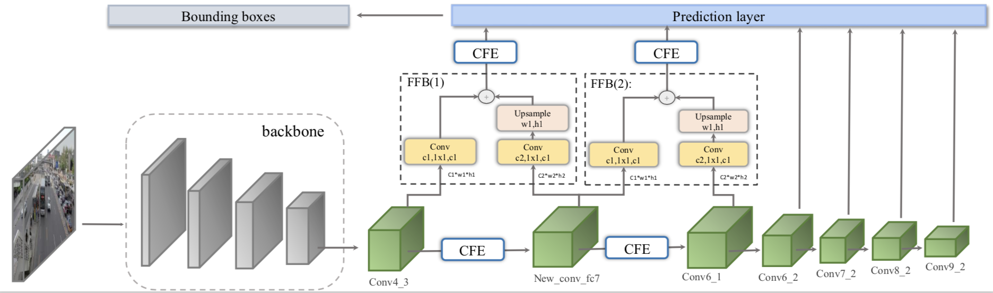
CFENet
An accurate and efficient single-shot object detector for autonomous driving
Assemble CFE modules at detection branches as well as the main path.
Notably, the six feature maps share 2,3,2,2,2,2 CFE modules, respectively.

Slide 17
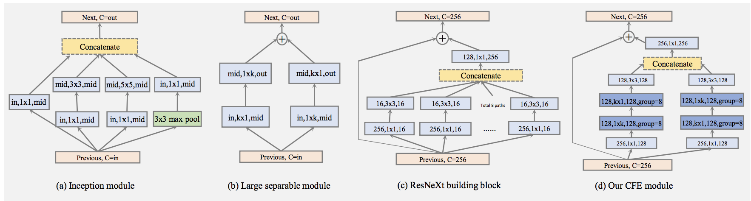
CFENet
An accurate and efficient single-shot object detector for autonomous driving
Receptive field -> Large kernel, i.e., 1xk and kx1, k=7.
3x3 conv followed by a 1x1 conv & group convolution -> Group=8.
Feature fusion -> Residual learning, Symmetric learning.

Slide 18
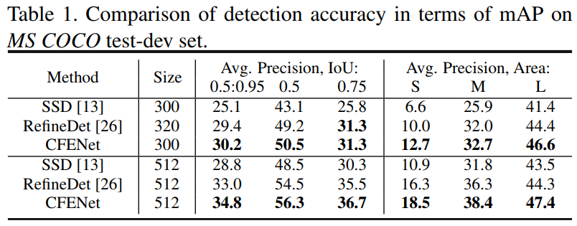
CFENet
An accurate and efficient single-shot object detector for autonomous driving
Reference : PR12 - SSD

Slide 19
CFENet
An accurate and efficient single-shot object detector for autonomous driving
For one-stage detectors, densely post process (NMS) will cost a lot of time.
Tuning score threshold and nms algorithm will help improve efficiency.
for VGG-CFENet800:
Model | Score | NMS | CNN time | NMS time | AP
CFENet | 0.01 | Hard | 13 ms | 7 ms | 15.5
CFENet | 0.05 | Hard | 13 ms | 3 ms | 15.2
CFENet | 0.01 | Soft, linear | 13 ms | 11 ms | 15.9
CFENet | 0.05 | Soft, linear | 13 ms | 4 ms | 15.5
CFENet | 0.05 | Soft, gaussian | 13 ms | 8 ms | 15.6
Including the time of image preprocessing, VGG-CFENet800 can still achieve 23 fps, a real-time speed.

